Slide 1
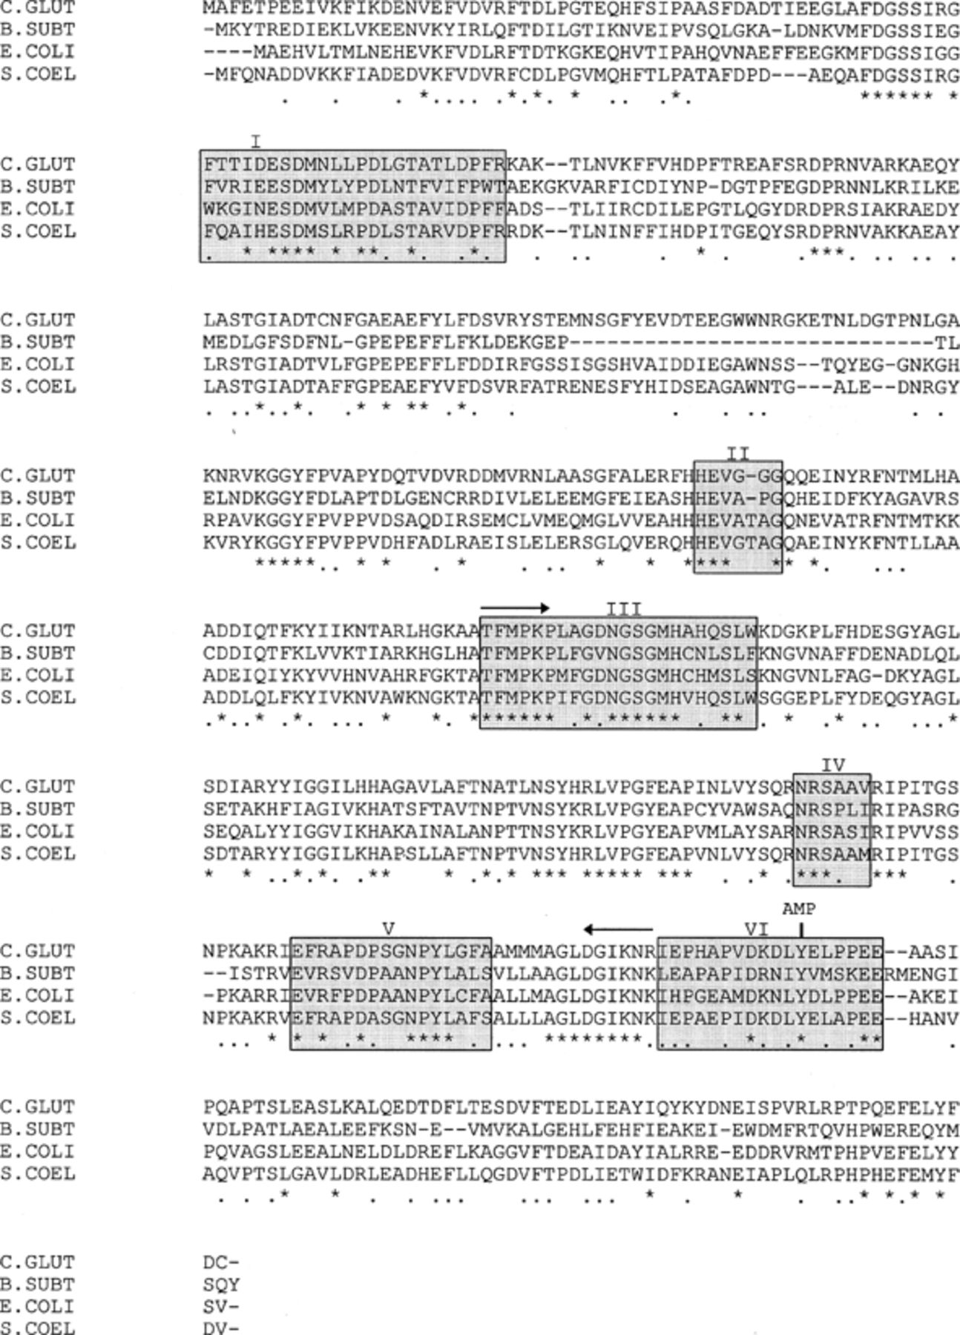
1 Alignment of GSI proteins from different sources. C.GLUT, C. glutamicum (GenBank accession number Y13221); ...
Notes:
1 Alignment of GSI proteins from different sources. C.GLUT, C. glutamicum (GenBank accession number Y13221); B.SUBT, B. subtilis[31]; E.COLI, E. coli[5, 22]; and S.COEL, S. coelicolor[35]. Amino acids identical in three proteins are marked by dots, those identical in all four proteins are marked by asterisks. Amino acids shaded in gray comprise conserved regions with the following functions [12, 32]: I, subunit interaction with regions II–V; II, binding of Mn2+; III, nucleotide binding; IV, binding of glutamate and Mn2+; V, unknown; VI, adenylation region, the adenylation site (Tyr-405) is marked. Amino acid sequences from which the oligonucleotide primers were derived are indicated by arrows.
Unless provided in the caption above, the following copyright applies to the content of this slide: © 1997 Federation of European Microbiological Societies. Published by Elsevier Science B.V.

Slide 2
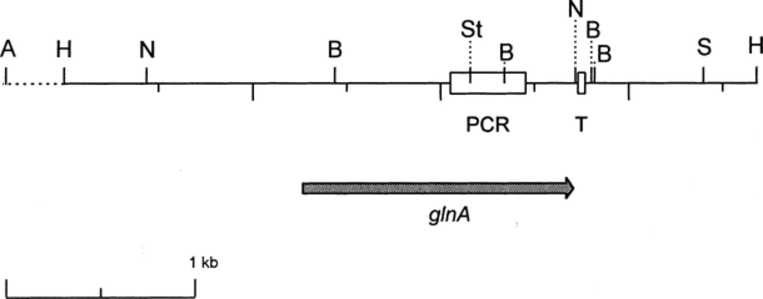
2 Schematic presentation of the organization of the C. glutamicum glnA gene. A box marks the position of the ...
Notes:
2 Schematic presentation of the organization of the C. glutamicum glnA gene. A box marks the position of the DNA fragment amplified by PCR using the degenerated primers. The location of the putative terminator (T) and restriction sites for Asp718 (A), BamHI (B), HindIII (H), NheI (N), SalI (S), and StuI (St) are indicated. The Asp718 site is located approximately 7.5 kb upstream of the glnA gene.
Unless provided in the caption above, the following copyright applies to the content of this slide: © 1997 Federation of European Microbiological Societies. Published by Elsevier Science B.V.

Slide 3
3 Southern blot. Chromosomal DNA of C. glutamicum wild-type ATCC 13032 was digested with BamHI (2) and SalI ...
Notes:
3 Southern blot. Chromosomal DNA of C. glutamicum wild-type ATCC 13032 was digested with BamHI (2) and SalI (3), resulting DNA fragments were separated by agarose gel electrophoresis and probed with a 0.8 kb HincII/NaeI DNA fragment of the S. viridochromogenes glnII gene. (1) DIG-labelled marker VII (Boehringer); from top to bottom 8576, 7427, 6106, 4899, 3639, 2799, 1953, 1882, 1515, 1482, 1164, and 992 bp.
Unless provided in the caption above, the following copyright applies to the content of this slide: © 1997 Federation of European Microbiological Societies. Published by Elsevier Science B.V.

