Slide 1
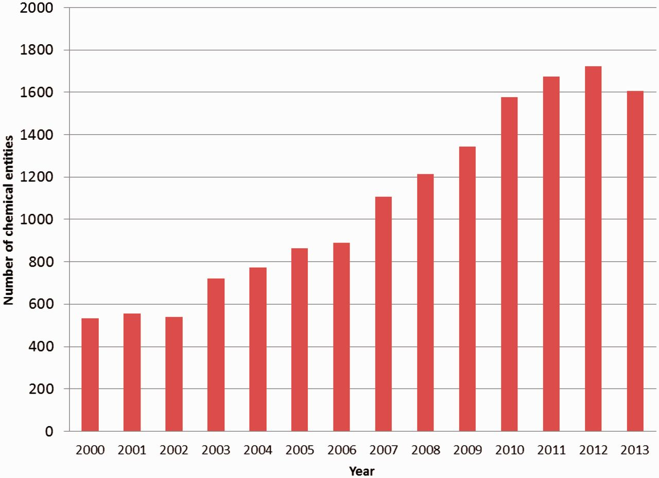
Figure 1. Number of new PDB chemical entity definitions created annually between 2000 and 2013.
Notes:
Figure 1. Number of new PDB chemical entity definitions created annually between 2000 and 2013.
Unless provided in the caption above, the following copyright applies to the content of this slide: © The Author(s) 2014. Published by Oxford University Press.This is an Open Access article distributed under the terms of the Creative Commons Attribution License (http://creativecommons.org/licenses/by/4.0/), which permits unrestricted reuse, distribution, and reproduction in any medium, provided the original work is properly cited.

Slide 2
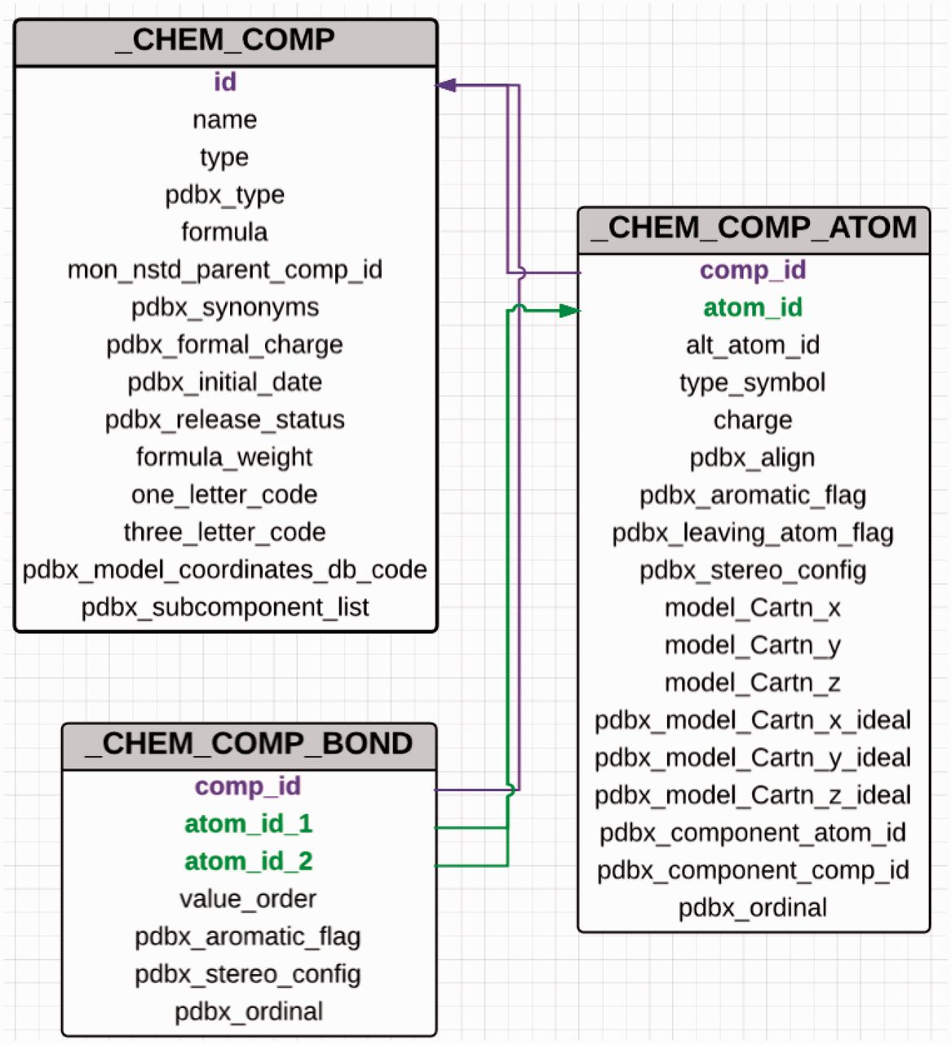
Figure 2. Abbreviated category relationship diagram for the key CIF categories that are used in the CCD. Three major ...
Notes:
Figure 2. Abbreviated category relationship diagram for the key CIF categories that are used in the CCD. Three major categories _chem_comp, _chem_comp_bond and _chem_comp_atom are joined together to generate the machine readable dictionary description of the chemical entity. The unique three character code assigned to every new chemical entity acts as the primary key in the _chem_comp category.id (coloured in purple) and is used to connect the other categories (_chem_comp_bond.comp_id and _chem_comp_atom.comp_id).
Unless provided in the caption above, the following copyright applies to the content of this slide: © The Author(s) 2014. Published by Oxford University Press.This is an Open Access article distributed under the terms of the Creative Commons Attribution License (http://creativecommons.org/licenses/by/4.0/), which permits unrestricted reuse, distribution, and reproduction in any medium, provided the original work is properly cited.

Slide 3
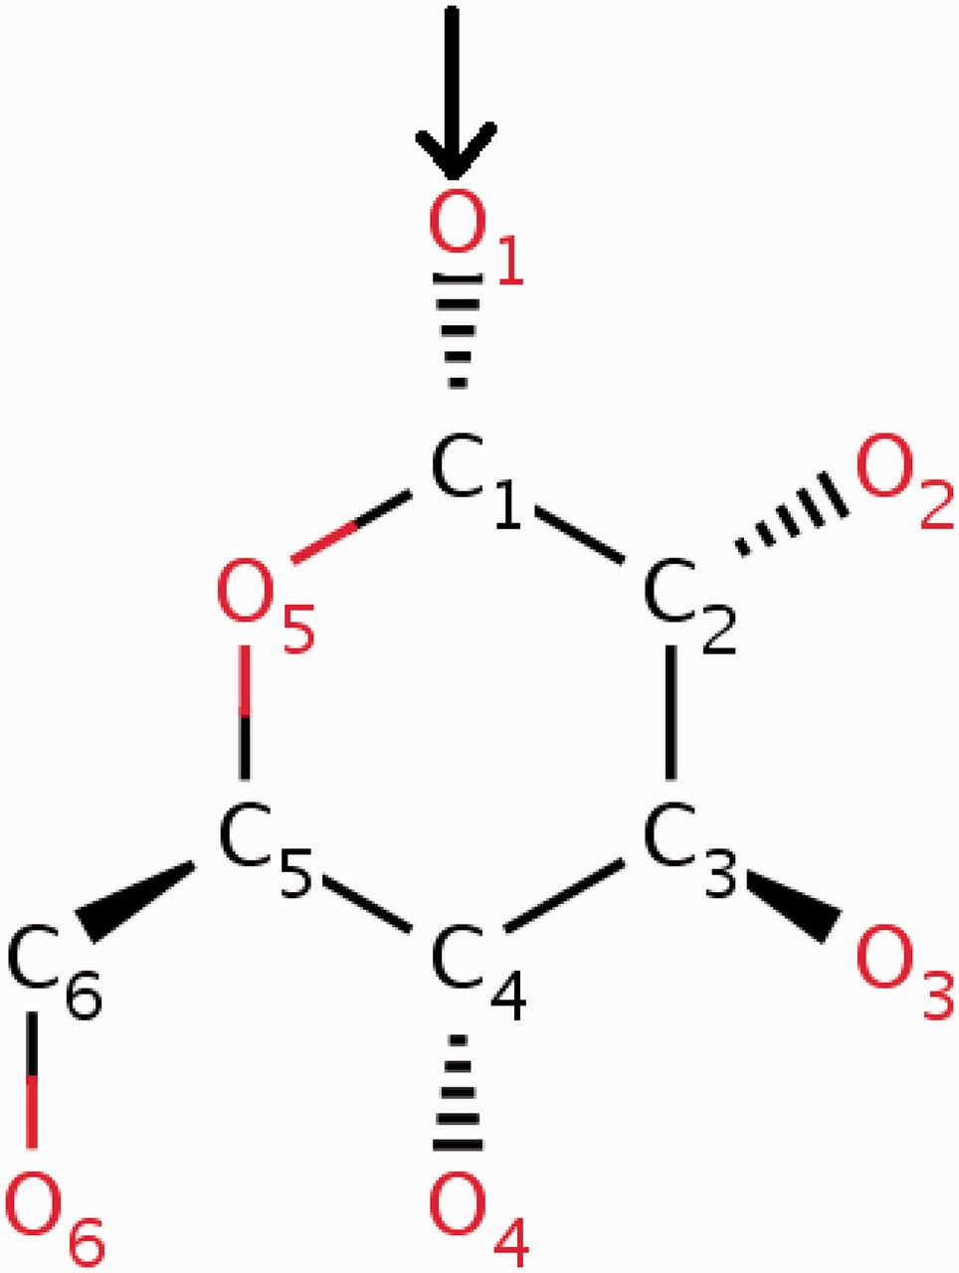
Figure 3. α- d -Glucose can form α( 1–4 ) glycosidic linkages with other carbohydrate molecules. During the ...
Notes:
Figure 3. α- d -Glucose can form α( 1–4 ) glycosidic linkages with other carbohydrate molecules. During the oligomerization process, the O1 oxygen (highlighted in the figure) of the glucose is eliminated by the O4 oxygen of the other carbohydrate. To account for this condensation reaction, the O1 oxygen of α- d -glucose (GLC) is annotated in the CCD as a leaving atom. The two-dimensional diagram in this figure is a copy of the image from the RCSB PDB website ( http://rcsb.org/pdb/ligand/ligandsummary.do?hetId=GLC ). It was generated using the ChemAxon software ( http://www.chemaxon.com ).
Unless provided in the caption above, the following copyright applies to the content of this slide: © The Author(s) 2014. Published by Oxford University Press.This is an Open Access article distributed under the terms of the Creative Commons Attribution License (http://creativecommons.org/licenses/by/4.0/), which permits unrestricted reuse, distribution, and reproduction in any medium, provided the original work is properly cited.

Slide 4
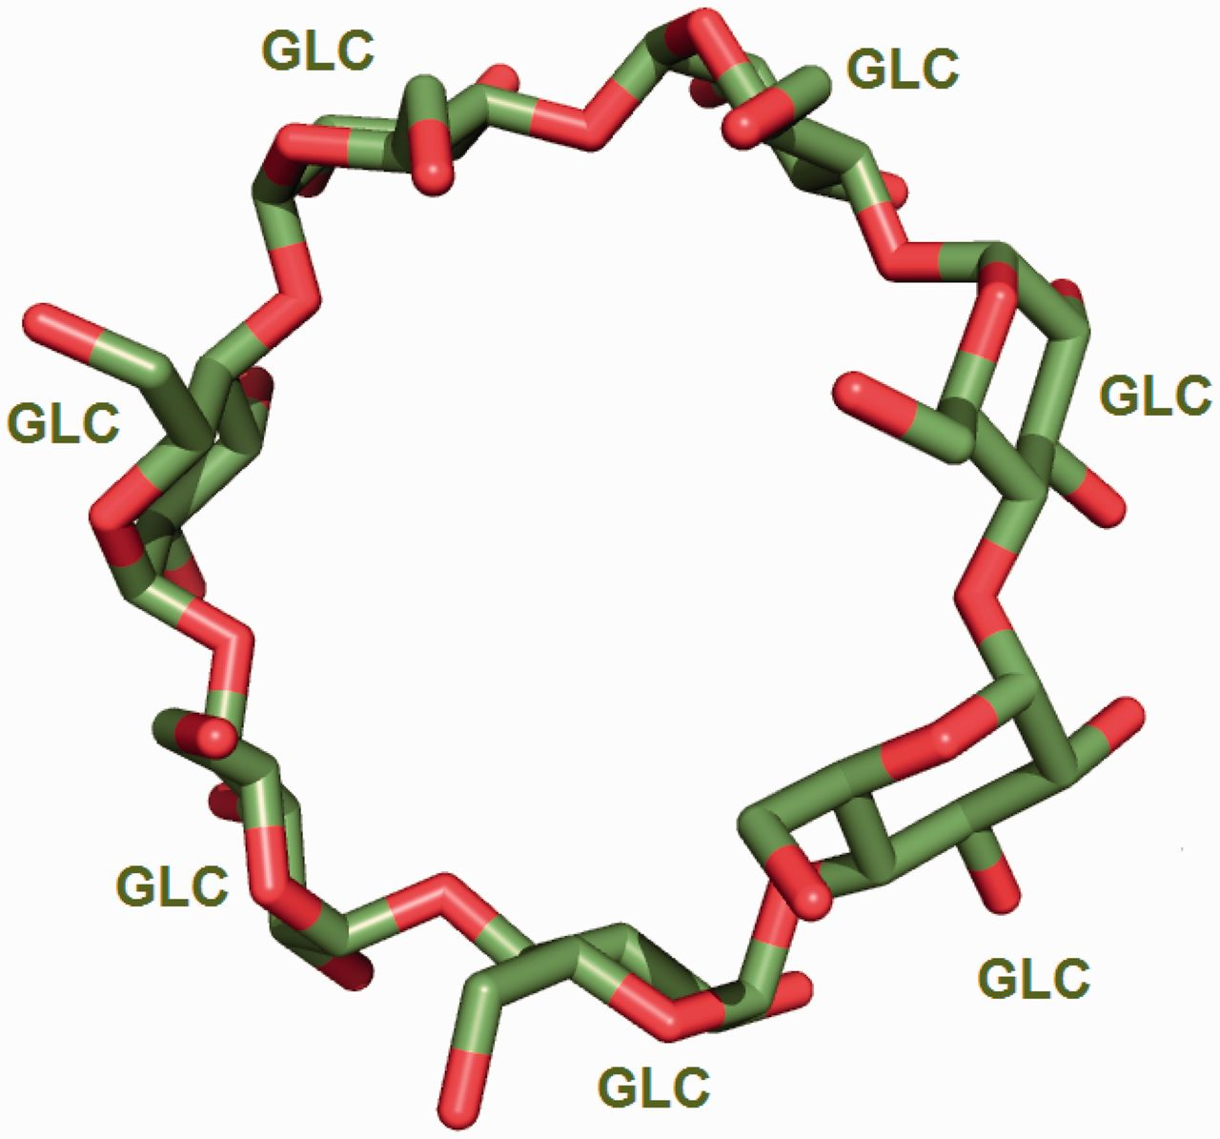
Figure 4. Seven α- d -glucose (GLC) molecules undergo condensation reaction to form the circular oligosaccharide ...
Notes:
Figure 4. Seven α- d -glucose (GLC) molecules undergo condensation reaction to form the circular oligosaccharide β-cyclodextrin [from PDB entry 2v8l ( 30 )].
Unless provided in the caption above, the following copyright applies to the content of this slide: © The Author(s) 2014. Published by Oxford University Press.This is an Open Access article distributed under the terms of the Creative Commons Attribution License (http://creativecommons.org/licenses/by/4.0/), which permits unrestricted reuse, distribution, and reproduction in any medium, provided the original work is properly cited.

Slide 5
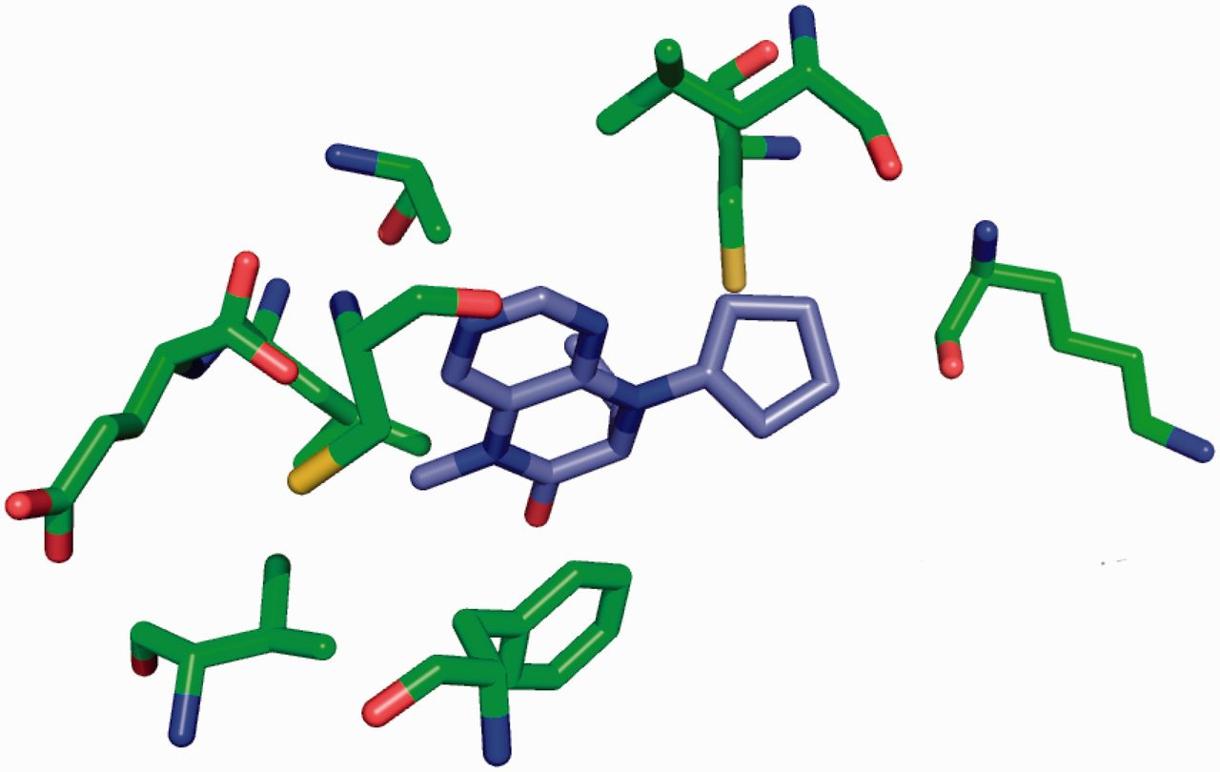
Figure 5. Binding site for the Plk-2 inhibitor (7R)-8-cyclopentyl-7-ethyl-5-methyl-7,8-dihydropteridin-6(5H)-one (3 ...
Notes:
Figure 5. Binding site for the Plk-2 inhibitor (7R)-8-cyclopentyl-7-ethyl-5-methyl-7,8-dihydropteridin-6(5H)-one (3 letter code 11 G) in PDB entry 4i6b ( 31 ). The figure depicts the neighbouring residues that are within 3.7 Å of the ligand 11 G.
Unless provided in the caption above, the following copyright applies to the content of this slide: © The Author(s) 2014. Published by Oxford University Press.This is an Open Access article distributed under the terms of the Creative Commons Attribution License (http://creativecommons.org/licenses/by/4.0/), which permits unrestricted reuse, distribution, and reproduction in any medium, provided the original work is properly cited.

Slide 6
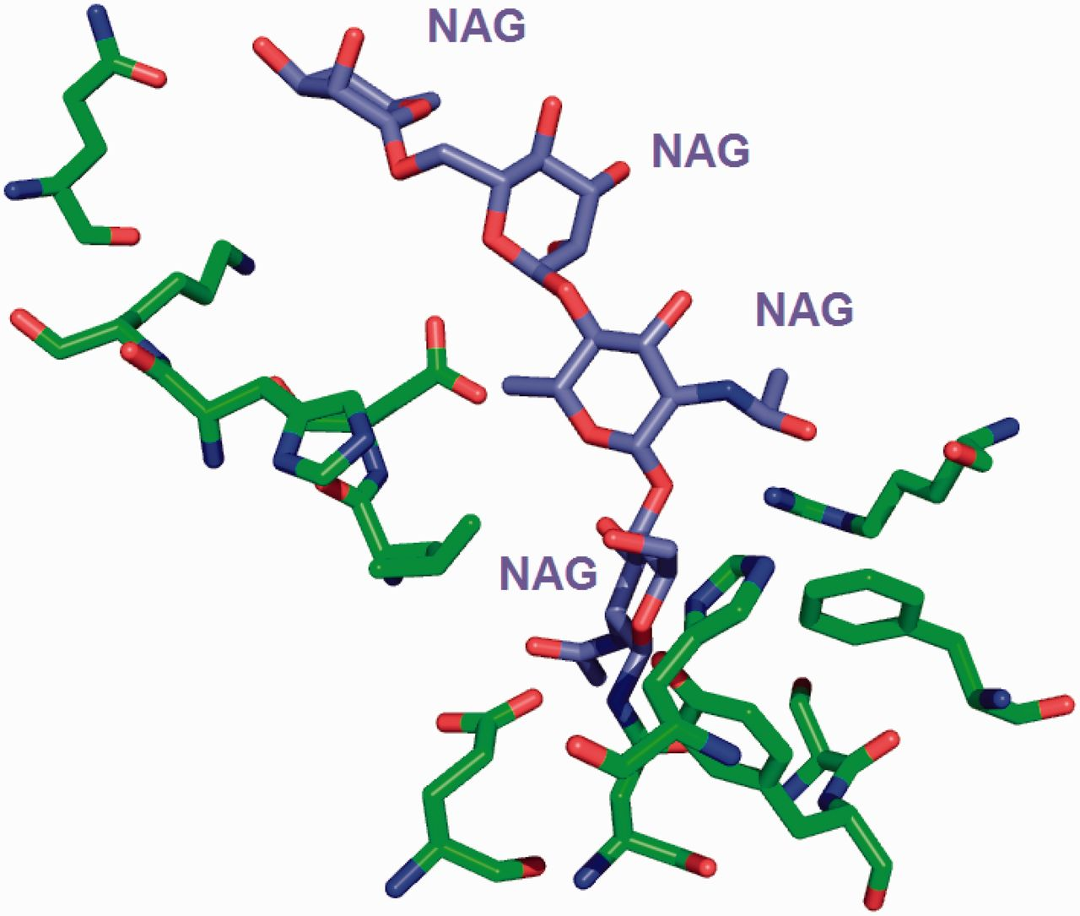
Figure 6. The environment for the oligosaccharide poly- N -acetylglucosamine (PNAG) is annotated instead of listing ...
Notes:
Figure 6. The environment for the oligosaccharide poly- N -acetylglucosamine (PNAG) is annotated instead of listing the environment of individual sugars. This avoids repeating the same sugar molecule in multiple binding sites.
Unless provided in the caption above, the following copyright applies to the content of this slide: © The Author(s) 2014. Published by Oxford University Press.This is an Open Access article distributed under the terms of the Creative Commons Attribution License (http://creativecommons.org/licenses/by/4.0/), which permits unrestricted reuse, distribution, and reproduction in any medium, provided the original work is properly cited.

Slide 7
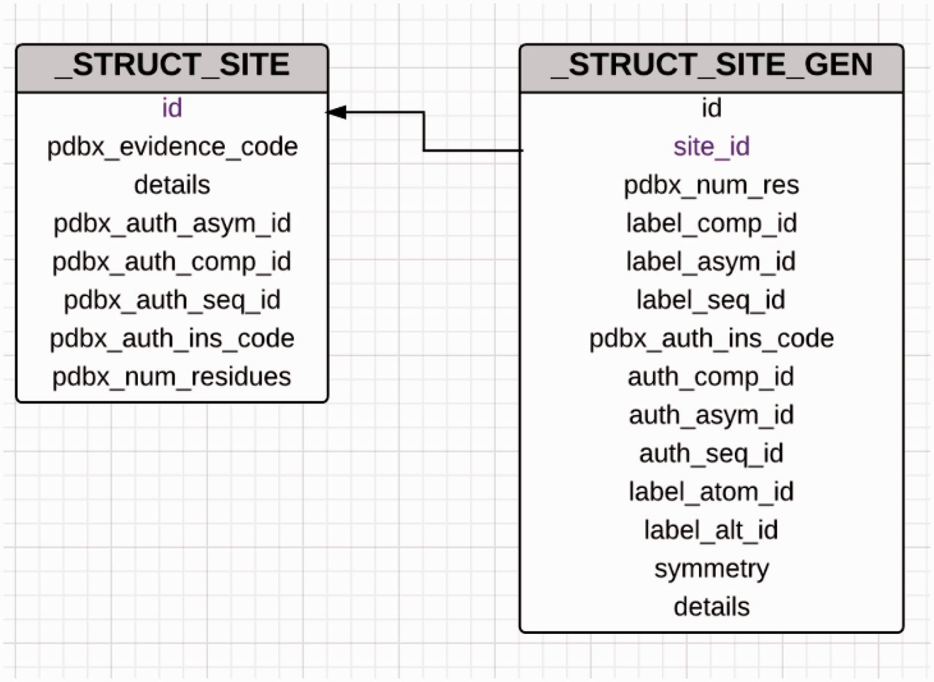
Figure 7. Diagram showing the relationship between the _struct_site and _struct_site_gen categories used for ...
Notes:
Figure 7. Diagram showing the relationship between the _struct_site and _struct_site_gen categories used for annotation of ligand-binding sites. The _struct_site category holds information about the ligands that are present in the PDB entry and every ligand in this category is assigned a alphanumeric binding site identifier. The _struct_site_gen category contains information of the residues that are present within the vicinity of the ligands described in the struct_site category. Both the categories are joined by the binding site identifier.
Unless provided in the caption above, the following copyright applies to the content of this slide: © The Author(s) 2014. Published by Oxford University Press.This is an Open Access article distributed under the terms of the Creative Commons Attribution License (http://creativecommons.org/licenses/by/4.0/), which permits unrestricted reuse, distribution, and reproduction in any medium, provided the original work is properly cited.

Slide 8
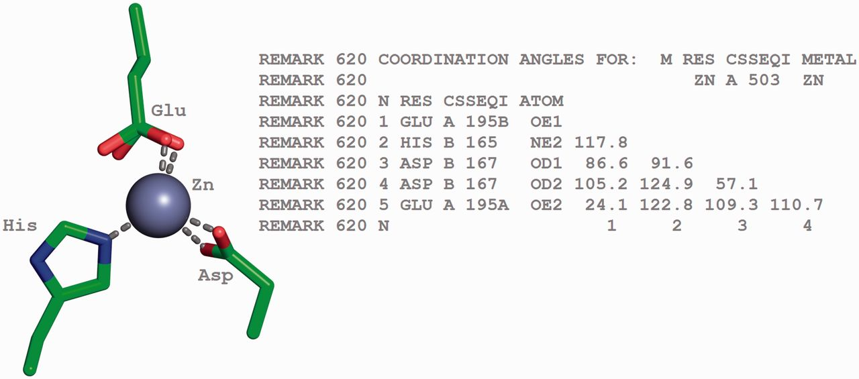
Figure 8. Tetrahedrally coordinated Zn ion in entry 2VW4 ( 32 ) along with the annotation of the bond angles. The ...
Notes:
Figure 8. Tetrahedrally coordinated Zn ion in entry 2VW4 ( 32 ) along with the annotation of the bond angles. The REMARK 620 annotation indicates the software calculated bond angle values between Zn A 503 and its surrounding residues. The surrounding residues in anticlockwise direction are Glu A 195, HisB 165 and Asp B 167. The sidechain carboxylate group of the Glu residue exists in two alternate conformation (A and B conformers). The angle between GluA195B-Zn-HisB165 is 117.8, GluA195B-Zn-Asp(OD1)B167 is 86.6, HisB165-Zn-Asp(OD1)B167 is 91.6, Glu195B-Zn-ASP(OD2)B167 is 105.2, HisB165-Zn-Asp(OD2)B167 is 124.9, Asp(OD1)B167-Zn-Asp(OD2)B167 is 57.1, Glu(OE1)A195B-Zn-Glu(OE2)A195A is 24.1, HisB165-Zn- Glu(OE2)A195A is 122.8, Asp(OD1)B167-Zn-Glu(OE2)A195A is 109.3 and Asp(OD2)B167-Zn-Glu(OE2)A195A is 110.7.
Unless provided in the caption above, the following copyright applies to the content of this slide: © The Author(s) 2014. Published by Oxford University Press.This is an Open Access article distributed under the terms of the Creative Commons Attribution License (http://creativecommons.org/licenses/by/4.0/), which permits unrestricted reuse, distribution, and reproduction in any medium, provided the original work is properly cited.

Slide 9
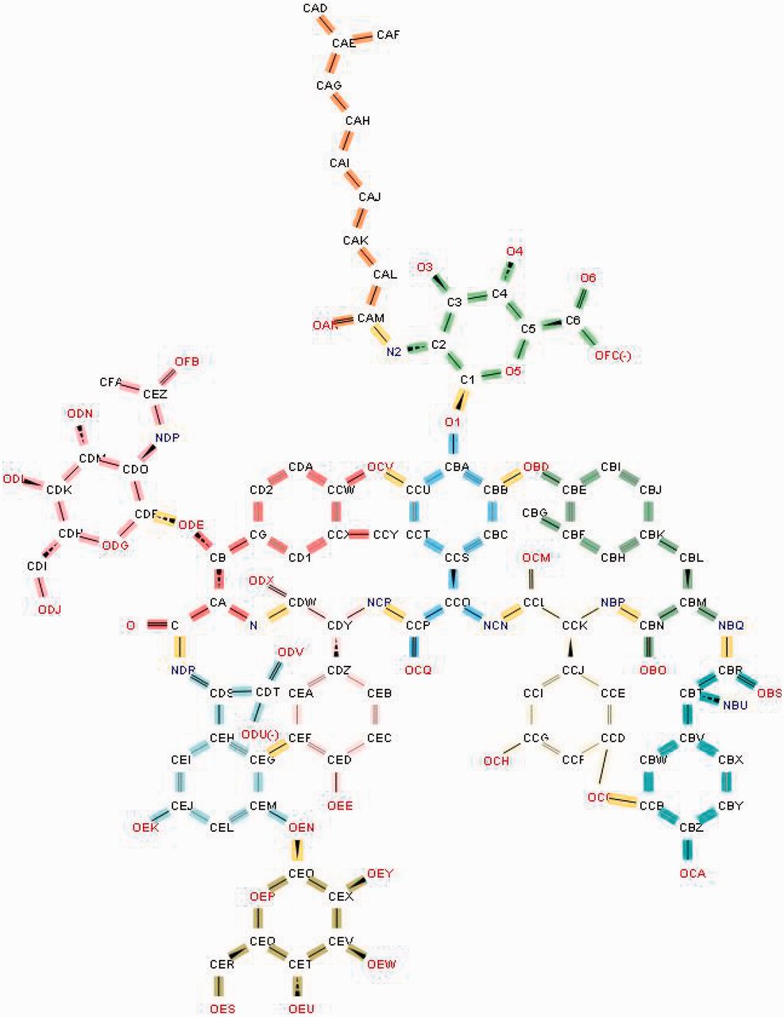
Figure 9. Annotation of the glycopeptide antibiotic teicoplanin involves ‘chopping up’ the molecule into its component ...
Notes:
Figure 9. Annotation of the glycopeptide antibiotic teicoplanin involves ‘chopping up’ the molecule into its component chemical entities that are validated against the CCD. The bonds highlighted in yellow demarcate the individual entities.
Unless provided in the caption above, the following copyright applies to the content of this slide: © The Author(s) 2014. Published by Oxford University Press.This is an Open Access article distributed under the terms of the Creative Commons Attribution License (http://creativecommons.org/licenses/by/4.0/), which permits unrestricted reuse, distribution, and reproduction in any medium, provided the original work is properly cited.

Slide 10
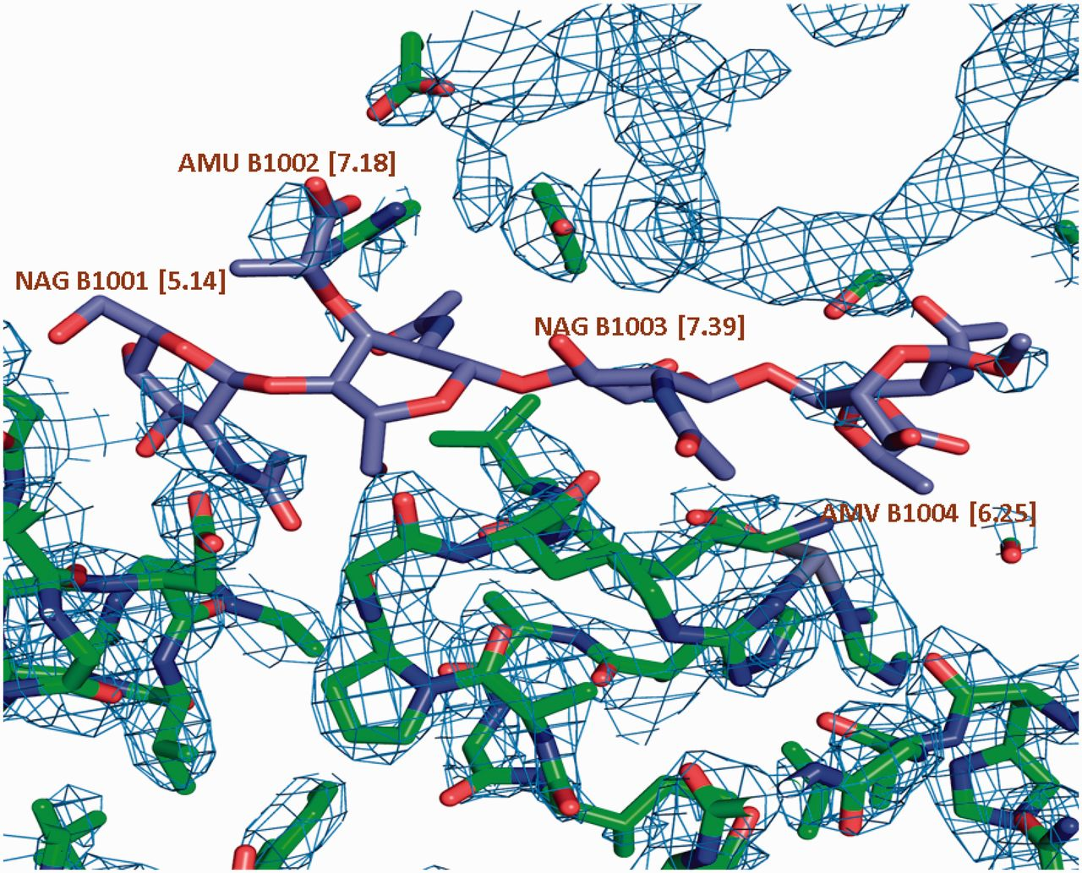
Figure 10. σ _{A} weighted 2Fo-Fc map of a carbohydrate binding protein shown at a contour level of 0.35e/A^3. ...
Notes:
Figure 10. σ A weighted 2Fo-Fc map of a carbohydrate binding protein shown at a contour level of 0.35e/A^3. Very little electron density is observed for the oligosaccharide molecule. This is reflected in the high LLDF values (shown in parentheses) for each of the component carbohydrate moieties.
Unless provided in the caption above, the following copyright applies to the content of this slide: © The Author(s) 2014. Published by Oxford University Press.This is an Open Access article distributed under the terms of the Creative Commons Attribution License (http://creativecommons.org/licenses/by/4.0/), which permits unrestricted reuse, distribution, and reproduction in any medium, provided the original work is properly cited.

