Slide 1
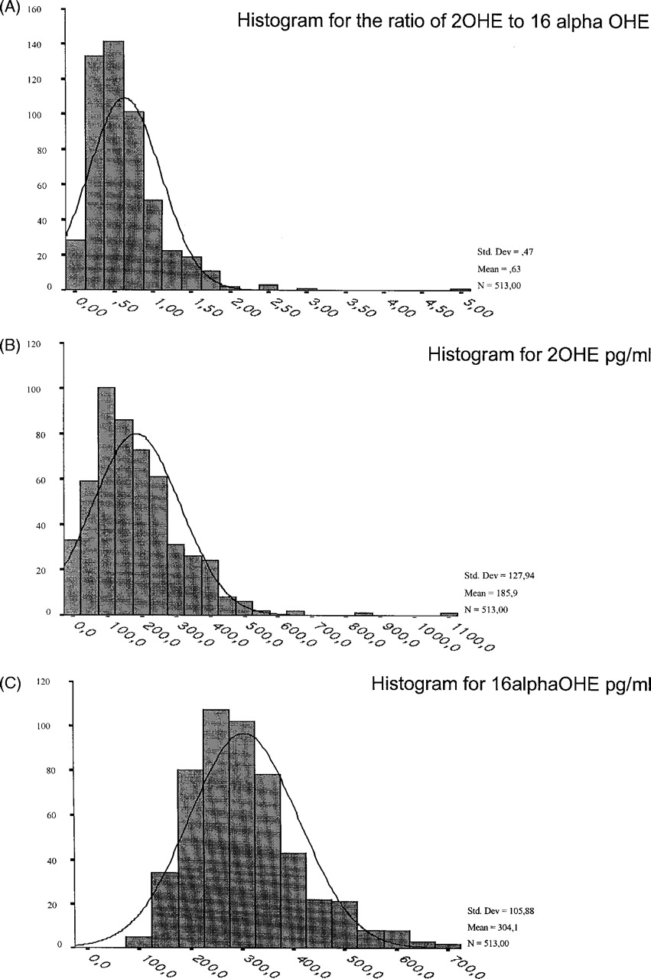
Fig. 1. ( A ) A histogram that demonstrates that the 2-OHE/16α-OHE ratio was not normally distributed. ( B ) A ...
Notes:
Fig. 1. ( A ) A histogram that demonstrates that the 2-OHE/16α-OHE ratio was not normally distributed. ( B ) A histogram that demonstrates that the levels of 2-OHE were not normally distributed. ( C ) A histogram that demonstrates that the levels of 16α-OHE were not normally distributed.
Unless provided in the caption above, the following copyright applies to the content of this slide: © Oxford University Press. All rights reserved

Slide 2
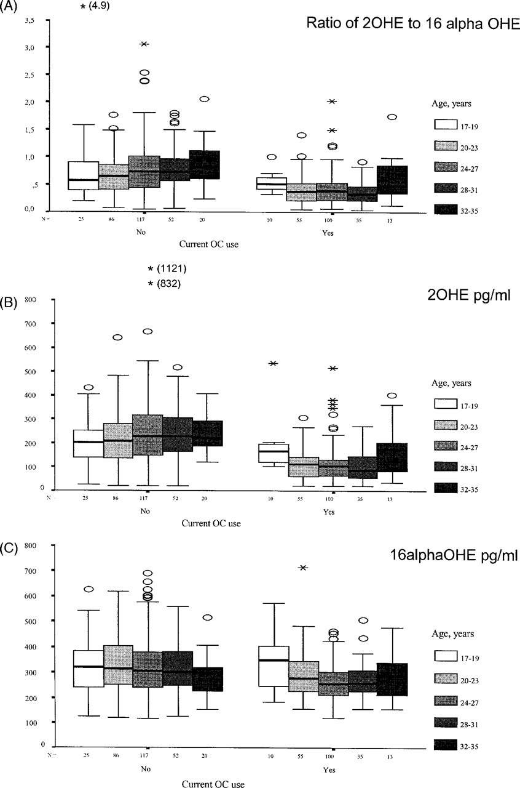
Fig. 2. ( A ) A significant positive correlation existed between age and the 2-OHE/16α-OHE ratio ( r_{s} = ...
Notes:
Fig. 2. ( A ) A significant positive correlation existed between age and the 2-OHE/16α-OHE ratio ( rs = 0.16, P = 0.004) among women who did not use oral contraceptives, which remained significant after adjustment for ethnicity and menstrual cycle day ( P = 0.01). No significant correlation was observed in the subgroup of oral contraceptive users. ( B ) There was no significant correlation between the levels of 2-OHE and age among pill non-users or among oral contraceptive users. ( C ) There was no significant correlation between the levels of 2-OHE and age among pill non-users or among oral contraceptive users. After adjustment for ethnicity and menstrual cycle day, the negative relationship between age and 16α-OHE among pill non-users became of borderline significance ( P = 0.048).
Unless provided in the caption above, the following copyright applies to the content of this slide: © Oxford University Press. All rights reserved

Slide 3
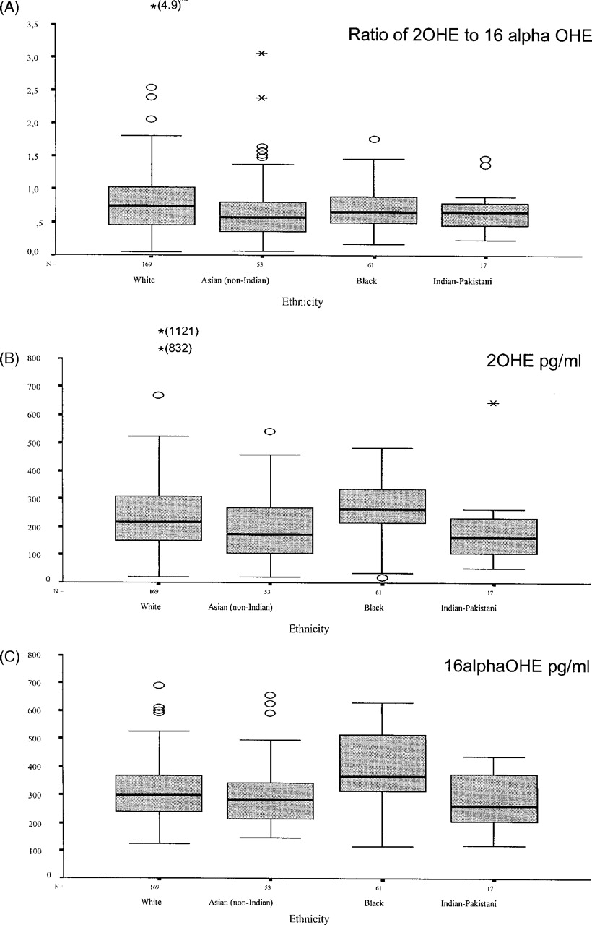
Fig. 3. ( A ) The 2-OHE/16α-OHE ratio in plasma in relation to ethnic background among women not using oral ...
Notes:
Fig. 3. ( A ) The 2-OHE/16α-OHE ratio in plasma in relation to ethnic background among women not using oral contraceptives. The 2-OHE/16α-OHE ratios were similar for white, black and Indian/Pakistani women. The 2-OHE/16α-OHE ratio was lower among Asian women than in white women ( P = 0.02), but this was no longer significant after adjustment for age and menstrual cycle phase. ( B ) The 2-OHE levels in relation to ethnic background. Compared with white women, 2-OHE levels were lower in Asian women ( P = 0.07) and in Indian/Pakistani women ( P = 0.04) and higher in black women ( P = 0.003). After adjustment for age and menstrual cycle phase, only black women had significantly higher 2-OHE levels compared with white women ( P = 0.002) in the follicular phase and mid-cycle. ( C ) The plasma levels of 16α-OHE in relation to ethnic background. The levels of 16α-OHE were similar in white, Asian and Indian/Pakistani women, but black women had significantly higher plasma levels of 16α-OHE than white women ( P = 2 × 10 −6 ). After adjustment for age and menstrual cycle phase, black women had significantly higher 16α-OHE levels compared with white women in both menstrual cycle phases ( P = 0.001 and P = 0.003, respectively).
Unless provided in the caption above, the following copyright applies to the content of this slide: © Oxford University Press. All rights reserved

Slide 4
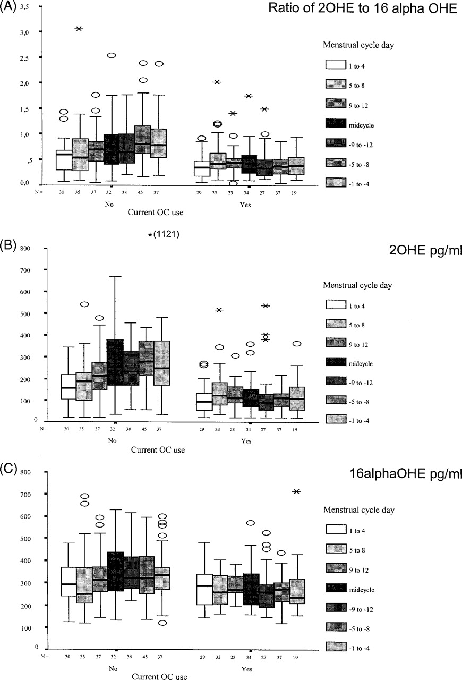
Fig. 4. ( A ) The plasma ratio of 2-OHE to 16α-OHE in relation to the day of the menstrual cycle. We divided the ...
Notes:
Fig. 4. ( A ) The plasma ratio of 2-OHE to 16α-OHE in relation to the day of the menstrual cycle. We divided the menstrual cycle into seven different categories depending on what day of the cycle the blood sample was drawn in relation to onset of bleeding of the previous and of the next menstrual period. Among pill non-users, the 2-OHE/16α-OHE ratio in plasma increased during the menstrual cycle ( rs = 0.26, P = 2 × 10 −5 ). Among oral contraceptive users the plasma ratio of 2-OHE to 16α-OHE was low during cycle days 1–4 when no pills or the placebo pills were consumed. There was a significant negative correlation between the 2-OHE/16α-OHE ratio from cycle day 5 until 4 days prior to onset of the next period, during which days active pills would have been consumed ( rs = −0.17, P = 0.04). The results remained essentially the same after adjustment for age and ethnicity. ( B ) The relationship between day of the menstrual cycle and the plasma level of 2-OHE. Among pill non-users the levels of 2-OHE in plasma increased during the menstrual cycle ( rs = 0.35, P = 10 −6 ). Among oral contraceptive users the plasma level of 2-OHE declined during the days when active pills were consumed ( rs = – 0.16, P = 0.05). The results remained essentially the same after adjustment for age and ethnicity. ( C ) The relationship between day of the menstrual cycle and 16α-OHE. Among pill non-users the levels of 16α-OHE in plasma increased during the menstrual cycle ( rs = 0.14, P = 0.03). There was no consistent pattern between day of menstrual cycle and the levels of 16α-OHE among oral contraceptive users. The results remained essentially the same after adjustment for age and ethnicity.
Unless provided in the caption above, the following copyright applies to the content of this slide: © Oxford University Press. All rights reserved

Slide 5
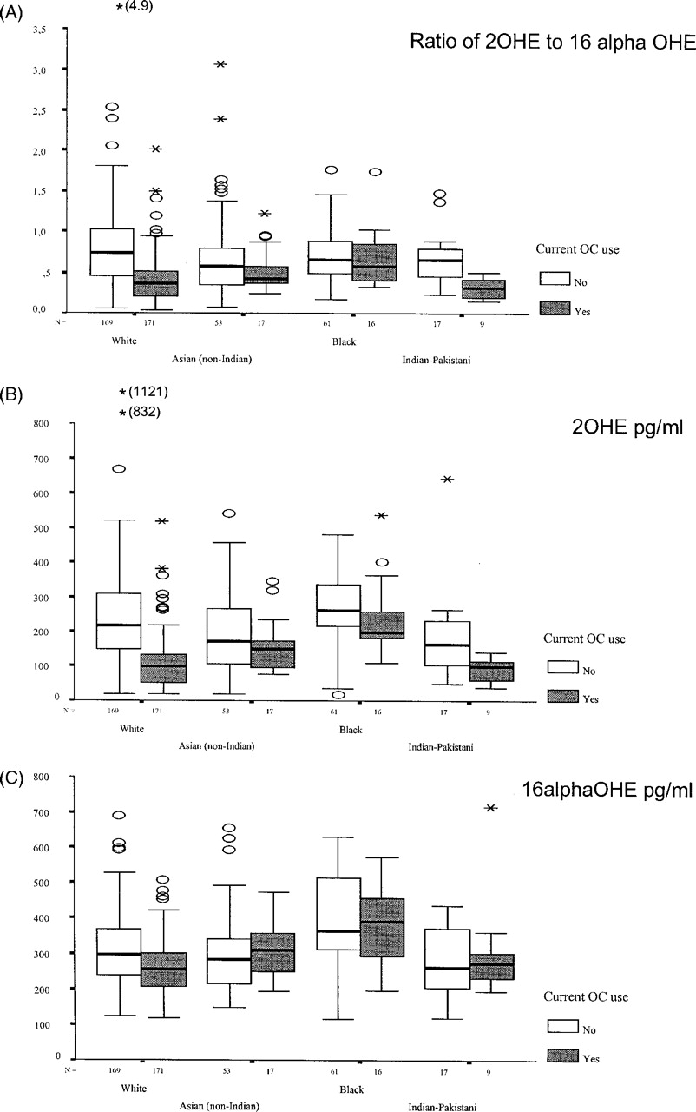
Fig. 5. ( A ) The relationship between the 2-OHE/16α-OHE ratio in women in relation to oral contraceptive use among ...
Notes:
Fig. 5. ( A ) The relationship between the 2-OHE/16α-OHE ratio in women in relation to oral contraceptive use among women of different ethnic background. The 2-OHE/16α-OHE ratio was significantly lower among white ( P = 4 × 10 −19 ) and Indian/Pakistani oral contraceptive users ( P = 0.003) compared with pill non-users of the same ethnic background, and remained significant in these two groups after adjustment for age and menstrual cycle day. ( B ) The relationship between the levels of 2-OHE and oral contraceptive use among women of different ethnic background. Lower 2-OHE levels among oral contraceptive users were observed in all four ethnic groups and was significant among white ( P = 4 × 10 −26 ), black ( P = 0.02) and Indian/Pakistani women ( P = 0.01). After adjustment for age and menstrual cycle day, 2-OHE levels remained significantly lower among white women. ( C ) The relationship between the levels of 16α-OHE and oral contraceptive use among women of different ethnic background. The levels of 16α-OHE in plasma were suppressed by oral contraceptive use among white women ( P = 2 × 10 −6 ), but not among Asian, black or Indian/Pakistani women, and remained significant in white women after adjustment for age and menstrual cycle day.
Unless provided in the caption above, the following copyright applies to the content of this slide: © Oxford University Press. All rights reserved

Slide 6
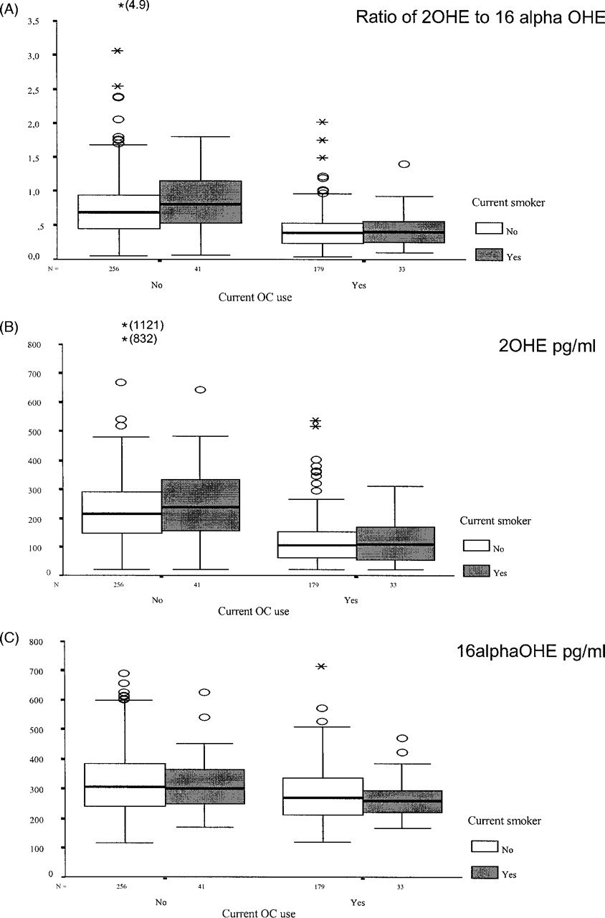
Fig. 6. ( A ) The relationship between 2-OHE/16α-OHE ratio and smoking. Among women who were not using oral ...
Notes:
Fig. 6. ( A ) The relationship between 2-OHE/16α-OHE ratio and smoking. Among women who were not using oral contraceptives, smoking was associated with a non-significantly higher plasma 2-OHE/16α-OHE ratio ( P = 0.06). Smoking had no effect on the plasma ratio of 2-OHE to 16α-OHE among oral contraceptive users ( P = 0.72). This was also true after adjustment for age and menstrual cycle day. ( B ) The relationship between 2-OHE levels and smoking. No significant effect of smoking was seen on the plasma levels of 2-OHE. This was also true after adjustment for age and menstrual cycle day. ( C ) The relationship between the 16α-OHE levels and smoking. No significant difference was observed between non-smokers and smokers. This was also true after adjustment for age and menstrual cycle day.
Unless provided in the caption above, the following copyright applies to the content of this slide: © Oxford University Press. All rights reserved

Slide 7
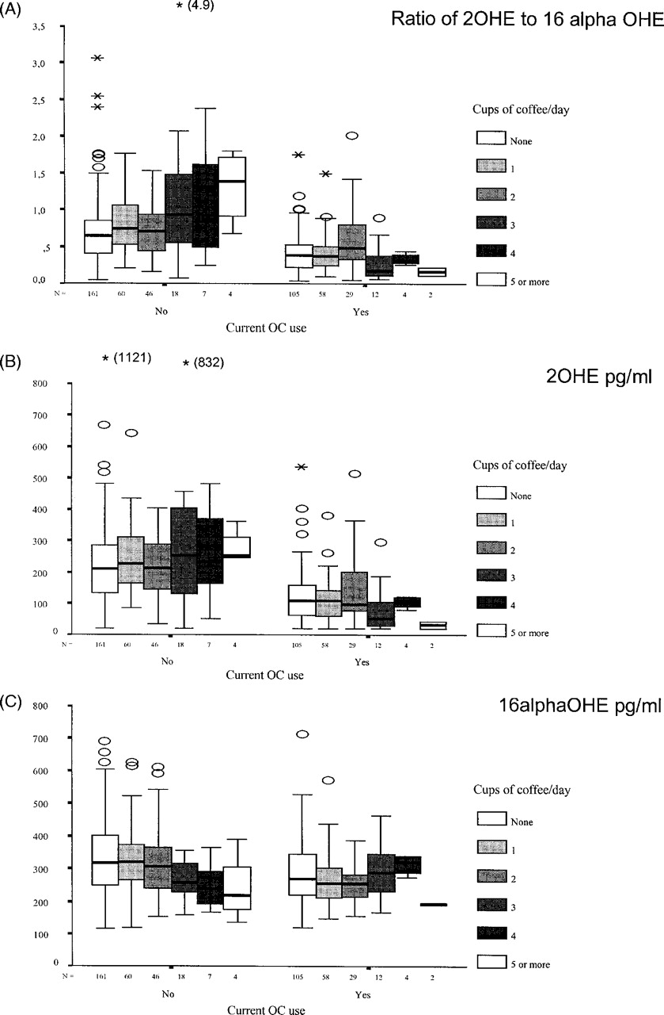
Fig. 7. ( A ) The relationship between daily coffee consumption and the plasma ratio of 2-OHE to 16α-OHE. Daily ...
Notes:
Fig. 7. ( A ) The relationship between daily coffee consumption and the plasma ratio of 2-OHE to 16α-OHE. Daily coffee consumption was positively correlated with the plasma ratio of 2-OHE to 16α-OHE among women not taking oral contraceptives ( rs = 0.18, P = 0.002), but not among oral contraceptive users ( rs = −0.01, P = 0.83). After adjustment for age, ethnicity and menstrual cycle day a high coffee consumption remained significantly associated with high plasma 2-OHE/16α-OHE ratios ( P = 0.003) among pill non-users. ( B ) The relationship between the plasma levels of 2-OHE and coffee consumption. Coffee consumption did not significantly affect the plasma levels of 2-OHE among pill non-users or among oral contraceptive users. After adjustment for age, ethnicity and menstrual cycle day a high coffee consumption remained significantly associated with high levels of 2-OHE ( P = 0.03) among pill non-users. ( C ) The relationship between coffee consumption and plasma levels of 16α-OHE. A high daily coffee consumption was correlated with suppressed plasma levels of 16α-OHE ( rs = −0.16, P = 0.007) among pill non-users, but not among oral contraceptive users. After adjustment for age, ethnicity and menstrual cycle day a high coffee consumption was only non-significantly associated with lower levels of 16α-OHE ( P = 0.11) among pill non-users.
Unless provided in the caption above, the following copyright applies to the content of this slide: © Oxford University Press. All rights reserved

Slide 8
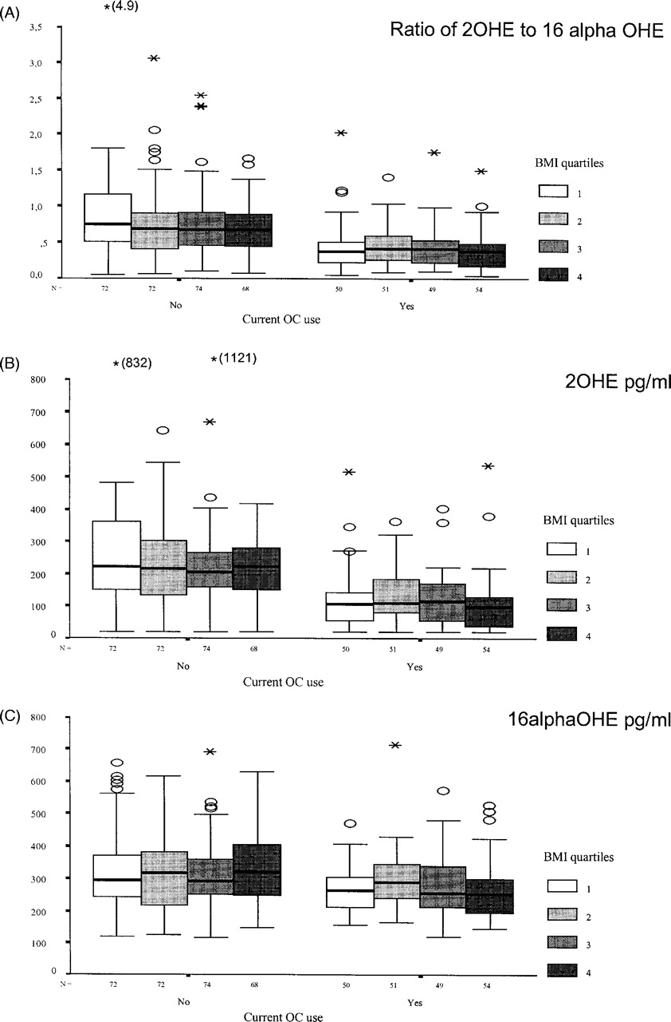
Fig. 8. ( A ) There was no relationship between the 2-OHE/16α-OHE ratio and BMI, as divided in quartiles. This was ...
Notes:
Fig. 8. ( A ) There was no relationship between the 2-OHE/16α-OHE ratio and BMI, as divided in quartiles. This was also true after adjustment for age and menstrual cycle day. ( B ) There was no relationship between the levels of 2-OHE and quartile of BMI. This was also true after adjustment for age and menstrual cycle day. ( C ) There was no relationship between the levels of 16α-OHE and quartile of BMI. This was also true after adjustment for age and menstrual cycle day.
Unless provided in the caption above, the following copyright applies to the content of this slide: © Oxford University Press. All rights reserved

