Slide 1
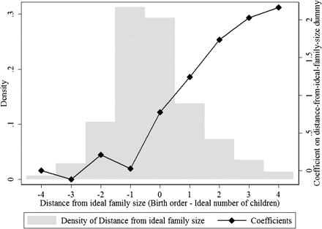
FIGURE II Breastfeeding Duration, by Distance from Ideal Family Size The figure plots the coefficients for “distance ...
Notes:
FIGURE II Breastfeeding Duration, by Distance from Ideal Family Size The figure plots the coefficients for “distance from ideal family size” dummies from a regression with breastfeeding duration in months as the dependent variable. Distance from ideal family size is defined as the child's birth order minus the mother's ideal family size. The omitted category is distance from ideal family size = − 4, for which the coefficient is normalized to 0. The regression includes age-in-month fixed effects and no other control variables. The histogram of the “distance from ideal family size” variable is also displayed.II
Unless provided in the caption above, the following copyright applies to the content of this slide: © The Author(s) 2011. Published by Oxford University Press, on behalf of President and Fellows of Harvard College. All rights reserved. For Permissions, please email: journals.permissions@oup.com.

Slide 2
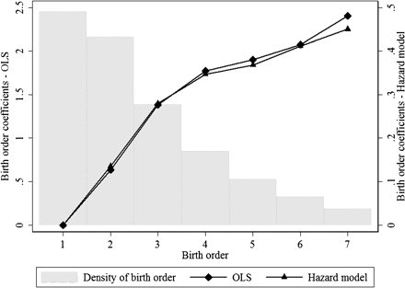
FIGURE I Breastfeeding Duration, by Birth Order The figure plots the coefficients for birth-order dummies from a ...
Notes:
FIGURE I Breastfeeding Duration, by Birth Order The figure plots the coefficients for birth-order dummies from a regression with breastfeeding duration in months as the dependent variable. The OLS model includes age-in-month fixed effects; no other control variables are included. The omitted category is birth order 1, for which the coefficient is normalized to 0. For the hazard rate, the coefficients are negated for comparability with the OLS coefficients; thus, the hazard coefficients represent “survival” in breastfeeding rather than exit from breastfeeding. The histogram of birth order for the sample is also displayed.I
Unless provided in the caption above, the following copyright applies to the content of this slide: © The Author(s) 2011. Published by Oxford University Press, on behalf of President and Fellows of Harvard College. All rights reserved. For Permissions, please email: journals.permissions@oup.com.

Slide 3
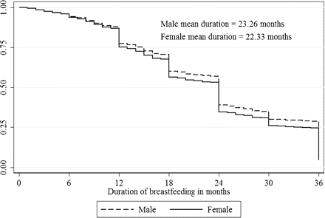
FIGURE III Survival Function for Breastfeeding, by Gender The figure plots the proportion of children, by gender, who ...
Notes:
FIGURE III Survival Function for Breastfeeding, by Gender The figure plots the proportion of children, by gender, who are still being breastfed at the duration (age) given on the horizontal axis. Both the plot and the reported means account for censoring of the breastfeeding duration variable for children who are still being breastfed at the time of the survey. The means listed in the figure are calculated assuming that all observations that report having 36 months of breastfeeding (the top-coded value) have exactly 36 months of breastfeeding. If instead we exponentially extend the survival curve to 0 for those observations, the male and female means are, respectively, 23.94 and 22.88, yielding a gender gap of 1.06 instead of 0.93 months. The survival curves are later used to calculate statistics used in the mortality calculation in Section VII. For example, the probability that a girl is breastfed between the ages of 12 and 36 months is the average height of the female survival curve in this age range, or 0.4597. The same probability for boys is 0.4964, yielding a gender gap of 3.67 percentage points. The average probability of being breastfed between 12 and 36 months, also needed in the mortality calculation, can be similarly calculated from the combined survival curve (not plotted), and is 0.481.III
Unless provided in the caption above, the following copyright applies to the content of this slide: © The Author(s) 2011. Published by Oxford University Press, on behalf of President and Fellows of Harvard College. All rights reserved. For Permissions, please email: journals.permissions@oup.com.

Slide 4
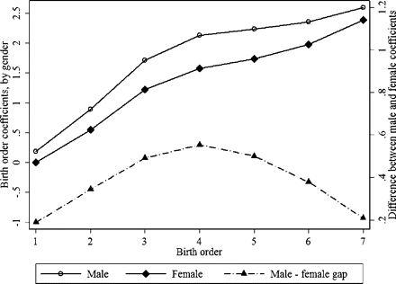
FIGURE IV Gender Differences in Breastfeeding Duration, by Birth Order The solid lines plot the gender-specific ...
Notes:
FIGURE IV Gender Differences in Breastfeeding Duration, by Birth Order The solid lines plot the gender-specific coefficients for birth-order dummies from a regression with breastfeeding duration as the dependent variable, with the coefficient for birth order 1 for females normalized to 0. The regression includes age-in-month fixed effects and no other control variables. The dashed line is the difference between the male and female coefficients.IV
Unless provided in the caption above, the following copyright applies to the content of this slide: © The Author(s) 2011. Published by Oxford University Press, on behalf of President and Fellows of Harvard College. All rights reserved. For Permissions, please email: journals.permissions@oup.com.

Slide 5
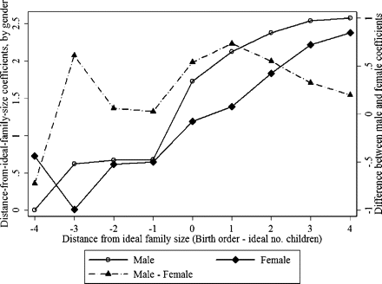
FIGURE V Gender Difference in Breastfeeding Duration, by Distance from Ideal Family Size The solid lines plot the ...
Notes:
FIGURE V Gender Difference in Breastfeeding Duration, by Distance from Ideal Family Size The solid lines plot the gender-specific coefficients for “distance from ideal family size” (birth order minus ideal family size) dummies from a regression with breastfeeding duration in months as the dependent variable. The coefficient for males for distance from ideal family size = − 4 is normalized to 0. The regression includes age-in-month fixed effects and no other control variables. The dashed line is the difference between the male and female coefficients.V
Unless provided in the caption above, the following copyright applies to the content of this slide: © The Author(s) 2011. Published by Oxford University Press, on behalf of President and Fellows of Harvard College. All rights reserved. For Permissions, please email: journals.permissions@oup.com.

