Slide 1
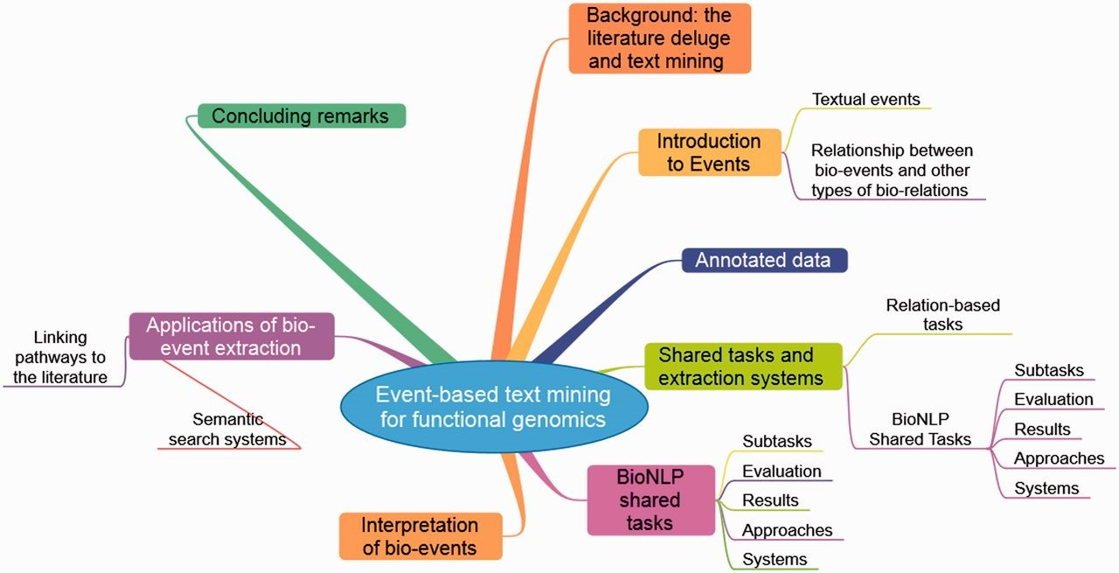
Figure 1: A ‘mind map’ summarising this Briefing. It should be read clockwise starting at 1 o’clock.
Notes:
Figure 1: A ‘mind map’ summarising this Briefing. It should be read clockwise starting at 1 o’clock.
Unless provided in the caption above, the following copyright applies to the content of this slide: © The Author 2014. Published by Oxford University Press.This is an Open Access article distributed under the terms of the Creative Commons Attribution License (http://creativecommons.org/licenses/by/3.0/), which permits unrestricted reuse, distribution, and reproduction in any medium, provided the original work is properly cited.

Slide 2
Figure 2: Simple bio-event example.
Notes:
Figure 2: Simple bio-event example.
Unless provided in the caption above, the following copyright applies to the content of this slide: © The Author 2014. Published by Oxford University Press.This is an Open Access article distributed under the terms of the Creative Commons Attribution License (http://creativecommons.org/licenses/by/3.0/), which permits unrestricted reuse, distribution, and reproduction in any medium, provided the original work is properly cited.

Slide 3
Figure 3: Sentence containing two events.
Notes:
Figure 3: Sentence containing two events.
Unless provided in the caption above, the following copyright applies to the content of this slide: © The Author 2014. Published by Oxford University Press.This is an Open Access article distributed under the terms of the Creative Commons Attribution License (http://creativecommons.org/licenses/by/3.0/), which permits unrestricted reuse, distribution, and reproduction in any medium, provided the original work is properly cited.

Slide 4
Figure 4: More complex sentence containing multiple events.
Notes:
Figure 4: More complex sentence containing multiple events.
Unless provided in the caption above, the following copyright applies to the content of this slide: © The Author 2014. Published by Oxford University Press.This is an Open Access article distributed under the terms of the Creative Commons Attribution License (http://creativecommons.org/licenses/by/3.0/), which permits unrestricted reuse, distribution, and reproduction in any medium, provided the original work is properly cited.

Slide 5
Figure 5: Annotated meta-knowledge example. The core elements of the event (i.e. the trigger for the Regulation event, ...
Notes:
Figure 5: Annotated meta-knowledge example. The core elements of the event (i.e. the trigger for the Regulation event, and its Theme and Cause participants) have been enriched through the identification of cues that are relevant to various dimensions interpretation of the event, according to the meta-knowledge model.
Unless provided in the caption above, the following copyright applies to the content of this slide: © The Author 2014. Published by Oxford University Press.This is an Open Access article distributed under the terms of the Creative Commons Attribution License (http://creativecommons.org/licenses/by/3.0/), which permits unrestricted reuse, distribution, and reproduction in any medium, provided the original work is properly cited.

Slide 6
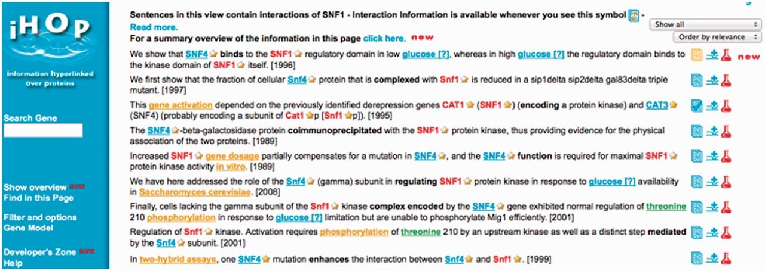
Figure 6: iHop search interface, showing results retrieved by search for SNF1. Additional entities, MeSH terms, ...
Notes:
Figure 6: iHop search interface, showing results retrieved by search for SNF1. Additional entities, MeSH terms, interactions and words are highlighted. (A colour version of this figure is available online at: http://bfg.oxfordjournals.org)
Unless provided in the caption above, the following copyright applies to the content of this slide: © The Author 2014. Published by Oxford University Press.This is an Open Access article distributed under the terms of the Creative Commons Attribution License (http://creativecommons.org/licenses/by/3.0/), which permits unrestricted reuse, distribution, and reproduction in any medium, provided the original work is properly cited.

Slide 7
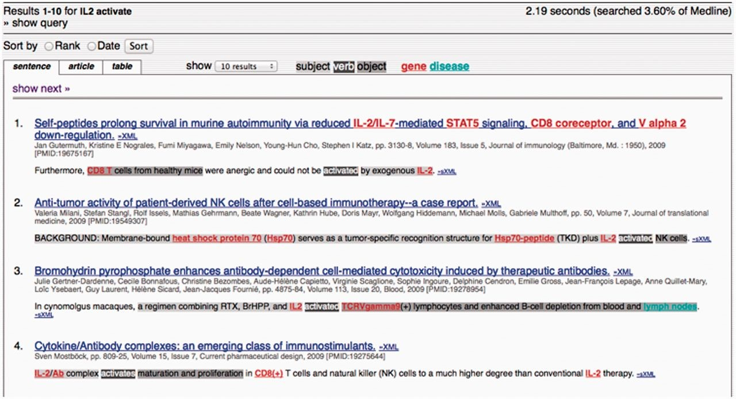
Figure 7: MEDIE search results. Relevant sentences from retrieved abstracts are shown, with separate colours for the ...
Notes:
Figure 7: MEDIE search results. Relevant sentences from retrieved abstracts are shown, with separate colours for the subject, object and verb. (A colour version of this figure is available online at: http://bfg.oxfordjournals.org)
Unless provided in the caption above, the following copyright applies to the content of this slide: © The Author 2014. Published by Oxford University Press.This is an Open Access article distributed under the terms of the Creative Commons Attribution License (http://creativecommons.org/licenses/by/3.0/), which permits unrestricted reuse, distribution, and reproduction in any medium, provided the original work is properly cited.

Slide 8
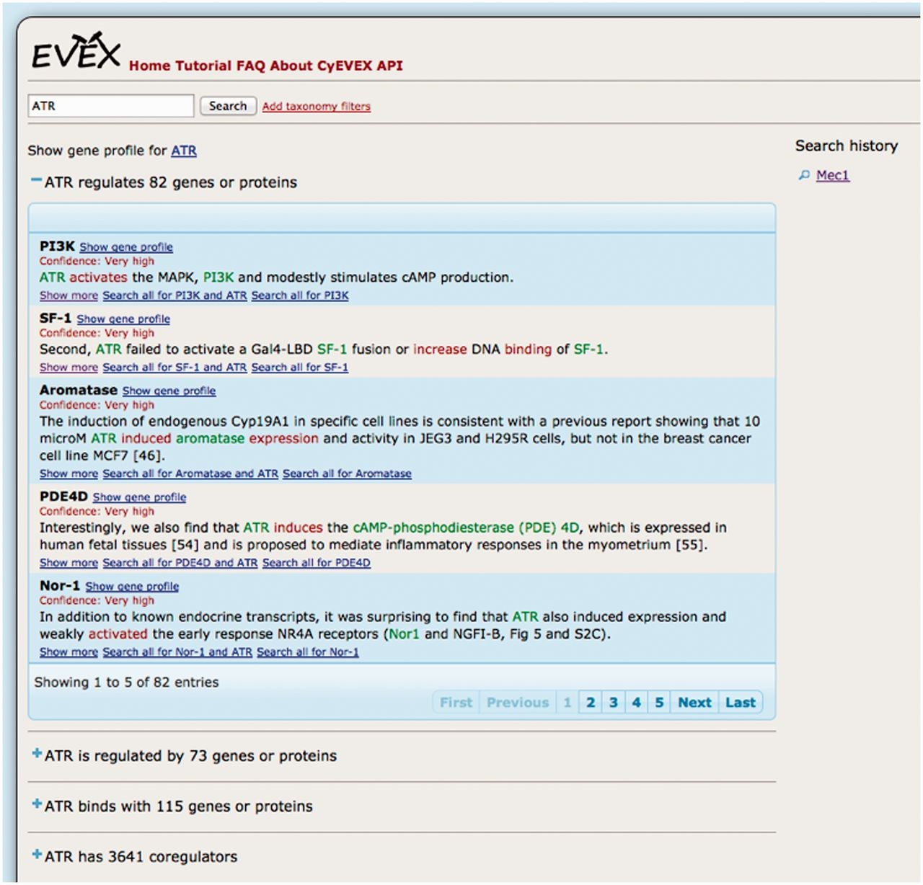
Figure 8: Interface to EVEX database, showing results after searching for the gene ATR.
Notes:
Figure 8: Interface to EVEX database, showing results after searching for the gene ATR.
Unless provided in the caption above, the following copyright applies to the content of this slide: © The Author 2014. Published by Oxford University Press.This is an Open Access article distributed under the terms of the Creative Commons Attribution License (http://creativecommons.org/licenses/by/3.0/), which permits unrestricted reuse, distribution, and reproduction in any medium, provided the original work is properly cited.

Slide 9
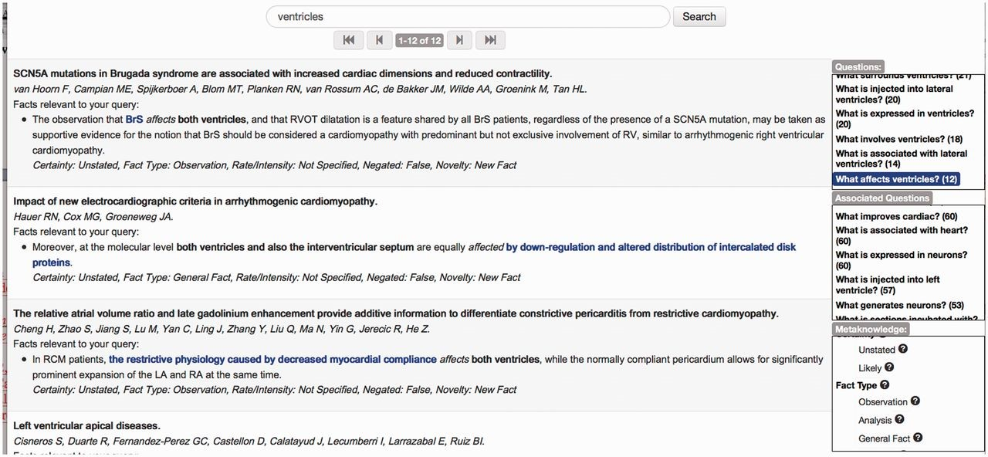
Figure 9: EvidenceFinder interface for anatomical entities.
Notes:
Figure 9: EvidenceFinder interface for anatomical entities.
Unless provided in the caption above, the following copyright applies to the content of this slide: © The Author 2014. Published by Oxford University Press.This is an Open Access article distributed under the terms of the Creative Commons Attribution License (http://creativecommons.org/licenses/by/3.0/), which permits unrestricted reuse, distribution, and reproduction in any medium, provided the original work is properly cited.

Slide 10
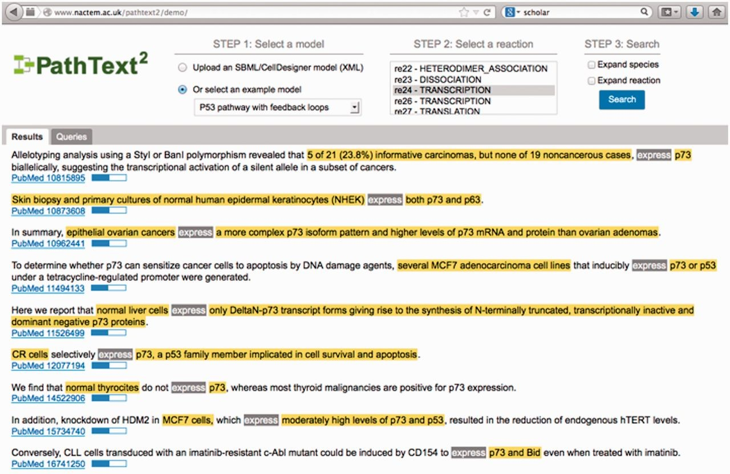
Figure 10: PathText 2 Interface.
Notes:
Figure 10: PathText 2 Interface.
Unless provided in the caption above, the following copyright applies to the content of this slide: © The Author 2014. Published by Oxford University Press.This is an Open Access article distributed under the terms of the Creative Commons Attribution License (http://creativecommons.org/licenses/by/3.0/), which permits unrestricted reuse, distribution, and reproduction in any medium, provided the original work is properly cited.

