Slide 1
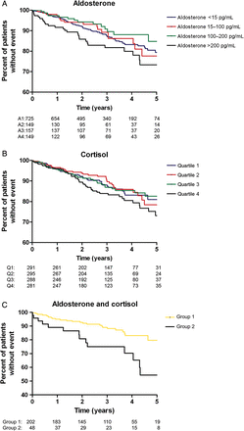
Figure 1 (A–C) Kaplan–Meier curves for the time to sudden cardiac death according to groups of (A) aldosterone ...
Notes:
Figure 1 (A–C) Kaplan–Meier curves for the time to sudden cardiac death according to groups of (A) aldosterone concentration, (B) cortisol concentration, and (C) combined aldosterone and cortisol status at baseline. The categories are: (A) aldosterone: Group 1: 200 pg/mL; log-rank test Group 1 vs. Group 4: P = 0.06. (B) Cortisol: quartile 1: 21.1 µg/dL; log-rank test quartile 1 vs. quartile 4: P = 0.16. (C) Aldosterone and cortisol combined: Group 1: low aldosterone <15 pg/mL and low cortisol 200 pg/mL and high cortisol >21.1 µg/dL log-rank test Group 1 vs. Group 2: P = 0.003.
Unless provided in the caption above, the following copyright applies to the content of this slide: Published on behalf of the European Society of Cardiology. All rights reserved. © The Author 2012This is an Open Access article distributed under the terms of the Creative Commons Attribution Non-Commercial License (http://creativecommons.org/licenses/by-nc/3.0/), which permits unrestricted non-commercial use, distribution, and reproduction in any medium, provided the original work is properly cited.

