Slide 1
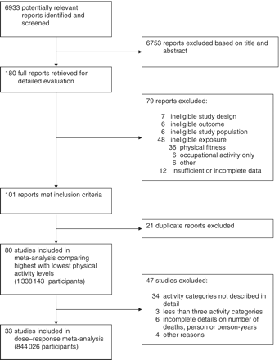
Figure 1 Selection of studies for meta-analysis
Notes:
Figure 1 Selection of studies for meta-analysis
Unless provided in the caption above, the following copyright applies to the content of this slide: Published by Oxford University Press on behalf of the International Epidemiological Association © The Author 2011; all rights reserved.

Slide 2
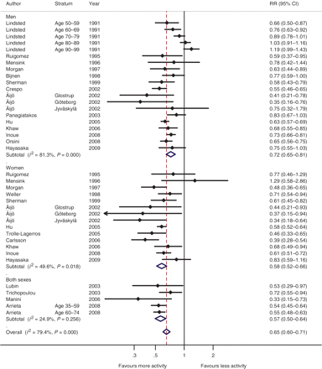
Figure 2 Mortality from all causes in individuals with highest compared with lowest levels of total physical activity. ...
Notes:
Figure 2 Mortality from all causes in individuals with highest compared with lowest levels of total physical activity. Results from random-effects meta-analysis of maximally adjusted RRs from 21 cohort studies (395 655 participants; 31 169 deaths). Arrows indicate that the plotted 95% CI is not showing the full width of the calculated 95% CI which is given in the RR column. The open diamonds show the summary estimate from the meta-analysis, and the dashed line the value of the summary estimate for all studies combined
Unless provided in the caption above, the following copyright applies to the content of this slide: Published by Oxford University Press on behalf of the International Epidemiological Association © The Author 2011; all rights reserved.

Slide 3
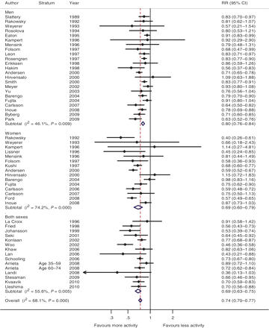
Figure 3 Mortality from all causes in individuals with highest compared with lowest levels of leisure-time physical ...
Notes:
Figure 3 Mortality from all causes in individuals with highest compared with lowest levels of leisure-time physical activity. Results from random-effects meta-analysis of maximally adjusted RRs from 41 cohort studies (544 056 participants; 61 465 deaths). Arrows indicate that the plotted 95% CI is not showing the full width of the calculated 95% CI which is given in the RR column. The open diamonds show the summary estimate from the meta-analysis, and the dashed line the value of the summary estimate for all studies combined
Unless provided in the caption above, the following copyright applies to the content of this slide: Published by Oxford University Press on behalf of the International Epidemiological Association © The Author 2011; all rights reserved.

Slide 4
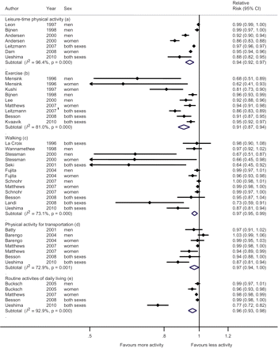
Figure 4 Meta-analysis of maximally adjusted RRs for all-cause mortality per increment of 1 h of physical activity per ...
Notes:
Figure 4 Meta-analysis of maximally adjusted RRs for all-cause mortality per increment of 1 h of physical activity per week for different domains and subdomains of physical activity. Results from random-effects meta-analysis of maximally adjusted RRs from 22 cohort studies (638 871 participants; 50 563 deaths). The median dose of physical activity for the lowest (reference) and highest activity category was 11 and 420 min/week, respectively. aIncluded studies that assessed mixed leisure-time physical activities of moderate and vigorous intensity. bIncluded studies that assessed vigorous-intensity exercise and sports. cIncluded studies that assessed walking as part of daily life, for transportation and for exercise. dIncluded studies that assessed walking and/or cycling to and from work. eIncluded studies that assessed moderate-intensity activities including housework, gardening, stair climbing, walking and cycling as part of daily life. Arrows indicate that the plotted 95% CI is not showing the full width of the calculated 95% CI which is given in the RR column. The open diamonds show the summary estimate from the meta-analysis, and the dashed line the value of the summary estimate for all studies combined
Unless provided in the caption above, the following copyright applies to the content of this slide: Published by Oxford University Press on behalf of the International Epidemiological Association © The Author 2011; all rights reserved.

Slide 5
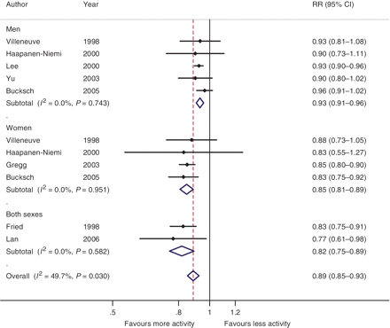
Figure 5 Meta-analysis of maximally adjusted RRs of all-cause mortality for 1000 kcal in energy expenditure per week ...
Notes:
Figure 5 Meta-analysis of maximally adjusted RRs of all-cause mortality for 1000 kcal in energy expenditure per week compared with lowest level of activity. Results from random-effects meta-analysis from eight cohort studies (56 773 study participants; 7742 deaths) of moderate- and vigorous-intensity leisure-time activities and moderate-intensity activities of daily living. The median level of energy expenditure for the lowest (reference) and highest activity category was 114 and 2490 kcal/week, respectively. Arrows indicate that the plotted 95% CI is not showing the full width of the calculated 95% CI which is given in the RR column. The open diamonds show the summary estimate from the meta-analysis, and the dashed line the value of the summary estimate for all studies combined
Unless provided in the caption above, the following copyright applies to the content of this slide: Published by Oxford University Press on behalf of the International Epidemiological Association © The Author 2011; all rights reserved.

Slide 6
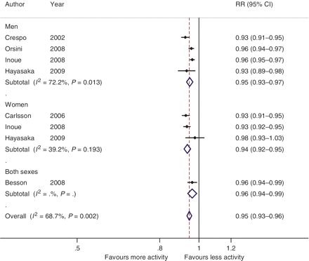
Figure 6 Meta-analysis of maximally adjusted RRs for all-cause mortality per increment of 2 MET-h/day. Results from ...
Notes:
Figure 6 Meta-analysis of maximally adjusted RRs for all-cause mortality per increment of 2 MET-h/day. Results from random-effects meta-analysis from six cohort studies (183 271 participants; 13 289 deaths) of total physical activity. The median level for the lowest (reference) and highest activity category was 27.3 and 44.4 MET-h/day, respectively. 1 MET represents an individual’s energy expenditure while sitting quietly, which is ~3.5 ml O2/kg/min.17 Activities 6 METs are defined as vigorous.15,17 MET-hours per day are estimated by multiplying the time score spent at each activity per day by its MET value. About 24 MET-h correspond to sitting quietly for 24 h. For example, an office worker with no outside exercise could have a score of 27 MET-h. A labourer who is involved in heavy activity in his job could have a score of >40 MET-h. An increment of 2 MET-h/day is ~1 h of light-intensity activity based on a MET value of 2.0 or 30 min of moderate-intensity activity based on a MET value of 4.5
Unless provided in the caption above, the following copyright applies to the content of this slide: Published by Oxford University Press on behalf of the International Epidemiological Association © The Author 2011; all rights reserved.

