Slide 1
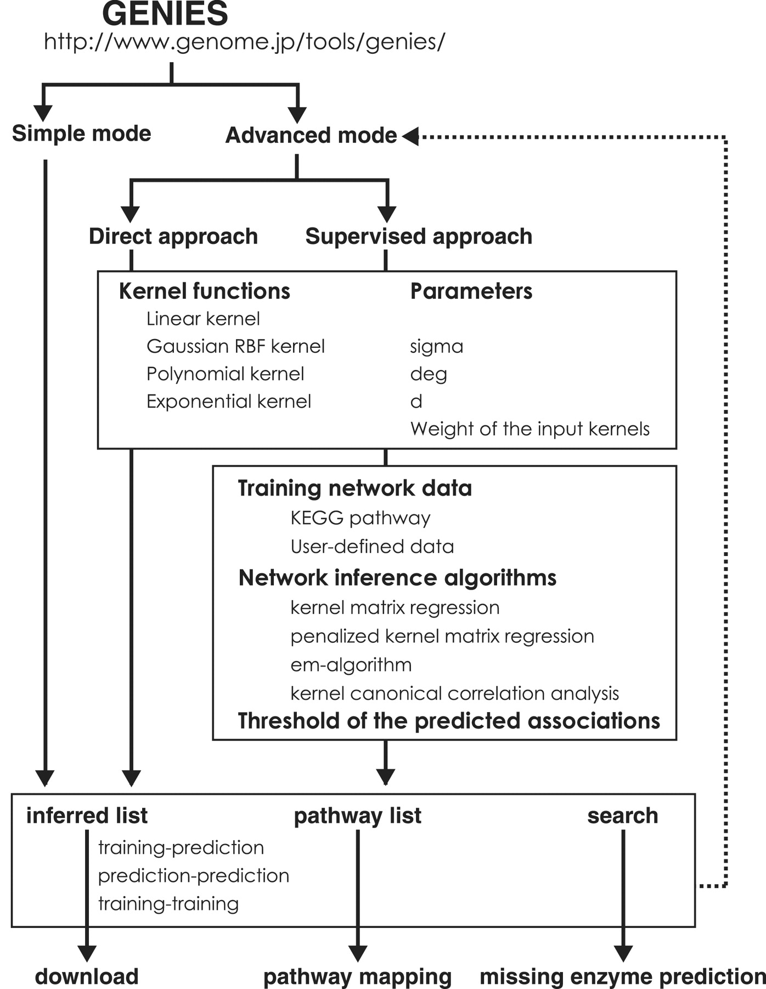
Figure 3. The workflow of GENIES.
Notes:
Figure 3. The workflow of GENIES.
Unless provided in the caption above, the following copyright applies to the content of this slide: © The Author(s) 2012. Published by Oxford University Press.This is an Open Access article distributed under the terms of the Creative Commons Attribution Non-Commercial License (http://creativecommons.org/licenses/by-nc/3.0), which permits unrestricted non-commercial use, distribution, and reproduction in any medium, provided the original work is properly cited.

Slide 2
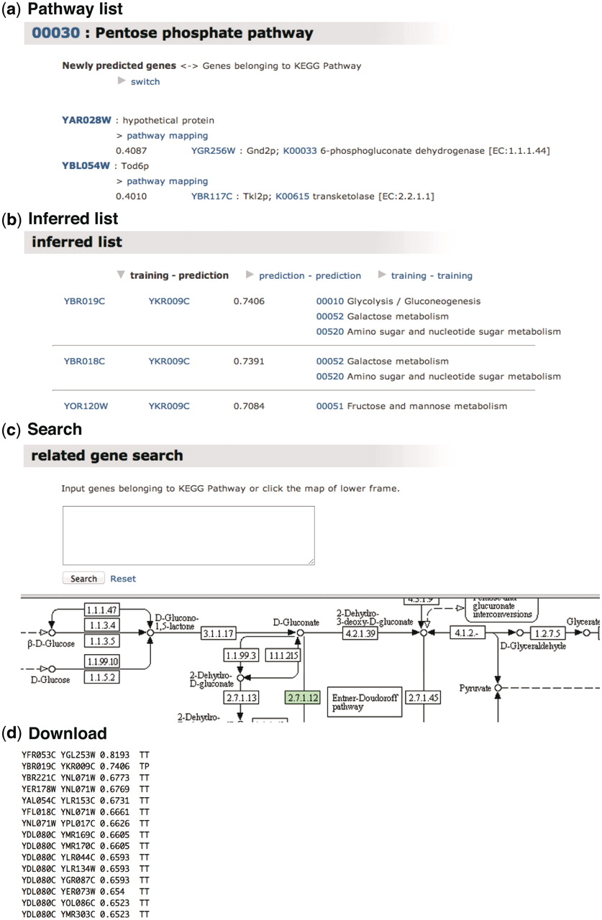
Figure 2. Output example of GENIES. (a) Pathway list shows the predicted gene–gene interactions grouped based on the ...
Notes:
Figure 2. Output example of GENIES. (a) Pathway list shows the predicted gene–gene interactions grouped based on the KEGG PATHWAY maps. (b) Inferred list classifies the gene–gene network into training–prediction (TP), prediction–prediction (PP) and training–training (TT), where ‘training’ and ‘prediction’ mean the genes found and not found in the KEGG PATHWAY maps, respectively. (c) Search option enables the user to find the gene of interest by inputting the gene name or by using the KEGG PATHWAY maps. (d) Tab-delimited files can be downloaded.
Unless provided in the caption above, the following copyright applies to the content of this slide: © The Author(s) 2012. Published by Oxford University Press.This is an Open Access article distributed under the terms of the Creative Commons Attribution Non-Commercial License (http://creativecommons.org/licenses/by-nc/3.0), which permits unrestricted non-commercial use, distribution, and reproduction in any medium, provided the original work is properly cited.

Slide 3
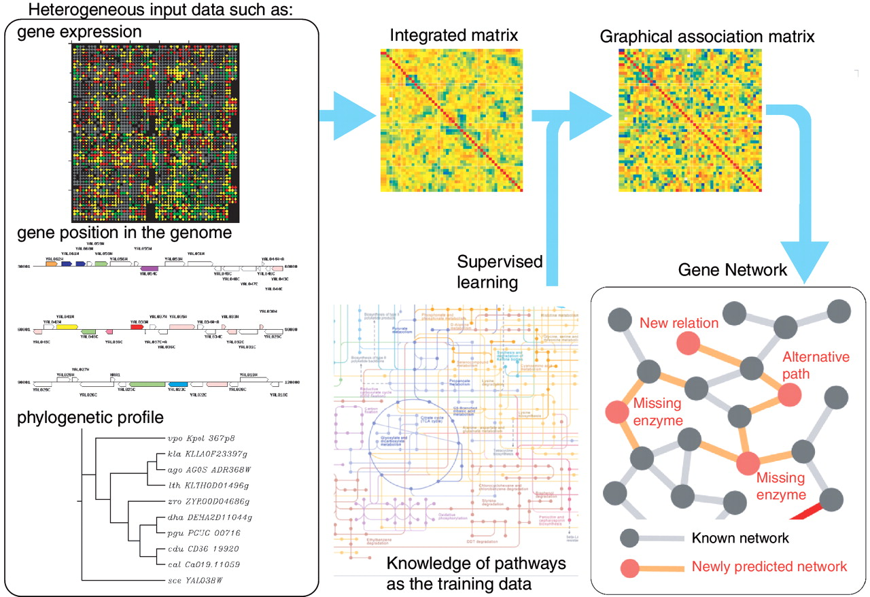
Figure 1. Overview of GENIES.
Notes:
Figure 1. Overview of GENIES.
Unless provided in the caption above, the following copyright applies to the content of this slide: © The Author(s) 2012. Published by Oxford University Press.This is an Open Access article distributed under the terms of the Creative Commons Attribution Non-Commercial License (http://creativecommons.org/licenses/by-nc/3.0), which permits unrestricted non-commercial use, distribution, and reproduction in any medium, provided the original work is properly cited.

Slide 4
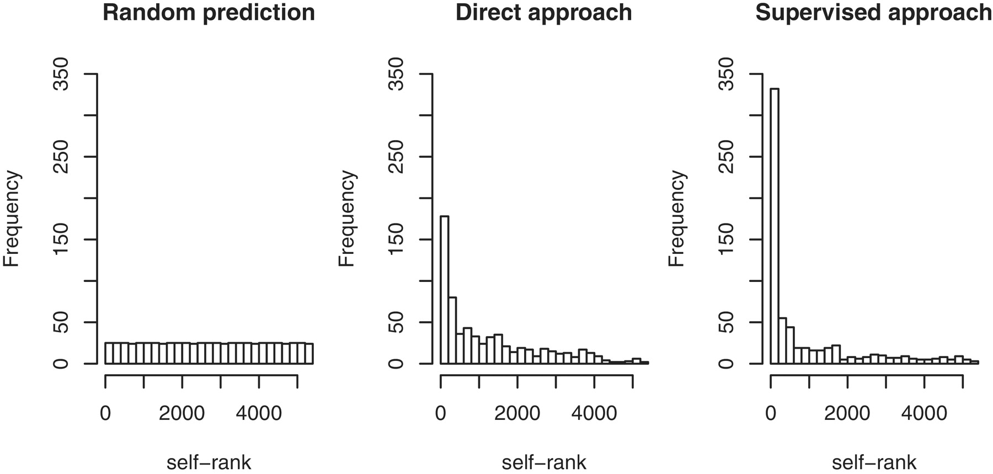
Figure 4. Self-rank test for predicting missing enzyme genes.
Notes:
Figure 4. Self-rank test for predicting missing enzyme genes.
Unless provided in the caption above, the following copyright applies to the content of this slide: © The Author(s) 2012. Published by Oxford University Press.This is an Open Access article distributed under the terms of the Creative Commons Attribution Non-Commercial License (http://creativecommons.org/licenses/by-nc/3.0), which permits unrestricted non-commercial use, distribution, and reproduction in any medium, provided the original work is properly cited.

