Slide 1
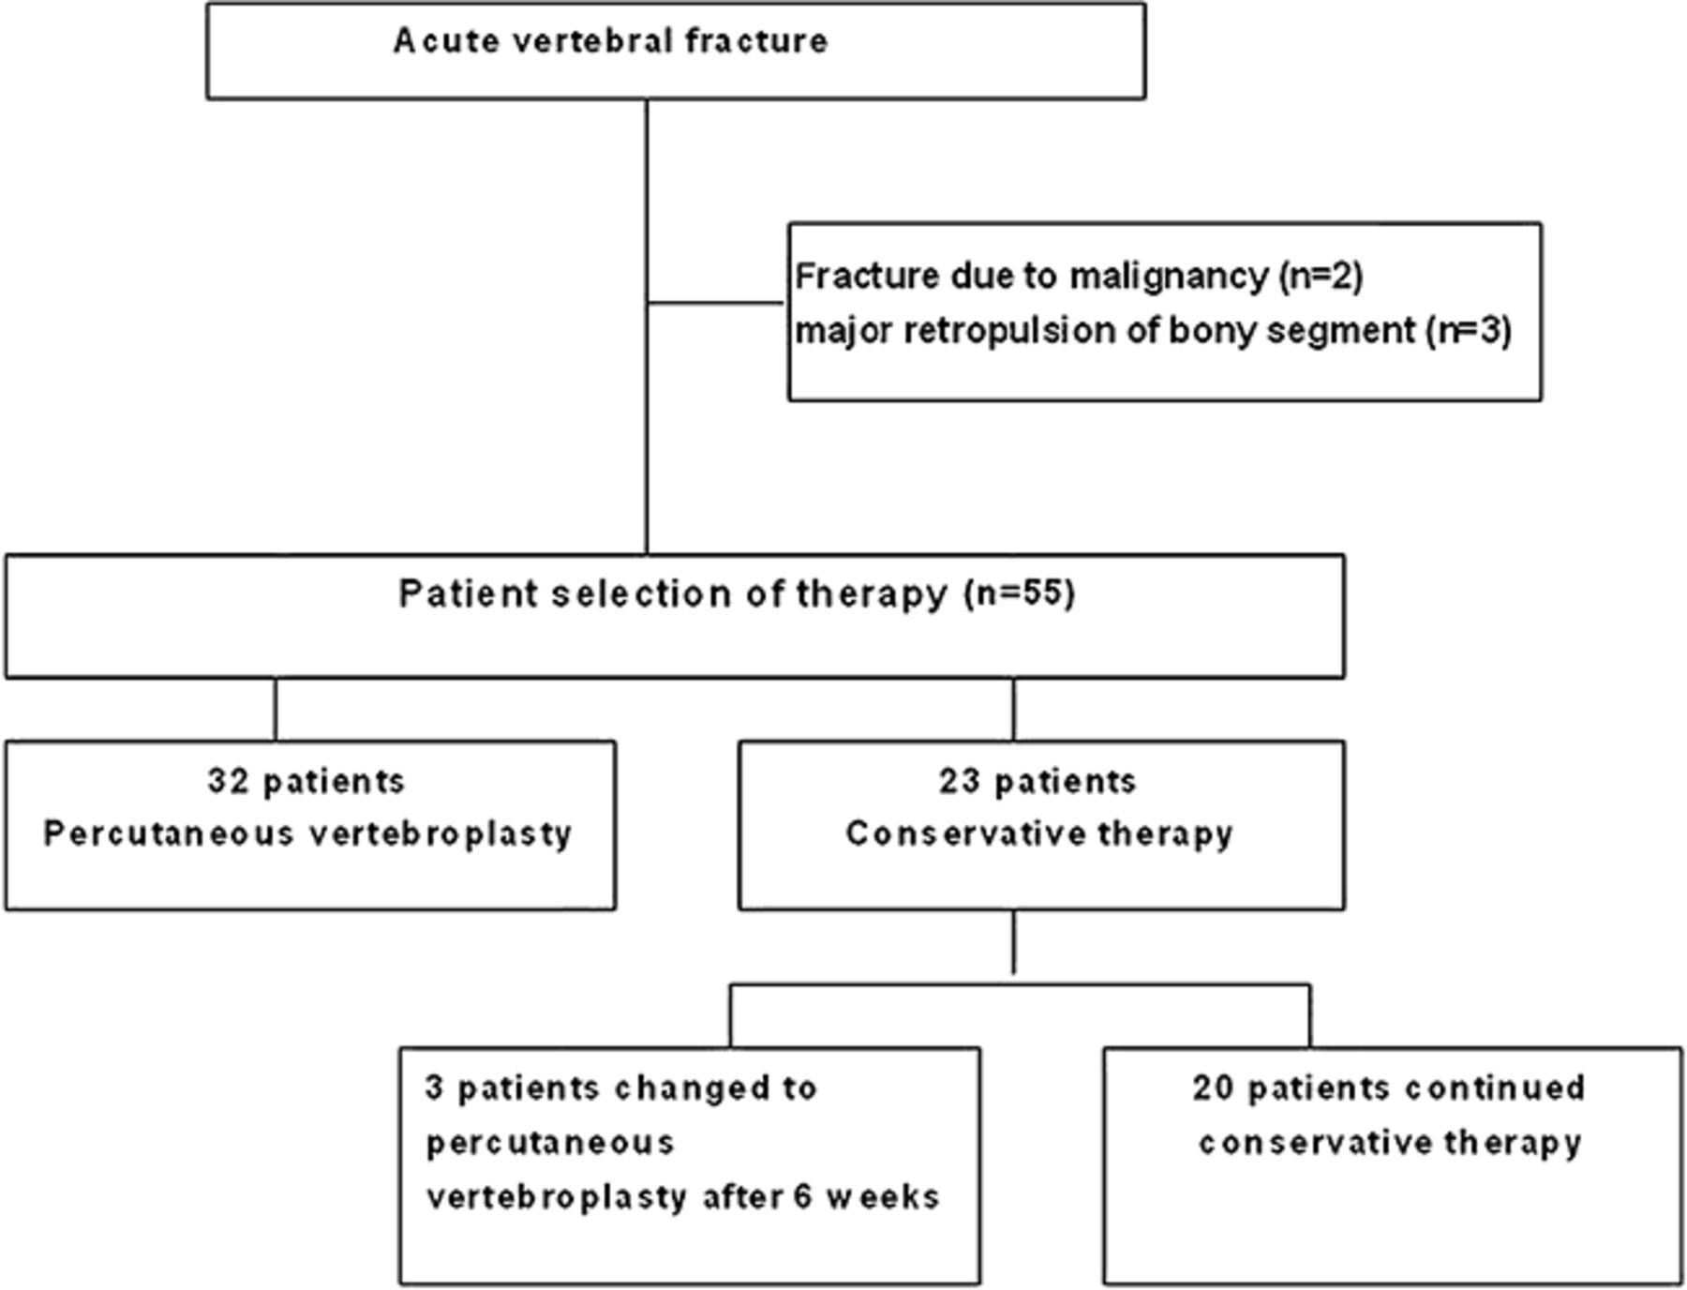
Figure 1 Flow diagram demonstrating study recruitment and treatment selection.
Notes:
Figure 1 Flow diagram demonstrating study recruitment and treatment selection.
Unless provided in the caption above, the following copyright applies to the content of this slide: Wiley Periodicals, Inc.

Slide 2
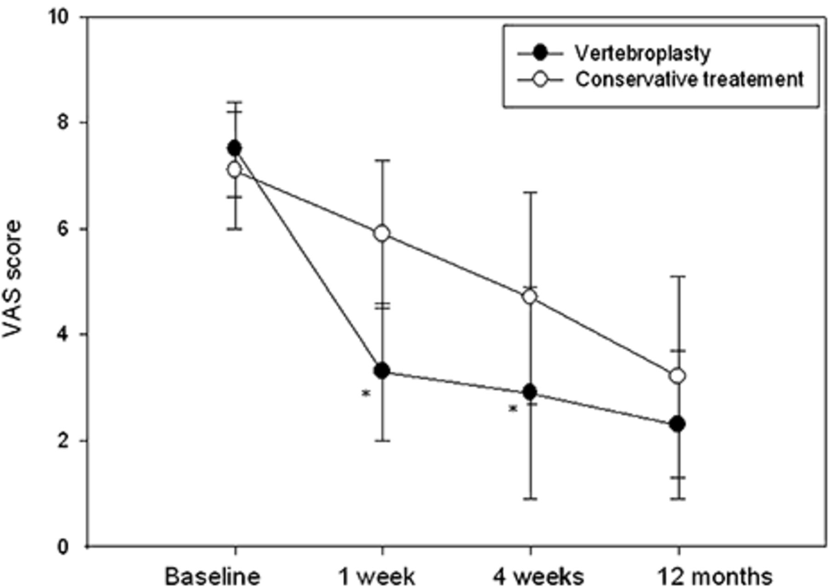
Figure 2 Longitudinal changes in mean (±SD) visual analog scale (VAS) scores. Patients treated by percutaneous ...
Notes:
Figure 2 Longitudinal changes in mean (±SD) visual analog scale (VAS) scores. Patients treated by percutaneous vertebroplasty are compared with patients treated conservatively. Asterisk indicates P < 0.01 for between-group comparisons.
Unless provided in the caption above, the following copyright applies to the content of this slide: Wiley Periodicals, Inc.

Slide 3
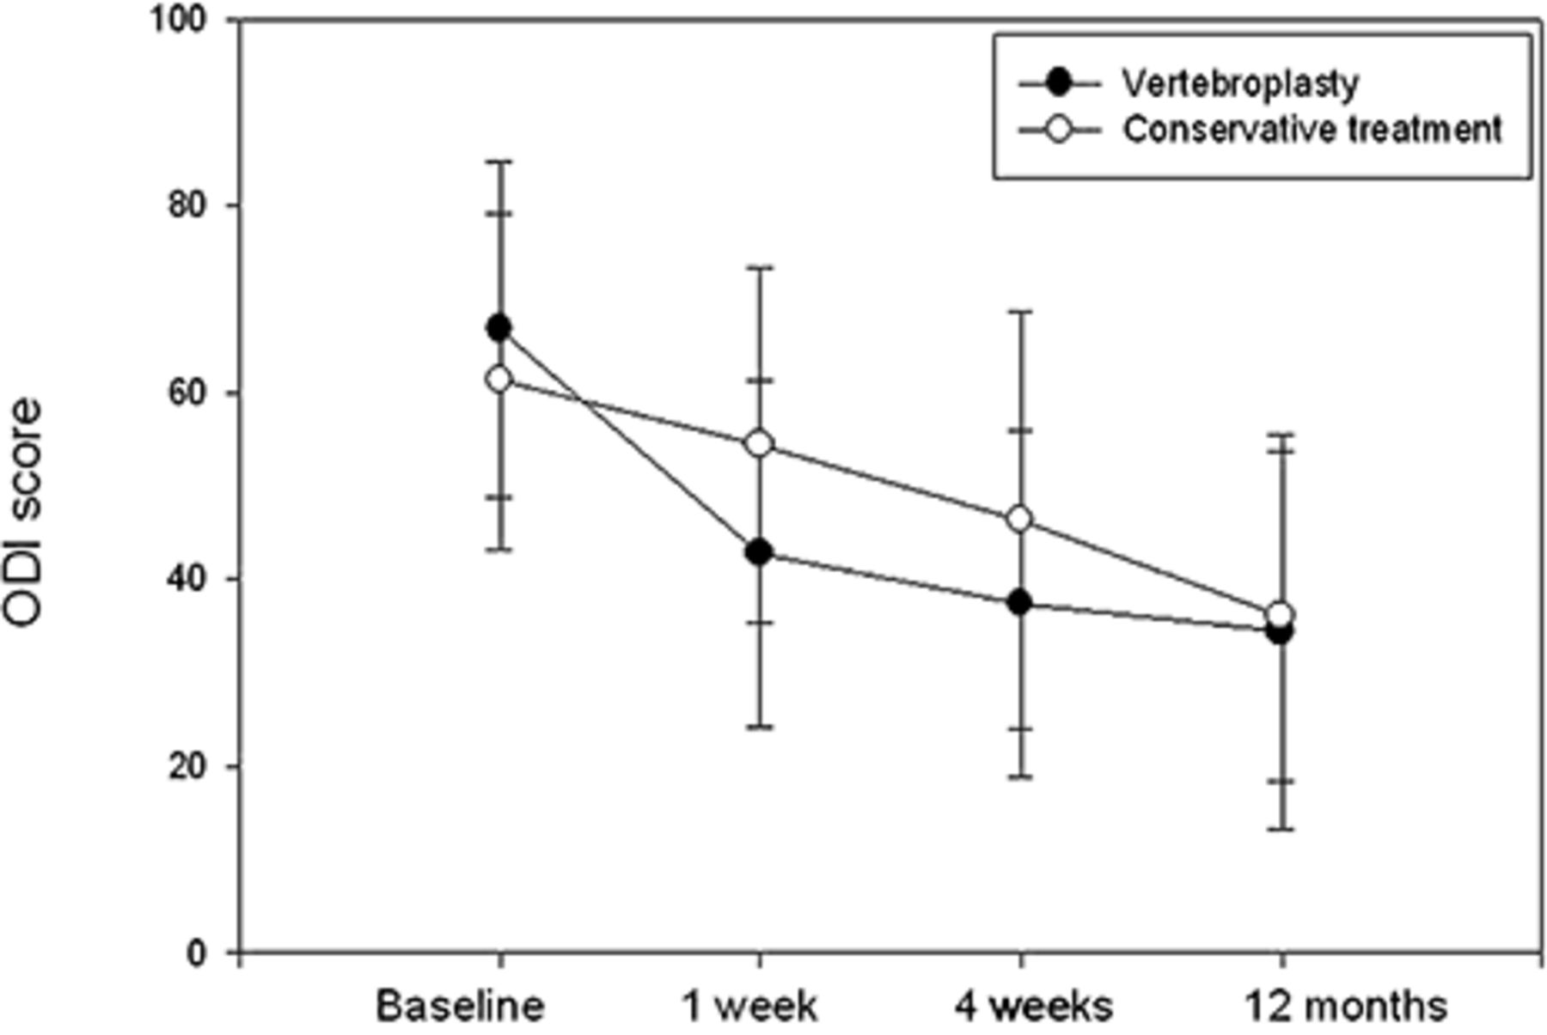
Figure 3 Longitudinal changes in mean (±SD) Revised Oswestry Disability Index (ODI) scores. Patients treated by ...
Notes:
Figure 3 Longitudinal changes in mean (±SD) Revised Oswestry Disability Index (ODI) scores. Patients treated by percutaneous vertebroplasty are compared with patients treated conservatively. Asterisk indicates P < 0.01 for between-group comparisons.
Unless provided in the caption above, the following copyright applies to the content of this slide: Wiley Periodicals, Inc.

Slide 4
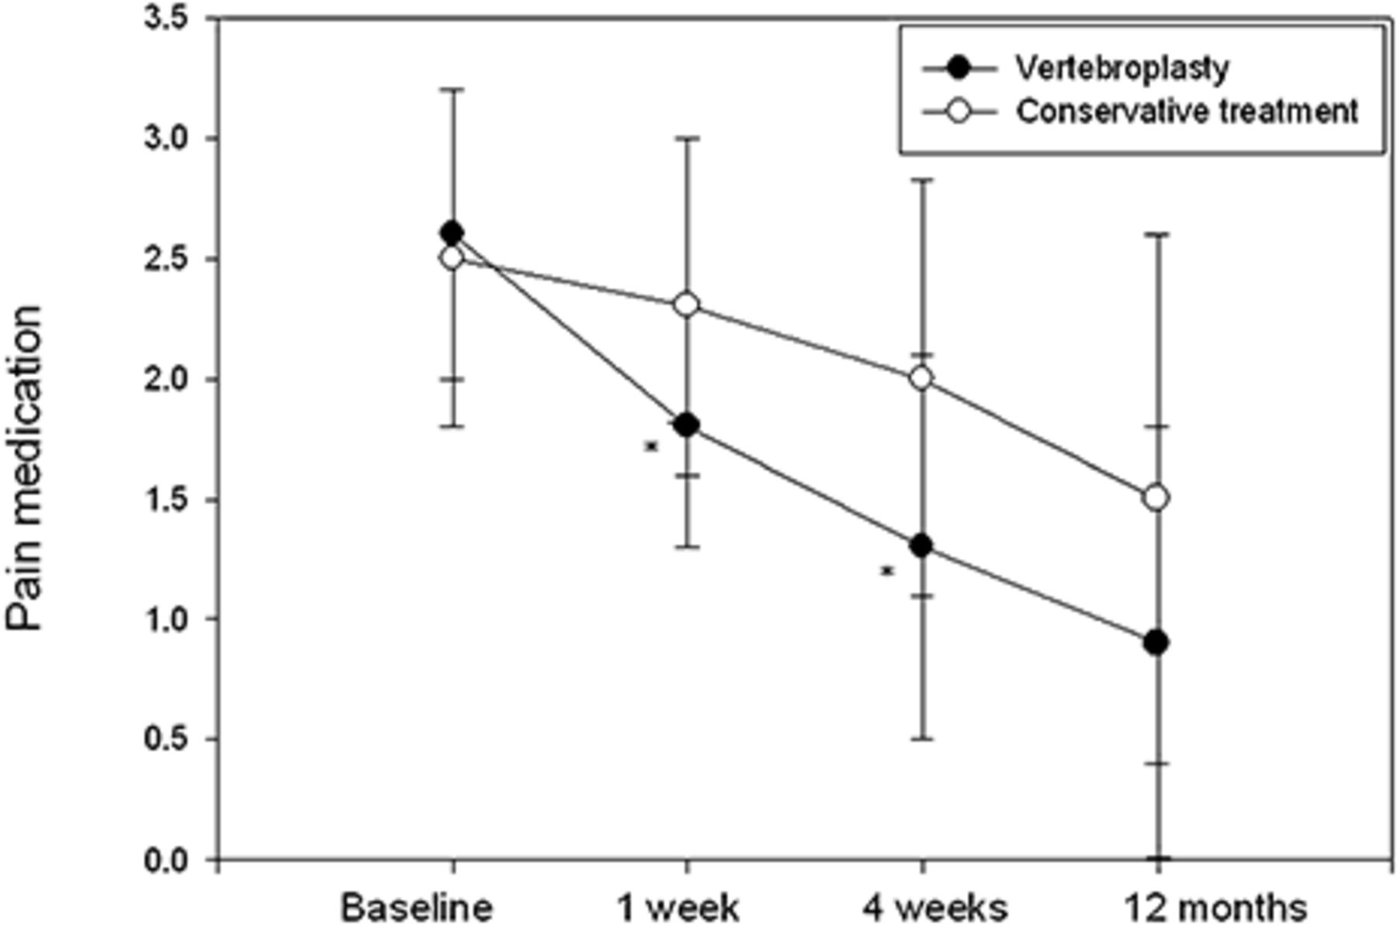
Figure 4 Longitudinal changes in pain medication scores. Patients treated by percutaneous vertebroplasty are compared ...
Notes:
Figure 4 Longitudinal changes in pain medication scores. Patients treated by percutaneous vertebroplasty are compared with patients treated conservatively. Asterisk indicates P < 0.01 for between-group comparisons.
Unless provided in the caption above, the following copyright applies to the content of this slide: Wiley Periodicals, Inc.

