Slide 1
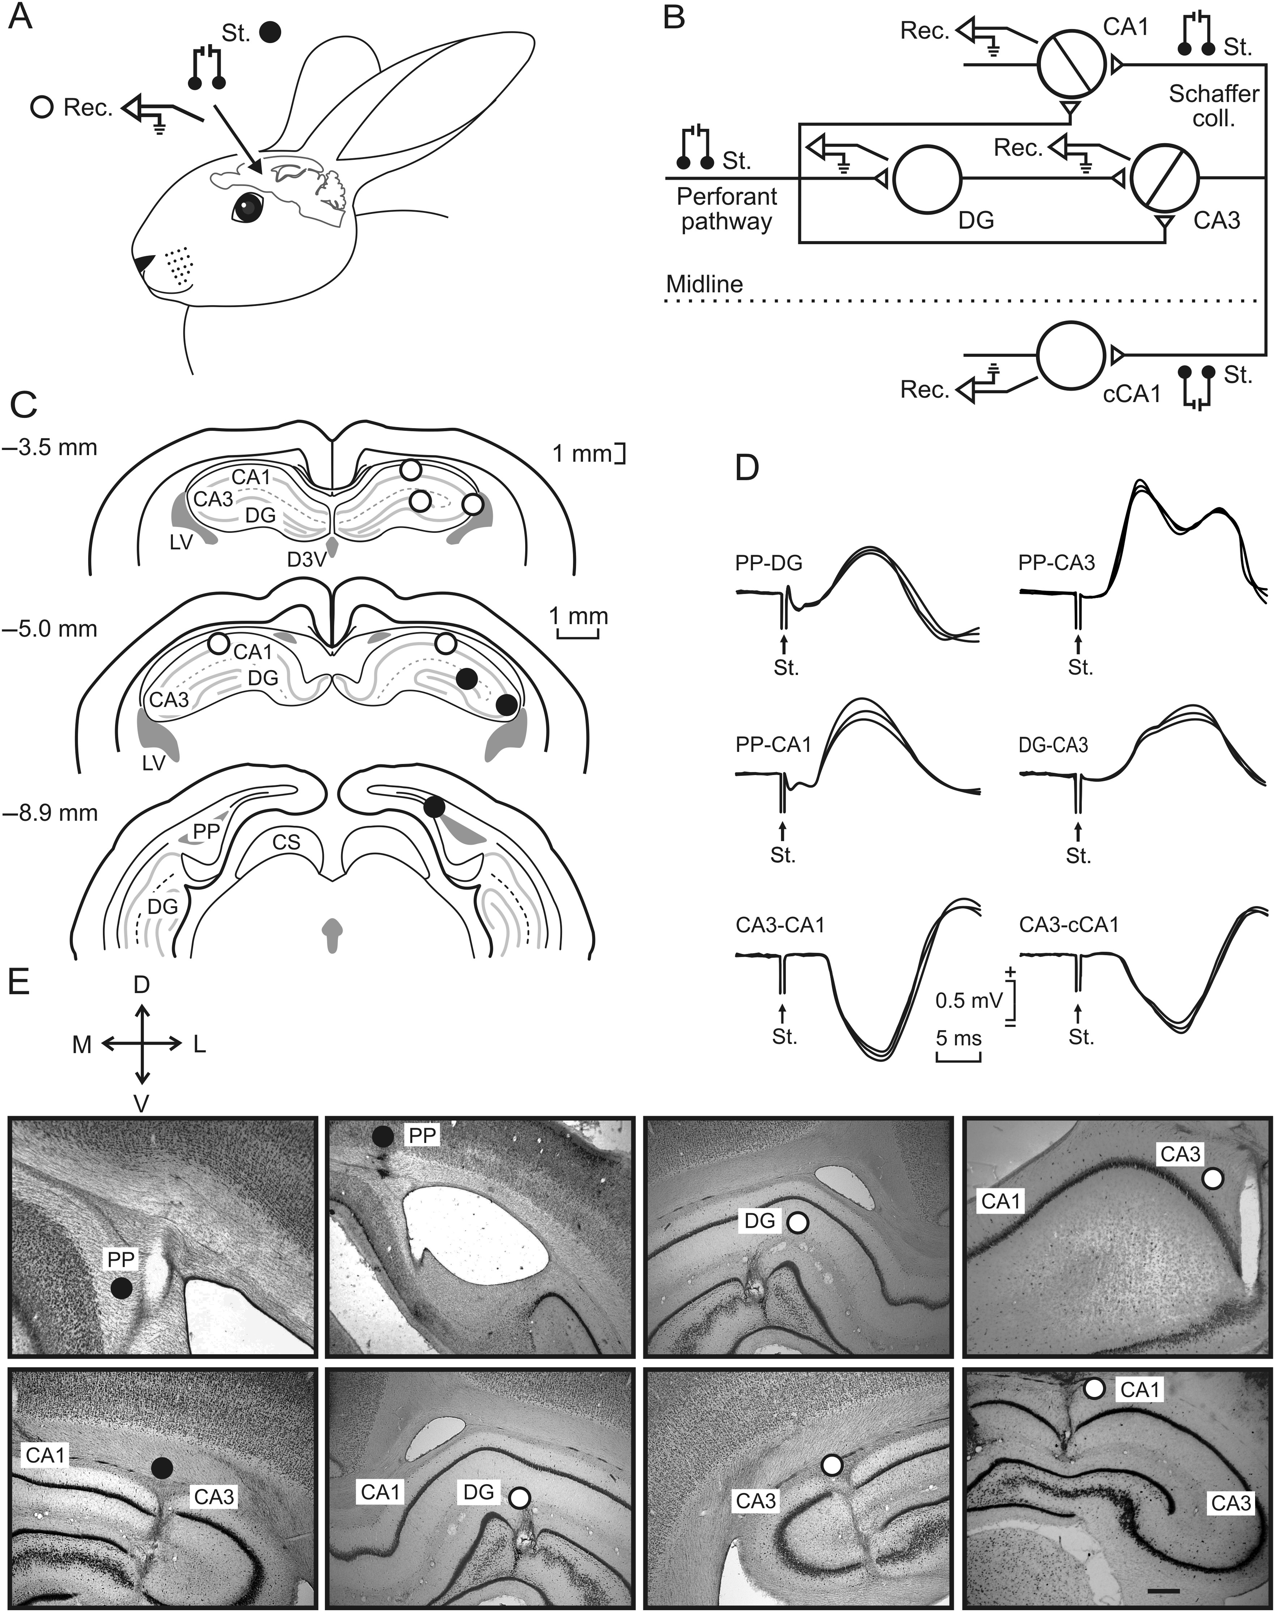
Figure 1. Experimental design. (A,B) For the classical conditioning of eyelid responses, rabbits were chronically ...
Notes:
Figure 1. Experimental design. (A,B) For the classical conditioning of eyelid responses, rabbits were chronically implanted with recording (Rec.) electrodes in the right dentate gyrus (DG) and hippocampal CA1 and CA3 areas, as well as in the contralateral CA1 (cCA1) area. Animals were also implanted with stimulating (St.) electrodes in the perforant pathway and in the ipsi- and contralateral Schaffer collateral/commissural pathway. (C) Schematic diagrams in stereotaxic coordinates from rabbit brain (modified from Girgis and Shih-Chang 1981) with indication of selected recording (white circles) and stimulating (black circles) sites. (D) Representative records collected from the 6 (PP-DG, PP-CA3, PP-CA1, DG-CA3, CA3-CA1, and CA3-cCA1) synapses included in this study. Calibration at the bottom is for all records. (E) Different photomicrographs illustrating the final location of stimulating (black circles) and recording (white circles) electrodes. Calibration bar is 1 mm. D, L, M, V, dorsal, lateral, medial, ventral; CS, superior colliculus; D3 V, dorsal part of the third ventricle; LV, lateral ventricle; PP, perforant pathway.
Unless provided in the caption above, the following copyright applies to the content of this slide: © The Author 2013. Published by Oxford University Press. All rights reserved. For Permissions, please e-mail: journals.permissions@oup.com

Slide 2
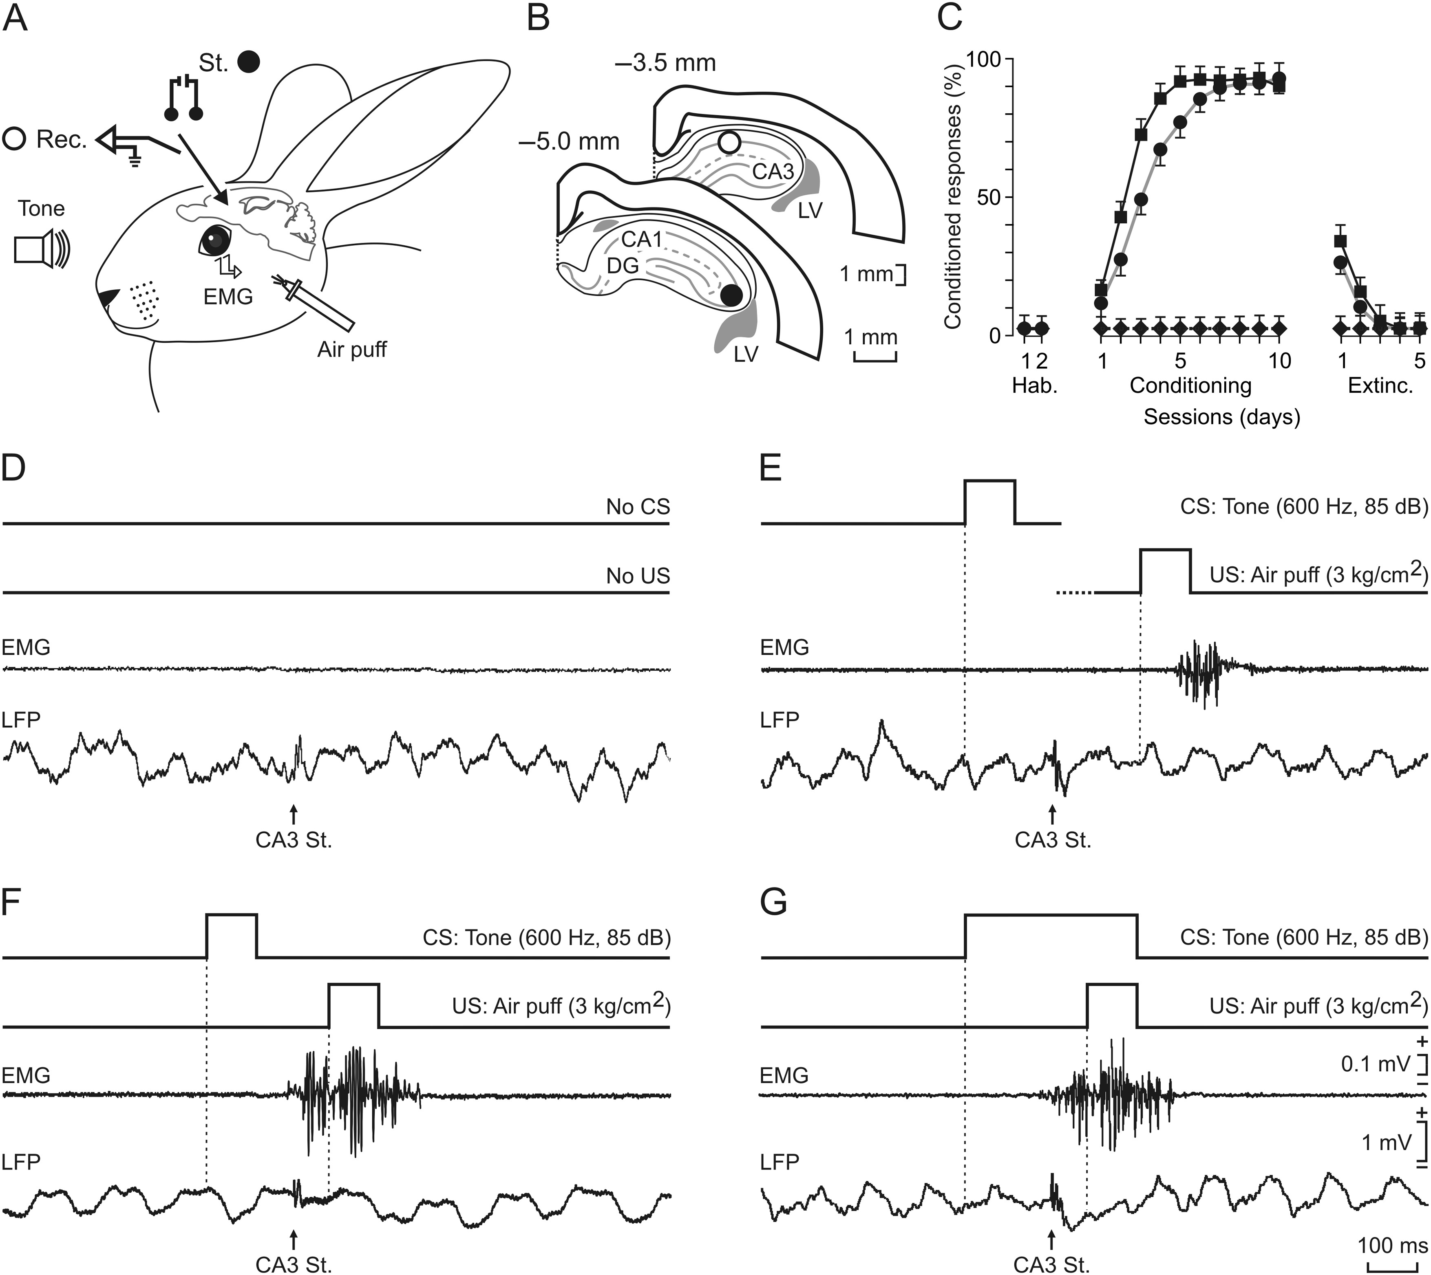
Figure 2. Classical conditioning paradigms. (A) In addition to hippocampal stimulating and recording electrodes ...
Notes:
Figure 2. Classical conditioning paradigms. (A) In addition to hippocampal stimulating and recording electrodes (Fig. 1), animals were implanted with EMG recording electrodes in the left orbicularis oculi muscle. For classical eyeblink conditioning, the US consisted of an air puff presented to the ipsilateral cornea, while the CS consisted of tones presented biaurally. (B–G) Animals were presented with 4 different training situations: 1) placed in the restraining box with no CS or US presentations (D); 2) pseudoconditioning (E) with non-paired CS and US presentations; 3) a trace conditioning paradigm (F); and, 4) a delay conditioning paradigm (G). In D–G and from top to bottom are illustrated CS and US presentations, the EMG activity of the orbicularis oculi muscle, and the local field potential recorded in the CA1 area (white circle in B), as well as the fEPSP evoked by a stimulus presented to the ipsilateral Schaffer collaterals (black circle in B). Calibrations in G are also for (D–F). Note that only trace and delay conditioning evoked CRs. The corresponding learning curves evoked by pseudoconditioning (black diamonds), and trace (black circles) and delay (black squares) paradigms are illustrated in (C), during the successive habituation (Hab.), conditioning, and extinction (Extinc.) sessions.
Unless provided in the caption above, the following copyright applies to the content of this slide: © The Author 2013. Published by Oxford University Press. All rights reserved. For Permissions, please e-mail: journals.permissions@oup.com

Slide 3
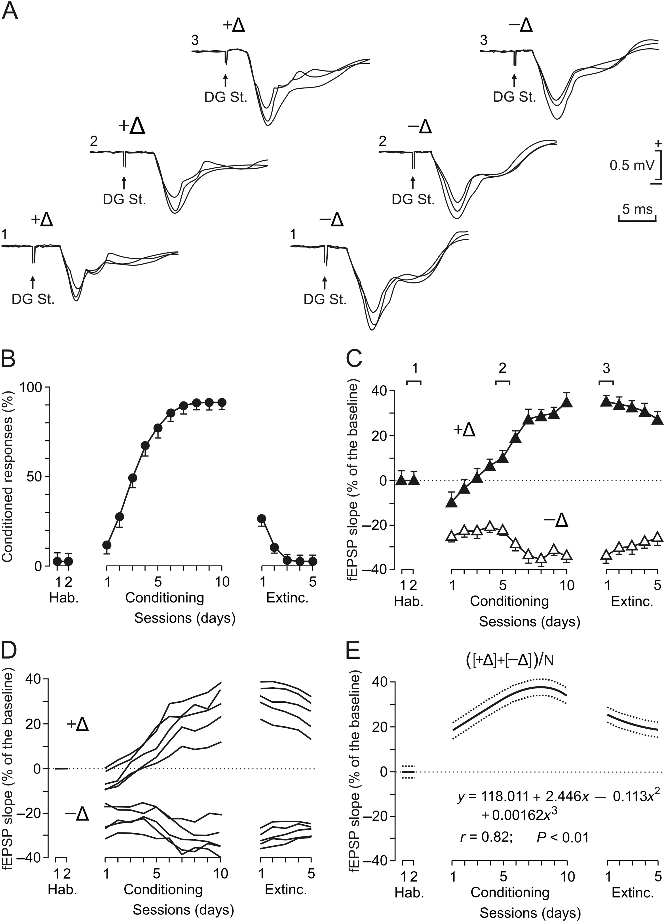
Figure 3. Results collected at the hippocampal DG-CA3 synapse during classical eyeblink conditioning using a trace ...
Notes:
Figure 3. Results collected at the hippocampal DG-CA3 synapse during classical eyeblink conditioning using a trace paradigm. (A) Representative examples of fEPSPs recorded from 2 different electrodes located in the hippocampal CA3 area and evoked by the electrical stimulation of the ipsilateral DG. (B) Evolution of CRs in the group of rabbits (n = 6) trained with a trace paradigm. (C) Evolution of fEPSP slopes, recorded from two different electrodes implanted in the CA3 area, across the successive training sessions illustrated in (B). Representative examples of the recorded fEPSPs at the indicated times (1, 2, 3) are illustrated in A for the 2 recording sites. (D) Evolution of fEPSP slopes recorded from selected electrodes implanted in the CA3 area. fEPSPs were evoked by the electrical stimulation of the ipsilateral DG. Note that fEPSPs either increase (+Δ, n = 5) or decrease (−Δ, n = 5) in slope across training. (E) Algebraic mean [([+Δ] + [−Δ])/N] of fEPSP evolution from electrodes (n = 15) located in the hippocampal CA3 area and activated by DG stimulation. The equation corresponding to the best polynomial fit to data collected during conditioning sessions is indicated, as well as the corresponding regression curve and the simultaneous 95% confidence bands.
Unless provided in the caption above, the following copyright applies to the content of this slide: © The Author 2013. Published by Oxford University Press. All rights reserved. For Permissions, please e-mail: journals.permissions@oup.com

Slide 4
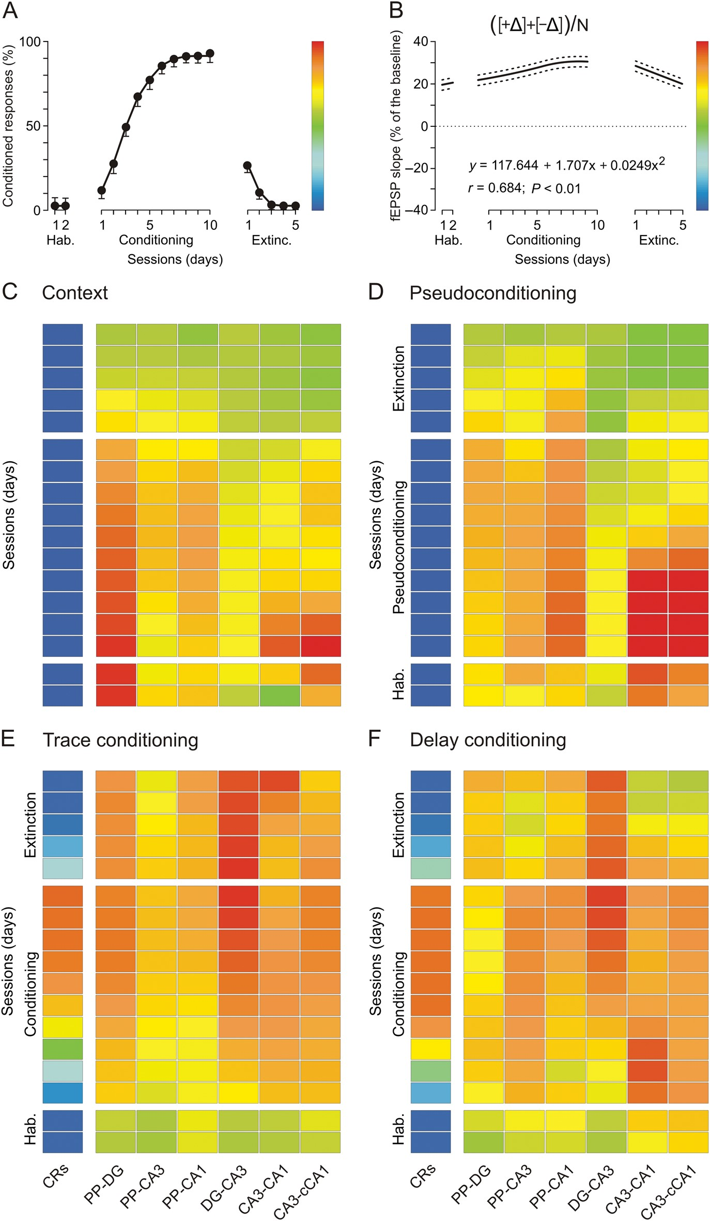
Figure 4. Evolution of fEPSP slopes at 6 different synapses of the hippocampal intrinsic circuit during the 4 selected ...
Notes:
Figure 4. Evolution of fEPSP slopes at 6 different synapses of the hippocampal intrinsic circuit during the 4 selected conditioning situations. (A,B) Evolution of CRs (A) and of fEPSP slopes evoked at the CA3-cCA1 synapse (B) across conditioning sessions using a trace paradigm (n = 6 animals). Illustrated fEPSP regression curves were averaged [([+Δ] + [−Δ])/N] from 15 electrodes implanted in the cCA1 area. The equation corresponding to the best polynomial fit to data collected during conditioning sessions is indicated, as well as the corresponding regression curve and the simultaneous 95% confidence bands. Note the color code bars located to the right of (A) and (B) panels. (C–F) Evolution of CRs (%) and of fEPSP slopes (as % of baseline values, see (B) collected at 6 hippocampal synapses across the successive training sessions in 4 different experimental situations: context (no CS or US presentations, (C), pseudoconditioning (D), and trace (E) and delay (F) conditioning paradigms. In the case of context (C) and pseudoconditioning (D), we took as baseline the values of fEPSP slopes collected during the last 2 (14th and 15th) training sessions. In contrast, baseline values for fEPSP slopes in trace (E) and delay (F) conditioning were collected from the first two (habituation) sessions.
Unless provided in the caption above, the following copyright applies to the content of this slide: © The Author 2013. Published by Oxford University Press. All rights reserved. For Permissions, please e-mail: journals.permissions@oup.com

Slide 5
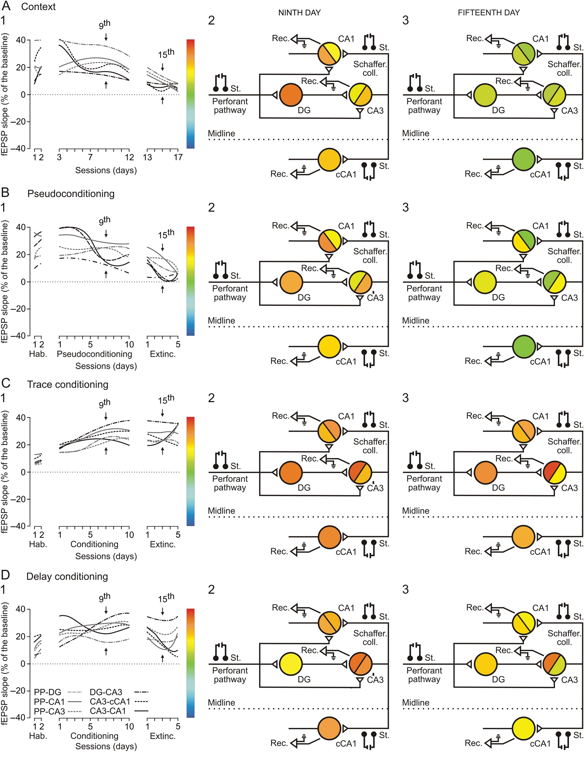
Figure 5. Main changes in synaptic strength evoked in the hippocampal circuit by context and cues present during ...
Notes:
Figure 5. Main changes in synaptic strength evoked in the hippocampal circuit by context and cues present during classical eyeblink conditioning tasks. (A–D) Evolution of fEPSP slopes at the 6 selected synapses during context (A), pseudoconditioning (B), and trace (C) and delay (D) conditioning. For (A–D) in 1 are illustrated the best polynomial fits (r ≥ 0.81; P ≤ 0.01) for the fEPSP data collected from the 6 selected synapses (see line codes in D1), while in 2–3 are represented the synaptic strength corresponding to each synapse and collected during the 9th (corresponding to the 7th conditioning or pseudoconditioning session; see arrows) and 15th (corresponding to the third extinction session; see arrows) recording days. The corresponding color codes are represented to the right of panels 1 (for A–D). Note that for context, the major changes in the 9th training session were observed at the PP-DG and—with lower intensity—the PP-CA3 and PP-CA1 synapses. Similar results were collected in the 9th training session from pseudoconditioned rabbits. In contrast, during the equivalent training session for trace conditioning, major changes in synaptic strength were observed not only in the input synapses to the hippocampus (PP-DG, PP-CA3, and PP-CA1), but also in the intrinsic circuit (DG-CA3, and to a lower degree in CA3-CA1 and CA3-cCA1 synapses). Similar results were collected during delay conditioning.
Unless provided in the caption above, the following copyright applies to the content of this slide: © The Author 2013. Published by Oxford University Press. All rights reserved. For Permissions, please e-mail: journals.permissions@oup.com

Slide 6
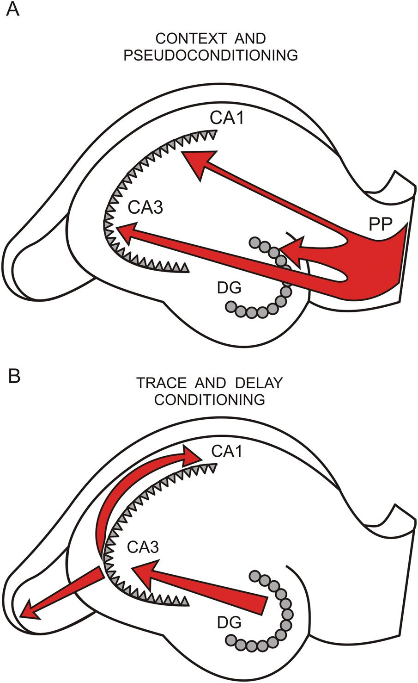
Figure 6. A diagrammatic representation of the major changes in synaptic strength taking place in hippocampal inputs ...
Notes:
Figure 6. A diagrammatic representation of the major changes in synaptic strength taking place in hippocampal inputs and intrinsic circuit during context and pseudoconditioning (A) and during trace and delay conditioning (B).
Unless provided in the caption above, the following copyright applies to the content of this slide: © The Author 2013. Published by Oxford University Press. All rights reserved. For Permissions, please e-mail: journals.permissions@oup.com

