Slide 1
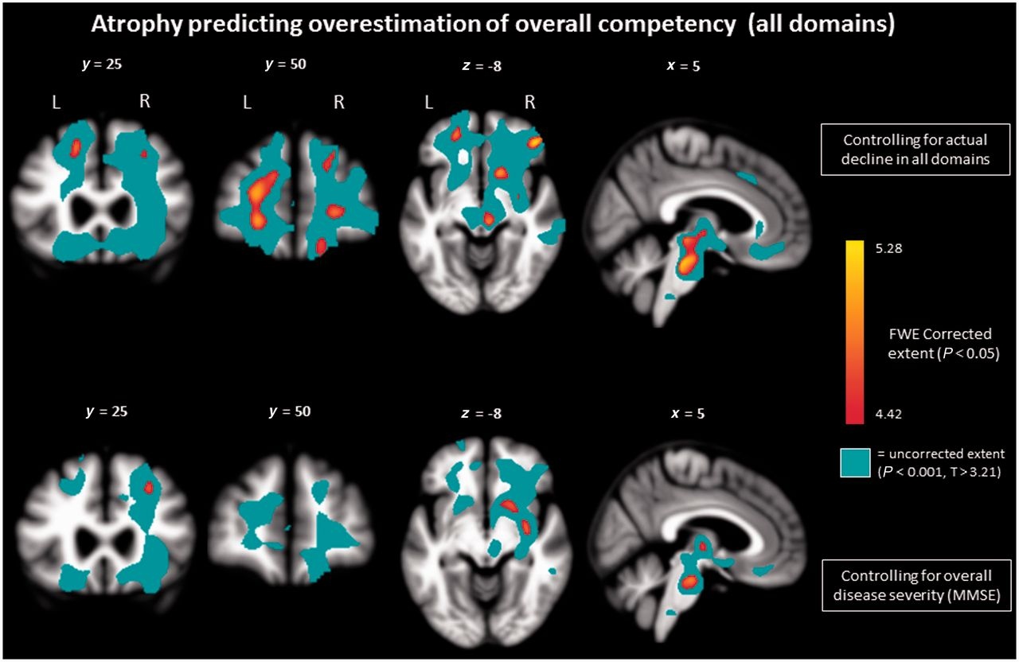
Figure 1 T-score maps showing regions where atrophy predicted overestimating self-functioning (measured by positive ...
Notes:
Figure 1 T-score maps showing regions where atrophy predicted overestimating self-functioning (measured by positive discrepancy scores between self and informant ratings on PCRS overall score), controlling for age, sex, total intracranial volume, scan type, and extent of actual functional decline (top row) or overall diseases severity (bottom row).
Unless provided in the caption above, the following copyright applies to the content of this slide: © The Author (2014). Published by Oxford University Press on behalf of the Guarantors of Brain. All rights reserved. For Permissions, please email: journals.permissions@oup.com

Slide 2
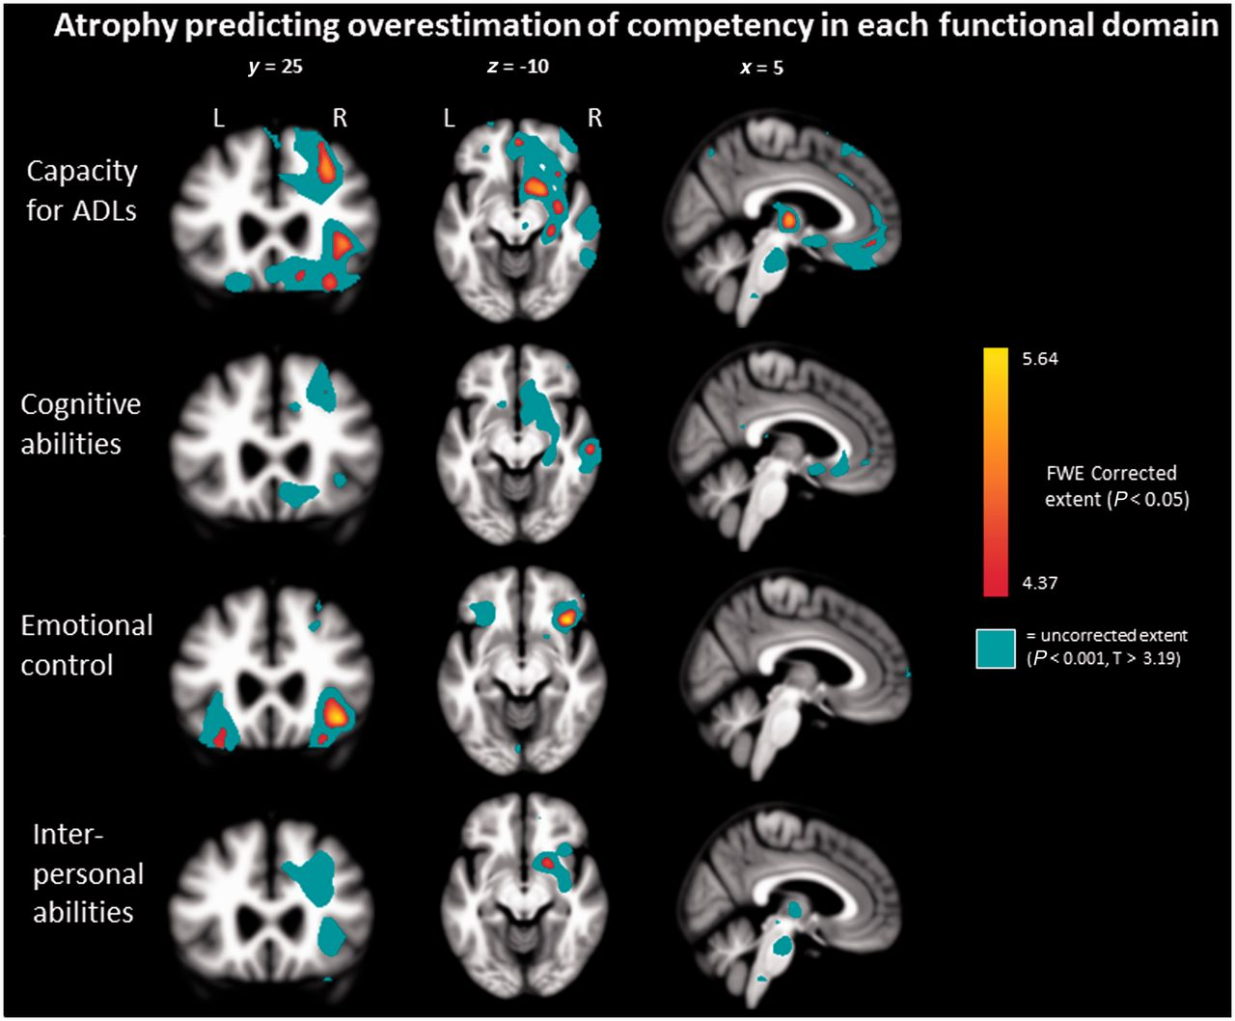
Figure 2 T-score maps showing regions where atrophy predicted overestimating self-functioning (measured by positive ...
Notes:
Figure 2 T-score maps showing regions where atrophy predicted overestimating self-functioning (measured by positive discrepancy scores between self and informant ratings) on each PCRS subscale, controlling for age, sex, total intracranial volume, scan type, and overall diseases severity (MMSE). ADL = activity of daily living.
Unless provided in the caption above, the following copyright applies to the content of this slide: © The Author (2014). Published by Oxford University Press on behalf of the Guarantors of Brain. All rights reserved. For Permissions, please email: journals.permissions@oup.com

