Slide 1
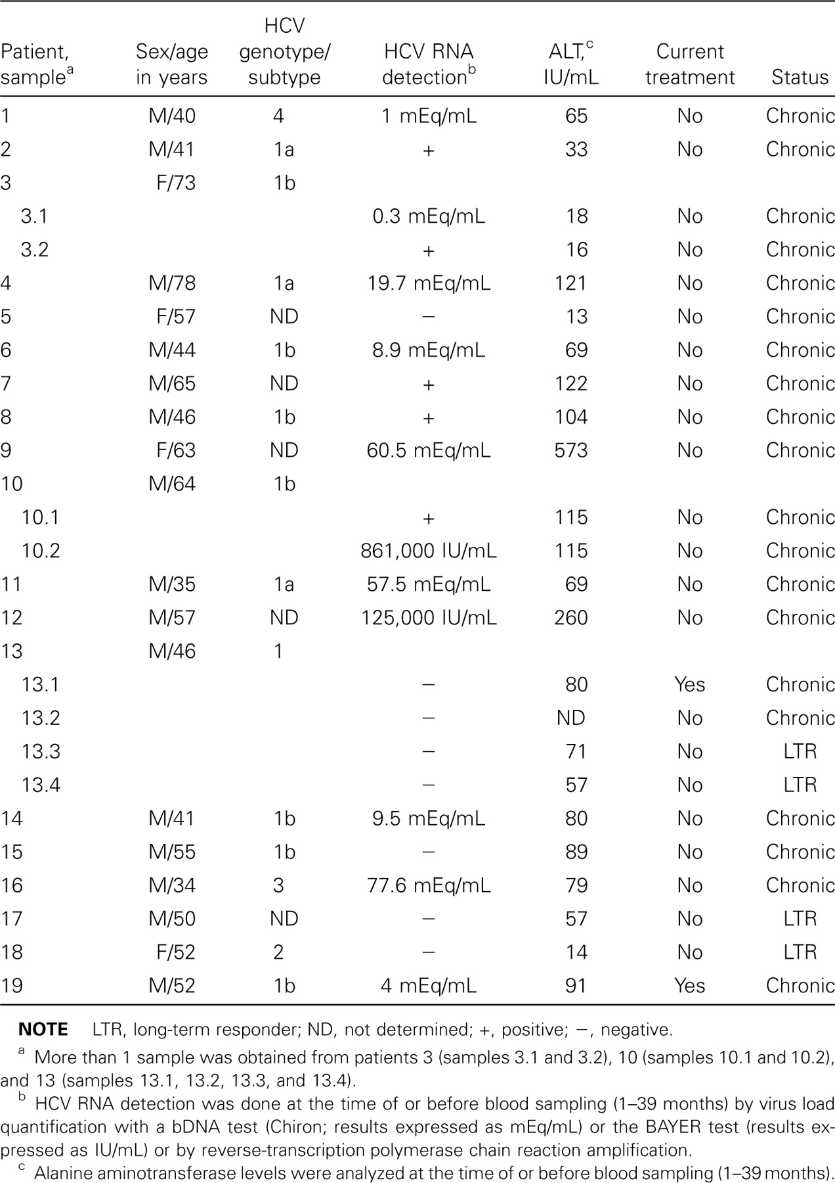
Table 1 Clinical characteristics of 19 patients with hepatitis C virus (HCV) infections with iron overload who were ...
Notes:
Table 1 Clinical characteristics of 19 patients with hepatitis C virus (HCV) infections with iron overload who were undergoing therapeutic phlebotomy
Unless provided in the caption above, the following copyright applies to the content of this slide: © 2003 by the Infectious Diseases Society of America

Slide 2
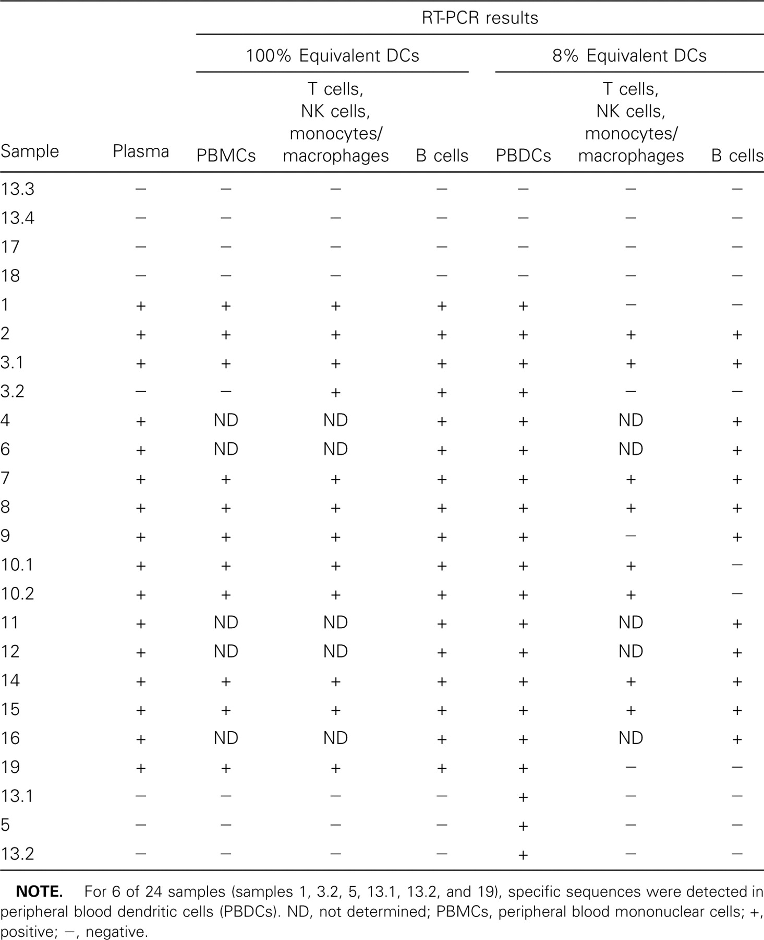
Table 2 Summary of reverse-transcription polymerase chain reaction (RT-PCR) analysis of hepatitis C virus (HCV) ...
Notes:
Table 2 Summary of reverse-transcription polymerase chain reaction (RT-PCR) analysis of hepatitis C virus (HCV) genomic sequences in different peripheral blood cell populations
Unless provided in the caption above, the following copyright applies to the content of this slide: © 2003 by the Infectious Diseases Society of America

Slide 3
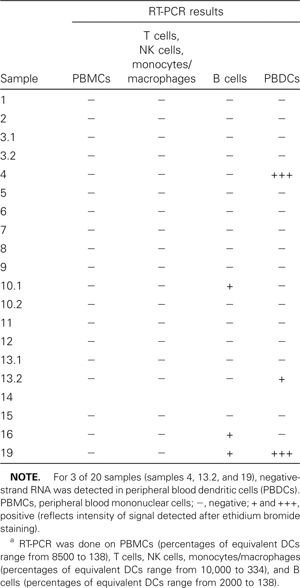
Table 3 Summary of reverse-transcription polymerase chain reaction (RT-PCR) analysis of hepatitis C virus (HCV) ...
Notes:
Table 3 Summary of reverse-transcription polymerase chain reaction (RT-PCR) analysis of hepatitis C virus (HCV) antigenomic sequences in different peripheral blood cell populations
Unless provided in the caption above, the following copyright applies to the content of this slide: © 2003 by the Infectious Diseases Society of America

Slide 4
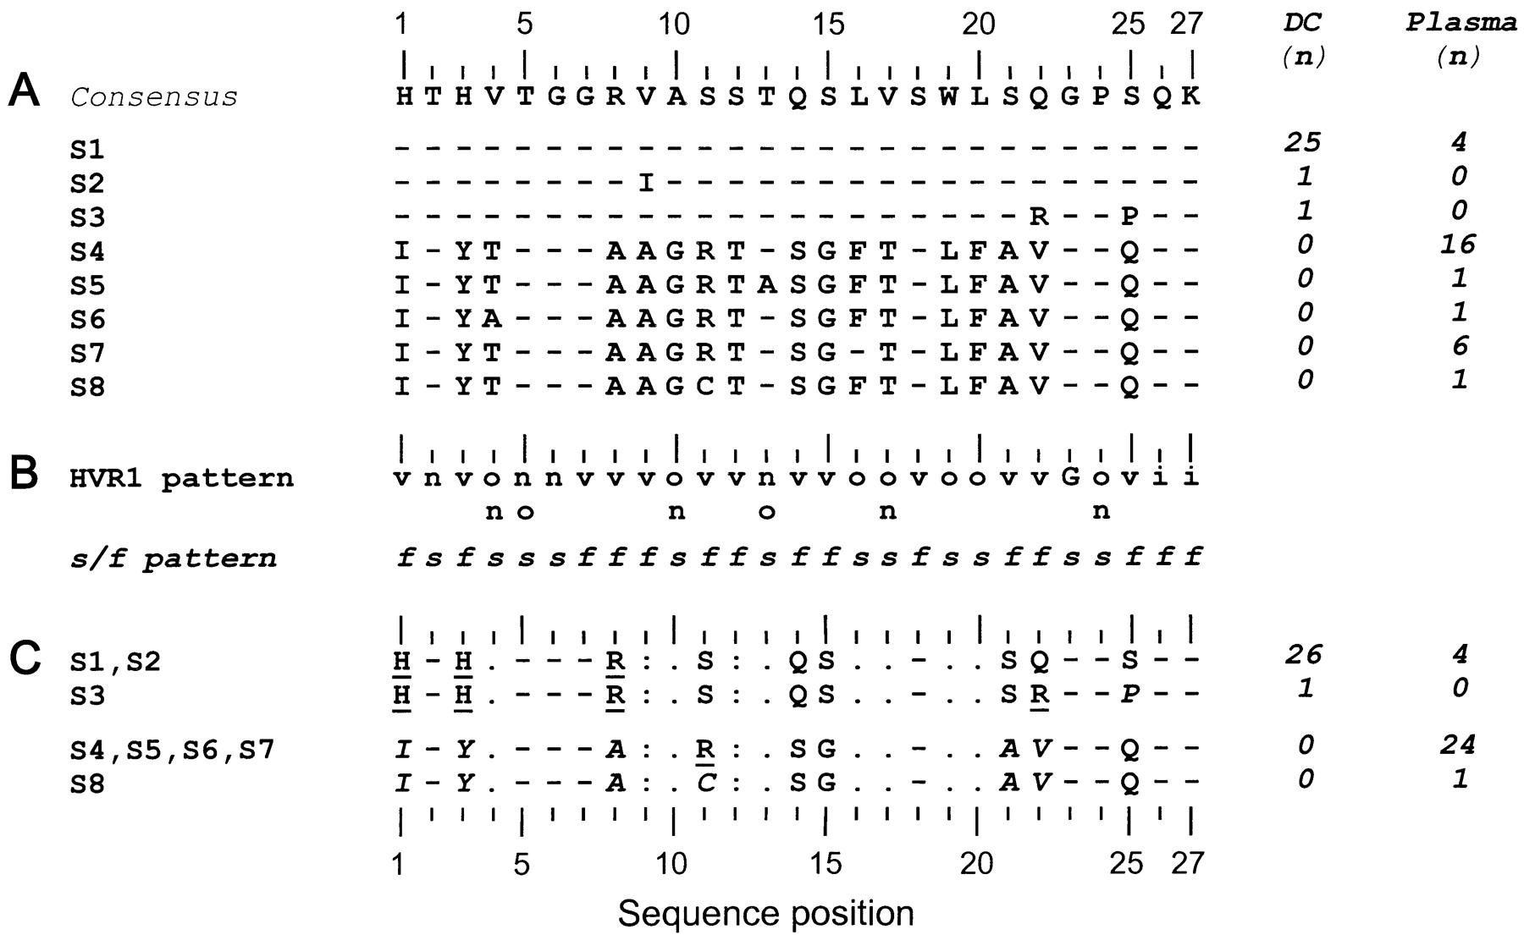
Figure 1 Analysis of hepatitis C virus (HCV) hypervariable region 1 (HVR1) quasi species based on amino acid sequences ...
Notes:
Figure 1 Analysis of hepatitis C virus (HCV) hypervariable region 1 (HVR1) quasi species based on amino acid sequences of 29 clones from plasma and 27 clones from peripheral blood dendritic cells (PBDCs) of patient 19. A Alignment of 8 different sequences (denoted S1–S8) showing amino acid changes. Consensus corresponds to most frequent amino acid sequence derived from alignment of all clones (56 sequences). Amino acids identical to consensus sequence are represented by a dash (−). No. of clones (n) exhibiting particular sequence in plasma and/or in PBDCs is given in the 2 right-hand columns. B HVR1 consensus hydropathy pattern established by Penin et al. [19]. This consensus was derived from analysis of 1382 HVR1 sequences reported in the European Molecular Biology Laboratory (EMBL) database. Hydrophobic (o), neutral (n), hydrophilic (i), and variable (v) positions are presented. G is a fully conserved Gly residue. s/f pattern summarizes the putative main role of each HVR1 position, with “s” and “f” meaning structural and functional, respectively. C Functional amino acid sequence signatures. To highlight main amino acid differences in “f” positions among 8 sequences reported in panel A residues in “s” positions are represented by a dot ( &b.dot;), whereas identical and very similar residues at given “f” position in all sequences are represented by a colon ( : ). Sequences exhibiting the same amino acid signature are grouped. Basic amino acids are underlined. Nucleotide sequences were deposited in EMBL (accession nos.: plasma sequence, AJ422080; DC sequence, AJ422081)
Unless provided in the caption above, the following copyright applies to the content of this slide: © 2003 by the Infectious Diseases Society of America

