Slide 1
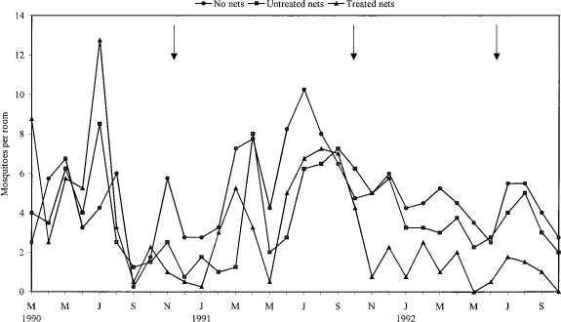
Fig. 1 Indoor resting density of Anopheles culicifacies in villages without nets and with untreated nets or treated ...
Notes:
Fig. 1 Indoor resting density of Anopheles culicifacies in villages without nets and with untreated nets or treated nets. Arrows indicate bednet treatment.
Unless provided in the caption above, the following copyright applies to the content of this slide: © 2001 Entomological Society of America

Slide 2
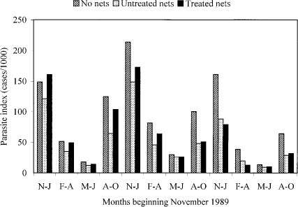
Fig. 2 Malaria incidence in the villages without nets, with untreated nets or treated nets. November 1989 to October ...
Notes:
Fig. 2 Malaria incidence in the villages without nets, with untreated nets or treated nets. November 1989 to October 1990 was the baseline period.
Unless provided in the caption above, the following copyright applies to the content of this slide: © 2001 Entomological Society of America

Slide 3
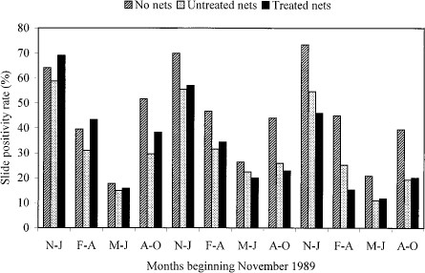
Fig. 3 Slide positivity rate in villages without nets and with untreated nets or treated nets.
Notes:
Fig. 3 Slide positivity rate in villages without nets and with untreated nets or treated nets.
Unless provided in the caption above, the following copyright applies to the content of this slide: © 2001 Entomological Society of America

