Slide 1
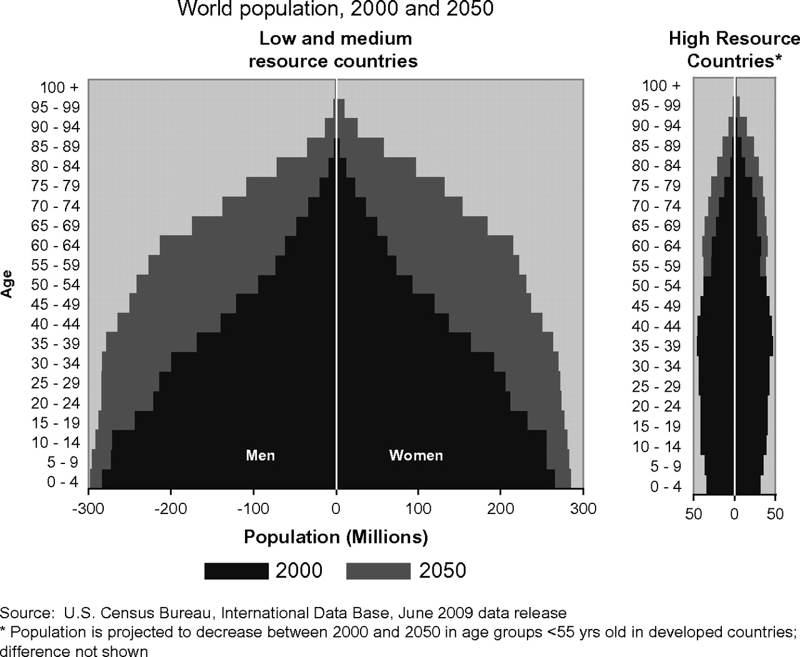
Fig. 1. Growth and aging of world population, 2000 and 2050 by gender and level of economic development.
Notes:
Fig. 1. Growth and aging of world population, 2000 and 2050 by gender and level of economic development.
Unless provided in the caption above, the following copyright applies to the content of this slide: © The Author 2009. Published by Oxford University Press.This is an Open Access article distributed under the terms of the Creative Commons Attribution Non-Commercial License (http://creativecommons.org/licenses/by-nc/2.5), which permits unrestricted non-commercial use, distribution, and reproduction in any medium, provided the original work is properly cited.

Slide 2
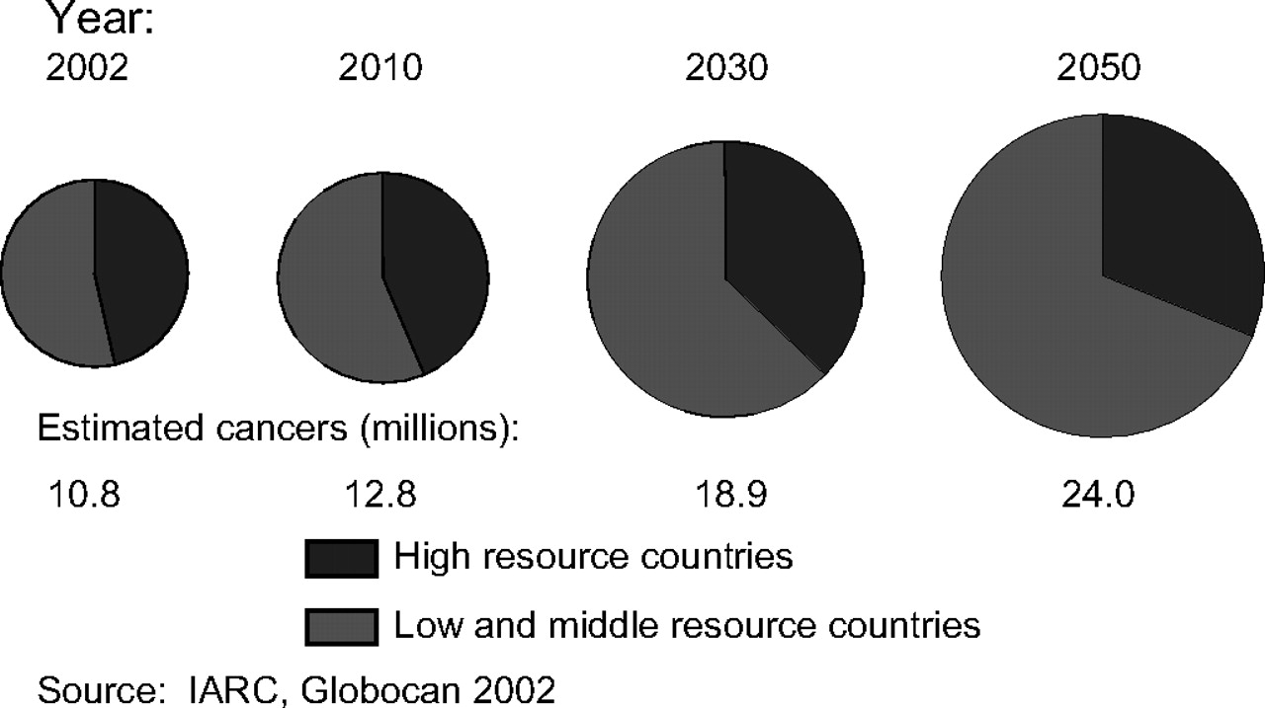
Fig. 2. Number and distribution of cancer cases by level of economic development and year assuming no change in the ...
Notes:
Fig. 2. Number and distribution of cancer cases by level of economic development and year assuming no change in the annual incidence rate.
Unless provided in the caption above, the following copyright applies to the content of this slide: © The Author 2009. Published by Oxford University Press.This is an Open Access article distributed under the terms of the Creative Commons Attribution Non-Commercial License (http://creativecommons.org/licenses/by-nc/2.5), which permits unrestricted non-commercial use, distribution, and reproduction in any medium, provided the original work is properly cited.

Slide 3
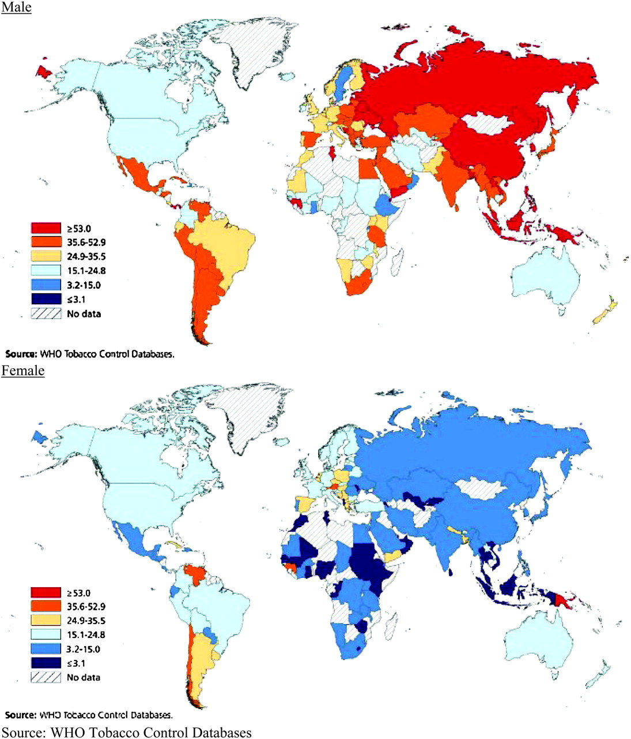
Fig. 3. Prevalence of male and female smoking by geographic region.
Notes:
Fig. 3. Prevalence of male and female smoking by geographic region.
Unless provided in the caption above, the following copyright applies to the content of this slide: © The Author 2009. Published by Oxford University Press.This is an Open Access article distributed under the terms of the Creative Commons Attribution Non-Commercial License (http://creativecommons.org/licenses/by-nc/2.5), which permits unrestricted non-commercial use, distribution, and reproduction in any medium, provided the original work is properly cited.

Slide 4
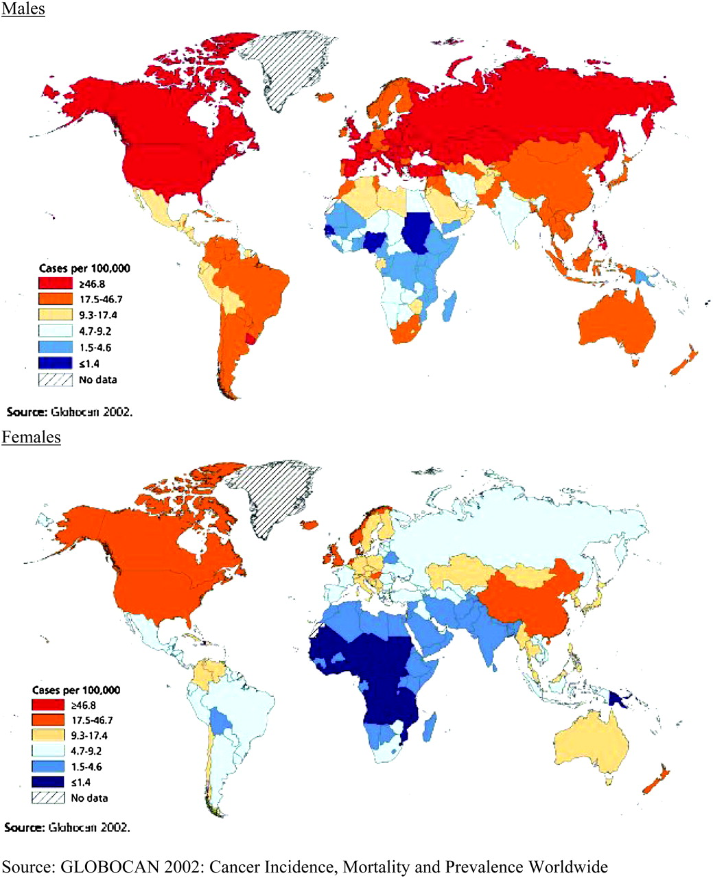
Fig. 4. Lung cancer incidence in males and females.
Notes:
Fig. 4. Lung cancer incidence in males and females.
Unless provided in the caption above, the following copyright applies to the content of this slide: © The Author 2009. Published by Oxford University Press.This is an Open Access article distributed under the terms of the Creative Commons Attribution Non-Commercial License (http://creativecommons.org/licenses/by-nc/2.5), which permits unrestricted non-commercial use, distribution, and reproduction in any medium, provided the original work is properly cited.

Slide 5
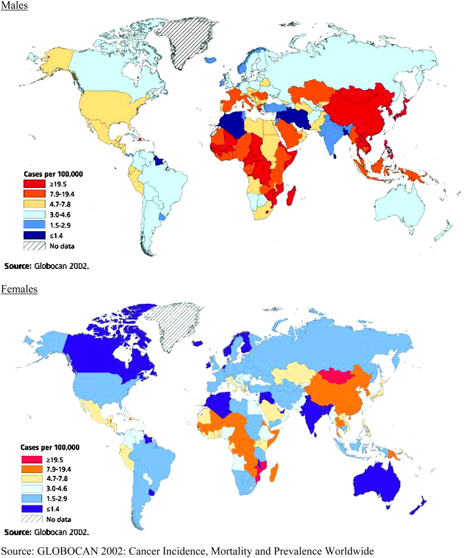
Fig. 5. Liver cancer incidence in males and females.
Notes:
Fig. 5. Liver cancer incidence in males and females.
Unless provided in the caption above, the following copyright applies to the content of this slide: © The Author 2009. Published by Oxford University Press.This is an Open Access article distributed under the terms of the Creative Commons Attribution Non-Commercial License (http://creativecommons.org/licenses/by-nc/2.5), which permits unrestricted non-commercial use, distribution, and reproduction in any medium, provided the original work is properly cited.

