Slide 1
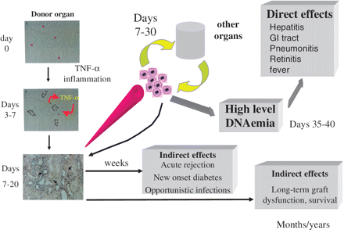
Figure 1. A model for CMV pathogenesis after solid organ transplantation. The donor organ harbours a small number of ...
Notes:
Figure 1. A model for CMV pathogenesis after solid organ transplantation. The donor organ harbours a small number of cells with latent infection (red dots), which become activated through the effects of the proinflammatory environment on the major immediate early promoter shortly after transplant. Subsequent local spread of virus in the infected organ ensues over the next 7 days, which may then spread through the blood to infect other target organs, which contributes to the overall level of CMV DNAemia. If left untreated, these high levels of replication will be associated with the direct effects of CMV infection. In addition, early graft infection may contribute to acute organ malfunction, occurrence of other opportunistic infections and also long-term graft and patient survival. GI: Gastrointestinal.
Unless provided in the caption above, the following copyright applies to the content of this slide: © The Author 2011. Published by Oxford University Press on behalf of the Association of Physicians. All rights reserved. For Permissions, please email: journals.permissions@oup.com

