Slide 1
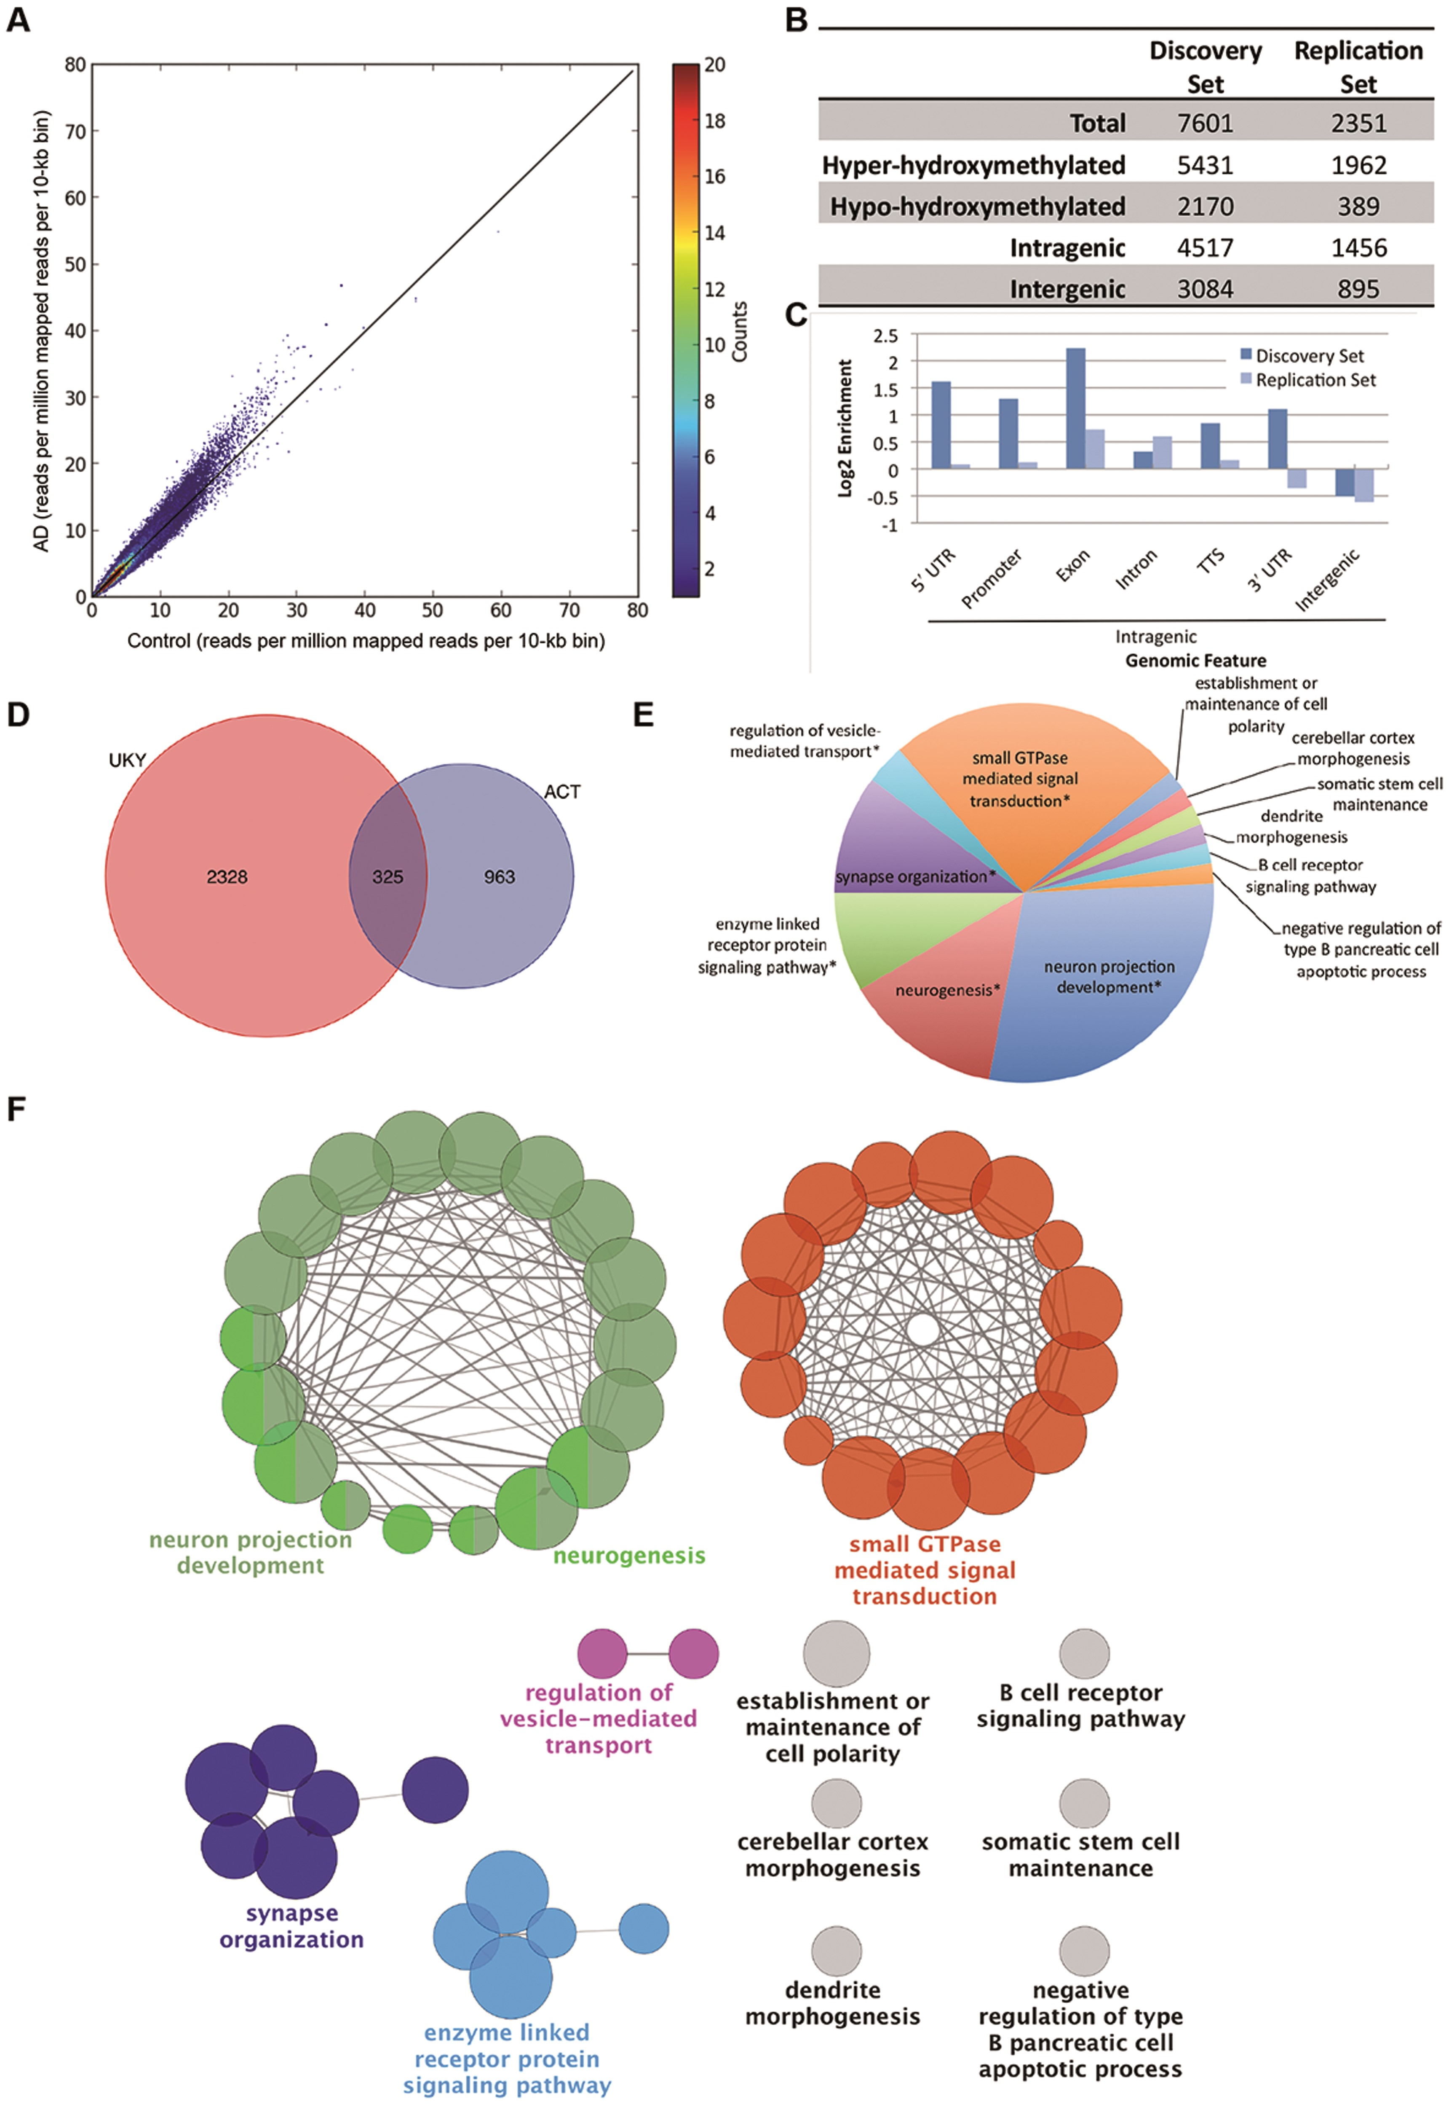
Figure 1. Identification and characterization of DhMLs. (A) Scatterplot of normalized genome-wide 5hmC reads within ...
Notes:
Figure 1. Identification and characterization of DhMLs. (A) Scatterplot of normalized genome-wide 5hmC reads within each 10-kb bin. Reads were normalized to coverage. Color of each point shows the number of bins with the given number of reads. (B) Characteristics of DhMLs from each dataset identified with diffReps. (C) Annotation of DhMLs by Homer shows enrichment and depletion of DhMLs by genomic feature. (D) Genes containing DhMLs were identified by Homer annotation for each dataset, and 325 genes were identified in both datasets. (E) The number of gene ontology terms assigned to significantly enriched gene ontology term groups for DhML-containing genes identified by ClueGO. Asterisks indicate that the displayed term is the most significant gene ontology term in a related group of gene ontology terms. (F) Gene ontology network of shared genes. For simplicity, only the most significant gene ontology term for each group is shown.
Unless provided in the caption above, the following copyright applies to the content of this slide: © The Author 2016. Published by Oxford University Press. All rights reserved. For permissions, please e-mail: journals.permissions@oup.com

Slide 2
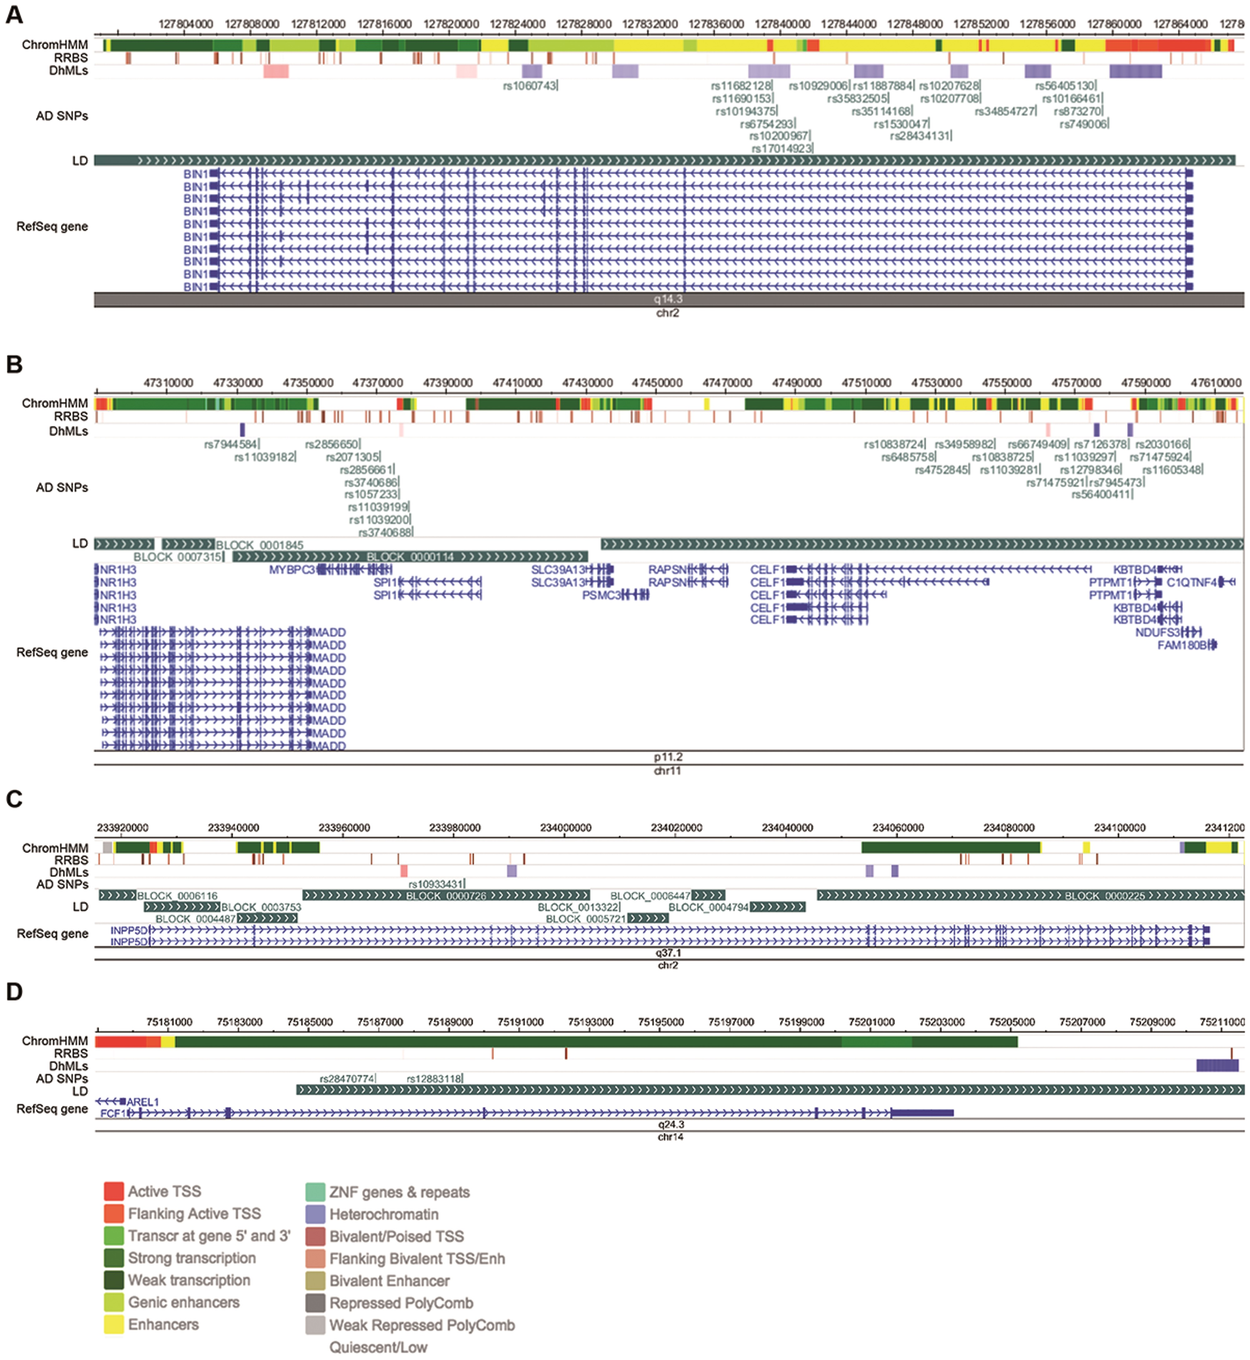
Figure 2. Genomic regions containing DhMLs and AD-associated SNPs. (A) Genomic loci containing (A) BIN1; (B) MADD, ...
Notes:
Figure 2. Genomic regions containing DhMLs and AD-associated SNPs. (A) Genomic loci containing (A) BIN1; (B) MADD, MYBPC3, SPI1, CELF1, PTPMT1 and NDUFS3; (C) INPP5D and (D) FCF1. Shown in each panel are, from top to bottom: 1) ChromHMM analysis and 2) RRBS results from a Roadmap Epigenomics Project reference sample (neuronal nuclei of frontal cortex from post-mortem brain tissue of an 81-year-old male). The legend for colors of the ChromHMM track is shown at the bottom of the figure. 3) The DhMLs identified in this analysis. Blue represents loss of 5hmC in AD; red represents a gain. Shading represents the fold change (with darker colors representing larger changes). 4) AD-associated SNPs located within 50 kb of the identified DhMLs. 4) Blocks of linkage disequilibrium for the CEU population generated by the HapMap project. 5) The RefSeq gene or genes located in the visualized regions. Genes and AD-associated SNPs within 50 kb of DhMLs Gene symbolGene nameChrNo. of SNPsSNPP-valueFunctionBIN1Bridging integrator 1220rs351141683.72E-16Adapter protein involved with synaptic vesicle endocytosisINPP5DInositol polyphosphate-5-phosphatase21rs109334316.62E-06Nuclear inositol phosphate signaling processesCELF1CUGBP, elav-like family member 1118rs667494093.24E-06mRNA alternative splicingMADDMAP-kinase activating death domain112rs79445843.05E-06ApoptosisMYBPC3Myosin binding protein C, cardiac113rs20713052.24E-06Myosin-associated proteinNDUFS3NADH dehydrogenase (ubiquinone) Fe-S protein 3113rs714759241.44E-06Core subunit of mitochondrial complex IPTPMT1Protein tyrosine phosphatase, mitochondrial 1115rs127983465.20E-06Dephosphorylates mitochondrial lipidsSPI1Spi-1 proto-oncogene115rs37406863.20E-06Transcription factor involved in myeloid and B-lymphoid cell developmentFCF1FCF1 RRNA-processing protein142rs128831183.58E-07pre-rRNA processing and 40S ribosomal subunit assemblyGenes annotated to AD-associated SNPs were within 50 kb of DhMLs from both the Discovery set and Replication set are shown. The number of AD-associated SNPs identified within these regions associated with each gene is indicated. The SNP with highest significance according to IGAP is reported.
Unless provided in the caption above, the following copyright applies to the content of this slide: © The Author 2016. Published by Oxford University Press. All rights reserved. For permissions, please e-mail: journals.permissions@oup.com

Slide 3
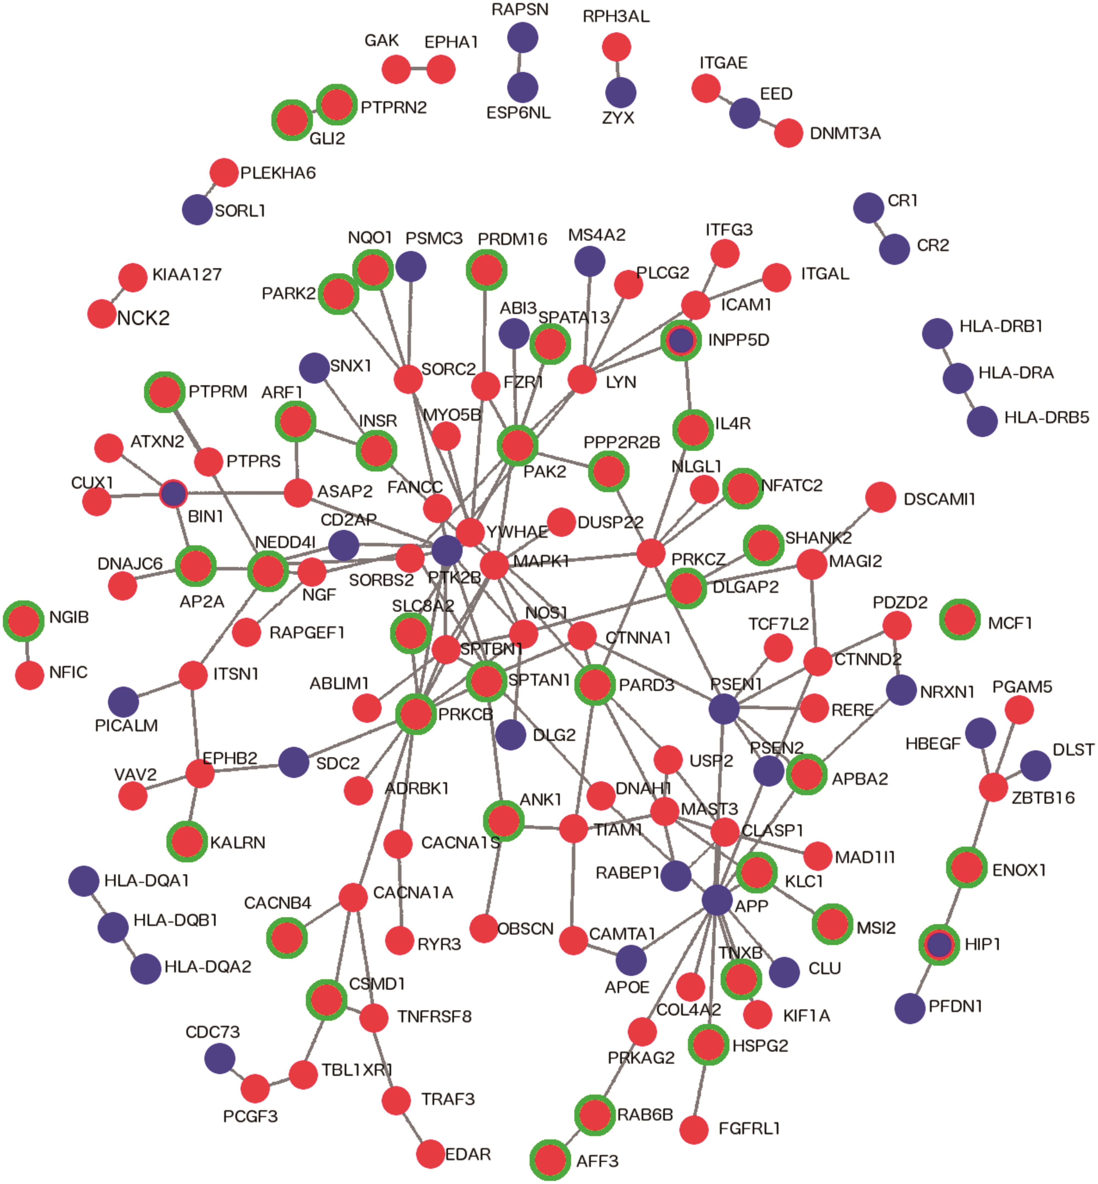
Figure 3. Direct PPIs between DhML-containing genes and an AD susceptibility network. Direct PPI network between genes ...
Notes:
Figure 3. Direct PPIs between DhML-containing genes and an AD susceptibility network. Direct PPI network between genes identified as containing intragenic DhMLs in the current analysis and AD susceptibility genes generated by DAPPLE (P = 0.001). Red indicates that a gene contains a DhML. Green indicates a significant result by RNA-Seq. Blue indicates an AD susceptibility gene.
Unless provided in the caption above, the following copyright applies to the content of this slide: © The Author 2016. Published by Oxford University Press. All rights reserved. For permissions, please e-mail: journals.permissions@oup.com

Slide 4
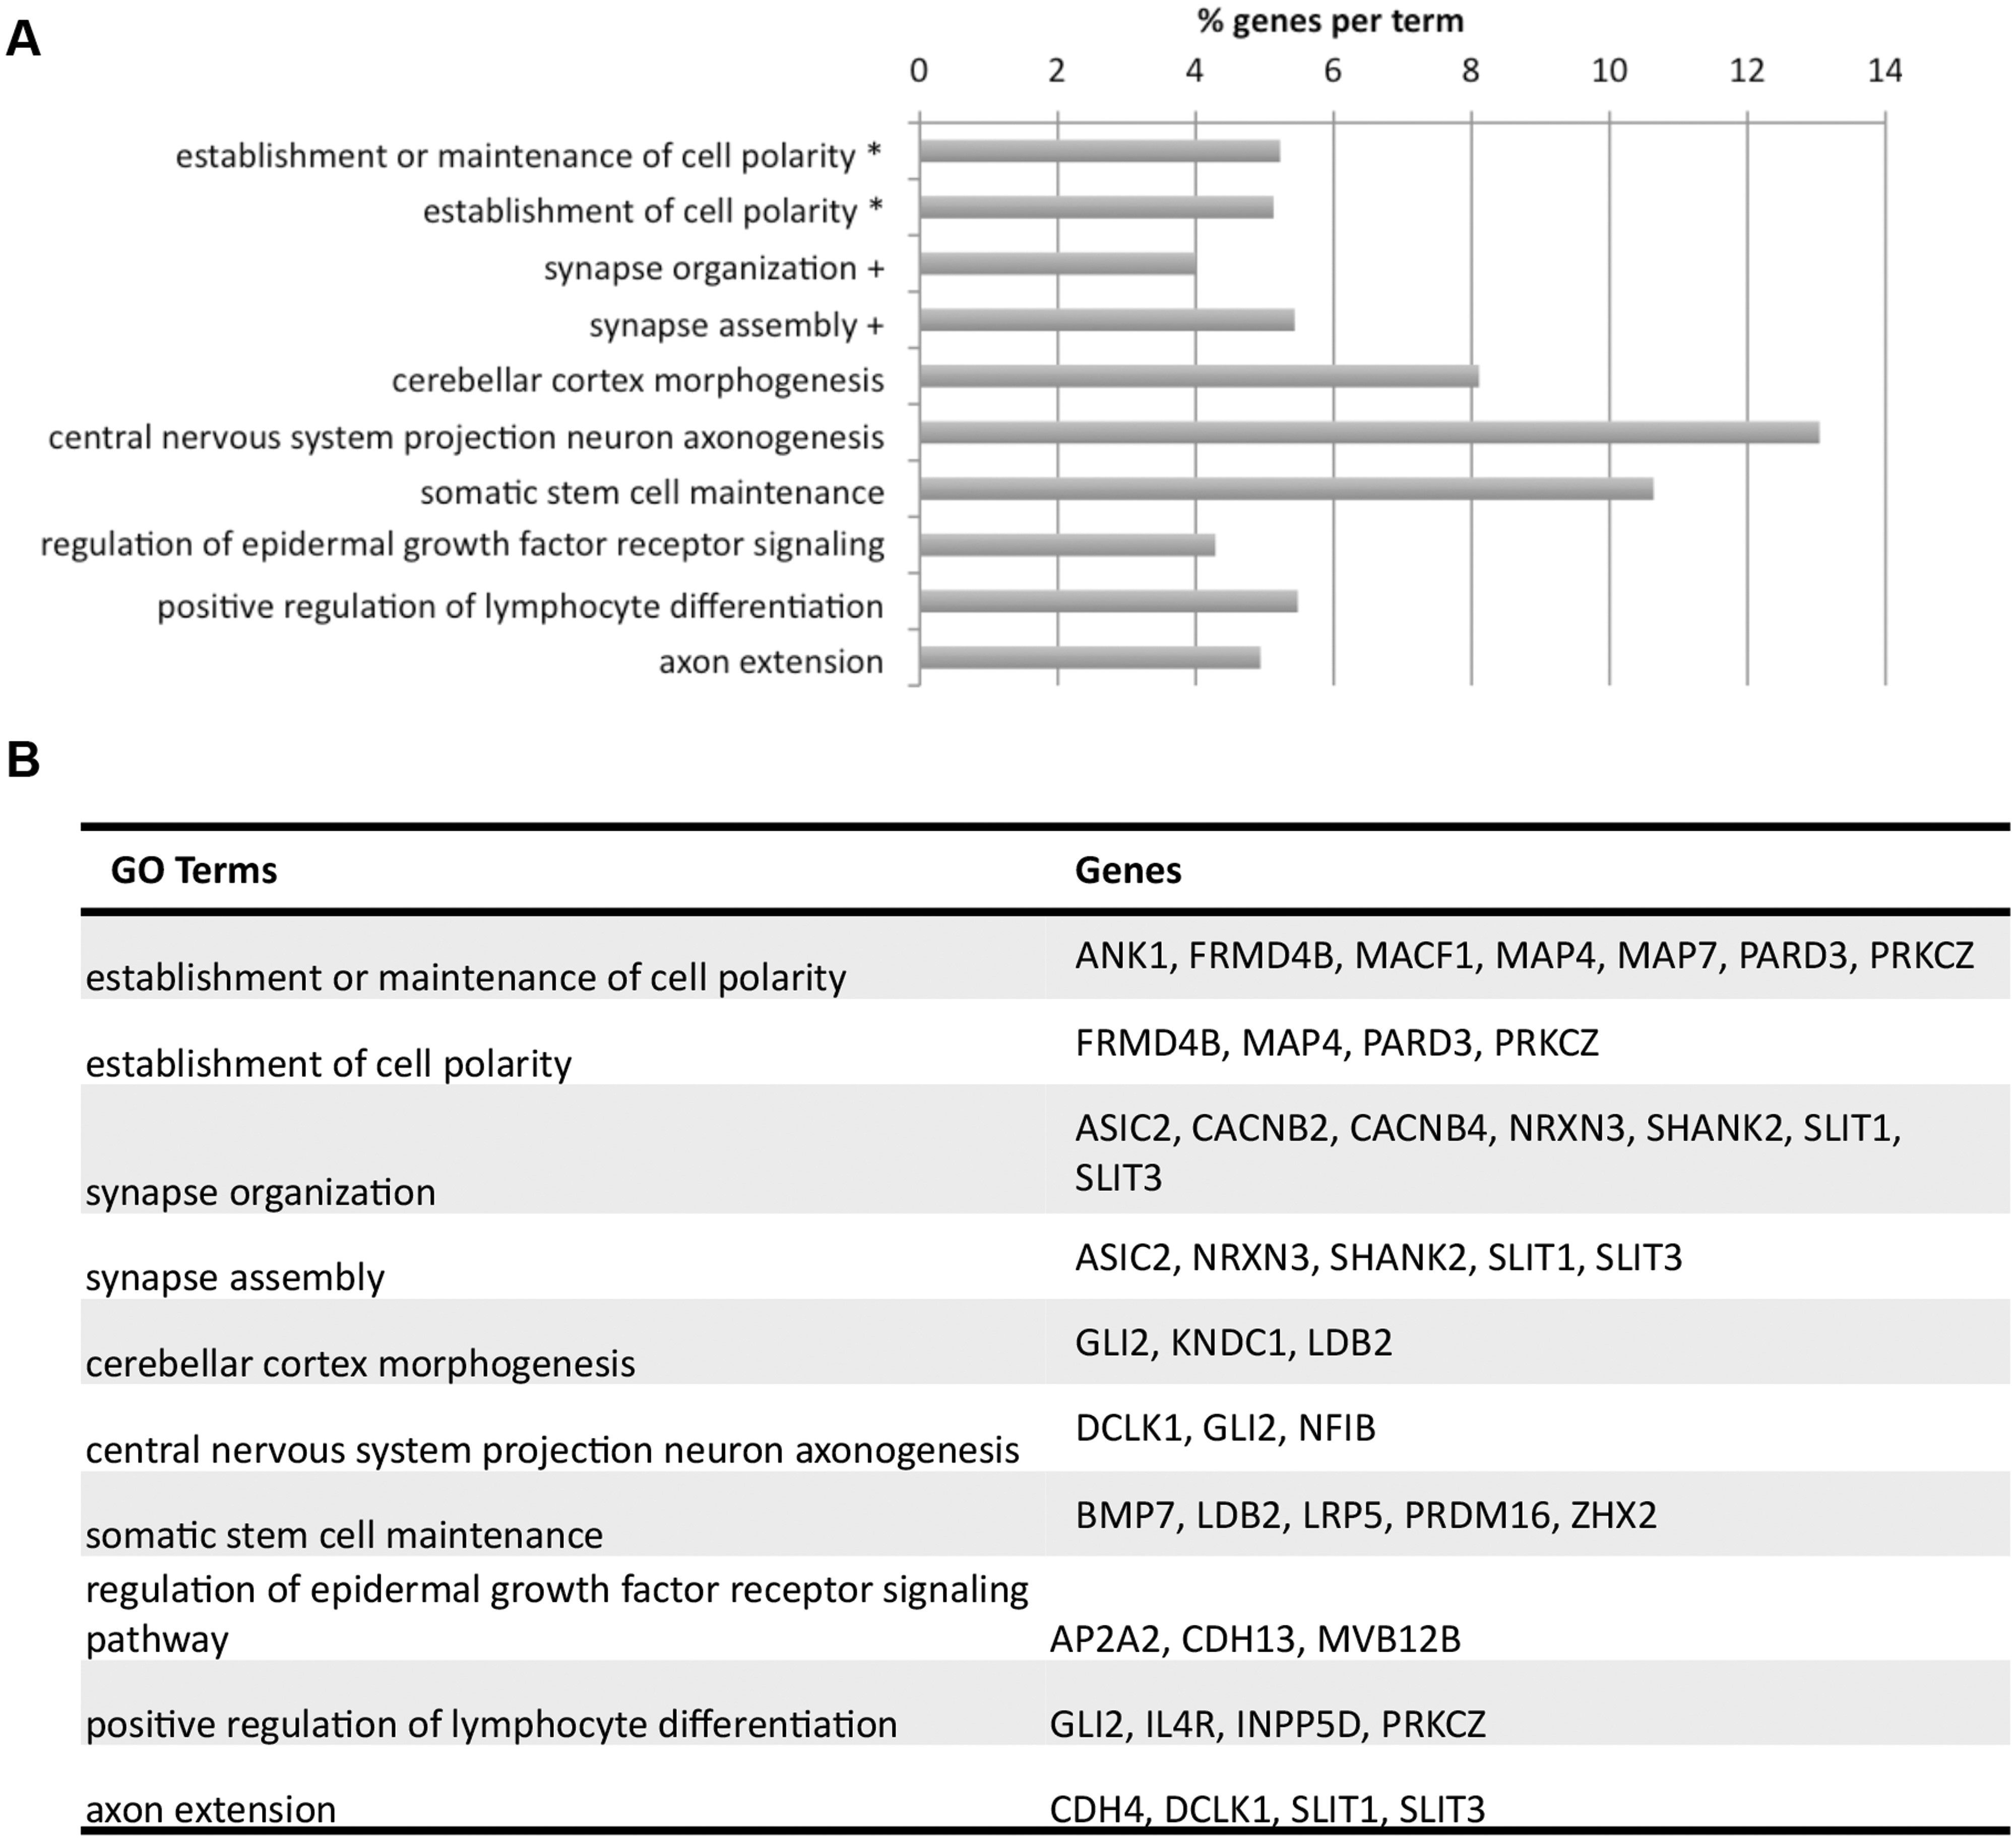
Figure 4. Enriched gene ontology terms for 140 DhML-containing genes with significant RNA-Seq results. (A) Symbols ...
Notes:
Figure 4. Enriched gene ontology terms for 140 DhML-containing genes with significant RNA-Seq results. (A) Symbols indicate terms that have been grouped. Bar length indicates the % of genes within each gene ontology term that are in the dataset. (B) Specific genes assigned to each GO term.
Unless provided in the caption above, the following copyright applies to the content of this slide: © The Author 2016. Published by Oxford University Press. All rights reserved. For permissions, please e-mail: journals.permissions@oup.com

Slide 5
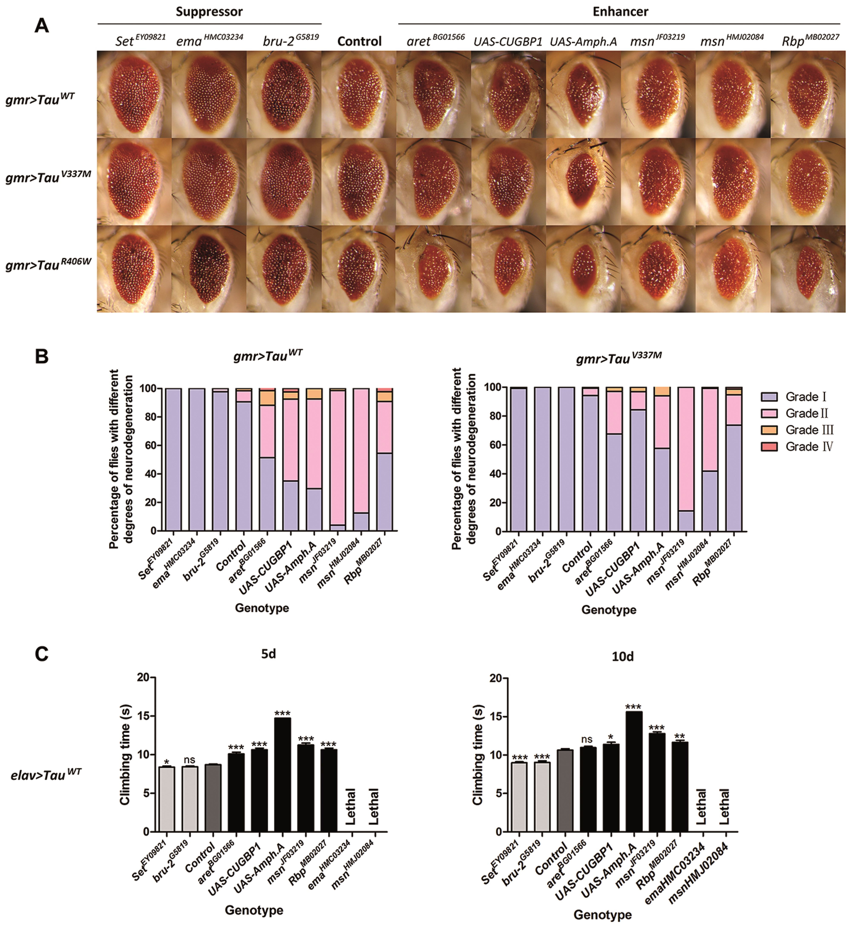
Figure 5. Identification of epigenetic modifiers of Tau-mediated neurotoxicity using an AD fly model. (A) Eye phenotype ...
Notes:
Figure 5. Identification of epigenetic modifiers of Tau-mediated neurotoxicity using an AD fly model. (A) Eye phenotype of 5-day-old flies expressing both Tau (wild-type or mutant) and modifiers. (B) Percentage bar chart of eye phenotypes. Data show percentage of flies divided into four grades (I, II, III and IV) on the basis of eye phenotypes. (C) Comparison of climbing ability of 5-day-old and 10-day-old Tau WT flies with the presence or absence of modifiers. Data show mean climbing time ± SEM (Student’s t-test or Mann–Whitney test (*** = P < 0.0001, ** = P < 0.01, * = P < 0.05, ns = no significant difference). Details of all the indicated genotypes in this figure are described in Supplementary Material. Modifiers of Tau toxicity in Drosophila Human geneDrosophila orthologLoss-of-function alleleOverexpression alleleModification on Tau toxicityEye evaluationClimbing assayCELF1 (CUGBP1)aretaretBG01566EnhancerEnhancerbru-2bru-2G5819SuppressorSuppressorUAS-CUGBP1EnhancerEnhancerBIN1AmphUAS-Amph.AEnhancerEnhancer (reduced viability)MINK1msnmsnJF03219EnhancerEnhancermsnHMJ02084EnhancerLethalBZRAP1RbpRbpMB02027EnhancerEnhancerCLEC16AemaemaHMC03234SuppressorLethalTSPYL5SetSetEY09821SuppressorSuppressorANK1, Ankryin 1; DIP2A, Disco interacting protein 2 homolog A.
Unless provided in the caption above, the following copyright applies to the content of this slide: © The Author 2016. Published by Oxford University Press. All rights reserved. For permissions, please e-mail: journals.permissions@oup.com

