Slide 1
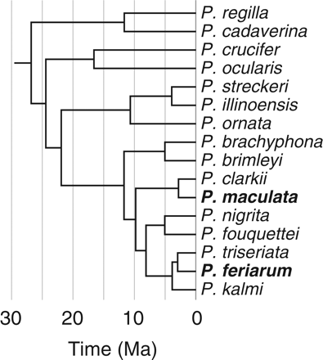
Figure 1. Chronogram of the target taxonomic group in this study (treefrog genus Pseudacris). One goal was to generate ...
Notes:
Figure 1. Chronogram of the target taxonomic group in this study (treefrog genus Pseudacris). One goal was to generate highly polymorphic loci for studying the phylogeography of one species, P. feriarum. A second goal was to identify loci to be used across the 17 species in the genus for phylogenetic studies. Species in bold were utilized in the locus identification portion of this study, whereas all species were used in the PCR screen portion of the study. Phylogeny and divergence times are from Lemmon et al. (2007).
Unless provided in the caption above, the following copyright applies to the content of this slide: © The Author(s) 2012. Published by Oxford University Press, on behalf of the Society of Systematic Biologists. All rights reserved. For Permissions, please email: journals.permissions@oup.com

Slide 2
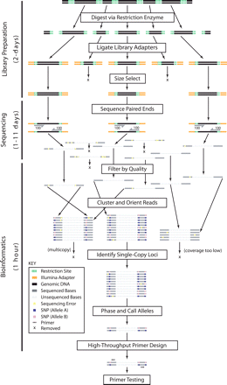
Figure 2. Overview of workflow. Thousands of single-copy nuclear loci can be identified in approximately three days. ...
Notes:
Figure 2. Overview of workflow. Thousands of single-copy nuclear loci can be identified in approximately three days. Library preparation includes digestion of genomic DNA using a restriction enzyme, ligation of sequencing adapters, and size selection. Paired-end sequencing produces sequence data for ∼100 bp on each end of fragments (sequence between unknown). Bioinformatics consists of removing reads with low-quality base calls, clustering reads based on sequenced ends, orienting reads to account for bi-directional sequencing, identifying single-copy loci with expected allelic proportions after accounting for sequencing error, phasing/calling alleles using read pairs, and high-throughput primer design using Primer3 (Rozen and Skaletsky 2000). The workflow can be adjusted to allow pooling of libraries from different restriction enzymes and/or individuals.
Unless provided in the caption above, the following copyright applies to the content of this slide: © The Author(s) 2012. Published by Oxford University Press, on behalf of the Society of Systematic Biologists. All rights reserved. For Permissions, please email: journals.permissions@oup.com

Slide 3
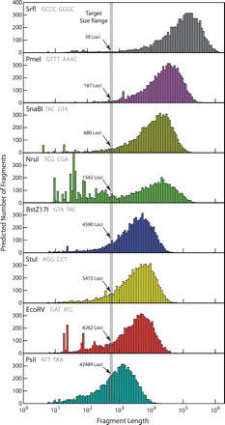
Figure 3. In silico predictions of fragment length distributions. Restriction sites corresponding to eight different ...
Notes:
Figure 3. In silico predictions of fragment length distributions. Restriction sites corresponding to eight different restriction enzymes were identified in the Xenopus tropicalis genome. The distances separating adjacent restriction sites for a particular enzyme predict the fragment lengths that would be obtained if genomic DNA were completely digested. The predicted distributions are given assuming each enzyme was used independently. Given a particular distribution, the number of fragments within a target size range can be used to estimate the number of loci that would be sequenced if this range were used during size selection. Predicted numbers of loci are given for each restriction enzyme. More details are given in Supplementary Tables 2–4.
Unless provided in the caption above, the following copyright applies to the content of this slide: © The Author(s) 2012. Published by Oxford University Press, on behalf of the Society of Systematic Biologists. All rights reserved. For Permissions, please email: journals.permissions@oup.com

Slide 4
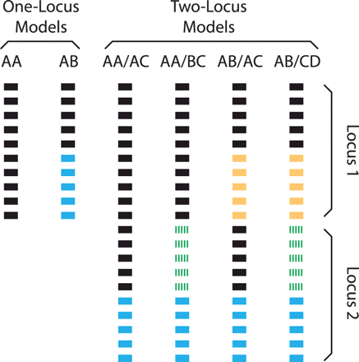
Figure 4. Models used to verify the quality of sequence assemblies and identify single-copy loci. Each site of each ...
Notes:
Figure 4. Models used to verify the quality of sequence assemblies and identify single-copy loci. Each site of each assembly was evaluated to determine whether the reads overlapping with that site were derived from a single locus or multiple loci. The six models producing distinct distributions of characters are shown, with each bar indicating a different read and each shade representing a different character state (A, T, C, and G). For simplicity, examples include 10 reads per locus, which is the minimum necessary to distinguish among the models. We computed the probability that the observed distribution of characters at a given site was derived from each of these models, allowing for sequencing error at the rate of 0.01 (see main text). Assemblies in which an Akaike information criterion test supported a one-locus model at all sites were identified as single-copy. Equations used to compute the probabilities are given in the pyton script provided on Dryad (http://datadryad.org, doi:10.5061/dryad.vh151q1c).
Unless provided in the caption above, the following copyright applies to the content of this slide: © The Author(s) 2012. Published by Oxford University Press, on behalf of the Society of Systematic Biologists. All rights reserved. For Permissions, please email: journals.permissions@oup.com

Slide 5
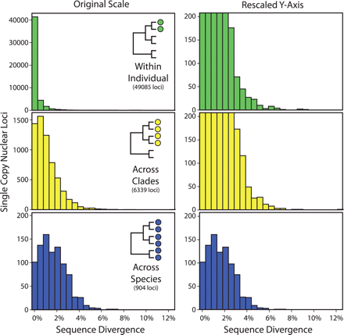
Figure 5. Estimates of sequence divergence at three time scales for thousands of loci. Pairwise sequence divergence is ...
Notes:
Figure 5. Estimates of sequence divergence at three time scales for thousands of loci. Pairwise sequence divergence is shown across alleles taken from: (i) within an individual (P. feriarum from the Coastal clade, top row), (ii) across individuals from Coastal and Inland clades of P. feriarum (center row), and (iii) across individuals from different species (P. feriarum and P. maculata; Supplementary Table 5). Note that the sequence divergence estimates for the nuclear loci were not corrected for multiple substitutions due to their short length and are thus conservative. For sequence divergence calculations involving more than two alleles, values were averaged across all pairwise combinations of alleles that spanned the node of interest. Combined results for all eight restriction enzymes are shown here. Distributions for within-individual comparisons of sequence divergence are similar for the two P. feriarum and for the P. maculata sequenced. Plotting the histograms on a rescaled y axis indicates that a large number of loci with substantial sequence variation can be obtained at shallow time scales (upper two rows).
Unless provided in the caption above, the following copyright applies to the content of this slide: © The Author(s) 2012. Published by Oxford University Press, on behalf of the Society of Systematic Biologists. All rights reserved. For Permissions, please email: journals.permissions@oup.com

Slide 6
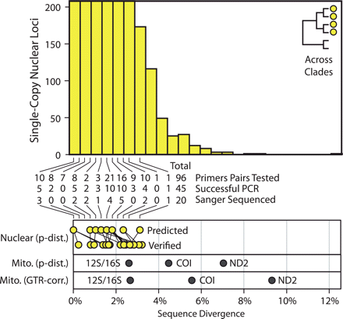
Figure 6. Comparison of sequence divergence between nuclear and mitochondrial loci. Estimates of pairwise sequence ...
Notes:
Figure 6. Comparison of sequence divergence between nuclear and mitochondrial loci. Estimates of pairwise sequence divergence across alleles from Coastal and Inland P. feriarum using Illumina sequencing are presented in the histogram, which is identical to the center right panel of Fig. 5. The number of loci tested and the PCR success for those loci are shown as a table that includes results for loci grouped by initial estimates of sequence divergence. Note that conserved primers could not be found for many of the loci with the highest estimated levels of sequence divergence. Twenty loci were Sanger sequenced to verify estimates of sequence divergence. Relationships between the predicted and verified sequence divergence are shown as lines connecting the points. Three mitochondrial regions commonly used for shallow taxonomic scales (12S/16S, COI, and ND2) were also Sanger sequenced for the same individuals (note that the 715 bp partial 12S/16S sequence was included). Comparison of sequence divergences for the mitochondrial and nuclear loci indicates that many nuclear loci will have phylogenetic utility at shallow taxonomic scales. Note that the sequence divergence estimates for the nuclear loci were not corrected for multiple substitutions due to their short length and are thus conservative. Both corrected and uncorrected estimates of sequence divergence are given for the mitochondrial loci, which are much longer (substitution models assumed and numerical results are given in Supplementary Table 6).
Unless provided in the caption above, the following copyright applies to the content of this slide: © The Author(s) 2012. Published by Oxford University Press, on behalf of the Society of Systematic Biologists. All rights reserved. For Permissions, please email: journals.permissions@oup.com

Slide 7
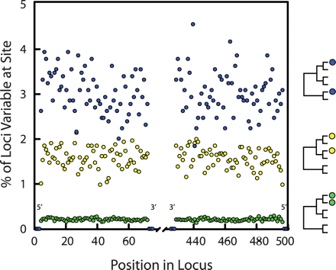
Figure 7. Estimates of sequence divergence are not biased by Illumina sequencing errors. Recall that Illumina ...
Notes:
Figure 7. Estimates of sequence divergence are not biased by Illumina sequencing errors. Recall that Illumina sequencing error is most pronounced at the 3′-ends of reads (Supplementary Fig. 1). If sequencing error has biased sequence divergence estimates, then sites toward the center of assembled loci (3′-ends of Illumina reads) should have inflated estimates of sequence divergence relative to sites at the ends of loci (corresponding to 5′-ends of Illumina reads). No such pattern exists at any of the three time scales. Instead, the percent of variable loci is consistent across sites. Moreover, the fact that the sequence variation scales with taxonomic depth further confirms that estimates of sequence variation are not an artifact of sequencing error. All loci are invariant at the 12 sites corresponding to 5′- and 3′-ends of reads because loci with variation at these sites were removed to ensure alignment accuracy (see Methods section). Note that the scale on the x-axis, which assumes that all loci are 500 bp in length, is used for convenience only. Accounting for unknown variation in locus length would affect the x-axis labels but would not change the pattern observed in the plotted points.
Unless provided in the caption above, the following copyright applies to the content of this slide: © The Author(s) 2012. Published by Oxford University Press, on behalf of the Society of Systematic Biologists. All rights reserved. For Permissions, please email: journals.permissions@oup.com

Slide 8
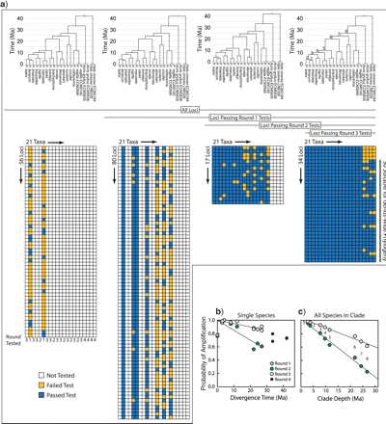
Figure 8. Utility of RRL-generated loci with increasing taxonomic depth. a) Primer pairs designed for 187 loci were ...
Notes:
Figure 8. Utility of RRL-generated loci with increasing taxonomic depth. a) Primer pairs designed for 187 loci were tested for across-species utility using four rounds, with 2, 5, 10, and 4 species being tested in the four rounds, respectively (see Methods section). Results from these tests are shown for each locus-by-species combination. Primers sequences for all loci tested are available on the Dryad data depository (http://datadryad.org, doi:10.5061/dryad.vh151q1c). The chronogram shown is adapted from Lemmon et al. (2007). b) For tests in each stage, we computed the probability of a successful PCR test for each species (number of successful amplifications/number of loci tested for that species) and plotted the result as a function of the divergence time between that species and P. feriarum or P. maculata (whichever was closer). c) We also computed for several nested clades within Pseudacris (clade numbers on far right chronogram in [a] also correspond to numbered points in [c]) the probability that all species of a given clade would amplify successfully. For each branch within a clade, the probability that amplification would be successful along the branch was computed using the branch length and the relationship obtained in b). These probabilities were multiplied across all branches within the given clade to obtain the overall probability that all species in the clade would amplify successfully.
Unless provided in the caption above, the following copyright applies to the content of this slide: © The Author(s) 2012. Published by Oxford University Press, on behalf of the Society of Systematic Biologists. All rights reserved. For Permissions, please email: journals.permissions@oup.com

Slide 9
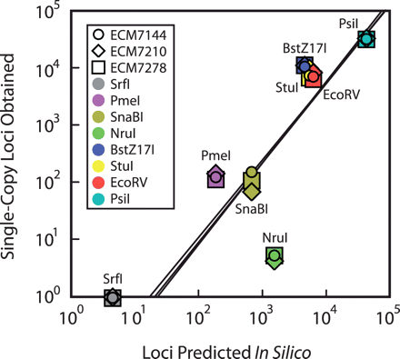
Figure 9. Accuracy of in silico predictions. The number of single-copy loci obtained is plotted against the number of ...
Notes:
Figure 9. Accuracy of in silico predictions. The number of single-copy loci obtained is plotted against the number of loci predicted for each individual and restriction enzyme. Predictions were accurate for all restriction enzymes, with the exception of NruI. Note the consistency across individuals with respect to the number of loci obtained. The best-fit regression line, presented for each individual, was computed using log-transformed values for all restriction enzymes except SrfI, for which zero loci were obtained. SrfI is plotted at 1 locus obtained (100) for visual purposes only.
Unless provided in the caption above, the following copyright applies to the content of this slide: © The Author(s) 2012. Published by Oxford University Press, on behalf of the Society of Systematic Biologists. All rights reserved. For Permissions, please email: journals.permissions@oup.com

Slide 10
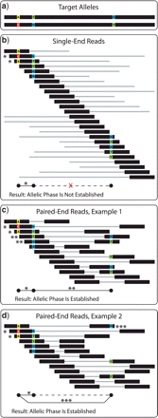
Figure 10. Use of paired-end sequencing reads facilitates the determination of allelic phase. In this example, a) an ...
Notes:
Figure 10. Use of paired-end sequencing reads facilitates the determination of allelic phase. In this example, a) an individual possesses two distinct alleles at a given 600 bp locus containing three heterozygous sites. With single-end reads b), allelic phase cannot be determined because the distance between the second and third heterozygous sites (300 bp) is greater than the read length (100 bp). With paired-end reads c, d), however, allelic phase can be determined because paired reads from long fragments can overlap with the distant heterozygous sites. Note that in the case of paired-end reads, it is not necessary for all pairs of adjacent heterozygous sites to be overlapped by paired reads d). Both the single and paired-end examples assume the same fragment length distribution, read length, and coverage. In b–d), black and gray lines indicate sequenced and unsequenced portions of fragments, respectively. Single, double, and triple asterisks indicate reads that enable phase of nearby, distant, and nonadjacent heterozygous sites, respectively.
Unless provided in the caption above, the following copyright applies to the content of this slide: © The Author(s) 2012. Published by Oxford University Press, on behalf of the Society of Systematic Biologists. All rights reserved. For Permissions, please email: journals.permissions@oup.com

