Slide 1
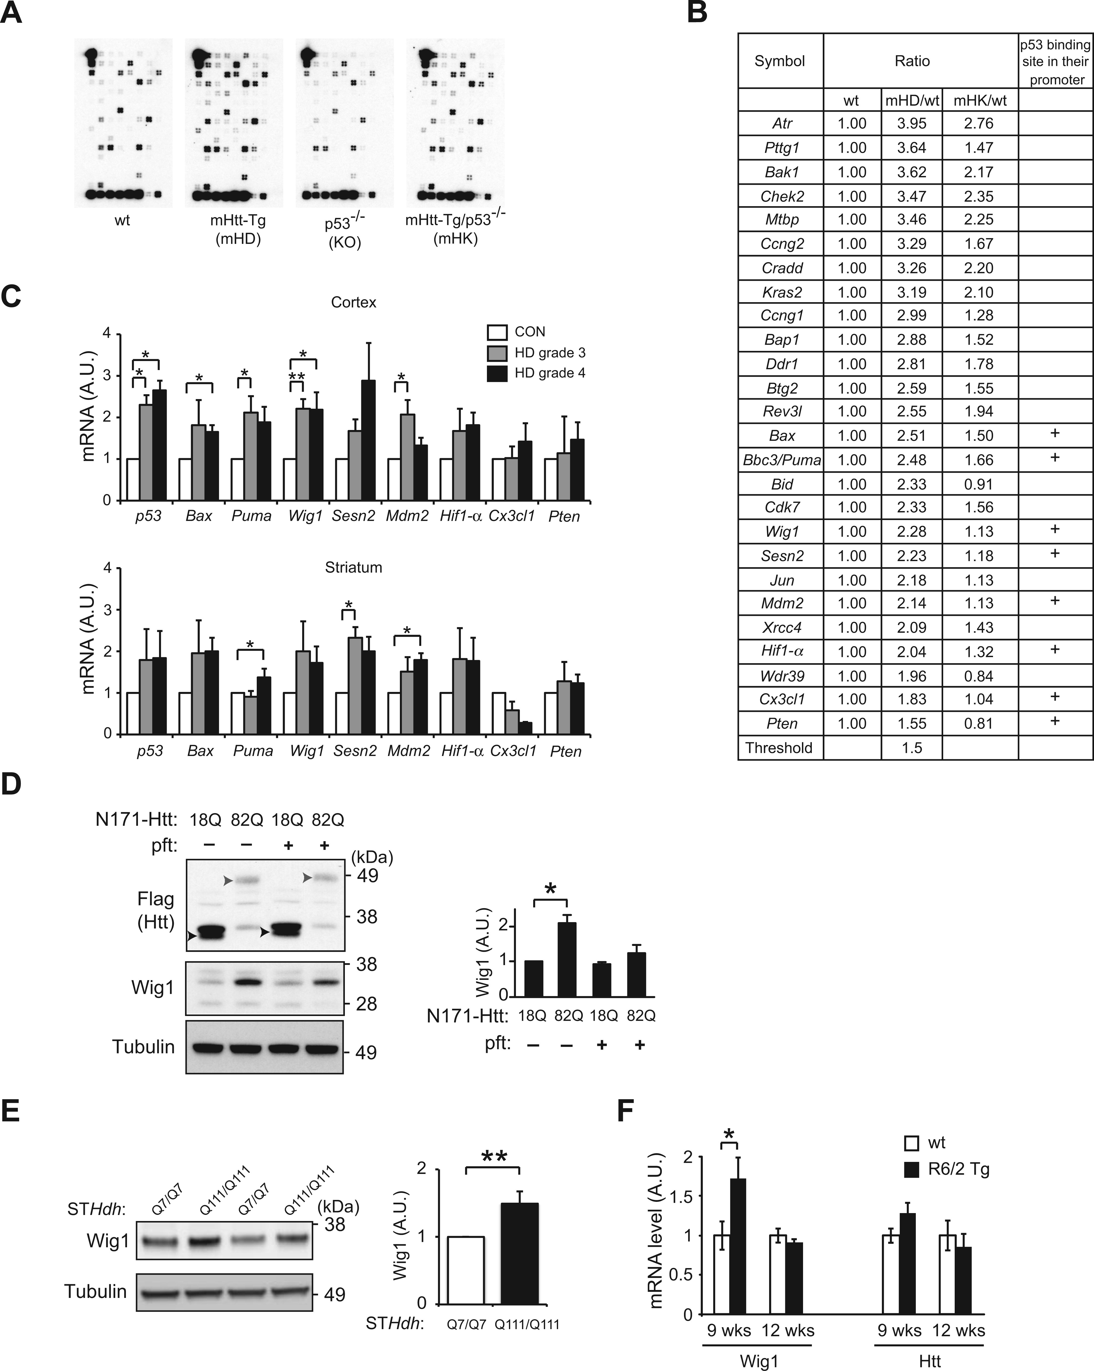
Figure 1. Screening of p53 downstream targets in HD using p53 microarray. (A) Differential expression of genes involved ...
Notes:
Figure 1. Screening of p53 downstream targets in HD using p53 microarray. (A) Differential expression of genes involved in the p53 signaling pathways among wild-type (wt), mHD, KO and mHK mice by using the Oligo GEArray for mouse p53 signaling pathway. Array images are shown. (B) Comparison of gene expression profiles between wt, mHD and mHK mice at 5 months old reveal a group of genes which show significantly different expression levels compared with wt mice including eight p53 target genes carrying p53 binding site. (C) Quantitative RT-PCR results using cortex and striatum of HD patients (grades 3 and 4) and healthy controls (CTL) reveal significant upregulation of p53, Bax, Puma, Wig1 and Mdm2 in the cortex of HD patients, and Puma, Sesn2 and Mdm2 in the striatum of HD patients compared with control group (Grade 3, n = 3; Grade 4, n = 5; age-matched controls, n = 5). (D) Expression of Wig1 in HD cell model. Protein level of Wig1 is significantly higher in N171-Htt-82Q-expressing differentiated PC12 cells compared with N171-Htt-18Q-expressing PC12 cells, which was blocked by pifithrin-α (pft, 10 μM), a p53 inhibitor. Upper arrow head and lower arrow head indicate N171-Htt-82Q and N171-Htt-18Q, respectively. (E) Upregulation of Wig1 in striatal cells that express endogenous full-length mutant Htt. Protein level of Wig1 is significantly higher in the mutant Htt-expressing striatal cells (STHdhQ111/Q111) than wt Htt-expressing striatal cells (STHdhQ7/Q7). (F) Quantitative RT-PCR results using the striatum of R6/2 transgenic (Tg) and wt mice. Wig1 mRNA levels are upregulated in R6/2 Tg striatum at 9 weeks but not at 12 weeks of age, when compared with those in wt mice. No significant difference, but a trend of increase, is observed in the levels of mouse-derived endogenous Htt mRNA between Tg and wt mice. Data are represented as mean ± s.e.m. (*P < 0.05, **P < 0.01, Student’s t-test). See also Supplementary Material, Tables S1 and S2.
Unless provided in the caption above, the following copyright applies to the content of this slide: © The Author 2016. Published by Oxford University Press. All rights reserved. For permissions, please e-mail: journals.permissions@oup.com

Slide 2
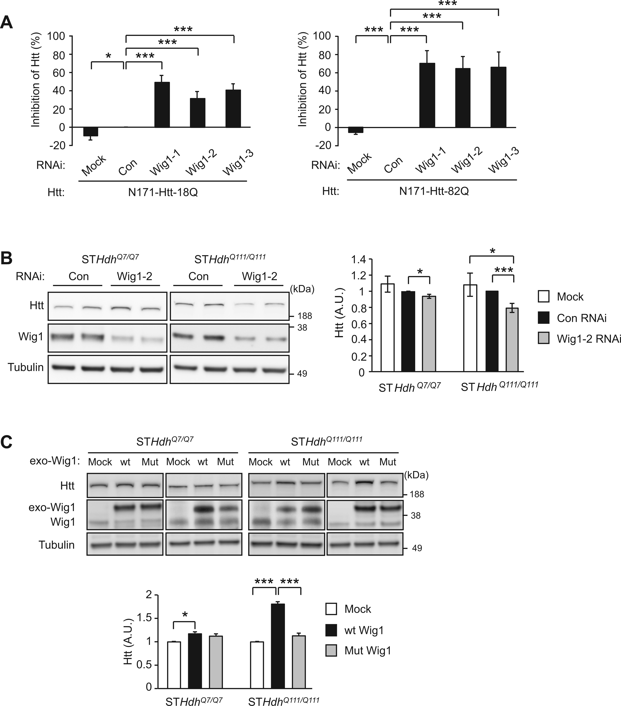
Figure 2. Upregulation of Htt protein expression level by Wig1. (A) Knockdown of Wig1 in differentiated, either wt or ...
Notes:
Figure 2. Upregulation of Htt protein expression level by Wig1. (A) Knockdown of Wig1 in differentiated, either wt or mutant Htt fragment (N171-Htt-18Q or N171-Htt-82Q, respectively)-expressing PC12 cells results in significant decrease in Htt fragments at the protein level, in particular mutant Htt fragemnts. (B) Knockdown of Wig1 in striatal cell lines expressing either wt or mutant full-length Htt (STHdhQ7/Q7 or STHdhQ111/Q111, respectively) results in significant decrease in Htt protein level, in particular mutant Htt protein. (C) Overexpression of Wig1 in STHdhQ7/Q7 or STHdhQ111/Q111 striatal cell lines significantly augments the mutant Htt protein level, which is suppressed by expression of RNA binding-defective mutant Wig1 (Wig1-H88A). The effect of overexpressed wt Wig1 in STHdhQ7/Q7 cells on wt Htt level is lesser extent than that of mutant Htt. Data are represented as mean ± s.e.m. (*P < 0.05, ***P < 0.001, Student’s t-test). See also Supplementary Material, Fig. S1.
Unless provided in the caption above, the following copyright applies to the content of this slide: © The Author 2016. Published by Oxford University Press. All rights reserved. For permissions, please e-mail: journals.permissions@oup.com

Slide 3
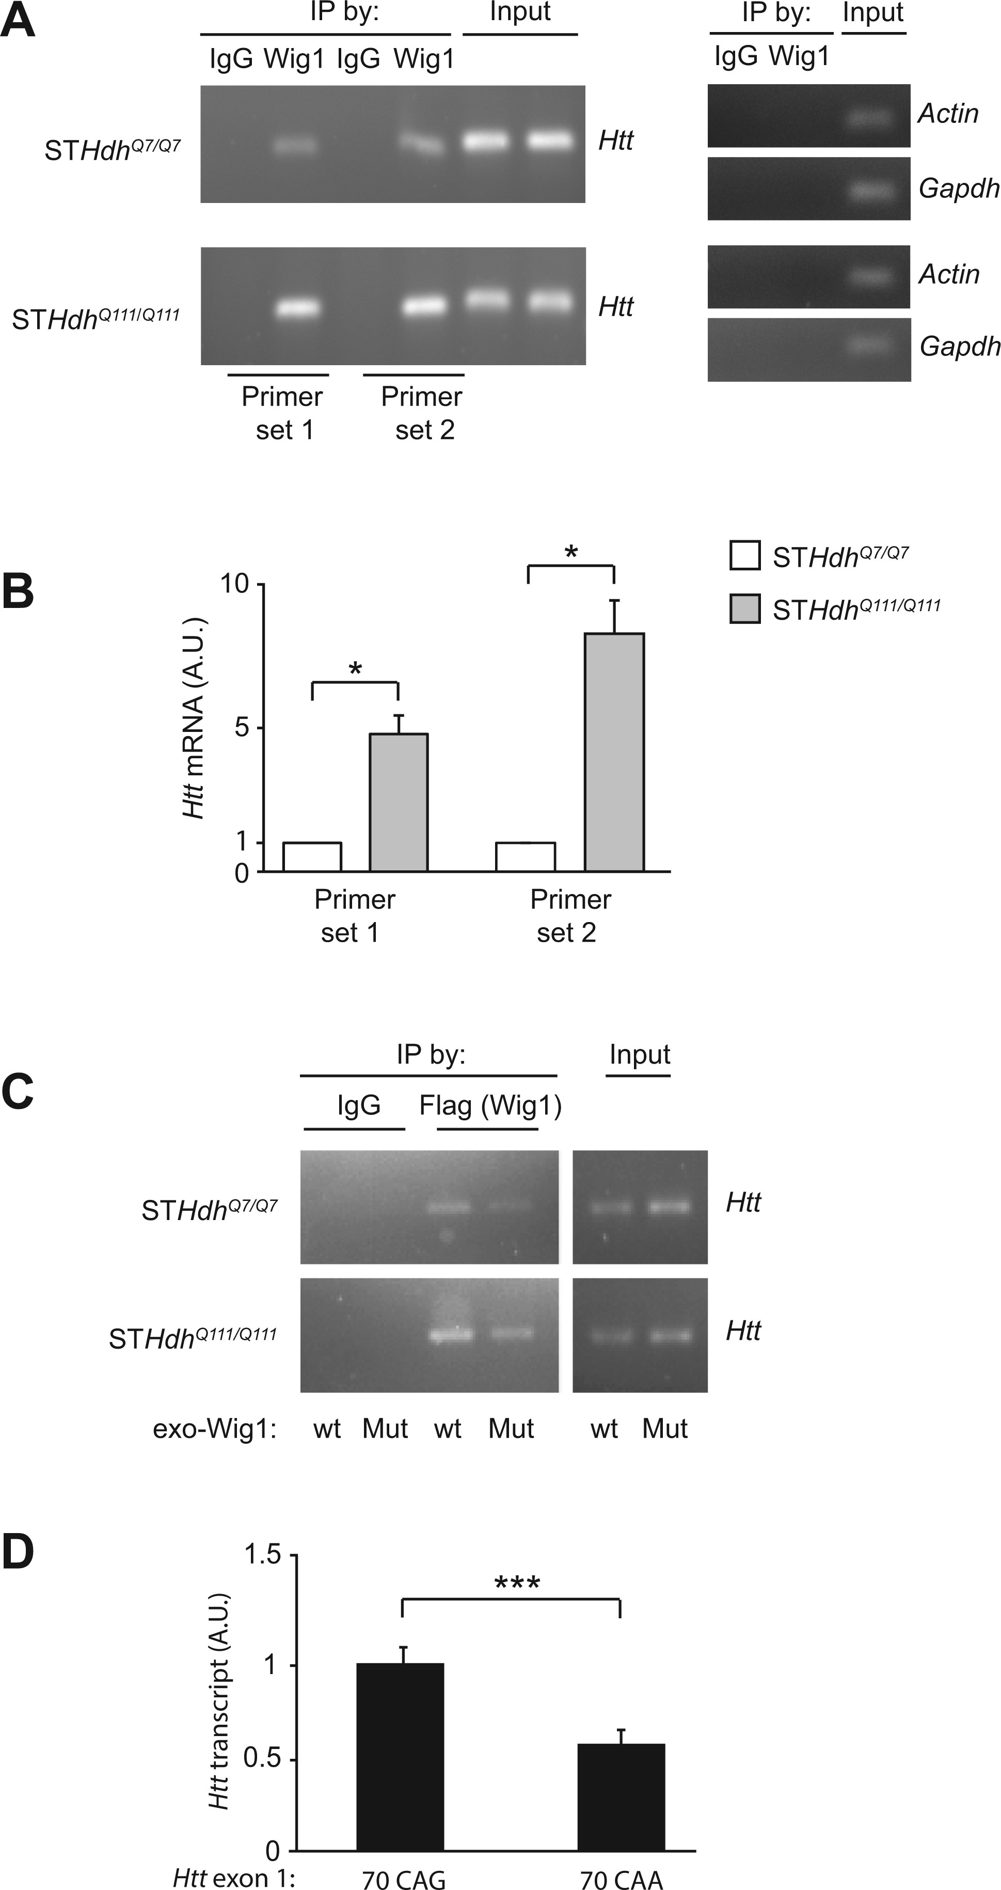
Figure 3. Preferential binding of Wig1 toward mHtt mRNA. (A) Examination of binding of Wig1 with Htt mRNA by RIP assay. ...
Notes:
Figure 3. Preferential binding of Wig1 toward mHtt mRNA. (A) Examination of binding of Wig1 with Htt mRNA by RIP assay. Wig1 proteins preferentially bind mutant Htt mRNA compared with its binding to wt Htt mRNA. (B) Quantitative RT-PCR analysis of Wig1 protein-Htt mRNA binding from RIP assay. Binding of Wig1 protein with mutant Htt mRNA is more enriched than Wig1 protein-wt Htt mRNA binding. (C) Attenuated Wig1 protein-Htt mRNA binding with RNA binding-defective mutant Wig1 (Wig1-H88A). (D) Quantitative RT-PCR analysis of binding between the GST-Wig1 protein and Htt exon 1 transcript in the RNA-protein binding assay. Wig1 protein binds with the Htt exon1 transcript containing 70 CAG more efficiently than the 70 CAA-carrying transcript. Data are represented as mean ± s.e.m. (*P < 0.05, ***P < 0.001, Student’s t-test). See also Supplementary Material, Table S2 and Fig. S2.
Unless provided in the caption above, the following copyright applies to the content of this slide: © The Author 2016. Published by Oxford University Press. All rights reserved. For permissions, please e-mail: journals.permissions@oup.com

Slide 4
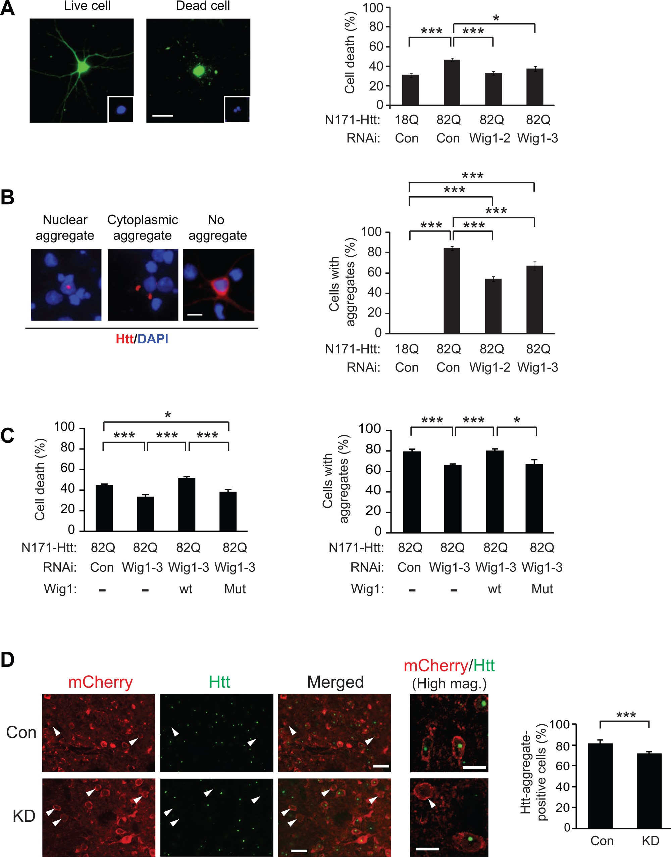
Figure 4. Role for Wig1 in mHtt-elicited pathology in HD models. (A) Suppression of mutant Htt-elicited cell toxicity ...
Notes:
Figure 4. Role for Wig1 in mHtt-elicited pathology in HD models. (A) Suppression of mutant Htt-elicited cell toxicity by knockdown of Wig1 in rat cortical primary neurons. Green, GFP. Inset shows DAPI-stained nucleus. The scale bar represents 20 µm. (B) Amelioration of mutant Htt-elicited aggregate formation by knockdown of Wig1 in rat cortical primary neurons. Red, Htt aggregates; blue, DAPI nuclear staining. The scale bar represents 10 µm. (C) RNA-binding region in Wig1 is critical for its facilitation of mutant Htt-elicited cytotoxicity and aggregate formation. Expression of wt Wig1 in rat cortical primary neurons expressing mutant Htt fragment (N171-Htt-Q82) and RNAi against Wig1 completely suppresses Wig1 RNAi-mediated amelioration of cell death (the left panel) and aggregate formation (the right panel), whereas RNA binding-defective mutant Wig1 (Wig1-H88A) does not. All the graphs represent at least three independent experiments. (D) Reduction of the Htt-positive aggregate formation by knockdown of Wig1 in the striatum of R6/2 mice. Htt-positive aggregates were labeled with an antibody against Htt MAB5374 (EM48; green) at 9 weeks of age. White arrowhead indicates the AAV-infected striatal cells that do not contain Htt-positive aggregates. Con, control AAV; KD, Wig1 KD AAV. Scale bars represent 20 μm. High magnification (High mag.): Scale bars represent 10 μm. Data are represented as mean ± s.e.m. (*P < 0.05, ***P < 0.001, Student’s t-test). See also Supplementary Material, Figs S1 and S3.
Unless provided in the caption above, the following copyright applies to the content of this slide: © The Author 2016. Published by Oxford University Press. All rights reserved. For permissions, please e-mail: journals.permissions@oup.com

