Slide 1
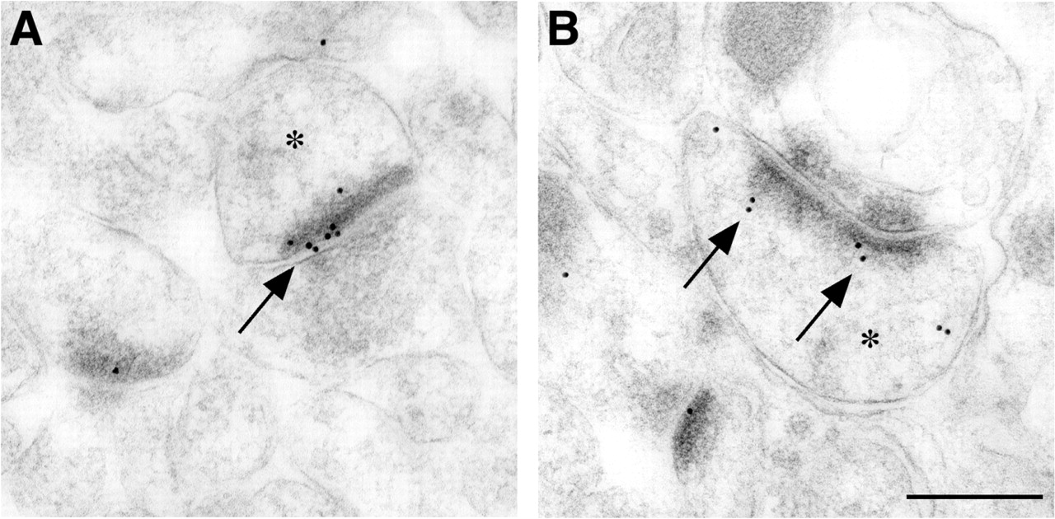
Figure 1. Images of NMDAR1-positive asymmetric synapses between axon terminals and dendritic spines (*) in ...
Notes:
Figure 1. Images of NMDAR1-positive asymmetric synapses between axon terminals and dendritic spines (*) in the CA1 subfield of the hippocampus (A, B). Immunogold particles, indicated by the arrowheads, were observed to be associated with the postsynaptic density. Immunogold particles were also observed within the head of the spine, which may represent a non-synaptic pool. Scale bar = 250 nm.
Unless provided in the caption above, the following copyright applies to the content of this slide:

Slide 2
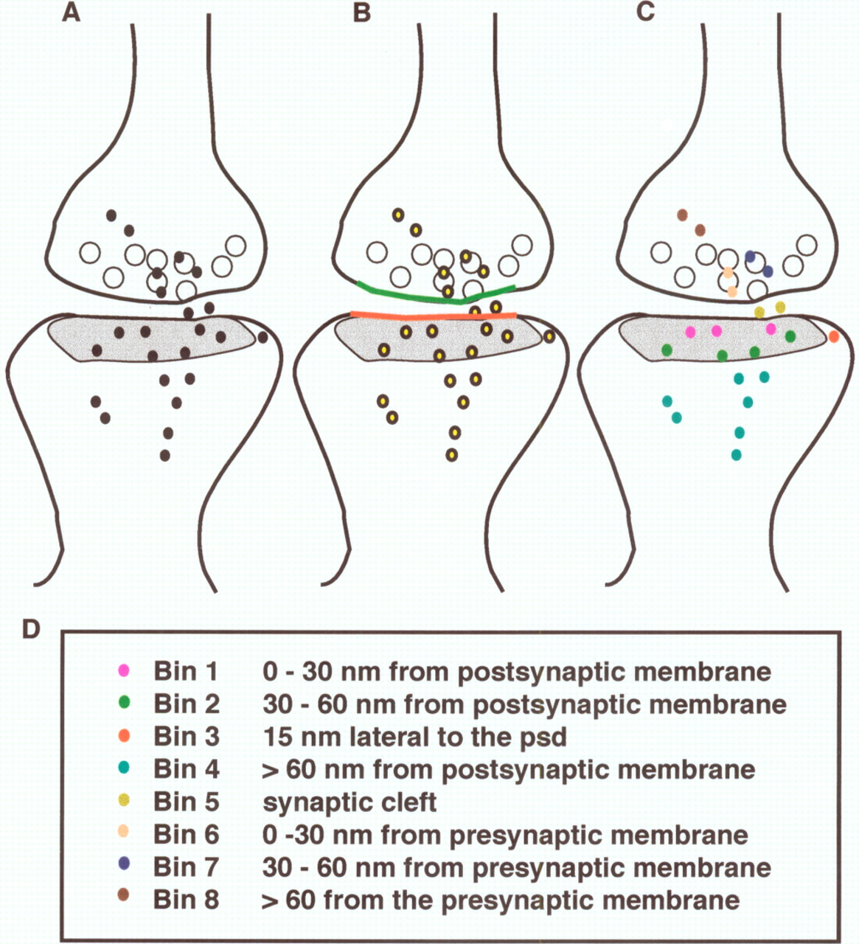
Figure 2. Schematic images that illustrate the software developed in our laboratory for quantification of the ...
Notes:
Figure 2. Schematic images that illustrate the software developed in our laboratory for quantification of the distribution of gold particles associated with the synaptic complex. (A) Schematic diagram illustrates the possible distribution of gold particles within a synapse. (B) The user outlines the relevant synaptic components [i.e. the length of the postsynaptic density (red line), the length of the presynaptic membrane that corresponds to the length of the postsynaptic density (green line), and the location of the gold particles (yellow closed circles)]. (C) The computer program provides a data map of the distribution of the gold particles relative to these membranes and postsynaptic compartments. (D) Table representing the different synaptic compartments or bins that are associated with the synaptic complex.
Unless provided in the caption above, the following copyright applies to the content of this slide:

Slide 3
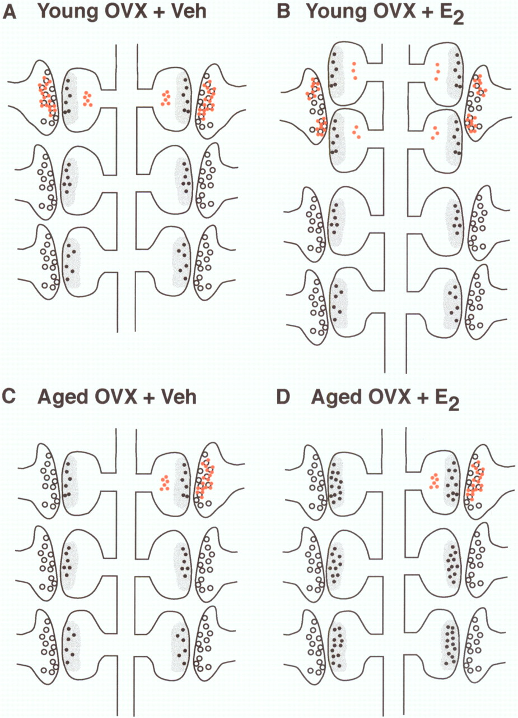
Figure 3. Schematic diagram illustrating the potential sites of synaptic alterations induced by estrogen in ...
Notes:
Figure 3. Schematic diagram illustrating the potential sites of synaptic alterations induced by estrogen in the CA1 region of young [A, B; 3- to 4-month-old female Sprague–Dawley rats; n = 4–5 per group (Adams et al., 2001)] and aged animals [C, D; 24-month-old female Sprague–Dawley rats; n = 4–5 per group (Adams et al., 2001)]. Estrogen treatment increases NMDAR1 expression per synapse in aged hippocampus, whereas it increases spine number but not synaptic NMDAR1 in young female rat hippocampus. Estrogen treatment either decreases the amount of ER-α per synapse in young animals or leads to a redistribution of the receptor resulting from the formation of new dendritic spines and alterations in presynaptic terminal shape. Presynaptic terminal numbers remain unchanged in the young animal that is given estrogen replacement and they form multiple synapse boutons with new spines (Woolley et al., 1996; Yankova et al., 2001). Moreover, the presynaptic terminals become irregular in shape and less spherical (Woolley et al., 1996). ER-α levels are unchanged in aged animals in both presynaptic and postsynaptic compartments, but there is an overall decrease in the percentage of terminals that express ER-α. The events depicted in this schematic are occurring in the absence of changes in the lengths of the postsynaptic densities [average length for all animals approximately 250 nm (Adams et al., 2001)]. Small black dots represent immunogold particles labeling NMDAR1 associated with postsynaptic Bin 1, small red dots represent immunogold particles labeling ER-α, open circles represent synaptic vesicles, and the gray zones represent the postsynaptic density. OVX = ovariectomized; Veh = vehicle-treated; E2 = estrogen-replaced.
Unless provided in the caption above, the following copyright applies to the content of this slide:

