Slide 1
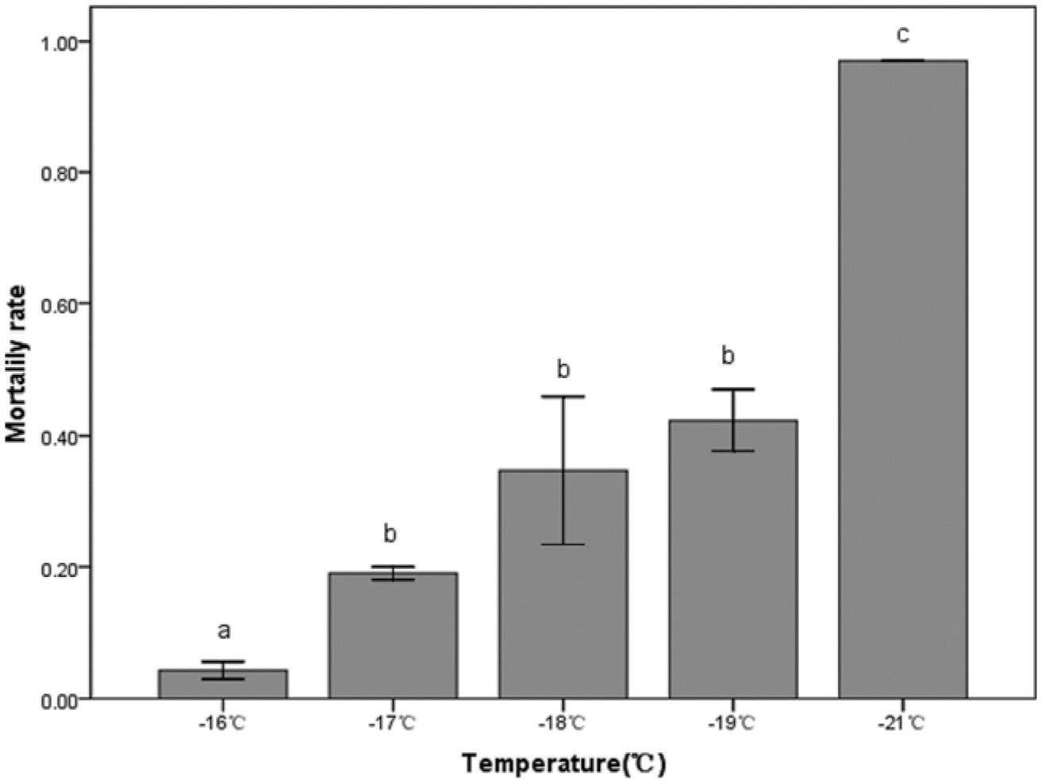
Fig. 1. Mortality of C. suppressalis after exposure to -16, -17, -18, -19, or -21°C, for 1h. Mean values based on ...
Notes:
Fig. 1. Mortality of C. suppressalis after exposure to -16, -17, -18, -19, or -21°C, for 1h. Mean values based on three replicates, each with thirty larvae. Significant differences are indicated as P < 0.05.
Unless provided in the caption above, the following copyright applies to the content of this slide: © 2012 Entomological Society of AmericaThis article is published and distributed under the terms of the Oxford University Press, Standard Journals Publication Model (https://academic.oup.com/journals/pages/open_access/funder_policies/chorus/standard_publication_model)

Slide 2
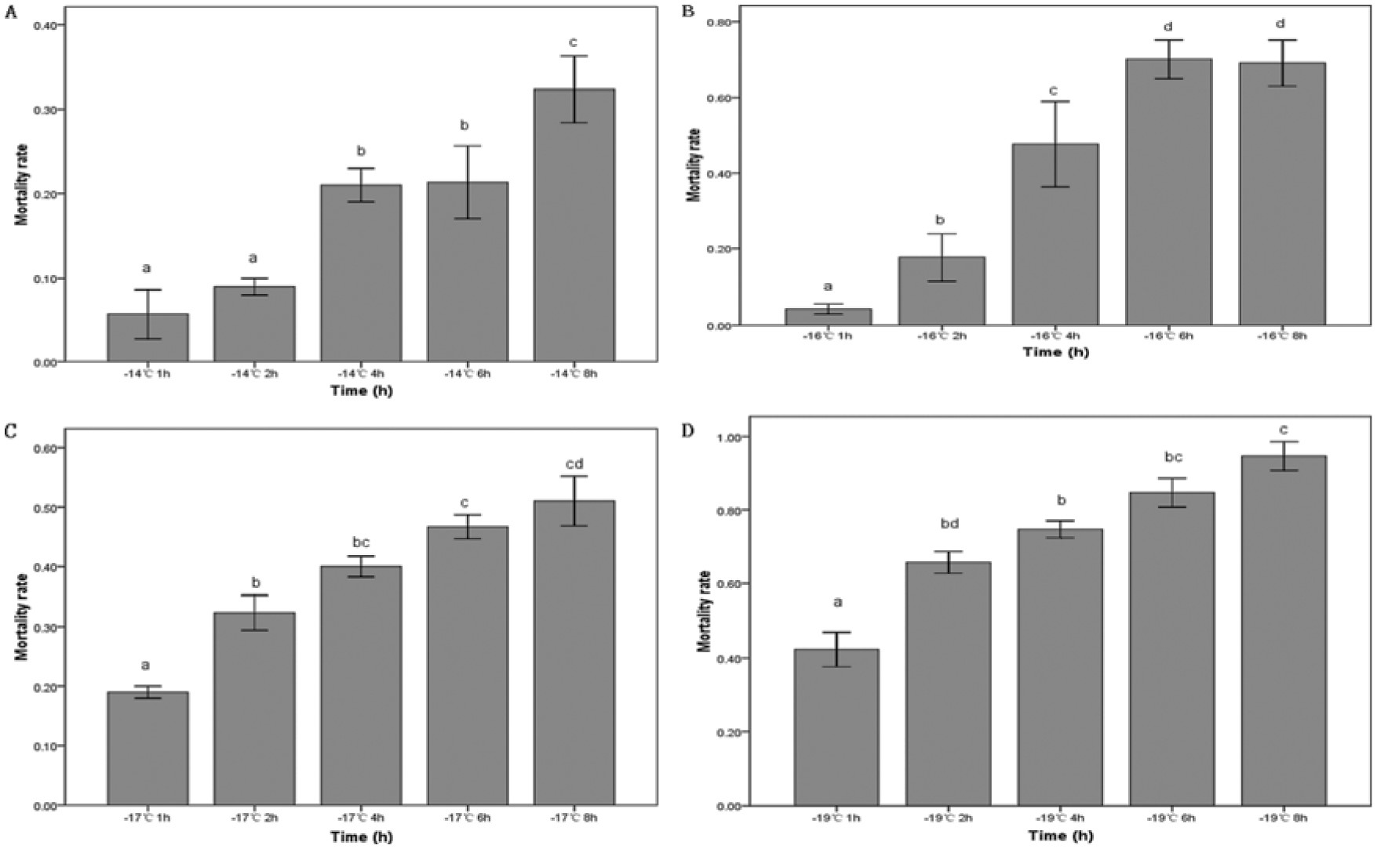
Fig. 2. Mortality of C. suppressalis after exposure to cold stress for 1, 2, 4, 6, or 8 h at -14°C (A), -16°C (B), ...
Notes:
Fig. 2. Mortality of C. suppressalis after exposure to cold stress for 1, 2, 4, 6, or 8 h at -14°C (A), -16°C (B), -17°C (C), or -19°C (D). Mean values based on three replicates, each with thirty larvae. Significant differences are indicated as P < 0.05.
Unless provided in the caption above, the following copyright applies to the content of this slide: © 2012 Entomological Society of AmericaThis article is published and distributed under the terms of the Oxford University Press, Standard Journals Publication Model (https://academic.oup.com/journals/pages/open_access/funder_policies/chorus/standard_publication_model)

Slide 3
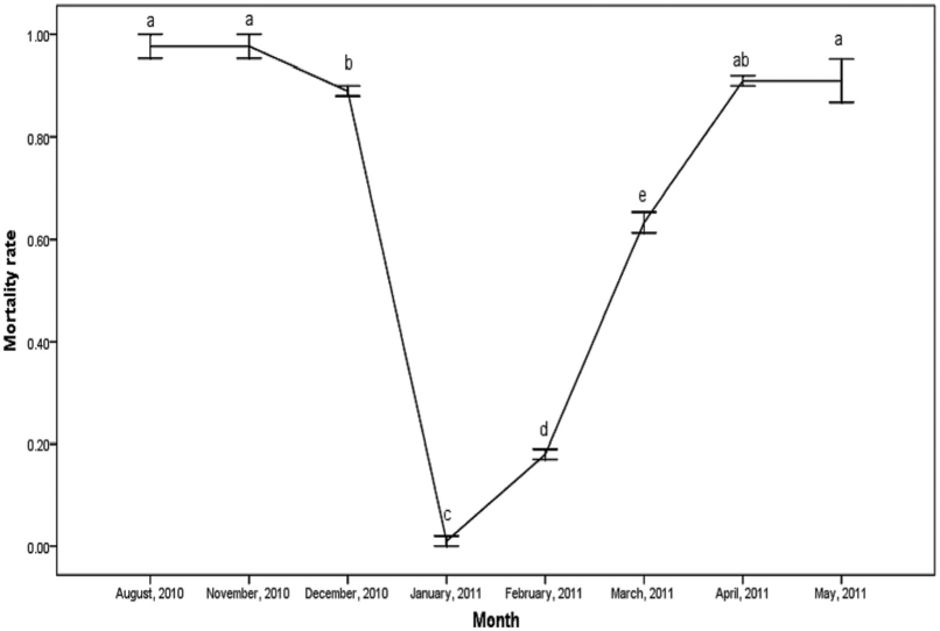
Fig. 3. Mortality of C. suppressalis collected in different months after exposure to -18°C for 2 h. Mean values based ...
Notes:
Fig. 3. Mortality of C. suppressalis collected in different months after exposure to -18°C for 2 h. Mean values based on three replicates, each with thirty larvae. Significant differences are indicated as P < 0.05.
Unless provided in the caption above, the following copyright applies to the content of this slide: © 2012 Entomological Society of AmericaThis article is published and distributed under the terms of the Oxford University Press, Standard Journals Publication Model (https://academic.oup.com/journals/pages/open_access/funder_policies/chorus/standard_publication_model)

