Slide 1
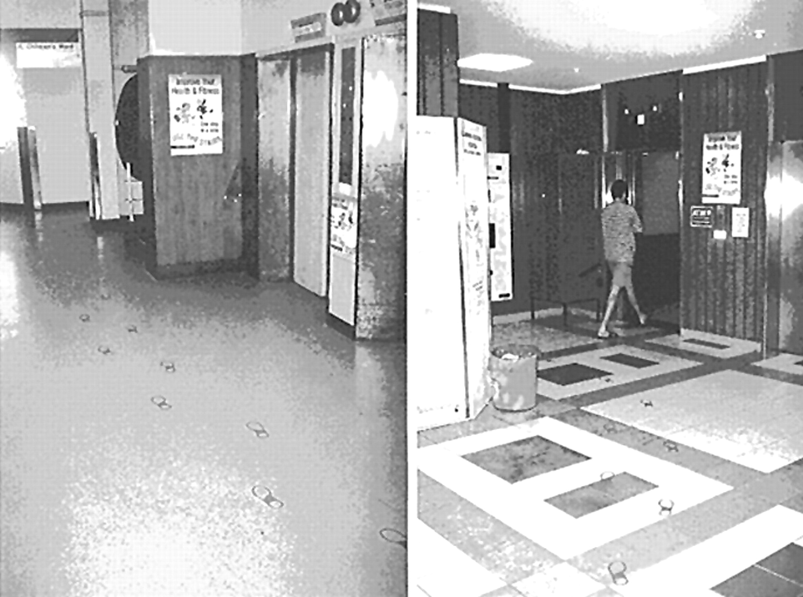
Fig. 1. Motivational signs and footprints were used to promote use of the stairs.
Notes:
Fig. 1. Motivational signs and footprints were used to promote use of the stairs.
Unless provided in the caption above, the following copyright applies to the content of this slide: © Oxford University Press

Slide 2
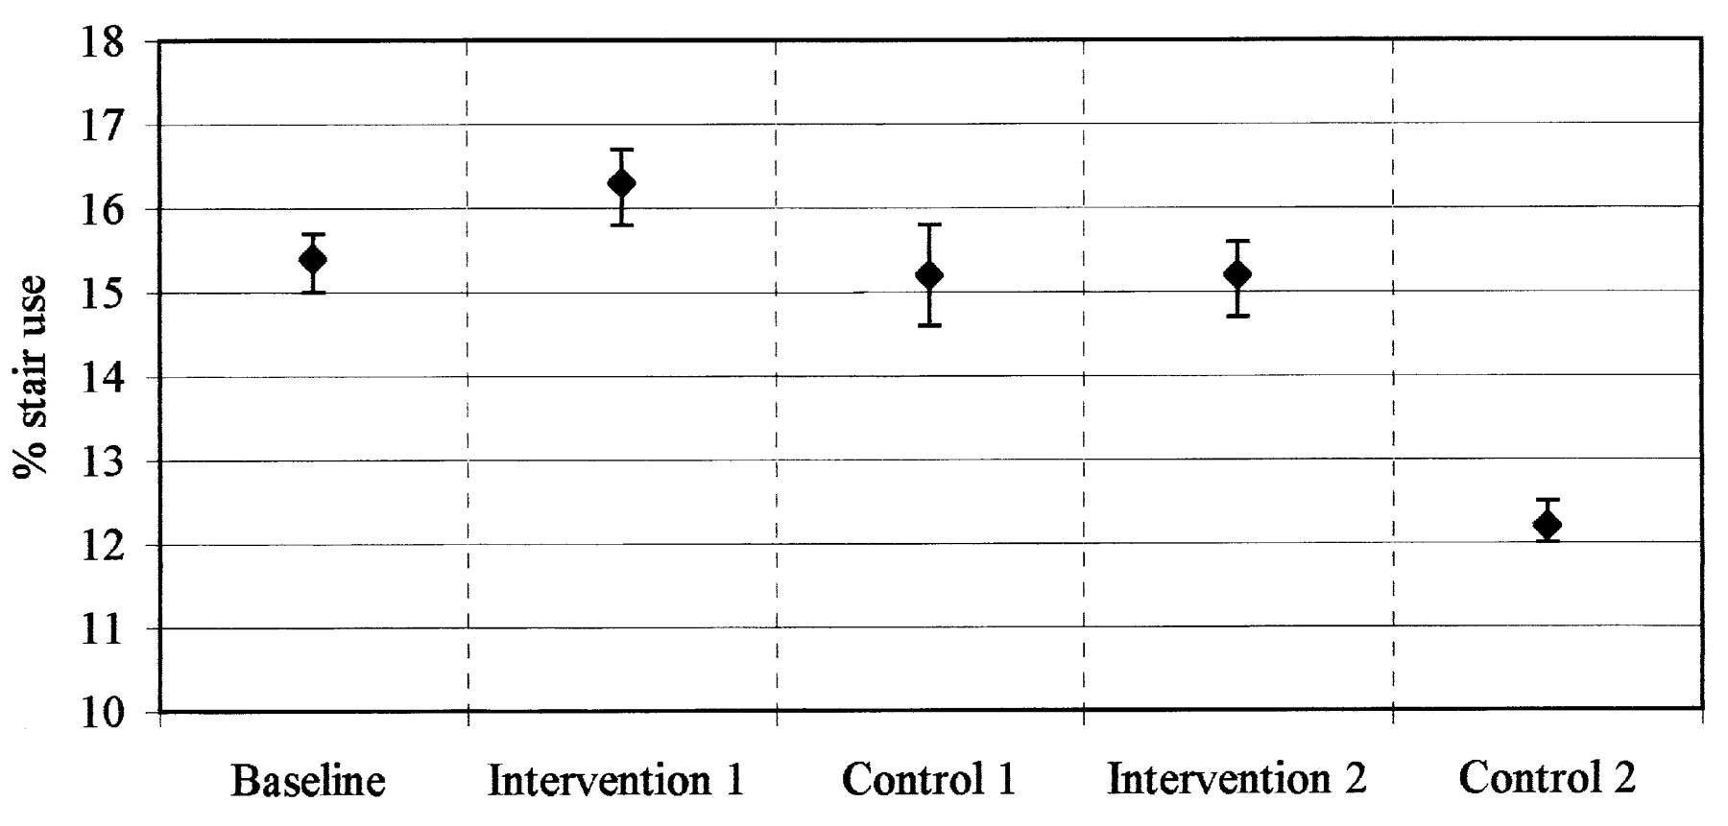
Fig. 2. The proportions and 95% confidence intervals of stair users based on observations recorded by the motion ...
Notes:
Fig. 2. The proportions and 95% confidence intervals of stair users based on observations recorded by the motion sensing devices during the different phases of the study.
Unless provided in the caption above, the following copyright applies to the content of this slide: © Oxford University Press

