Slide 1
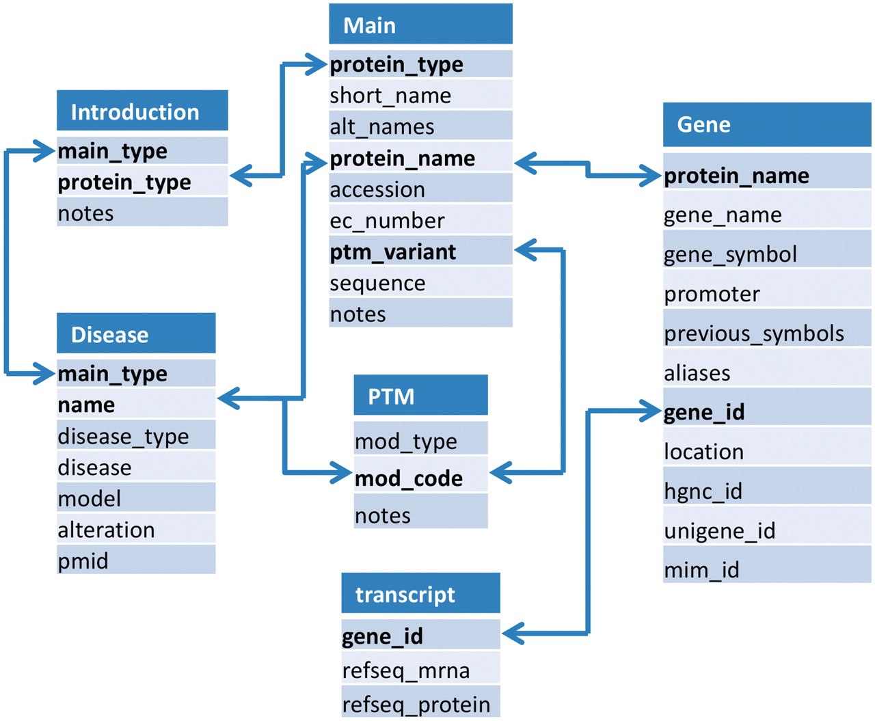
Figure 1. Organization of the histone infobase and relationships between tables. The Intro table stores information ...
Notes:
Figure 1. Organization of the histone infobase and relationships between tables. The Intro table stores information about types of histones, enzymes and PTMs. Since histone proteins are often coded by multiple non-allelic genes, and because many genes produce multiple mRNA species through alternative splicing; protein, gene and mRNA specific information has been stored in three different tables (viz. main, gene and transcript). PTM related information has been stored in a separate PTM table. Disease related information about histones, enzymes and PTMs has been stored. Tables are interlinked to other tables.
Unless provided in the caption above, the following copyright applies to the content of this slide: © The Author(s) 2011. Published by Oxford University Press.This is an Open Access article distributed under the terms of the Creative Commons Attribution Non-Commercial License (http://creativecommons.org/licenses/by-nc/3.0), which permits unrestricted non-commercial use, distribution, and reproduction in any medium, provided the original work is properly cited.

Slide 2
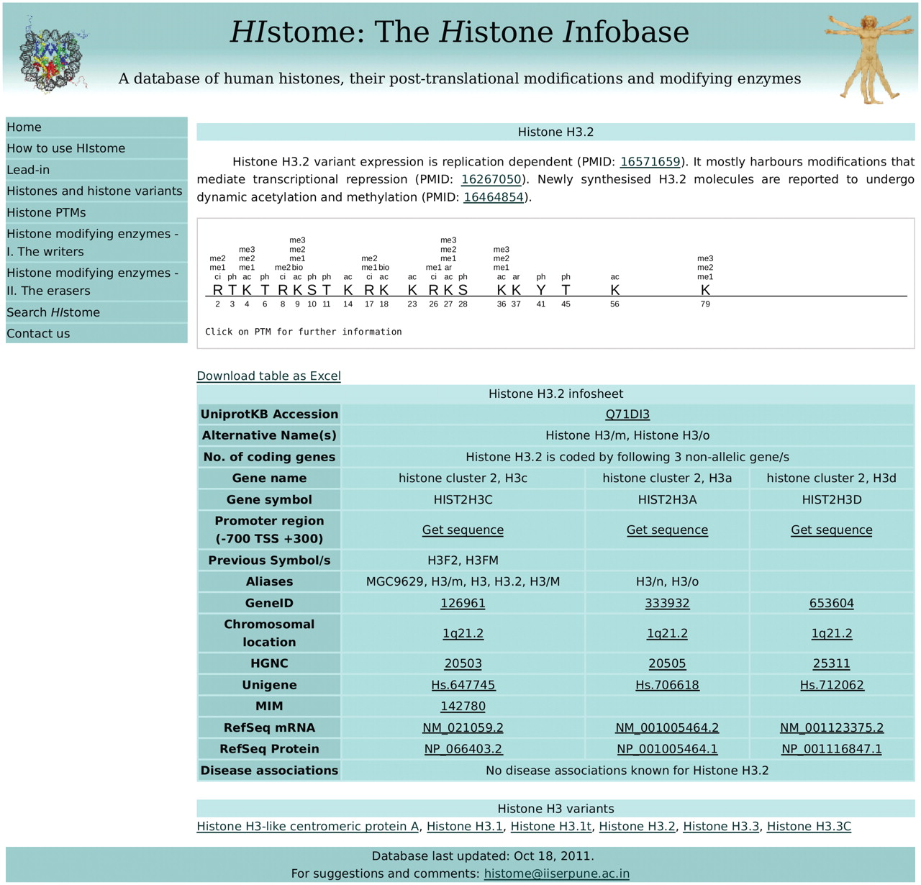
Figure 2. Screenshot depicting the information retrieved from a search for Histone H3.2. A visualization of all ...
Notes:
Figure 2. Screenshot depicting the information retrieved from a search for Histone H3.2. A visualization of all post-translational modifications on histone variant 3.2 appears at the top. The table below provides links to more information from HIstome as well as other public databases.
Unless provided in the caption above, the following copyright applies to the content of this slide: © The Author(s) 2011. Published by Oxford University Press.This is an Open Access article distributed under the terms of the Creative Commons Attribution Non-Commercial License (http://creativecommons.org/licenses/by-nc/3.0), which permits unrestricted non-commercial use, distribution, and reproduction in any medium, provided the original work is properly cited.

