Slide 1
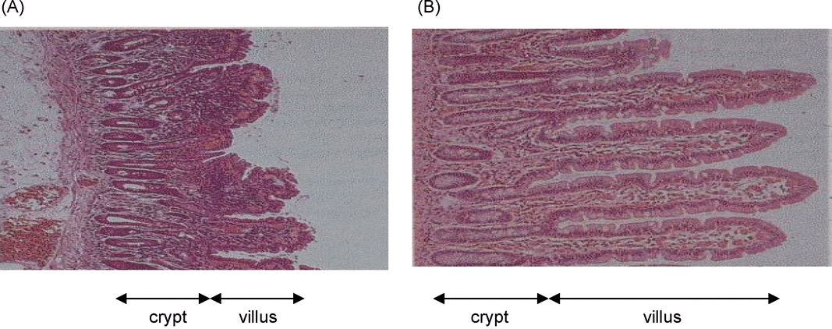
Figure 1 Histological features of the small intestinal mucosa of children with or without environmental enteropathy: ...
Notes:
Figure 1 Histological features of the small intestinal mucosa of children with or without environmental enteropathy: villus atrophy and crypt hyperplasia are characteristics of EE. Note high numbers of immune cells in lamina propria. (A) Abnormal, EE Crypt to villus ratio1:2 (Photographs reproduced with permission of P. Lunn).
Unless provided in the caption above, the following copyright applies to the content of this slide: © Royal Society of Tropical Medicine and Hygiene 2010

Slide 2
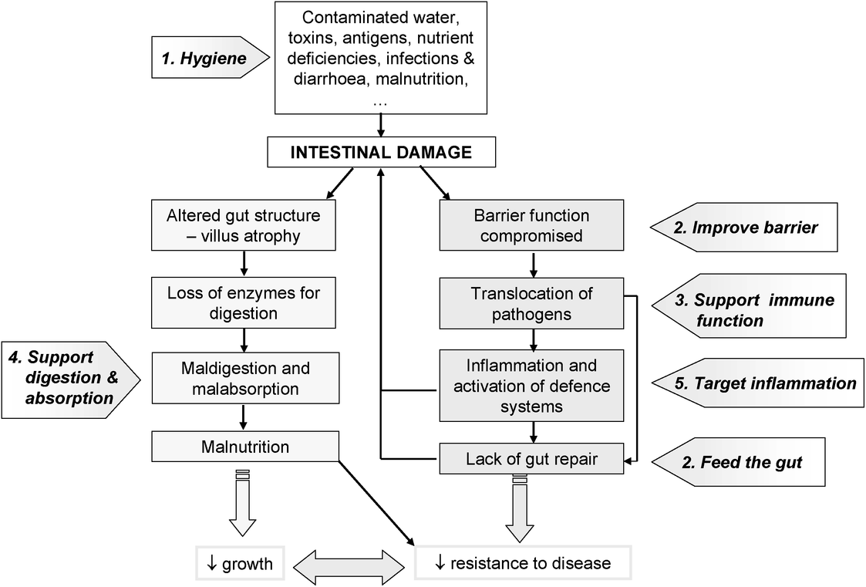
Figure 2 Potential targets to intervene in environmental enteropathy.
Notes:
Figure 2 Potential targets to intervene in environmental enteropathy.
Unless provided in the caption above, the following copyright applies to the content of this slide: © Royal Society of Tropical Medicine and Hygiene 2010

Slide 3
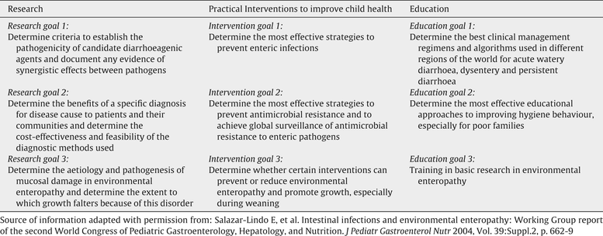
Table 1 Recommendations as described in the Working Group report.
Notes:
Table 1 Recommendations as described in the Working Group report.
Unless provided in the caption above, the following copyright applies to the content of this slide: © Royal Society of Tropical Medicine and Hygiene 2010

Slide 4
Table 2 Summary of nutritional intervention studies performed specifically in children with environmental ...
Notes:
Table 2 Summary of nutritional intervention studies performed specifically in children with environmental enteropathy, i.e. raised small intestinal permeability values and growth faltering.
Unless provided in the caption above, the following copyright applies to the content of this slide: © Royal Society of Tropical Medicine and Hygiene 2010

