Slide 1
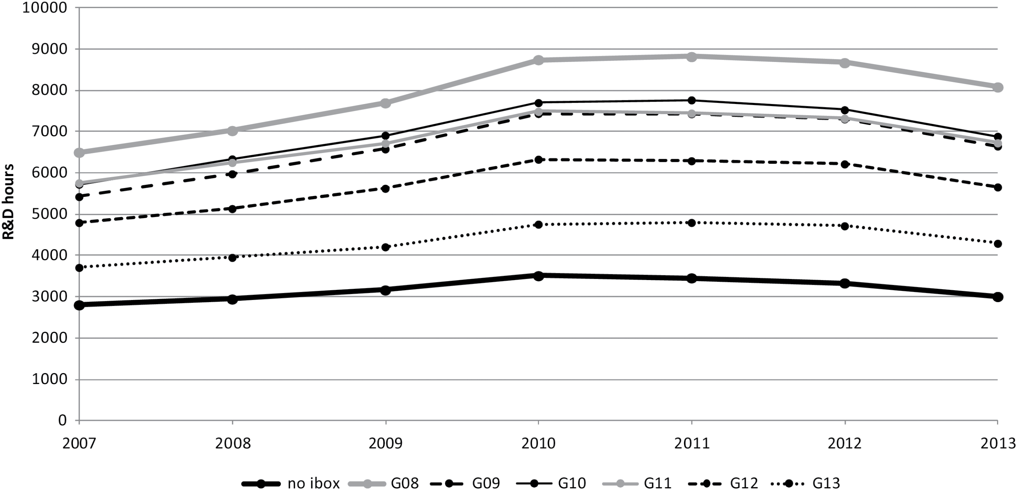
Figure 1: Estimated differences between generations of users and non-users of the innovation box policy
Notes:
Figure 1: Estimated differences between generations of users and non-users of the innovation box policy
Unless provided in the caption above, the following copyright applies to the content of this slide: © The Authors 2017. Published by Oxford University Press. For permissions please e-mail: journals.permissions@oup.com

Slide 2
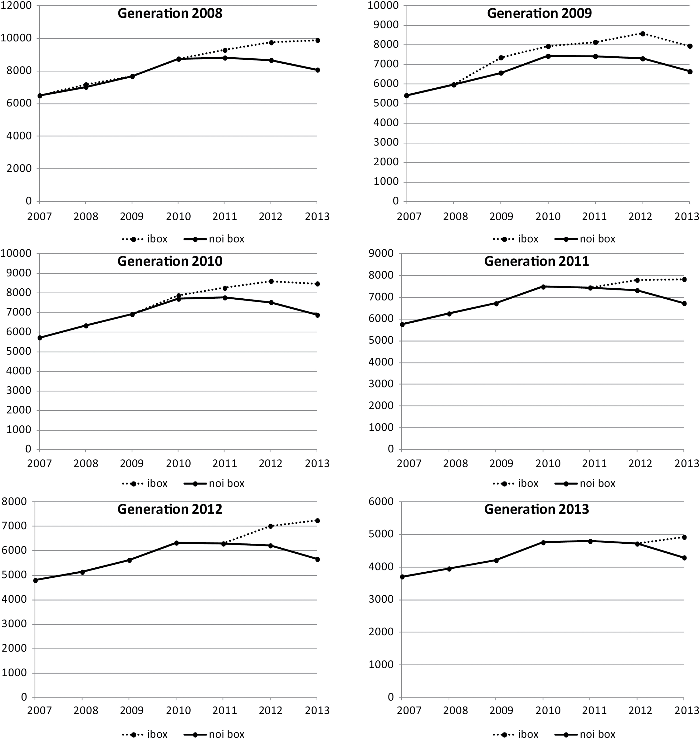
Figure 2: Innovation box effects on different user generations against the benchmark of no use, ...
Notes:
Figure 2: Innovation box effects on different user generations against the benchmark of no use, difference-in-differences estimations (R&D hours on the vertical axis of each figure)
Unless provided in the caption above, the following copyright applies to the content of this slide: © The Authors 2017. Published by Oxford University Press. For permissions please e-mail: journals.permissions@oup.com

