Slide 1
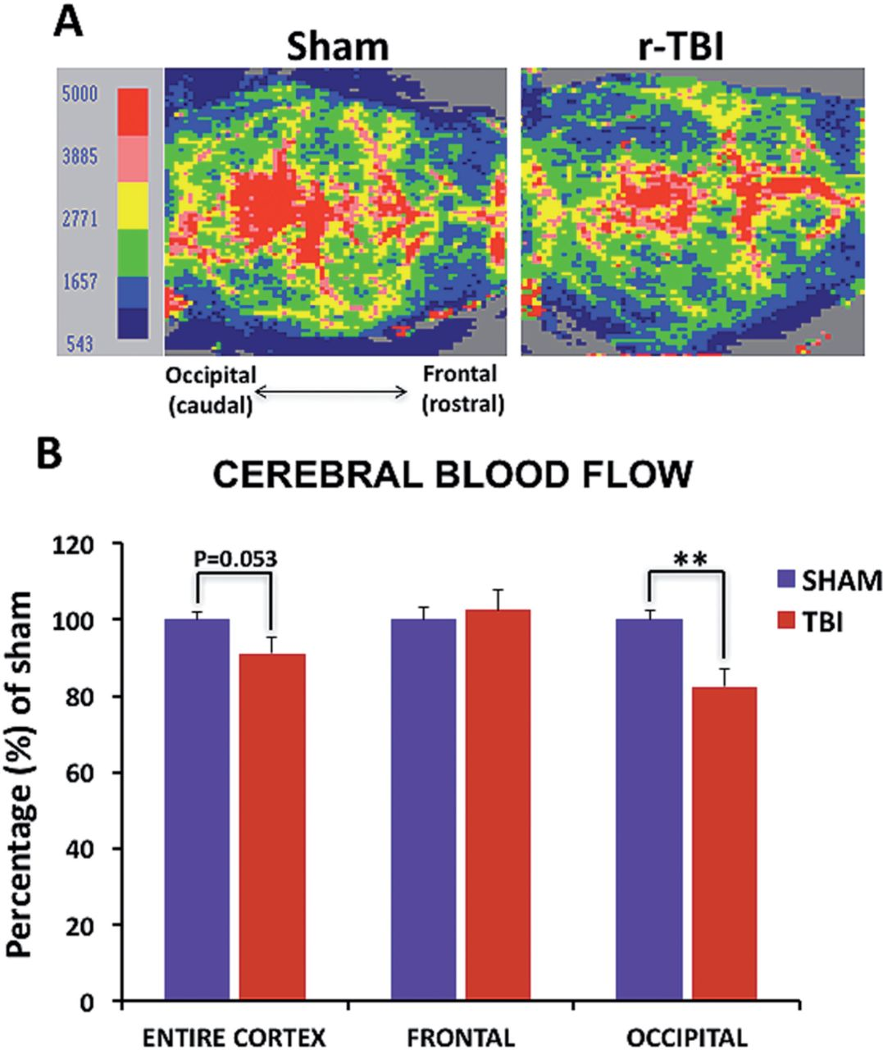
FIGURE 1 Cerebral blood flow in an hTau mouse model of chronic repeated traumatic brain injury (r-TBI). (A) ...
Notes:
FIGURE 1 Cerebral blood flow in an hTau mouse model of chronic repeated traumatic brain injury (r-TBI). (A) Two-dimensional color-coded cerebral microvascular blood flow maps recorded using the laser Doppler imager show flow data representing variation of regional blood flow in the cortex of sham and injured animals. (B) Quantitative analysis of mean cerebral blood flow, obtained from 6 measurements per animal, demonstrates significant reduction in the occipital cortex of injured compared with sham animals and a trend towards decrease in the entire cortex, with no change observed in the frontal cortex. Data are presented as percentage of sham. Blood flow velocity was visualized as a 2-dimensional color-coded map, and expressed in an arbitrary perfusion unit as cerebral blood flow flux. N = 6 (injured) or 8 (shams); **p < 0.01.
Unless provided in the caption above, the following copyright applies to the content of this slide: © 2016 American Association of Neuropathologists, Inc. All rights reserved.

Slide 2
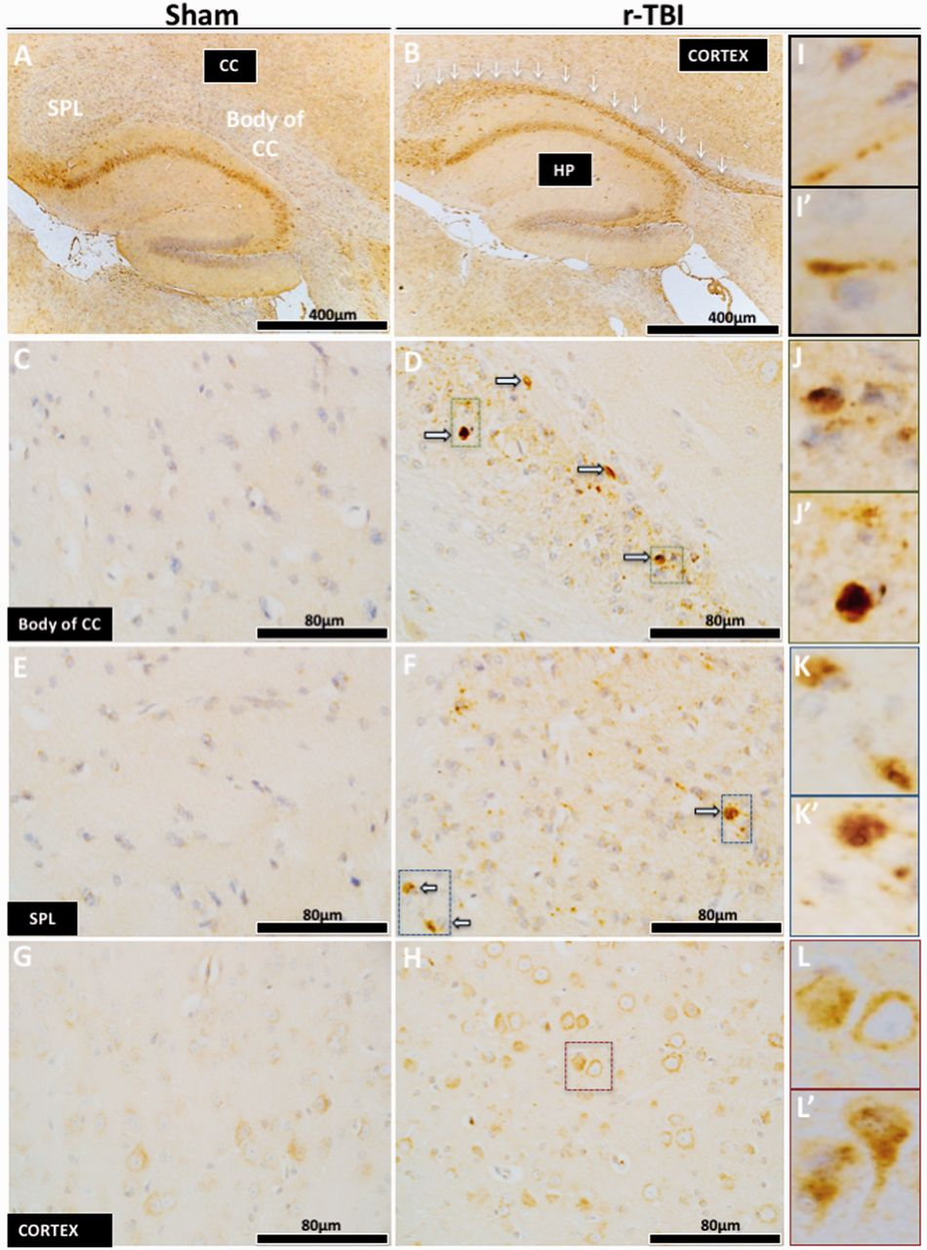
FIGURE 2 Axonal injury in an hTau mouse model of chronic repeated traumatic brain injury (r-TBI). (A–L′) ...
Notes:
FIGURE 2 Axonal injury in an hTau mouse model of chronic repeated traumatic brain injury (r-TBI). (A–L′) Immunohistochemical staining for amyloid precursor protein ([APP] axonal injury) demonstrated an increase in the corpus callosum (white arrows) versus sham; this was localized within the body (C, D) and the splenium (E, F) of the corpus callosum. High-power micrographs show APP accumulation along the length of damaged axons (I, I′) , and in axonal bulbs or swellings (J, J′, K, K′) throughout the entire length of the corpus callosum of injured animals. Increased APP staining was observed in the cell body of pyramidal neurons in layer III of the parietal cortex of injured versus sham animals (G, H) . High-power micrograph (L, L′) shows increase APP staining in the cell body and dendrites of injured neurons. CC, corpus callosum; HP, hippocampus; SPL, splenium.
Unless provided in the caption above, the following copyright applies to the content of this slide: © 2016 American Association of Neuropathologists, Inc. All rights reserved.

Slide 3
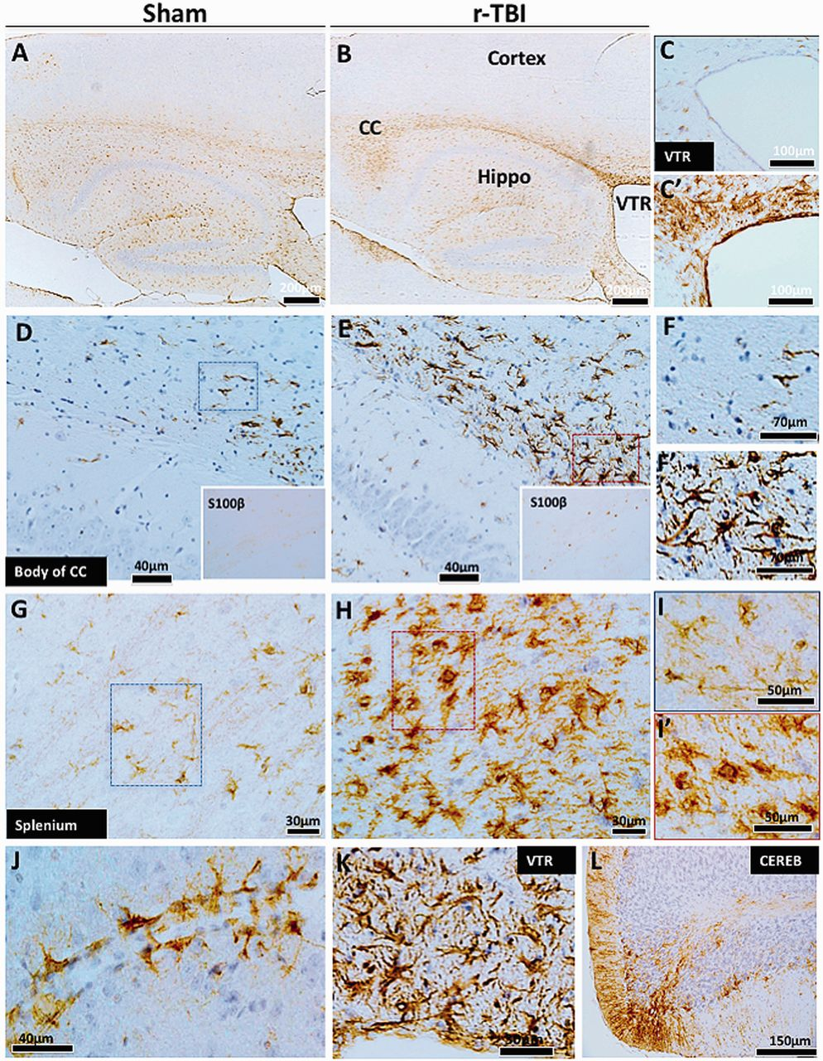
FIGURE 3 Astrogliosis in an hTau mouse model of chronic repeated traumatic brain injury (r-TBI). (A–L) . ...
Notes:
FIGURE 3 Astrogliosis in an hTau mouse model of chronic repeated traumatic brain injury (r-TBI). (A–L) . Immunohistochemical staining for GFAP (astrogliosis) demonstrates a dramatic increase along the length of the corpus callosum of injured animals compared with shams (A, B) . Astroglial activation was not present in the cortex of sham or injured animals (A, B) . White matter regions surrounding the ventricles also showed increased GFAP staining in the injured (C′) compared with sham animals (C) . There are hypertrophic astrocytes in the body (D, E) and splenium (G, H) of the corpus callosum of injured compared with sham animals. A parallel increase in astroglial marker S100ß was also observed in the cell body of astroglial cells in the corpus callosum of injured compared with sham animals (insets of D and E ). Hypertrophic astrocytes demonstrated large cell body and prominent thick processes in these regions ( F vs F′ , I vs I′ ). Prominent and hypertrophic perivascular astrocyte endfeet (strongly stained with GFAP) are seen along the length of small blood vessels in injured animals (J) . High-power micrograph of periventricular region is shown in (K) . GFAP staining was increased in the cerebellar molecular cell layer in injured animals (L) . CC, corpus callosum; VTR, ventricles; CEREB, cerebellum; Hippo, hippocampus.
Unless provided in the caption above, the following copyright applies to the content of this slide: © 2016 American Association of Neuropathologists, Inc. All rights reserved.

Slide 4
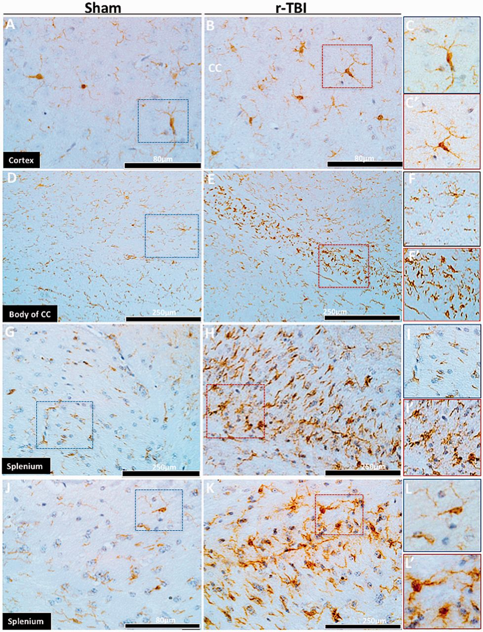
FIGURE 4 Microgliosis in an hTau mouse model of chronic repeated traumatic brain injury (r-TBI). (A–L′) ...
Notes:
FIGURE 4 Microgliosis in an hTau mouse model of chronic repeated traumatic brain injury (r-TBI). (A–L′) Immunohistochemical staining for Iba1 (microgliosis) demonstrated no differences in the cortex of sham and injured animals (A, B) . Microglial cells in the cortex had a quiescent morphology in both sham and injured animals (C, C′) . The body (D) and the splenium (E–K) of the corpus callosum showed marked immunostaining of Iba1 in injured animals (see body [C, D] and splenium [ E, F and J, K ] of the corpus callosum) compared with their sham counterparts. Higher-power micrographs of activated microglial cells demonstrate a prominent cell body and short thick processes in injured animals ( F vs F′ , I vs I′ , L vs L′ ). CC, corpus callosum.
Unless provided in the caption above, the following copyright applies to the content of this slide: © 2016 American Association of Neuropathologists, Inc. All rights reserved.

Slide 5
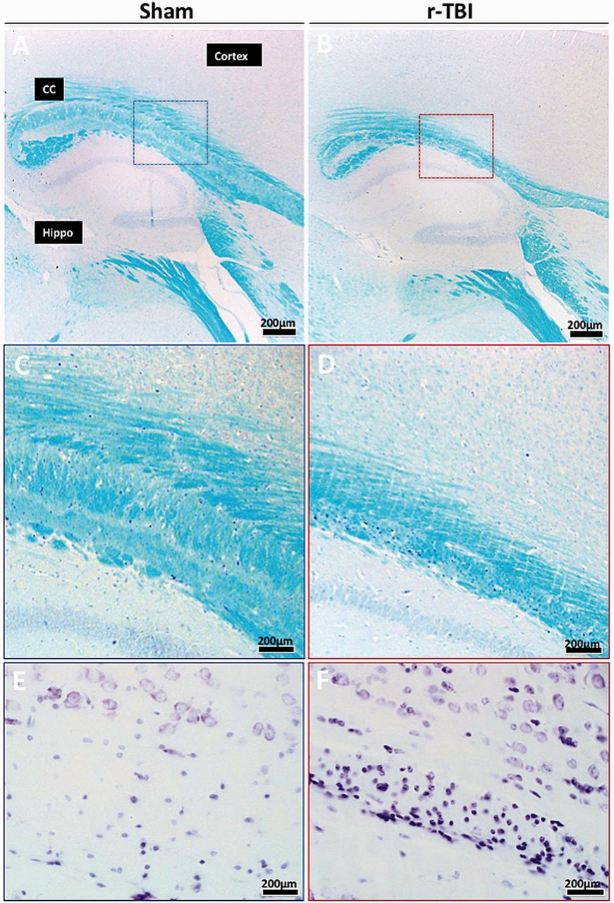
FIGURE 5 Luxol fast blue (LFB) and Cresyl violet staining in an hTau mouse model of chronic repeated traumatic brain ...
Notes:
FIGURE 5 Luxol fast blue (LFB) and Cresyl violet staining in an hTau mouse model of chronic repeated traumatic brain injury (r-TBI). (A–D) LFB stain shows thinning of the corpus callosum in the injured (r-TBI) compared with sham animal; staining intensity appears similar in both sham and injured animals. (E, F) Cresyl violet staining shows a marked increase in cellularity within this region in injured compared with sham animals. CC, corpus callosum; Hippo, hippocampus. Panels (C)–(F) are higher-magnification images of the areas in the boxes in panels (A) and (B).
Unless provided in the caption above, the following copyright applies to the content of this slide: © 2016 American Association of Neuropathologists, Inc. All rights reserved.

Slide 6
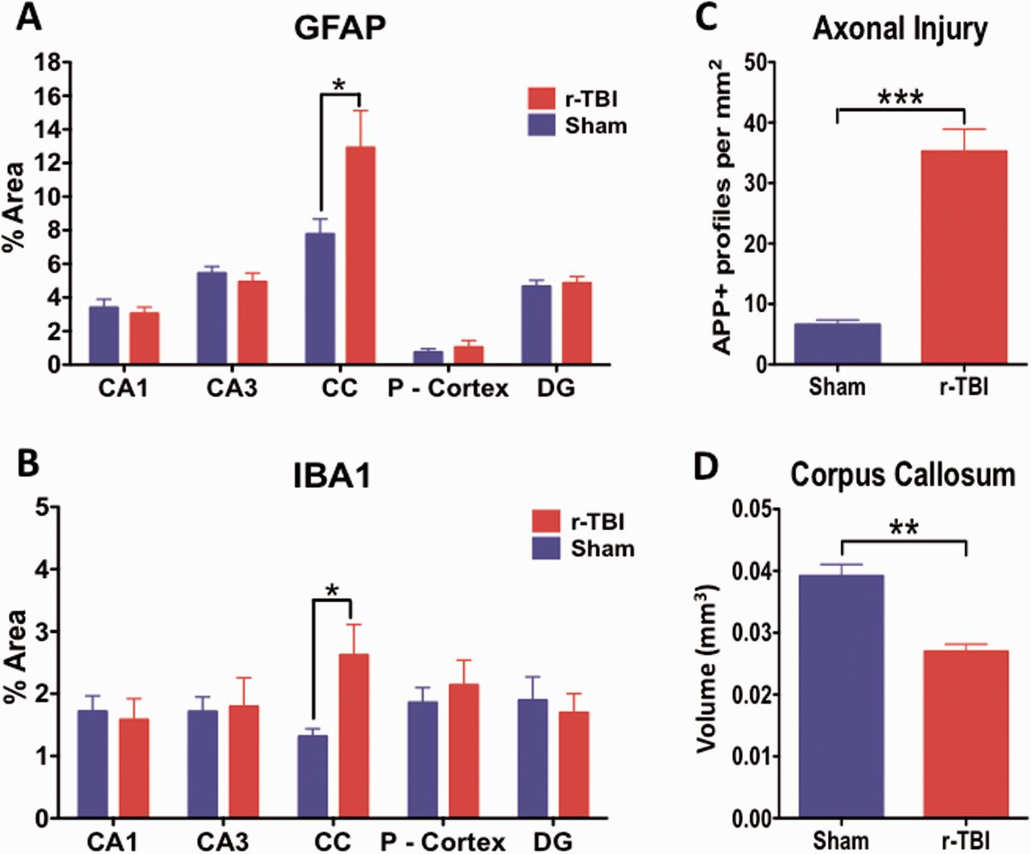
FIGURE 6 Quantitative assessment of GFAP, Iba1, and APP immunostaining and corpus callosum volume in an hTau mouse ...
Notes:
FIGURE 6 Quantitative assessment of GFAP, Iba1, and APP immunostaining and corpus callosum volume in an hTau mouse model of chronic repeated traumatic brain injury (r-TBI). GFAP and Iba1 immunostaining are significantly upregulated in the corpus callosum of injured (r-TBI) vs. sham animals (A, B) . No changes in GFAP or Iba1 were observed in other regions (gray matter) analyzed ( A, B ). (C) APP-positive spherical profiles in the corpus callosum were increased by ∼6-fold in the corpus callosum of injured versus sham animals. (D) The volume of the subregion of the corpus callosum bound by bregma (−0.36 to − 0.72 mm lateral) was significantly reduced by ∼30% in injured versus sham animals. N = 6 (sham/injured) for (A)–(C) and n = 4 (sham/injured) for (D) ; *p < 0.05; **p < 0.01; ***p < 0.001. CC, corpus callosum; P-Cortex, parietal cortex; DG, dentate gyrus.
Unless provided in the caption above, the following copyright applies to the content of this slide: © 2016 American Association of Neuropathologists, Inc. All rights reserved.

Slide 7
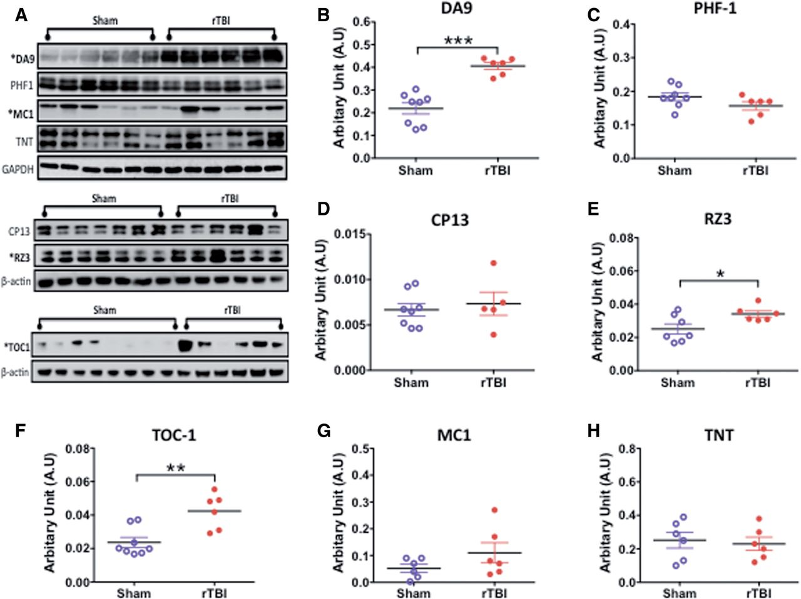
FIGURE 7 Quantitative assessment of total tau, pTau, and conformational tau species in gray matter by Western ...
Notes:
FIGURE 7 Quantitative assessment of total tau, pTau, and conformational tau species in gray matter by Western blotting in an hTau mouse model of chronic repeated traumatic brain injury (r-TBI). (A) Representative immunoblots for different tau antibodies. (B–H) Total tau (DA9), pTau Thr231 (RZ3), and tau oligomer (TOC-1) levels are significantly greater in injured compared with sham animals (B, E, F) . The conformational tau antibody MC1 raised against neurofibrillary tangles was marginally increased in injured animals compared with sham animals (G) . No changes were observed in pTau S396/404 (PHF1), pTau S202 (CP13), and tau-positive N-terminal phosphatase-activated domain (TNT) levels between sham and injured animals (C, D, H) . Data are expressed as ratio of GAPDH or ß-actin levels. N = 6–8 (sham/injured); *p < 0.05; **p < 0.01; ***p < 0.001.
Unless provided in the caption above, the following copyright applies to the content of this slide: © 2016 American Association of Neuropathologists, Inc. All rights reserved.

Slide 8
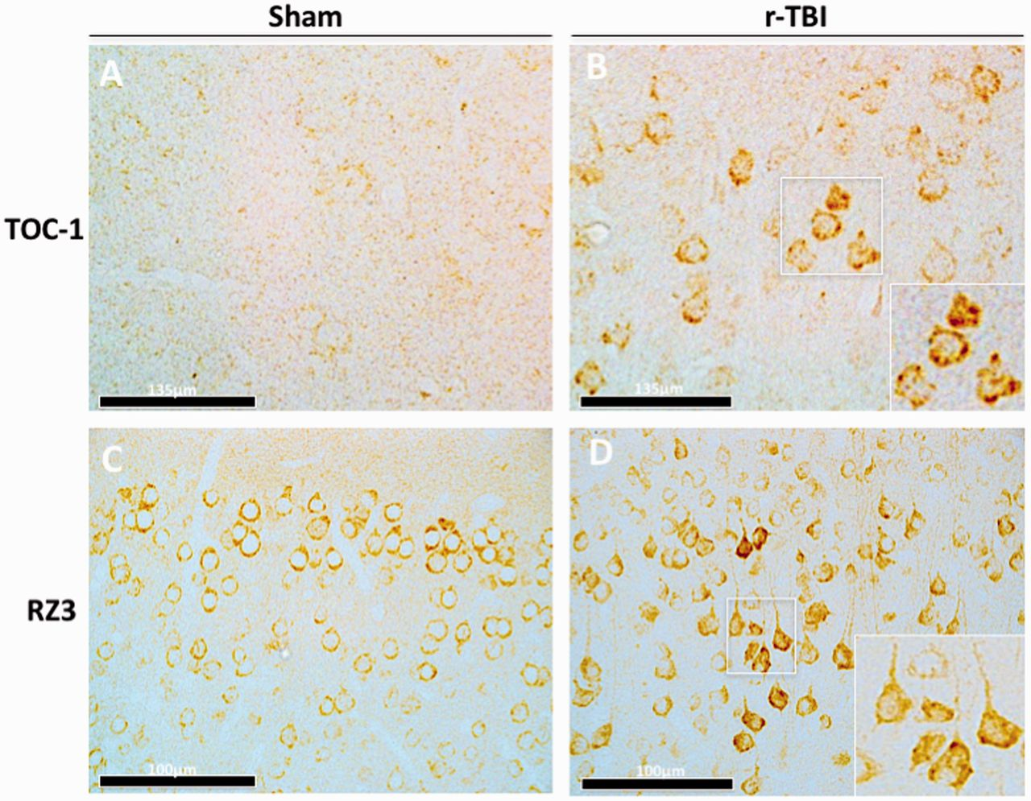
FIGURE 8 Immunohistochemical assessment of conformational tau antibody TOC1 and phosphorylated tau antibody RZ3 ...
Notes:
FIGURE 8 Immunohistochemical assessment of conformational tau antibody TOC1 and phosphorylated tau antibody RZ3 (pThr231) in an hTau mouse model of chronic repeated traumatic brain injury (r-TBI). (A, B) There is an increase in anti-TOC-1 immunostaining in the cortex of injured (r-TBI) compared with sham animals. (C, D) There was also an increase in pTau Thr231 (RZ3) immunostaining in pyramidal neurons in layers II-IV of the cortex of injured versus sham animals. High-power micrographs insets B and D were taken from injured animals (white boxes).
Unless provided in the caption above, the following copyright applies to the content of this slide: © 2016 American Association of Neuropathologists, Inc. All rights reserved.

Slide 9
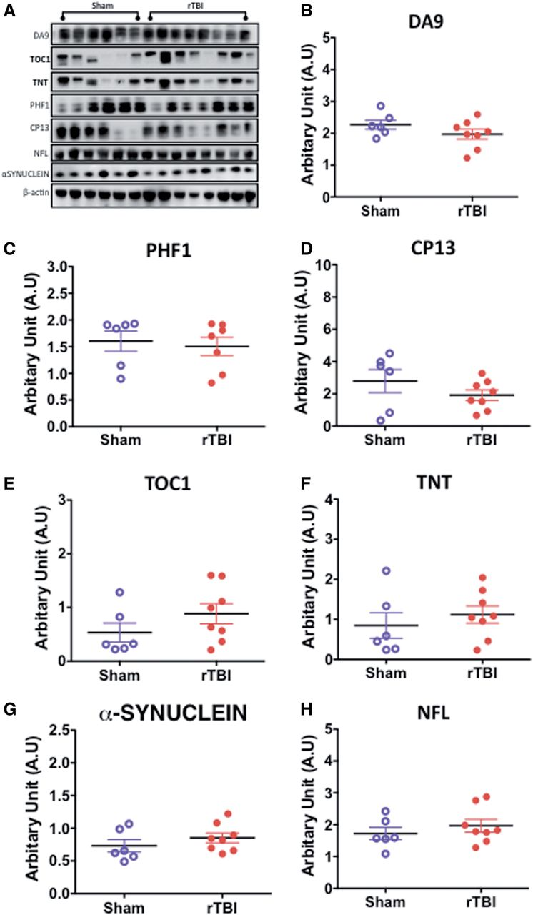
FIGURE 9 Quantitative assessment of total tau, pTau, conformational tau species, α-synuclein and neurofilament 200kda ...
Notes:
FIGURE 9 Quantitative assessment of total tau, pTau, conformational tau species, α-synuclein and neurofilament 200kda (NFL) in the white matter by Western blotting in an hTau mouse model of chronic repeated traumatic brain injury (r-TBI). (A–H) Representative immunoblots for different protein markers are shown in (A) . No changes were observed in total tau (DA9), pTau S202 (CP13), and tau-positive N-terminal phosphatase-activated domain (TNT) levels between sham and injured animals (B–D, F) . A marginally significant increase was observed in tau oligomer (TOC-1) levels in injured compared with sham animals (E) . No changes were observed in α-synuclein or neurofilament 200kda (NFL) levels between sham and injured animals (G, H) . Data are expressed as ratio of ß-actin or total protein levels. N = 6–8 (injured/sham).
Unless provided in the caption above, the following copyright applies to the content of this slide: © 2016 American Association of Neuropathologists, Inc. All rights reserved.

Slide 10
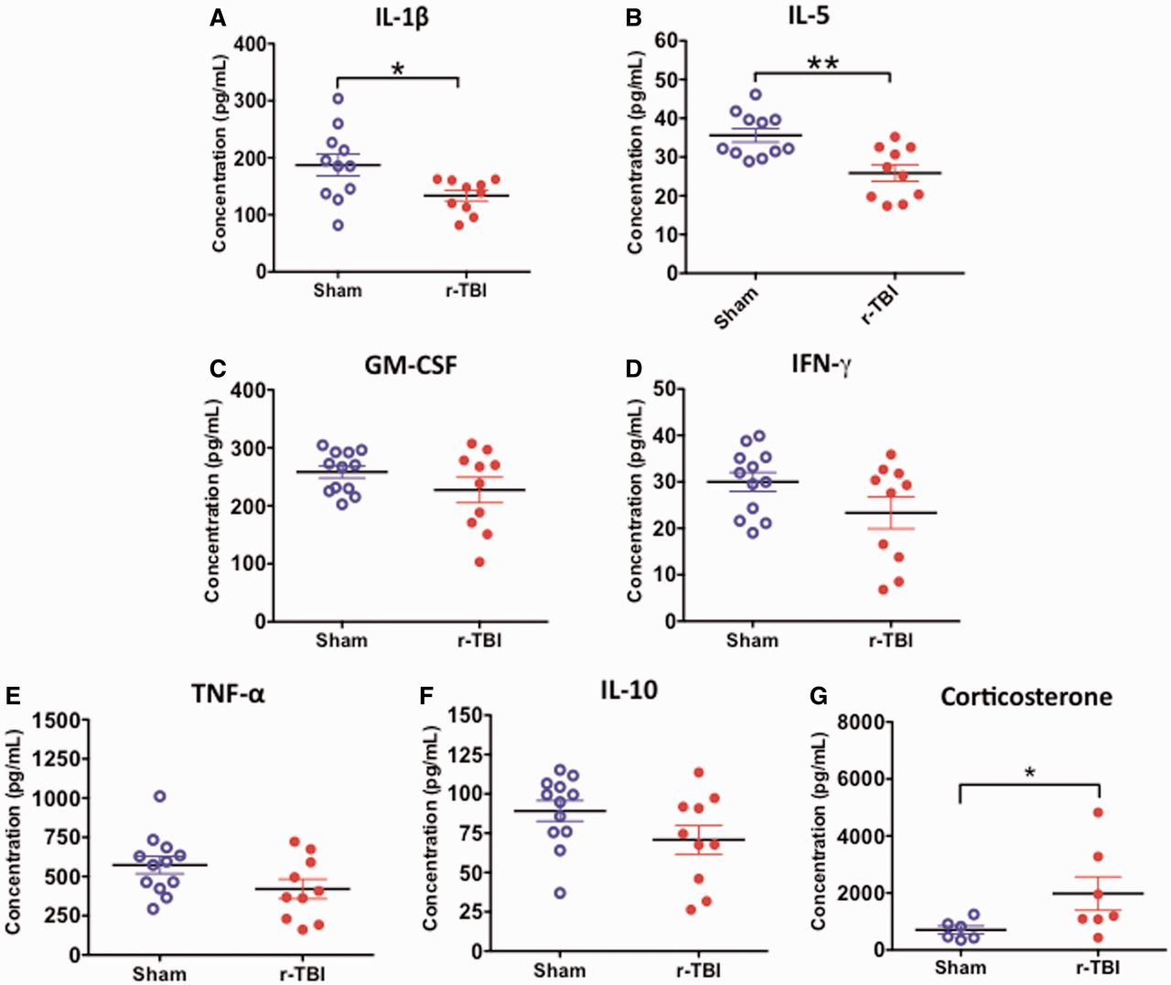
FIGURE 10 Inflammatory cytokine profile and corticosterone levels in the plasma in an hTau mouse model of chronic ...
Notes:
FIGURE 10 Inflammatory cytokine profile and corticosterone levels in the plasma in an hTau mouse model of chronic repeated traumatic brain injury (r-TBI). (A, B) There was a significant decrease in IL-1ß and IL-5 observed in the plasma of injured versus sham animals. (C–F) There was a trend toward decrease in GM-CSF, IFN-γ, TNF, and IL-10 in injured versus sham animals but these did not reach statistical significance. N = 10–12 (sham/injured). (G) There was a significant increase in corticosterone in the plasma of injured versus sham animals. N = 6–8 (sham/injured); *p < 0.05; **p < 0.01.
Unless provided in the caption above, the following copyright applies to the content of this slide: © 2016 American Association of Neuropathologists, Inc. All rights reserved.

