Slide 1
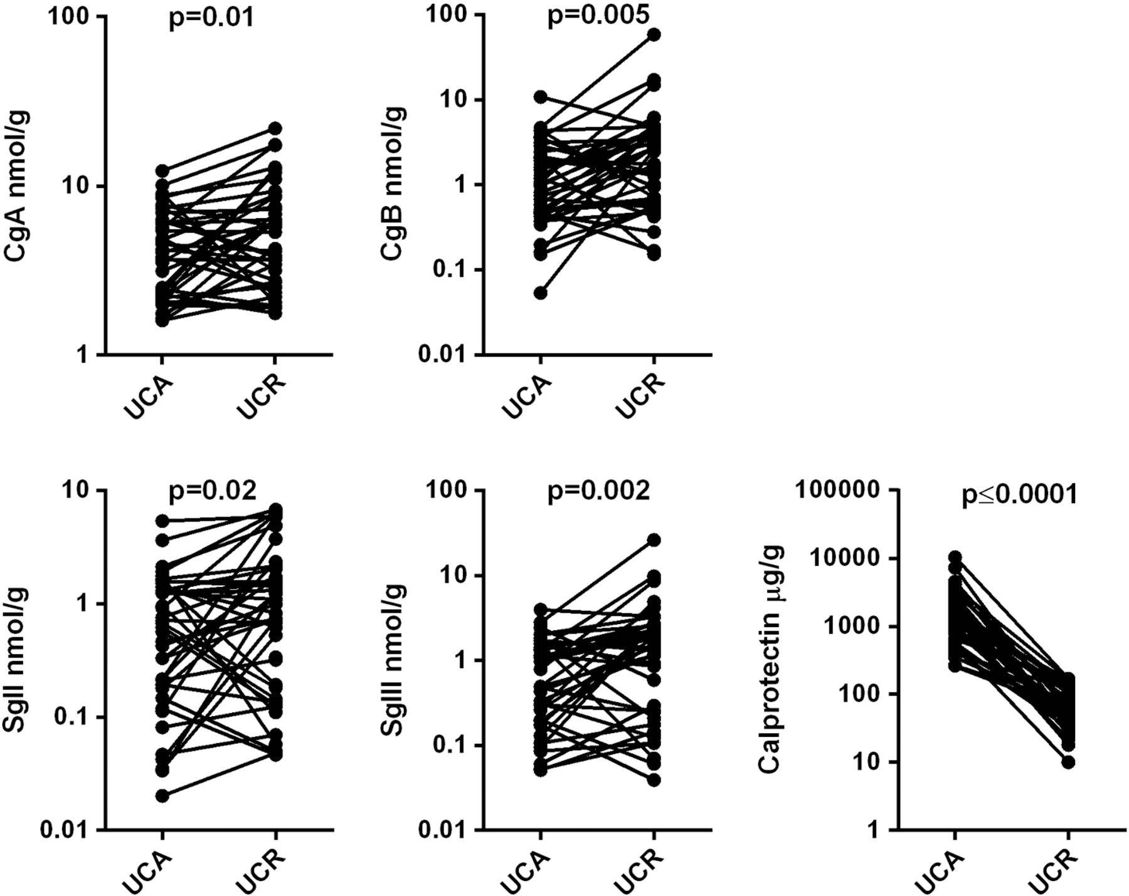
Figure 1 Baseline IBDQ scores, with median, 25th and 75th percentiles indicated (middle, lower, and upper horizontal ...
Notes:
Figure 1 Baseline IBDQ scores, with median, 25th and 75th percentiles indicated (middle, lower, and upper horizontal lines, respectively), for CLASSIC I, CHARM, and EXTEND. Dotted line at IBDQ = 135 indicates threshold for severely impaired quality of life.
Unless provided in the caption above, the following copyright applies to the content of this slide: © 2013 European Crohn's and Colitis Organisation

Slide 2
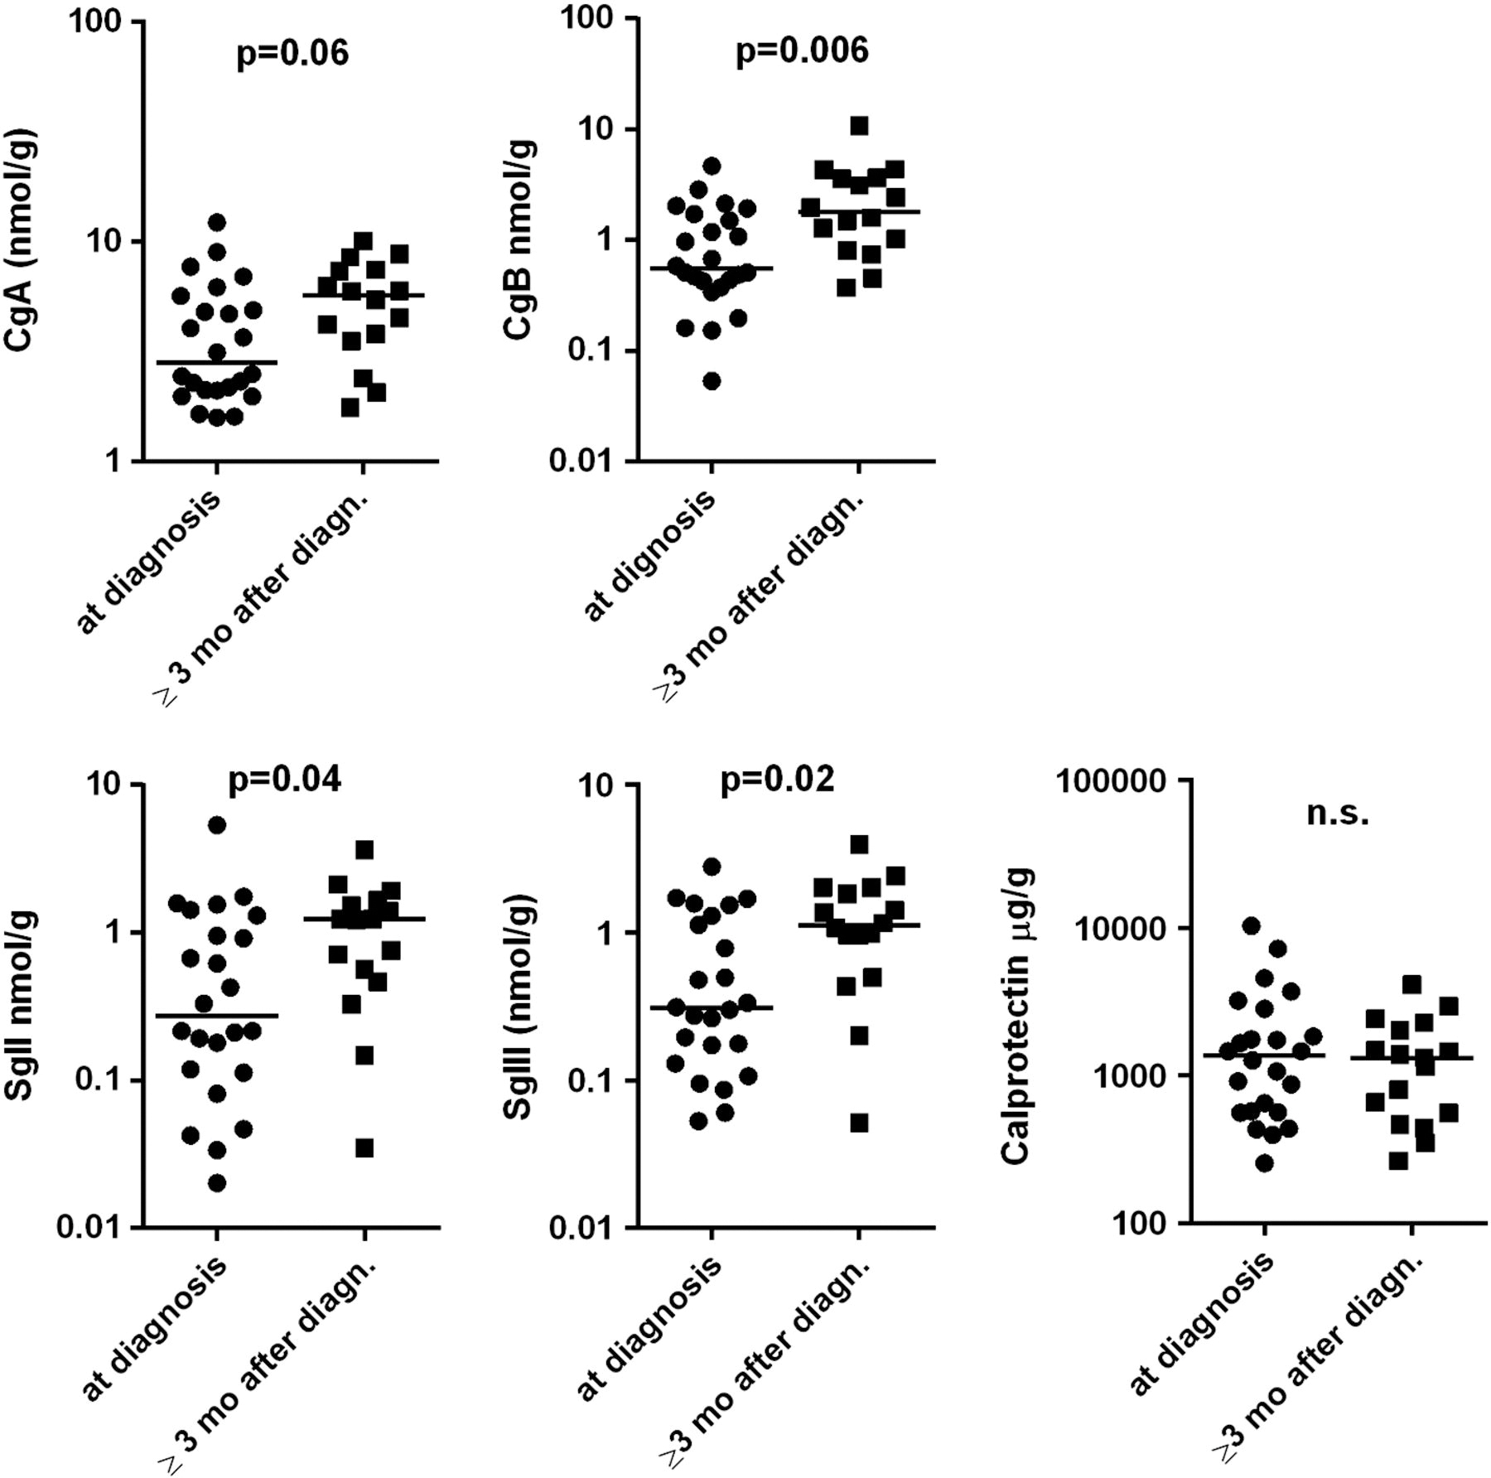
Figure 2 Mean (SD) CDAI over time in placebo subgroups of CHARM (LOCF after week 4).
Notes:
Figure 2 Mean (SD) CDAI over time in placebo subgroups of CHARM (LOCF after week 4).
Unless provided in the caption above, the following copyright applies to the content of this slide: © 2013 European Crohn's and Colitis Organisation

Slide 3
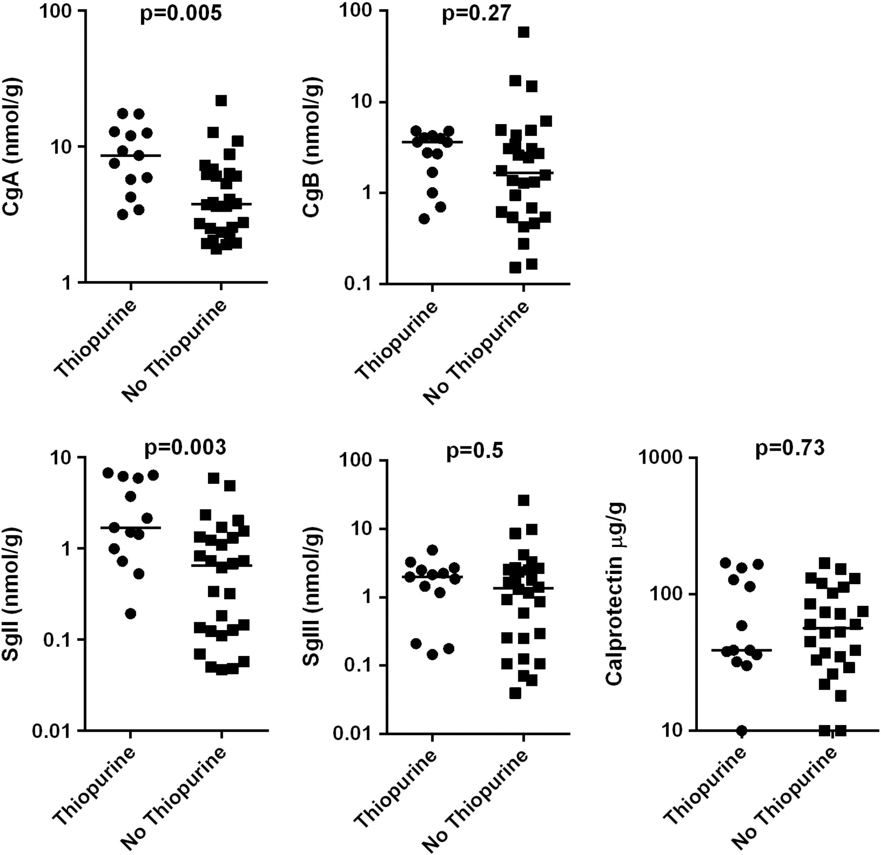
Figure 3 Kaplan–Meier plot for time to CD-related hospitalization in the double-blind period, placebo group only, by ...
Notes:
Figure 3 Kaplan–Meier plot for time to CD-related hospitalization in the double-blind period, placebo group only, by baseline CDAI and baseline CRP.
Unless provided in the caption above, the following copyright applies to the content of this slide: © 2013 European Crohn's and Colitis Organisation

Slide 4
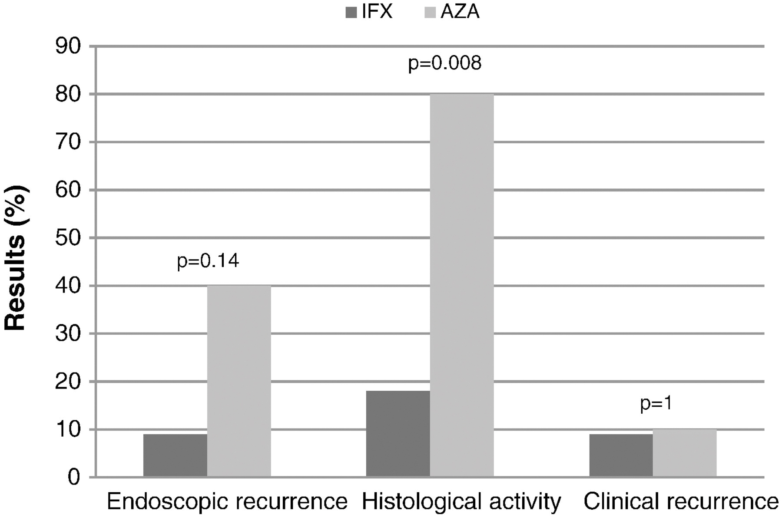
Figure 4 Clinical remission at week 4 in CLASSIC I: A) by baseline Crohn's disease activity, and B) by baseline CRP in ...
Notes:
Figure 4 Clinical remission at week 4 in CLASSIC I: A) by baseline Crohn's disease activity, and B) by baseline CRP in patients with moderate Crohn's disease.
Unless provided in the caption above, the following copyright applies to the content of this slide: © 2013 European Crohn's and Colitis Organisation

Slide 5
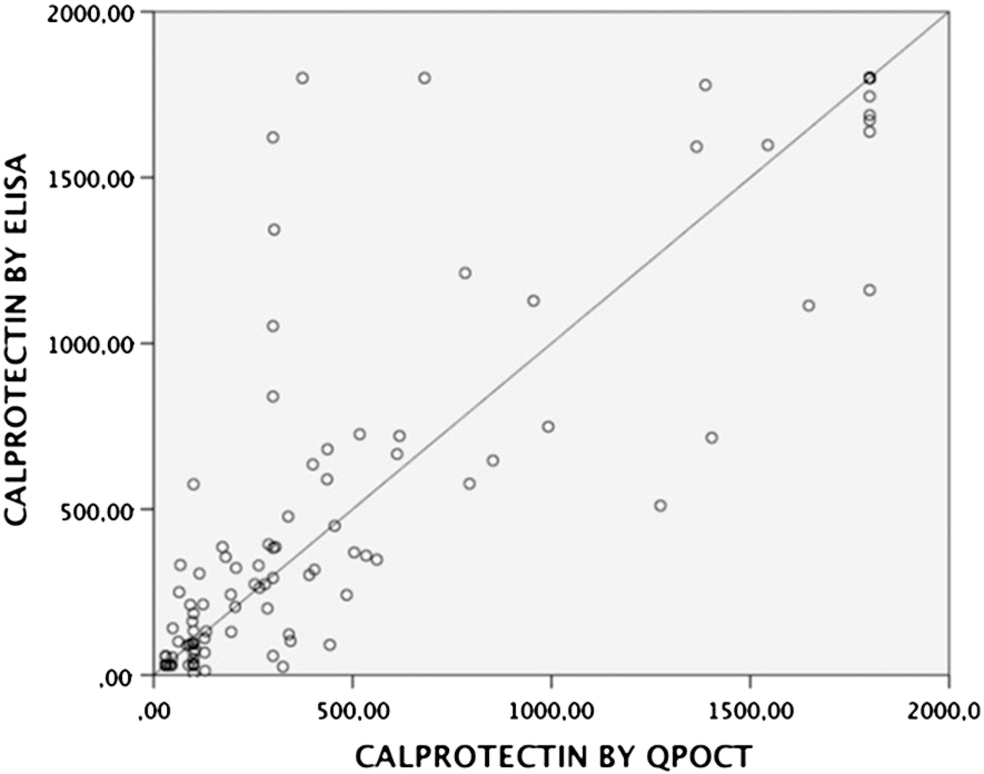
Figure 5 Clinical remission at week 56 (CHARM) or week 52 (EXTEND): A) by baseline Crohn's disease activity, and B) by ...
Notes:
Figure 5 Clinical remission at week 56 (CHARM) or week 52 (EXTEND): A) by baseline Crohn's disease activity, and B) by baseline CRP in patients with moderate Crohn's disease. Placebo and ADA eow groups include CHARM and EXTEND pooled data; ADA weekly group is from CHARM only.
Unless provided in the caption above, the following copyright applies to the content of this slide: © 2013 European Crohn's and Colitis Organisation

