Slide 1
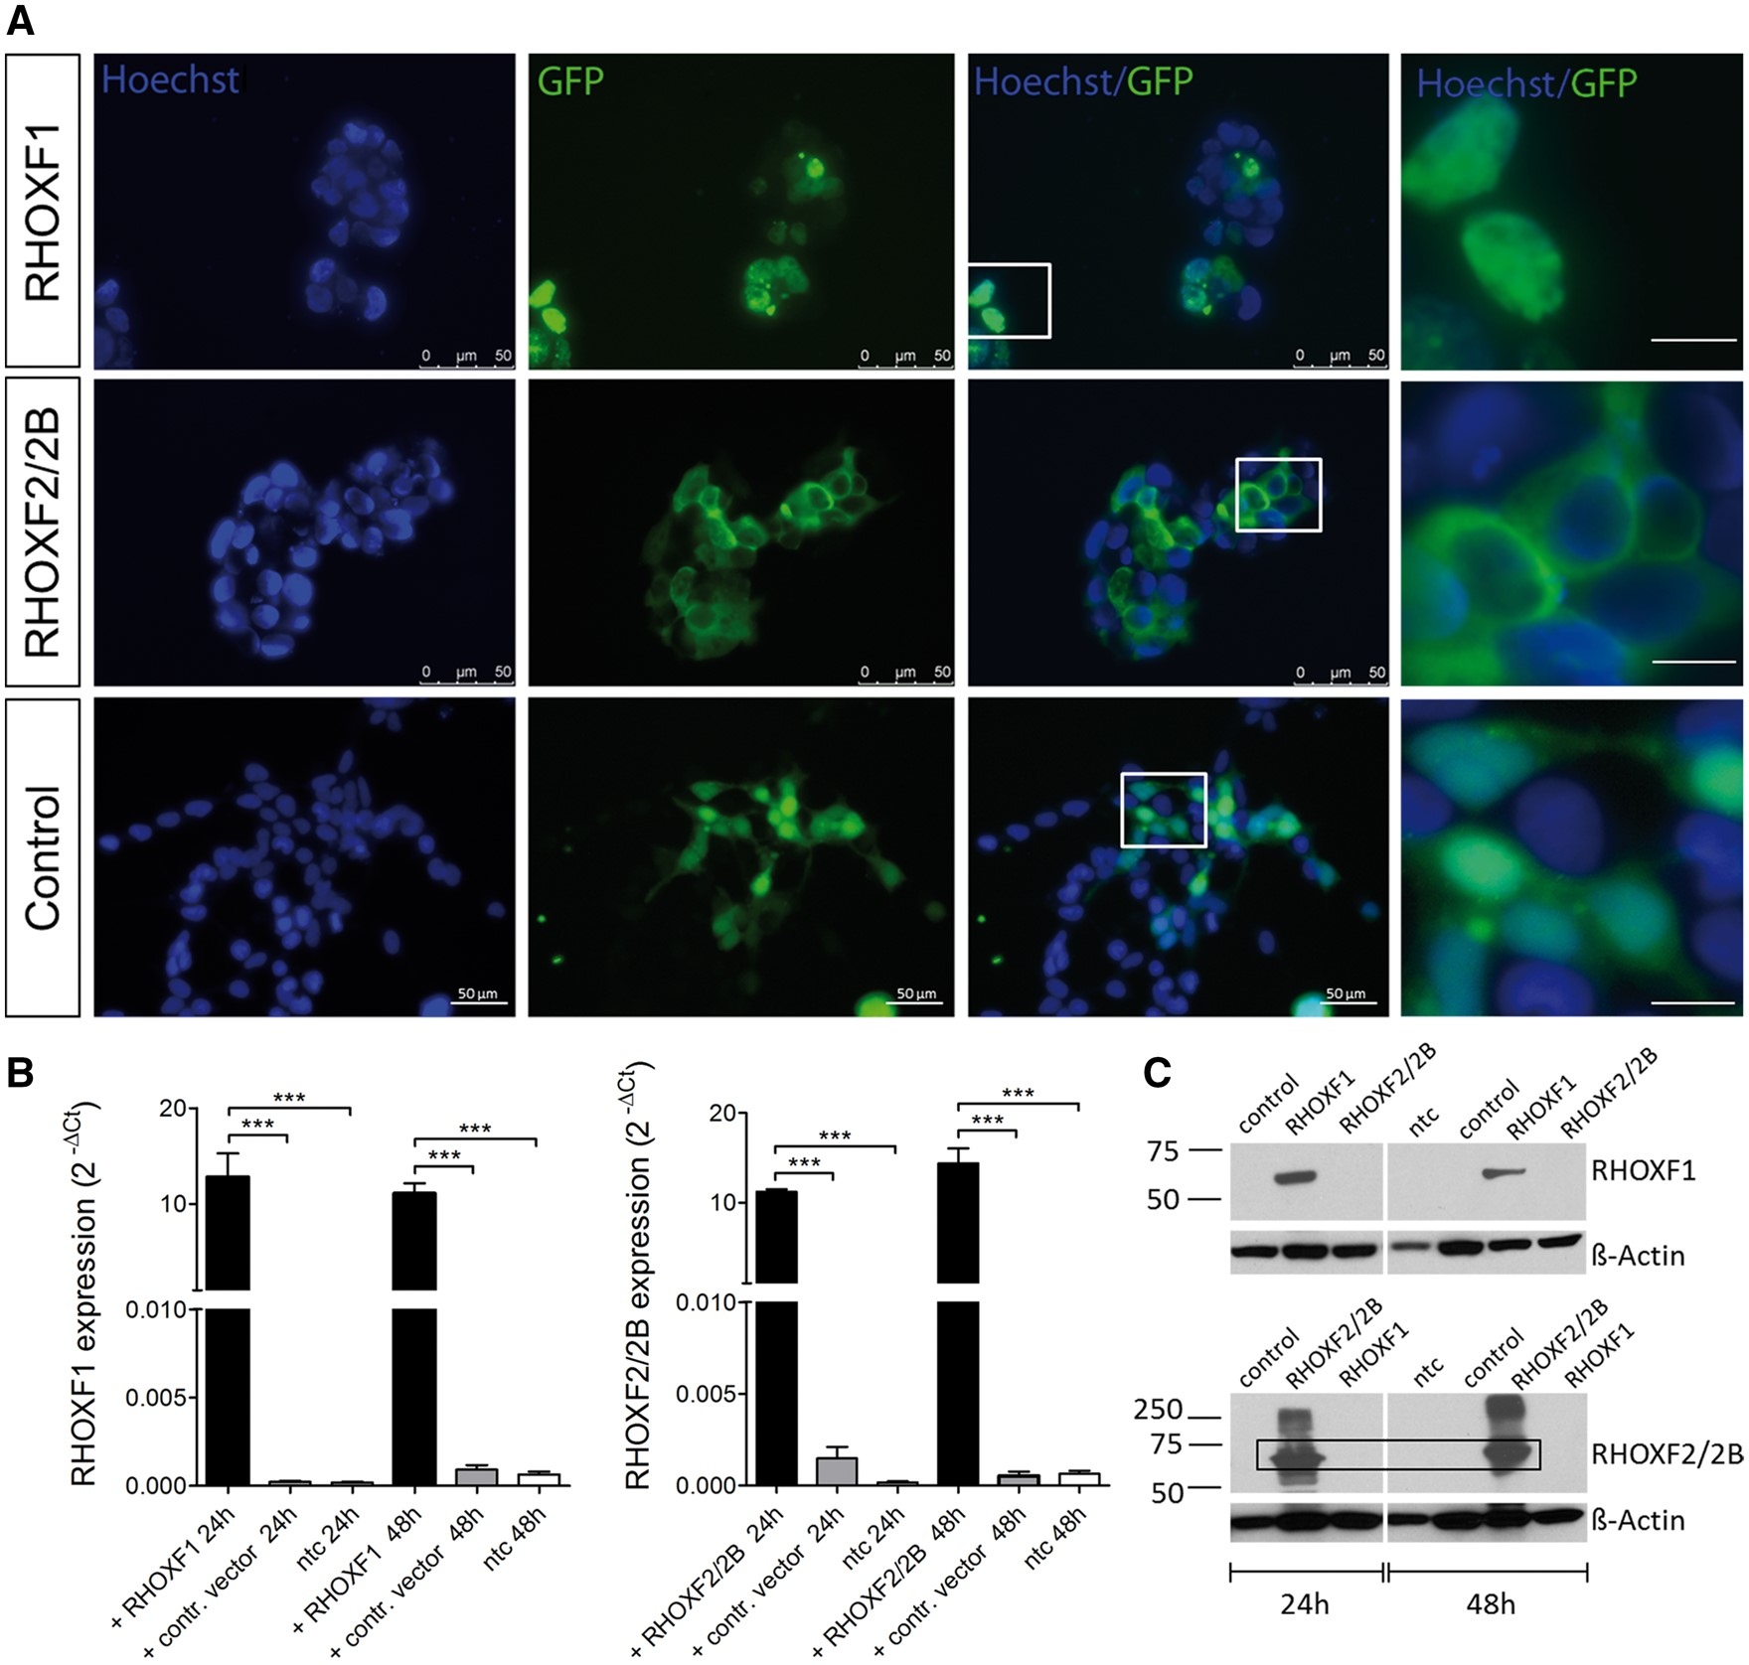
Figure 1. RHOX expression in transiently transfected HEK293 cells. (A) Immunofluorescent imaging of HEK293 cells 48h ...
Notes:
Figure 1. RHOX expression in transiently transfected HEK293 cells. (A) Immunofluorescent imaging of HEK293 cells 48h after transfection. GFP signal reflects RHOX expression while nuclei were counterstained with Hoechst. Scale bar: 10 µm (right row). (B) RHOX expression after 24h and 48h of transfection (n = 8). Total RNA was isolated, reverse transcribed, and amplified with specific primers. Values were normalized to endogenous GAPDH. ***P < 0.001. (C) Western Blot analysis of RHOX after 24h and 48h of transfection.
Unless provided in the caption above, the following copyright applies to the content of this slide: © The Author 2016. Published by Oxford University Press. All rights reserved. For Permissions, please email: journals.permissions@oup.com

Slide 2
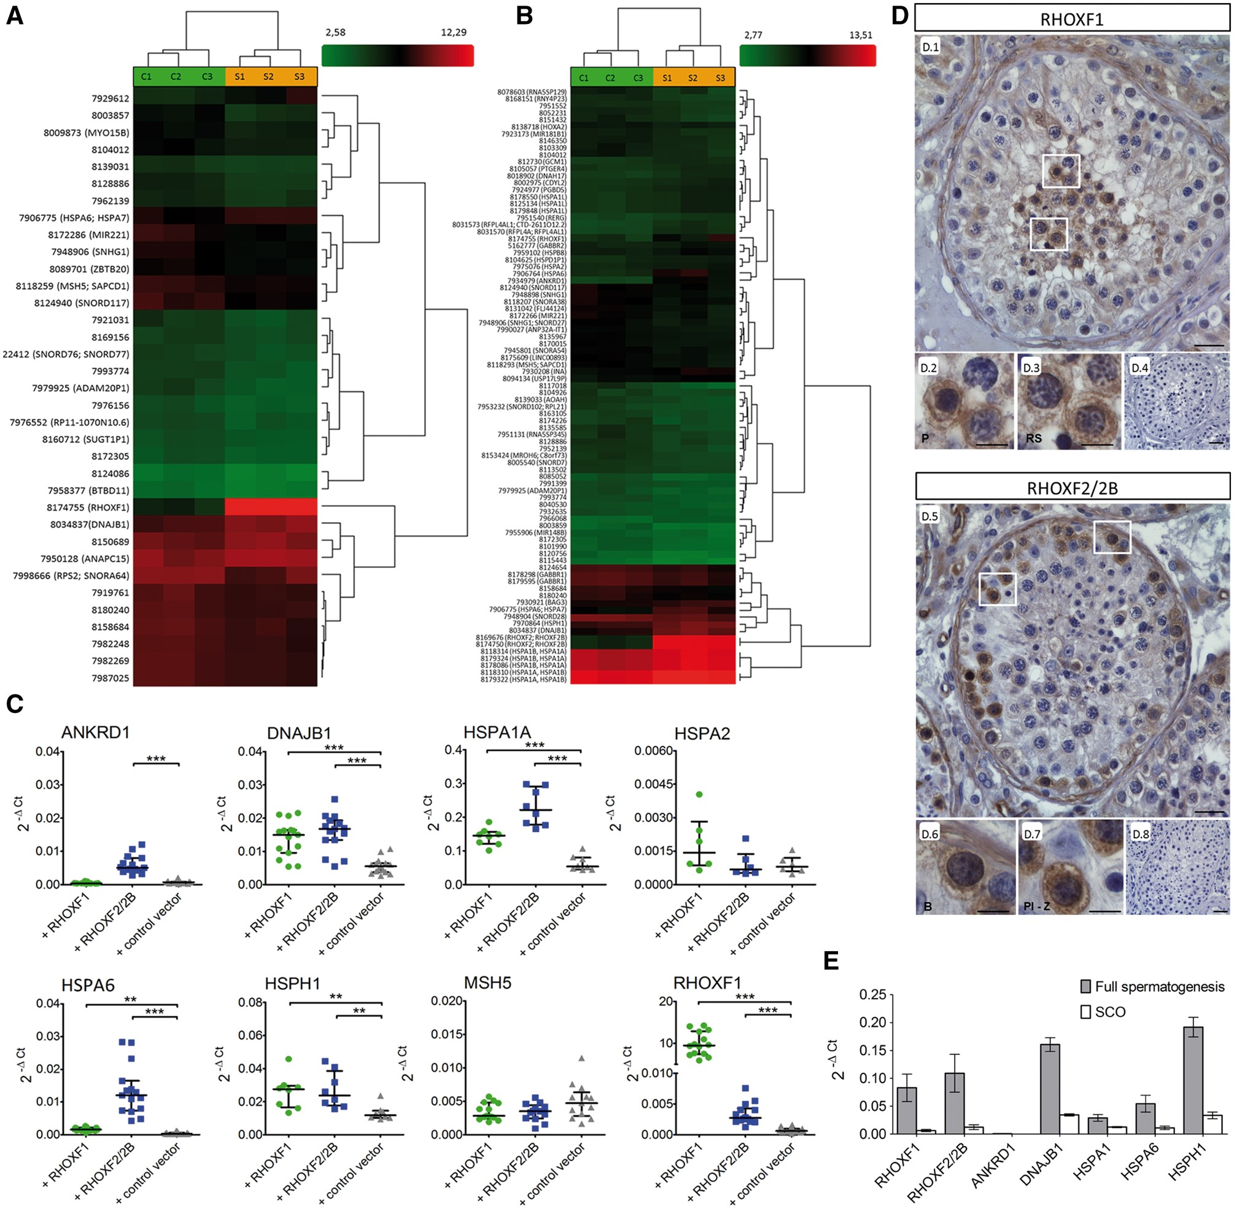
Figure 2. Identification of genes regulated by the RHOX gene cluster. Heat map of RHOXF1 (A) and RHOXF2/2B (B) ...
Notes:
Figure 2. Identification of genes regulated by the RHOX gene cluster. Heat map of RHOXF1 (A) and RHOXF2/2B (B) differentially expressed genes (DEGs) after 48h of transfection. Each column represents individual samples (S: RHOX transfected samples, C: control vector transfected samples), each row shows a single gene and expression levels were indicated by a color scale (red: high expression, green: low expression). (C) Analysis of DEGs by qRT-PCR. After different transfections with RHOX, mRNA expression levels of MSH5 (n = 15), ANKRD1 (n = 15), DNAJB1 (n = 15), HSPA1A (n = 8), HSPA2 (n = 6), HSPA6 (n = 15), HSPH1 (n = 8) and RHOXF1 (n = 15) were measured and normalized to GAPDH. The data are represented as median and interquartile range. **P < 0.01, ***P < 0.001. (D) Immunohistological analysis of RHOX in men with normal spermatogenesis. Pachytene spermatocytes and round spermatids showed positive staining for RHOXF1 (D.1–D.3), while type B spermatogonia and preleptotene – zygotene spermatocytes were predominantly stained with RHOXF2/2B specific antibody (D.5–D.7). IgG controls were negative (D.4, D.8). B, type B spermatogonia; P, pachytene spermatocytes; Pl-Z, preleptotene – zygotene spermatocytes; RS, round spermatids. Scale bar: 50 μm (D.1, D.4, D.5, D.8) and 25 μm (D.2, D.3, D.6, D.7). (E) Expression of RHOX regulated genes in testis with normal spermatogenesis (grey, n = 3) and in testis with SCO (white; n = 3). Data are presented as mean with SEM. Protein coding differently expressed genes (DEGs) in RHOX transfected cells compared to control vector transfected cells. A threshold of fold change (FC) ≥1.5 and P-value ≤0.05 was used to identify DEGs. RHOXF1RHOXF2/2BGeneDescriptionFCP-valueGeneDescriptionFCP-valueDNAJB1DnaJ (Hsp40) homolog, subfamily B, member 11,970,003801ANKRD1ankyrin repeat domain 15,630,001485HSPA6/A7heat shock 70kDa protein 61,810,017932HSPA6heat shock 70kDa protein 64,640,018291ANAPC15anaphase promoting complex subunit 151,550,037242RHOXF1Rhox homeobox family, member 13,310,049385SLITRK3SLIT and NTRK-like family, member 31,520,021905DNAJB1DnaJ (Hsp40) homolog, subfamily B, member 12,730,002394TCL6f4T-cell leukaemia/lymphoma 6 ORF105−1,50,02937HSPH1heat shock 105kDa/110kDa protein 12,030,002656BTBD11BTB (POZ) domain containing 11−1,50,019466RFPL4Aret finger protein-like 4A1,940,002071MSH5mutS homolog 5−1,50,009626HSPA1Lheat shock 70kDa protein 1-like1,840,046973ZBTB20zinc finger and BTB domain containing 20−1,60,009686INAinternexin neuronal intermediate filament protein, alpha1,740,031778HSPA1Aheat shock 70kDa protein 1A1,70,002545DNAH17dynein, axonemal, heavy chain 171,680,027365HSPA1Bheat shock 70kDa protein 1B1,680,002698GABBR2gamma-aminobutyric acid (GABA) B receptor, 21,670,044556BAG3BCL2-associated athanogene 31,640,019302PGBD5piggyBac transposable element derived 51,630,006543HSPB8heat shock 22kDa protein 81,610,030736GCM1glial cells missing homolog 11,60,006529RERGRAS-like, oestrogen-regulated, growth inhibitor1,570,046276USP17Lubiquitin specific peptidase 17-like1,570,049222PTGER4prostaglandin E receptor 4 (subtype EP4)1,550,042114HSPA2heat shock 70kDa protein 21,540,018599CDYL2chromodomain protein, Y-like 21,520,024896HOXA2homeobox A2−1,50,047907ZFP92ZFP92 zinc finger protein−1,60,030135SPRR2Dsmall proline-rich protein 2D−1,60,032626LCE1Blate cornified envelope 1B−1,60,01887GABBR1gamma-aminobutyric acid (GABA) B receptor, 1−1,60,031487MSH5mutS homolog 5−1,60,031154CES1carboxylesterase 1−1,60,00629MROH6maestro heat-like repeat family member 6−1,60,012475AOAHacyloxyacyl hydrolase (neutrophil)−1,80,031603
Unless provided in the caption above, the following copyright applies to the content of this slide: © The Author 2016. Published by Oxford University Press. All rights reserved. For Permissions, please email: journals.permissions@oup.com

Slide 3
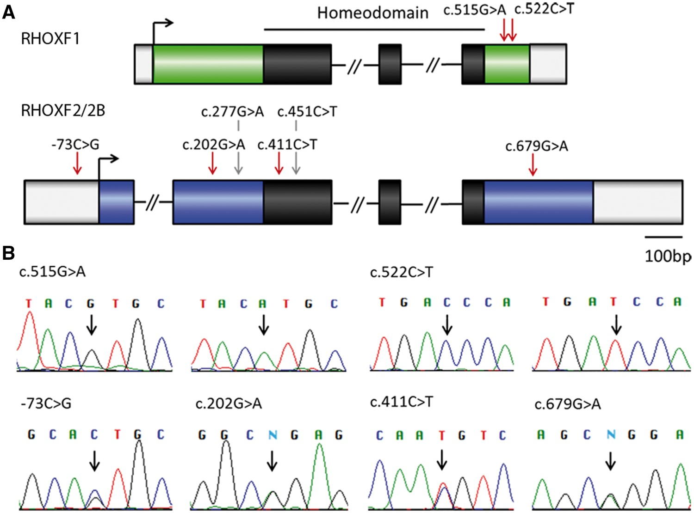
Figure 3. Genetic variants identified in RHOX genes in men with severe oligozoospermia. (A) Location of identified ...
Notes:
Figure 3. Genetic variants identified in RHOX genes in men with severe oligozoospermia. (A) Location of identified variants within RHOX gene structure. The homeodomain is shown in black, mutations are marked with red arrows and SNPs with grey arrows. (B) Chromatograms obtained from Sanger sequencing validate the mutations found by IonTorrent sequencing. For RHOXF1 c.515G > A and c.522C > T wild type sequence (left) and mutated sequence (right) are shown. In case of mutations -73C > G, c.202G > A, c.411C > T, and c.679G > A only one of the two RHOXF2 copies is affected resulting in a double peak at these positions. N = ambiguous call. RHOX mutations identified in 250 severe oligozoospermic patients. A list of all mutations (MAF ANon-synonymousp.Arg172His1/250(0.004)0/174rs23019770.0001/0.0002benign (0.001)/tolerated (0.025)noyes (weak)c.522C>TSynonymousp.Asp174Asp1/250(0.004)0/174ExAC0.003/0.008NAnontRHOXF2/2Bc.-73C>G5‘UTR1/250(0.004)noNANAntntc.202G>ANon-synonymousp.Gly68Arg2/250(0.008)2/174 (0.01)rs1486041520.008/0.005probably damaging (0.956)/tolerated (0.08)yesyes (strong)c.411C>TSynonymousp.Asn137Asn1/250(0.004)0/174rs1429633650.002/0.001NAnontc.679G>ANon-synonymousp.Gly227Arg1/250(0.004)0/269noNAbenign (0.012)/NAyesYes (strong)
Unless provided in the caption above, the following copyright applies to the content of this slide: © The Author 2016. Published by Oxford University Press. All rights reserved. For Permissions, please email: journals.permissions@oup.com

Slide 4
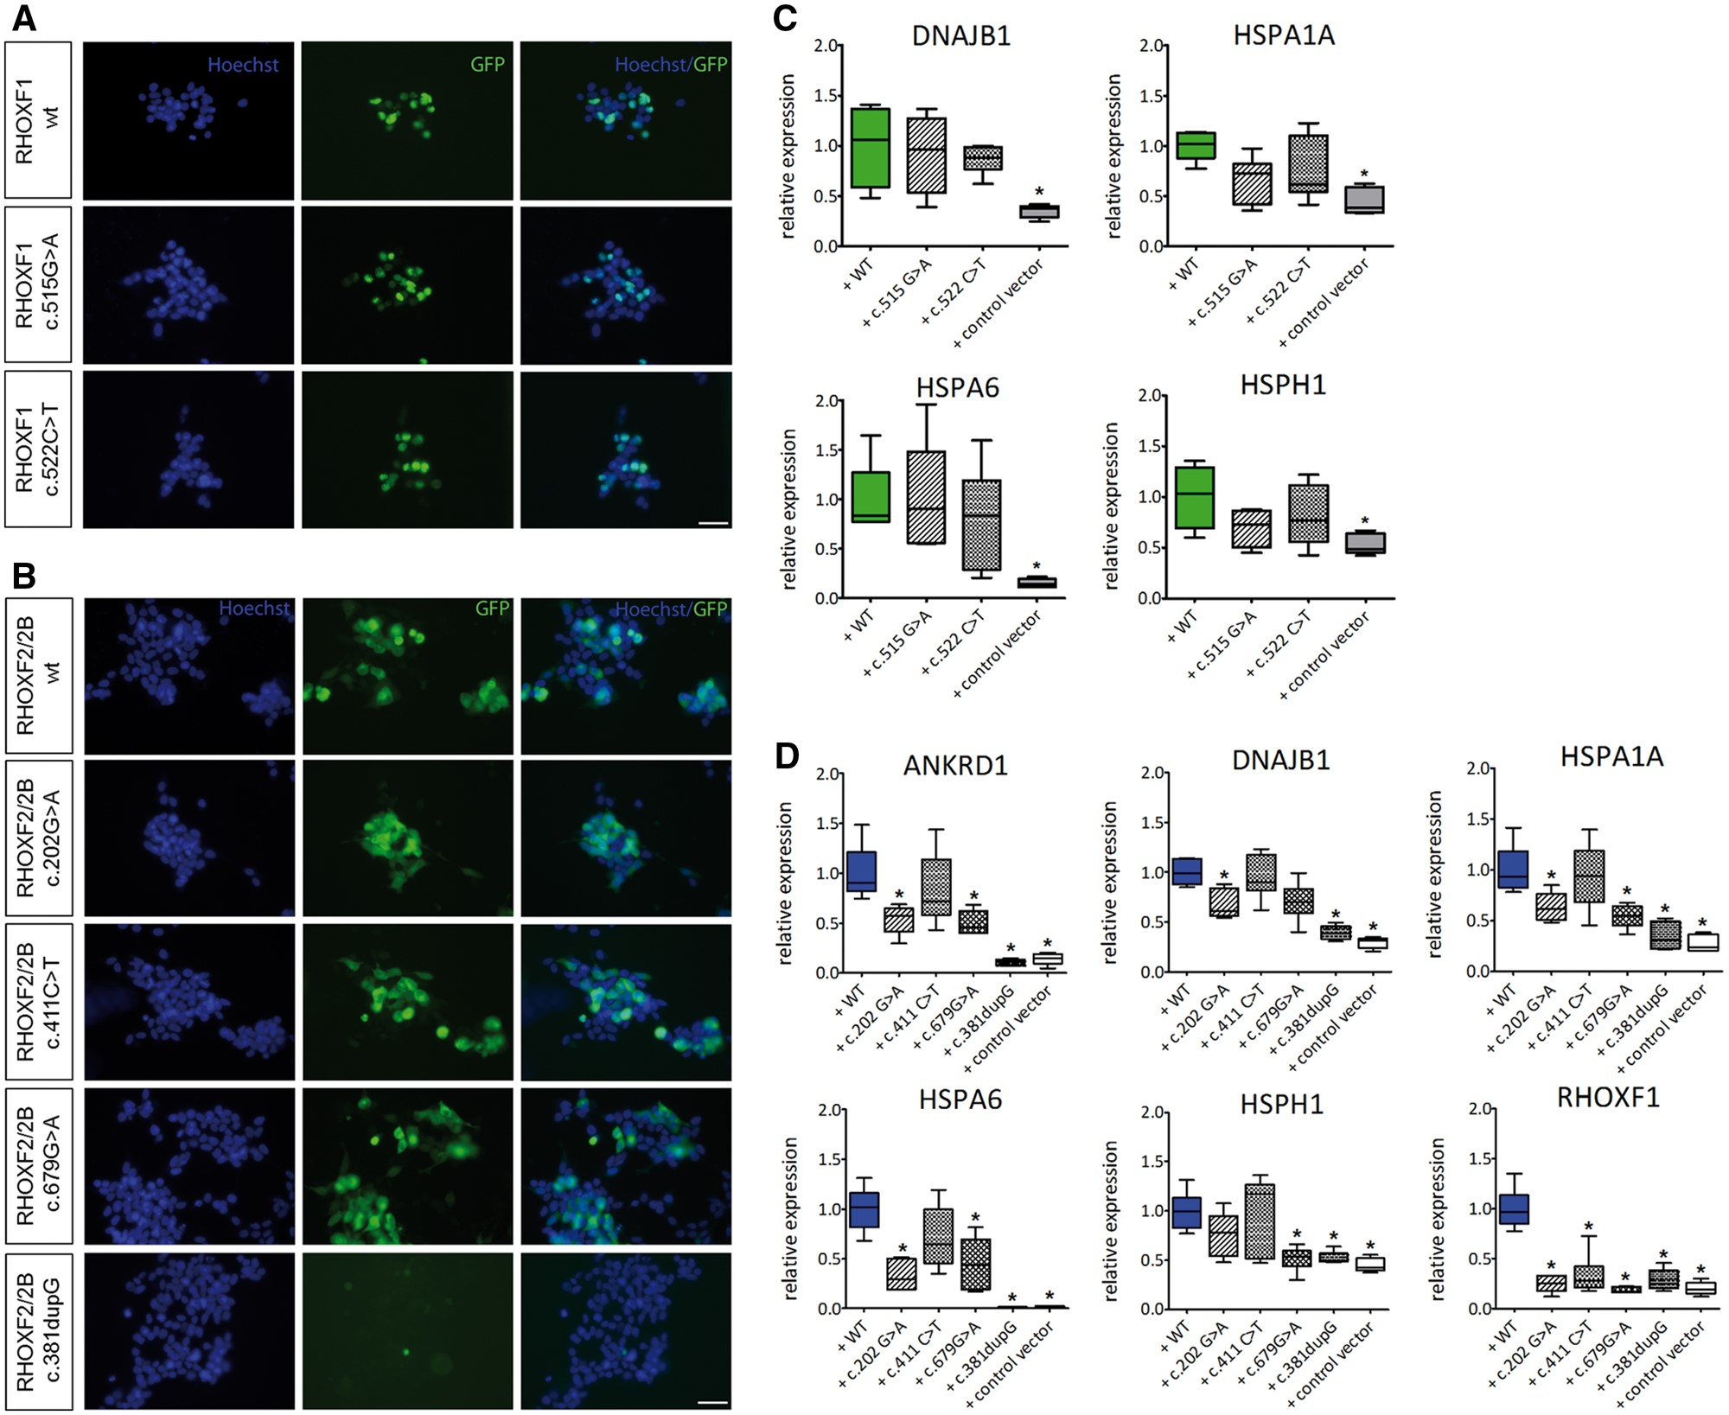
Figure 4. Functional analysis of RHOX mutations. (A) Immunofluorescent staining of HEK293 cells after 48h of ...
Notes:
Figure 4. Functional analysis of RHOX mutations. (A) Immunofluorescent staining of HEK293 cells after 48h of transfection with RHOXF1 c.515G > A, c.522C > T and (B) RHOXF2/2B c.202G > A, c.411C > T, c.679G > A, and c.381dupG expression vectors. GFP signal reflects RHOX expression, nuclei were counterstained with Hoechst. Scale bar: 50 μm. (C) Gene expression levels of RHOXF1 DEGs after transfection with c.515G > A and c.522C > T expression vectors. (D) Gene expression levels of RHOXF2/2B DEGs after transfection with c.202G > A, c.411C > T, c.679G > A, and c.381dupG expression vectors. Transformed data are represented as whiskers with 5–95 percentiles. *Results are significant after Bonferroni correction for multiple testing (P < 0.01).
Unless provided in the caption above, the following copyright applies to the content of this slide: © The Author 2016. Published by Oxford University Press. All rights reserved. For Permissions, please email: journals.permissions@oup.com

Slide 5
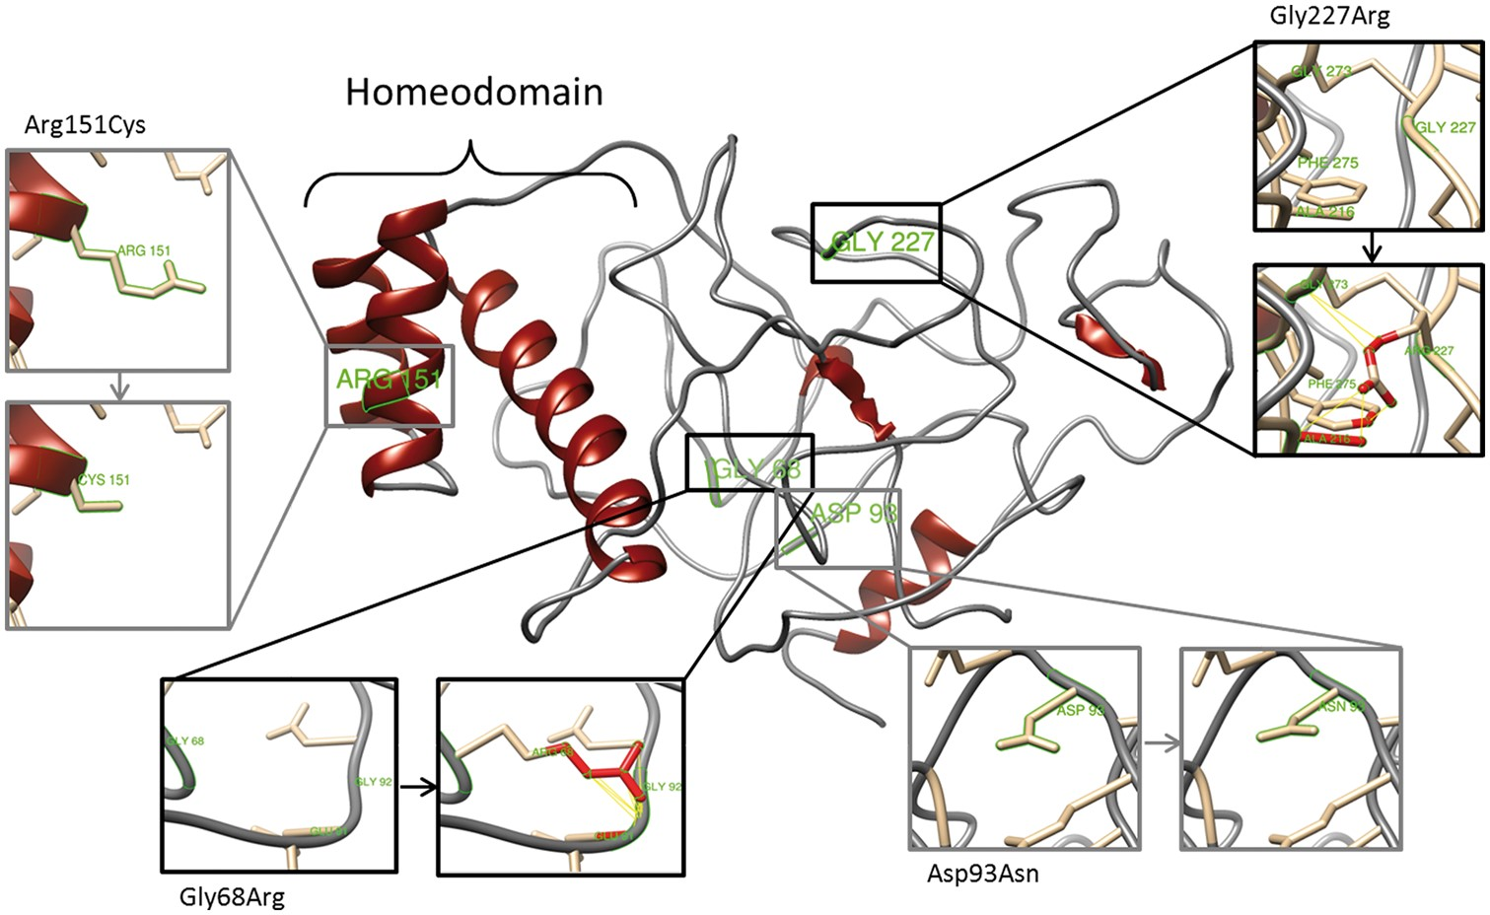
Figure 5. Effect of non-synonymous mutations on RHOXF2/2B protein structure. Diagram of the top predicted tertiary ...
Notes:
Figure 5. Effect of non-synonymous mutations on RHOXF2/2B protein structure. Diagram of the top predicted tertiary structure model of RHOXF2/2B using Phyre2. The homeodomain region was modeled with template structures of homeodomain containing proteins and the remaining residues ab initio. The model was colored by secondary structure using UCSF Chimera software: helix structures are shown in red and coiled structures are shown in grey. Each insert shows the identified non-synonymous mutations (grey) and SNPs (black) as sticks. Predicted clashes/contacts for c.202G > A (p.Gly68Arg) and c.679G > A (p.Gly227Arg) are marked with yellow lines (14 and 5, respectively) and atoms involved in the potential contacts are highlighted in red (10 and 8, respectively). No clashes/contacts were predicted for c.277G > A (p.Asp93Asn) and c.451C > T (p.Arg151Cys).
Unless provided in the caption above, the following copyright applies to the content of this slide: © The Author 2016. Published by Oxford University Press. All rights reserved. For Permissions, please email: journals.permissions@oup.com

