Slide 1
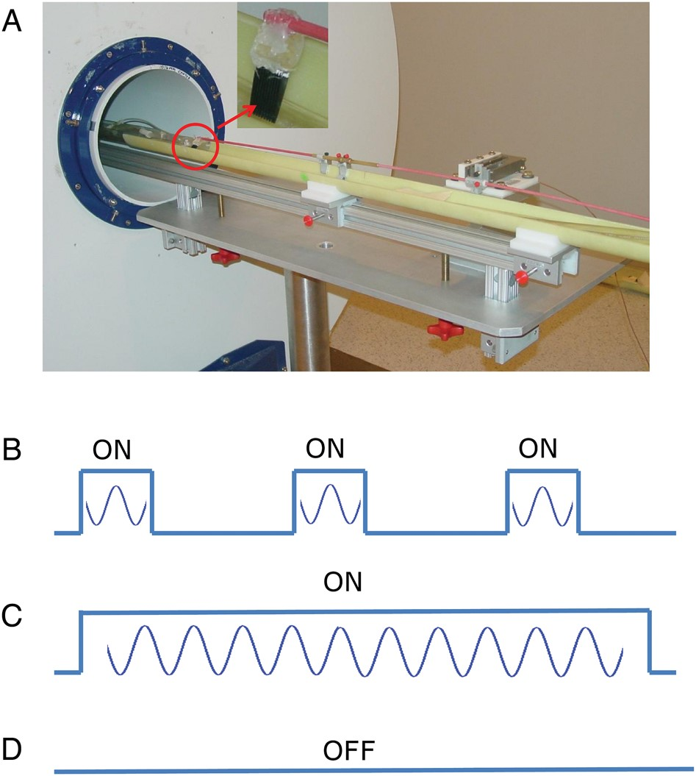
Figure 1. Experimental setup and schematic diagram of fMRI paradigms. (A) MRI-compatible whisker stimulator installed ...
Notes:
Figure 1. Experimental setup and schematic diagram of fMRI paradigms. (A) MRI-compatible whisker stimulator installed on the Bruker MRI platform. Red circle indicates the comb which was moved along the rostral–caudal direction by a rod actuated by the piezoelectric device. Three types of paradigm are employed in this study (B–D). (B) Block-design paradigm (20 s ON, 40 s OFF). This task was used to identify the whisker barrel cortex. (C) Continuous whisker stimulation (300 s ON; frequency: 2, 4, or 6 Hz; peak-to-peak amplitude of the sinusoidal wave form: 4 mm). (D) Resting condition during which no stimulation was applied (300 s OFF).
Unless provided in the caption above, the following copyright applies to the content of this slide: Published by Oxford University Press 2014. This work is written by (a) US Government employee(s) and is in the public domain in the US.

Slide 2
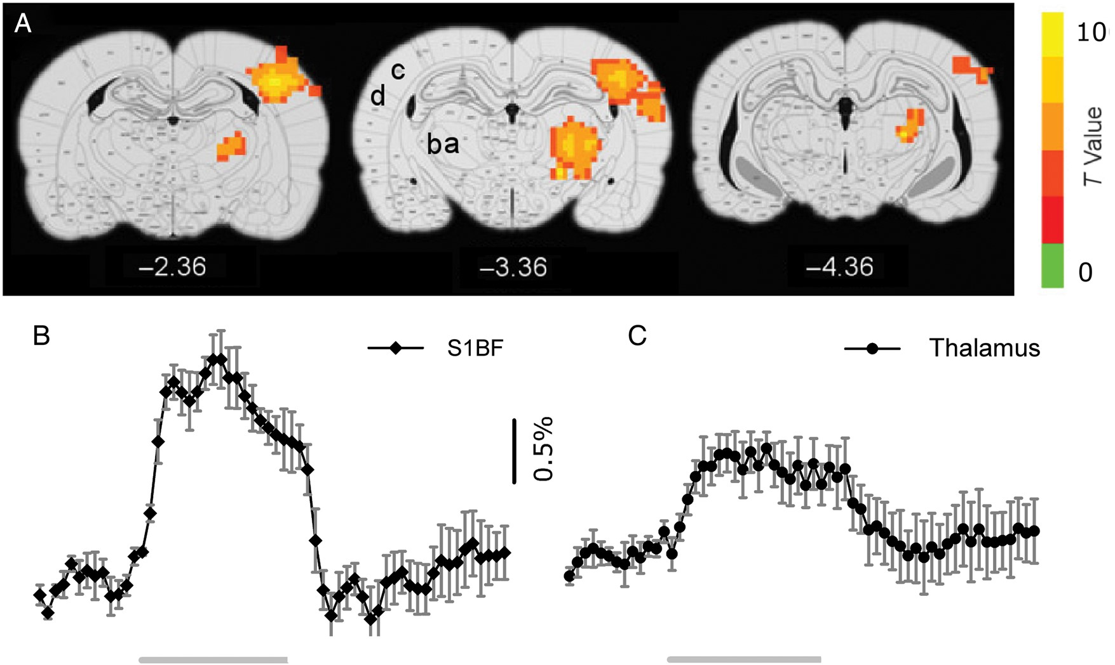
Figure 2. fMRI response to rat whisker barrel cortex stimulation. (A) Group statistical activation maps (N = 9) ...
Notes:
Figure 2. fMRI response to rat whisker barrel cortex stimulation. (A) Group statistical activation maps (N = 9) superimposed onto digital rat brain atlas. Activated areas include ventromedial and ventrolateral thalamic nuclei (VPM, VPL), primary whisker barrel cortex (S1BF), and secondary sensory cortex (S2). Numbers below figures are approximate coordinates relative to rat bregma. (B and C) Averaged BOLD responses in S1BF and thalamic nuclei (VPM and VPL) across animals (N = 9, mean ± SEM). The 2 gray lines below curves indicate the stimulus ON period, during which whiskers on the right side were deflected along the rostral–caudal direction. a and b: VPM, VPL; c: S1BF; d: S2.
Unless provided in the caption above, the following copyright applies to the content of this slide: Published by Oxford University Press 2014. This work is written by (a) US Government employee(s) and is in the public domain in the US.

Slide 3
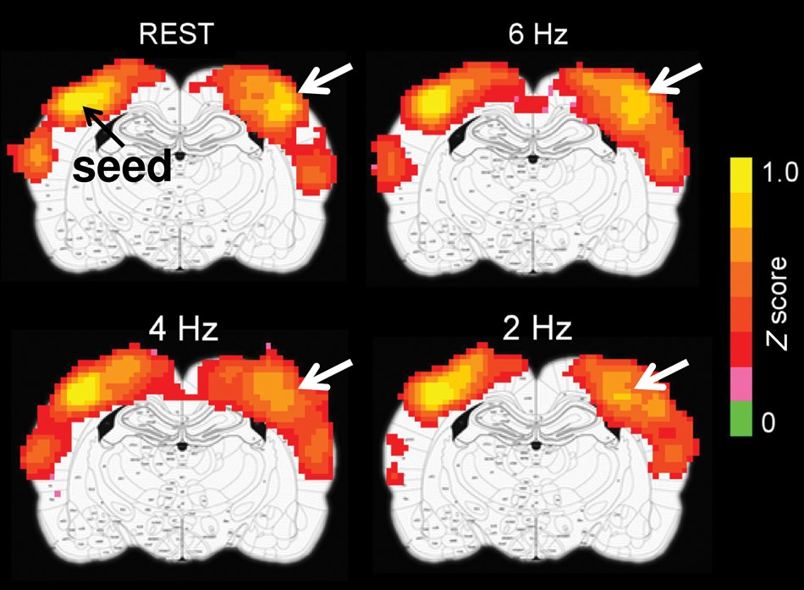
Figure 3. Raw functional connectivity maps during the resting condition and during continuous unilateral whisker ...
Notes:
Figure 3. Raw functional connectivity maps during the resting condition and during continuous unilateral whisker stimulation (frequency: 2, 4, and 6 Hz). Data were from one representative animal. Seed voxels are on the left side; white arrows indicate differential functional connectivity strength on the contralateral barrel cortex.
Unless provided in the caption above, the following copyright applies to the content of this slide: Published by Oxford University Press 2014. This work is written by (a) US Government employee(s) and is in the public domain in the US.

Slide 4
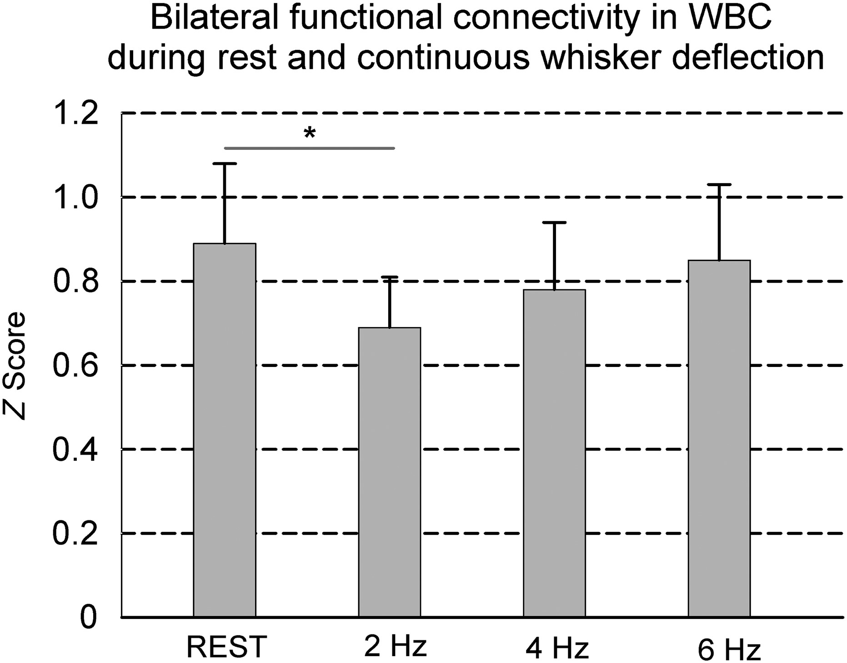
Figure 4. Comparison of functional connectivity during the rest and the 3 whisker deflection conditions (2, 4, and 6 ...
Notes:
Figure 4. Comparison of functional connectivity during the rest and the 3 whisker deflection conditions (2, 4, and 6 Hz). Continuous unilateral whisker stimulation at 2 Hz, but not at 4 or 6 Hz, significantly reduces functional connectivity in bilateral whisker barrel cortex (N = 9; *P = 0.001).
Unless provided in the caption above, the following copyright applies to the content of this slide: Published by Oxford University Press 2014. This work is written by (a) US Government employee(s) and is in the public domain in the US.

Slide 5
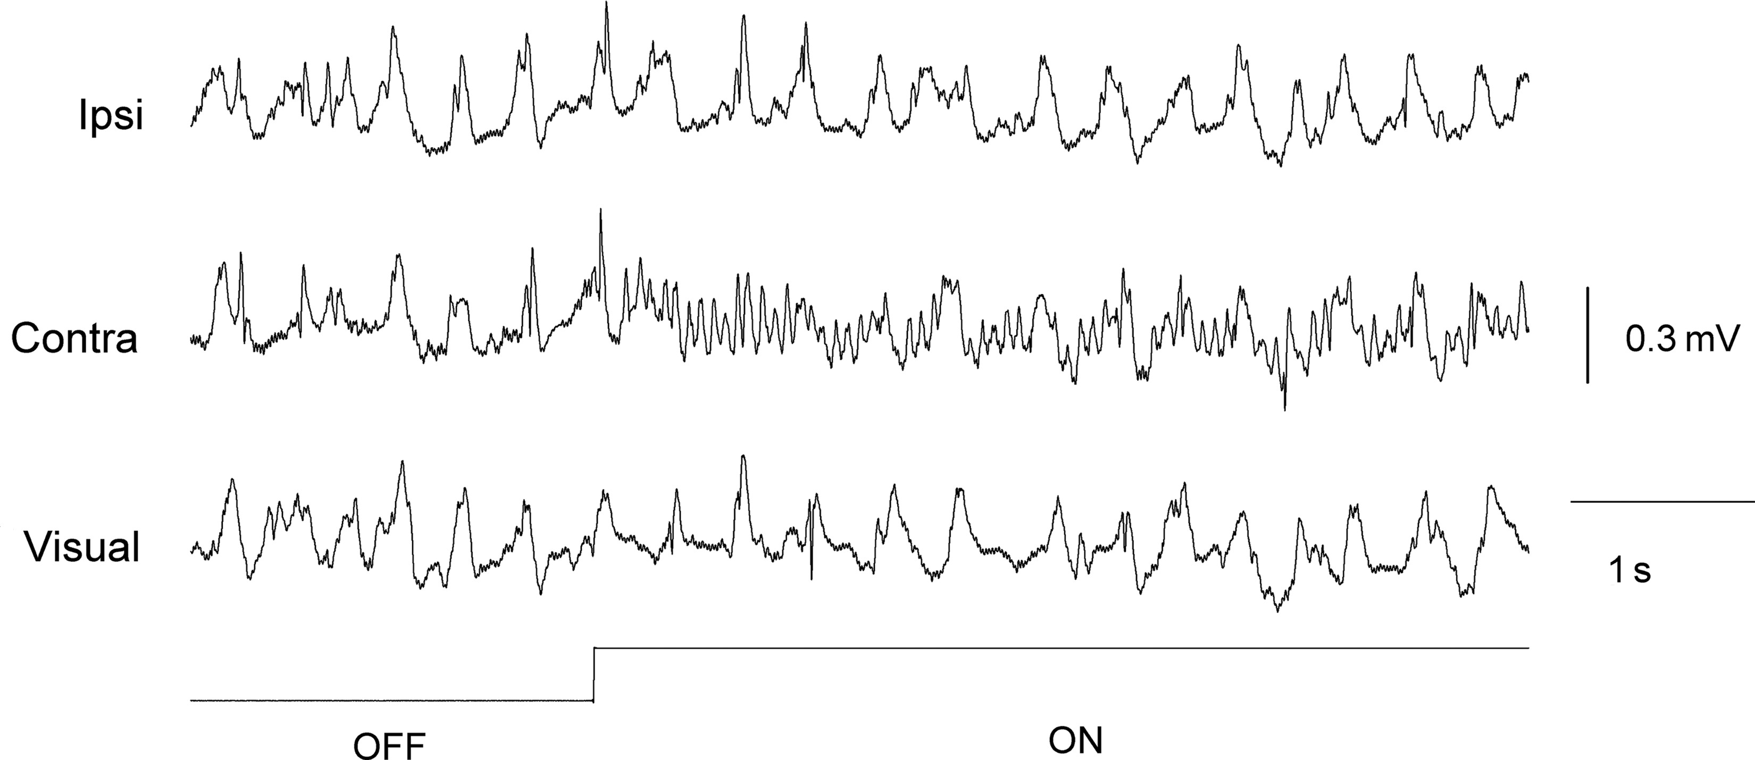
Figure 5. Raw epidural EEG traces from 3 recording sites (downsampled to 256 Hz). Unilateral whisker stimulation ...
Notes:
Figure 5. Raw epidural EEG traces from 3 recording sites (downsampled to 256 Hz). Unilateral whisker stimulation induces an enhancement in high-frequency component and a reduction of amplitude in the low-frequency component. Ipsi, barrel cortex ipsilateral to whisker deflection; Contra, barrel cortex contralateral to the whisker deflection; Visual, visual cortex. ON and OFF indicate periods during which the stimulator was turned on and off, respectively.
Unless provided in the caption above, the following copyright applies to the content of this slide: Published by Oxford University Press 2014. This work is written by (a) US Government employee(s) and is in the public domain in the US.

Slide 6
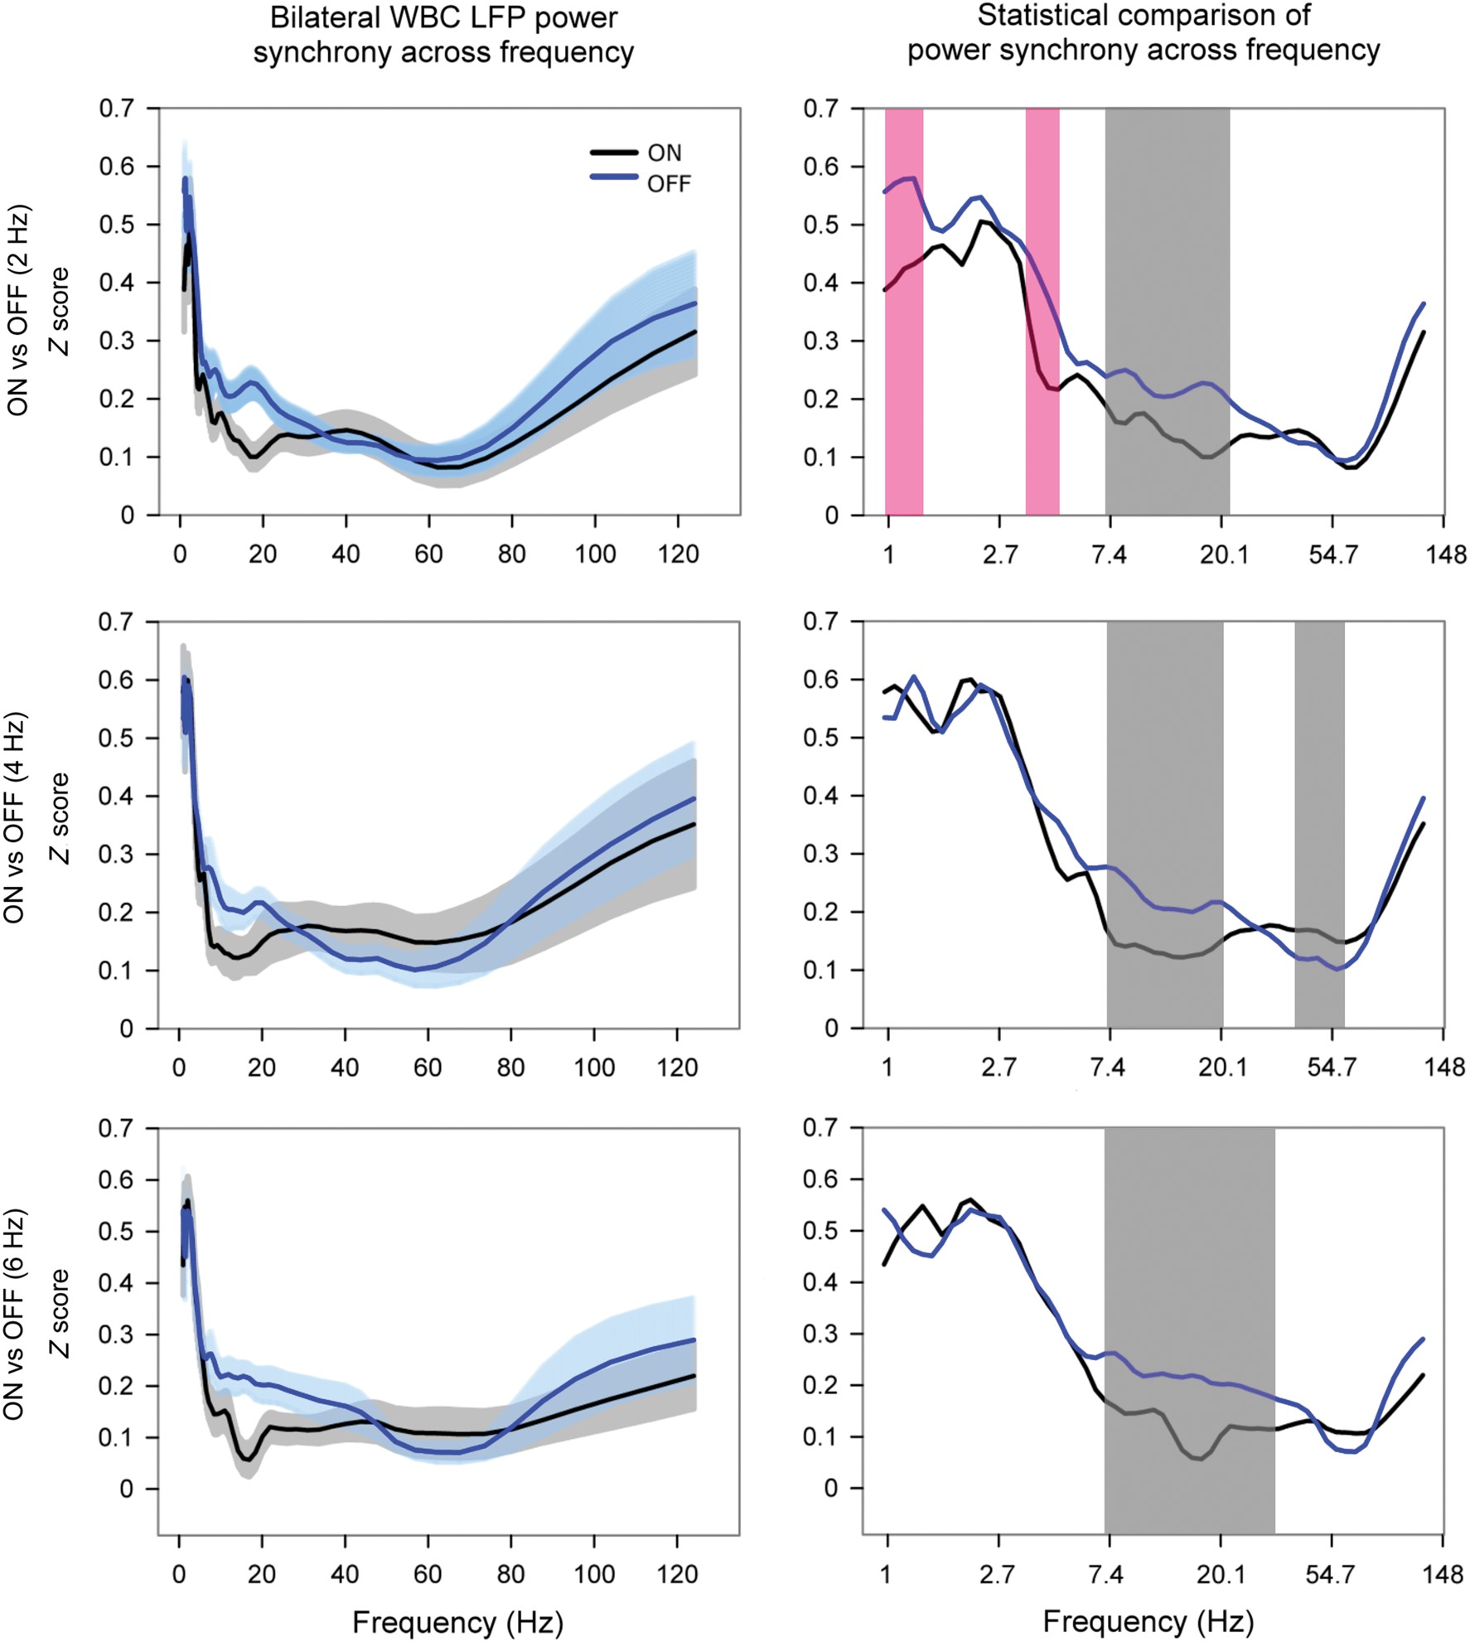
Figure 6. Comparison of power correlation during stimulus ON versus OFF period. Left panel: Plots of LFP power ...
Notes:
Figure 6. Comparison of power correlation during stimulus ON versus OFF period. Left panel: Plots of LFP power synchrony between bilateral whisker barrel cortices as a function of spectral frequency analyzed with the Morlet wavelet method. The correlation coefficients of the power time courses at each wavelet scale (Fourier frequency) were converted to Z score. Data are displayed as mean ± stand error. Note that unilateral whisker stimulation significantly reduced power correlations in low-frequency range (6 Hz, gray shading) was reduced across all 3 whisker stimulation conditions (2, 4, and 6 Hz). X-Axis is at exponential scale (ex) for visual clarity.
Unless provided in the caption above, the following copyright applies to the content of this slide: Published by Oxford University Press 2014. This work is written by (a) US Government employee(s) and is in the public domain in the US.

