Slide 1
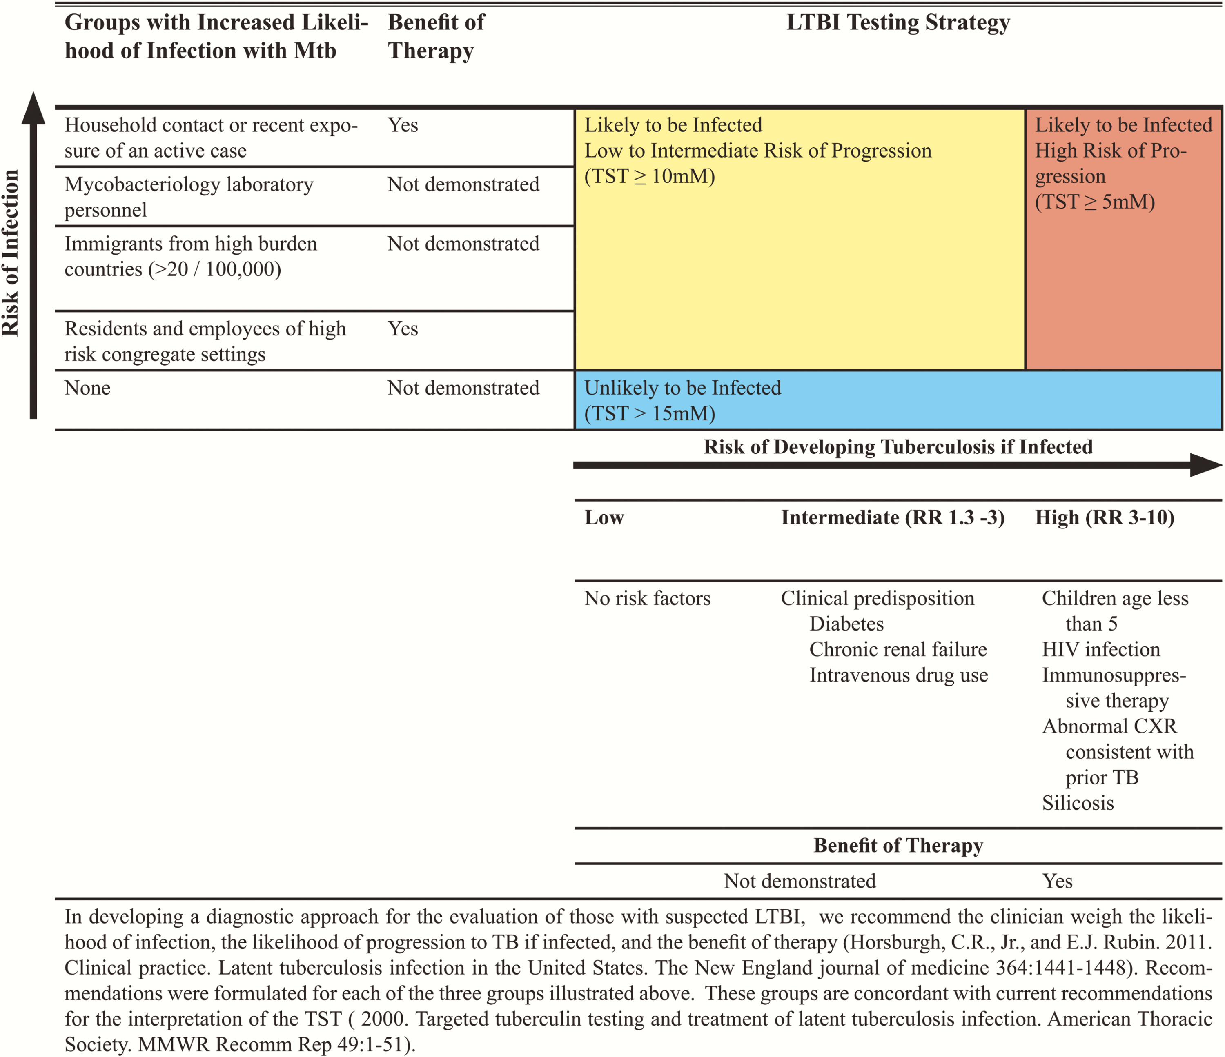
Figure 1. Paradigm for evaluation of those with latent tuberculosis infection (LTBI) based on risk of infection, risk ...
Notes:
Figure 1. Paradigm for evaluation of those with latent tuberculosis infection (LTBI) based on risk of infection, risk of progression to tuberculosis, and benefit of therapy. In developing a diagnostic approach for the evaluation of those with suspected LTBI, we recommend the clinician weigh the likelihood of infection, the likelihood of progression to tuberculosis if infected, and the benefit of therapy (Horsburgh and Rubin, Clinical practice: latent tuberculosis infection in the United States. N Engl J Med 2011; 364:1441–8). Recommendations were formulated for each of the 3 groups illustrated above. These groups are concordant with current recommendations for the interpretation of the tuberculin skin test (American Thoracic Society, Targeted tuberculin testing and treatment of latent tuberculosis infection. MMWR Recomm Rep 2000; 49:1–51). Abbreviations: CXR, chest radiograph; HIV, human immunodeficiency virus; LTBI, latent tuberculosis infection; Mtb, Mycobacterium tuberculosis; RR, ; TB, tuberculosis; TST, tuberculin skin test.
Unless provided in the caption above, the following copyright applies to the content of this slide: © The Author 2016. Published by Oxford University Press for the Infectious Diseases Society of America. All rights reserved. For permissions, e-mail journals.permissions@oup.com.

Slide 2
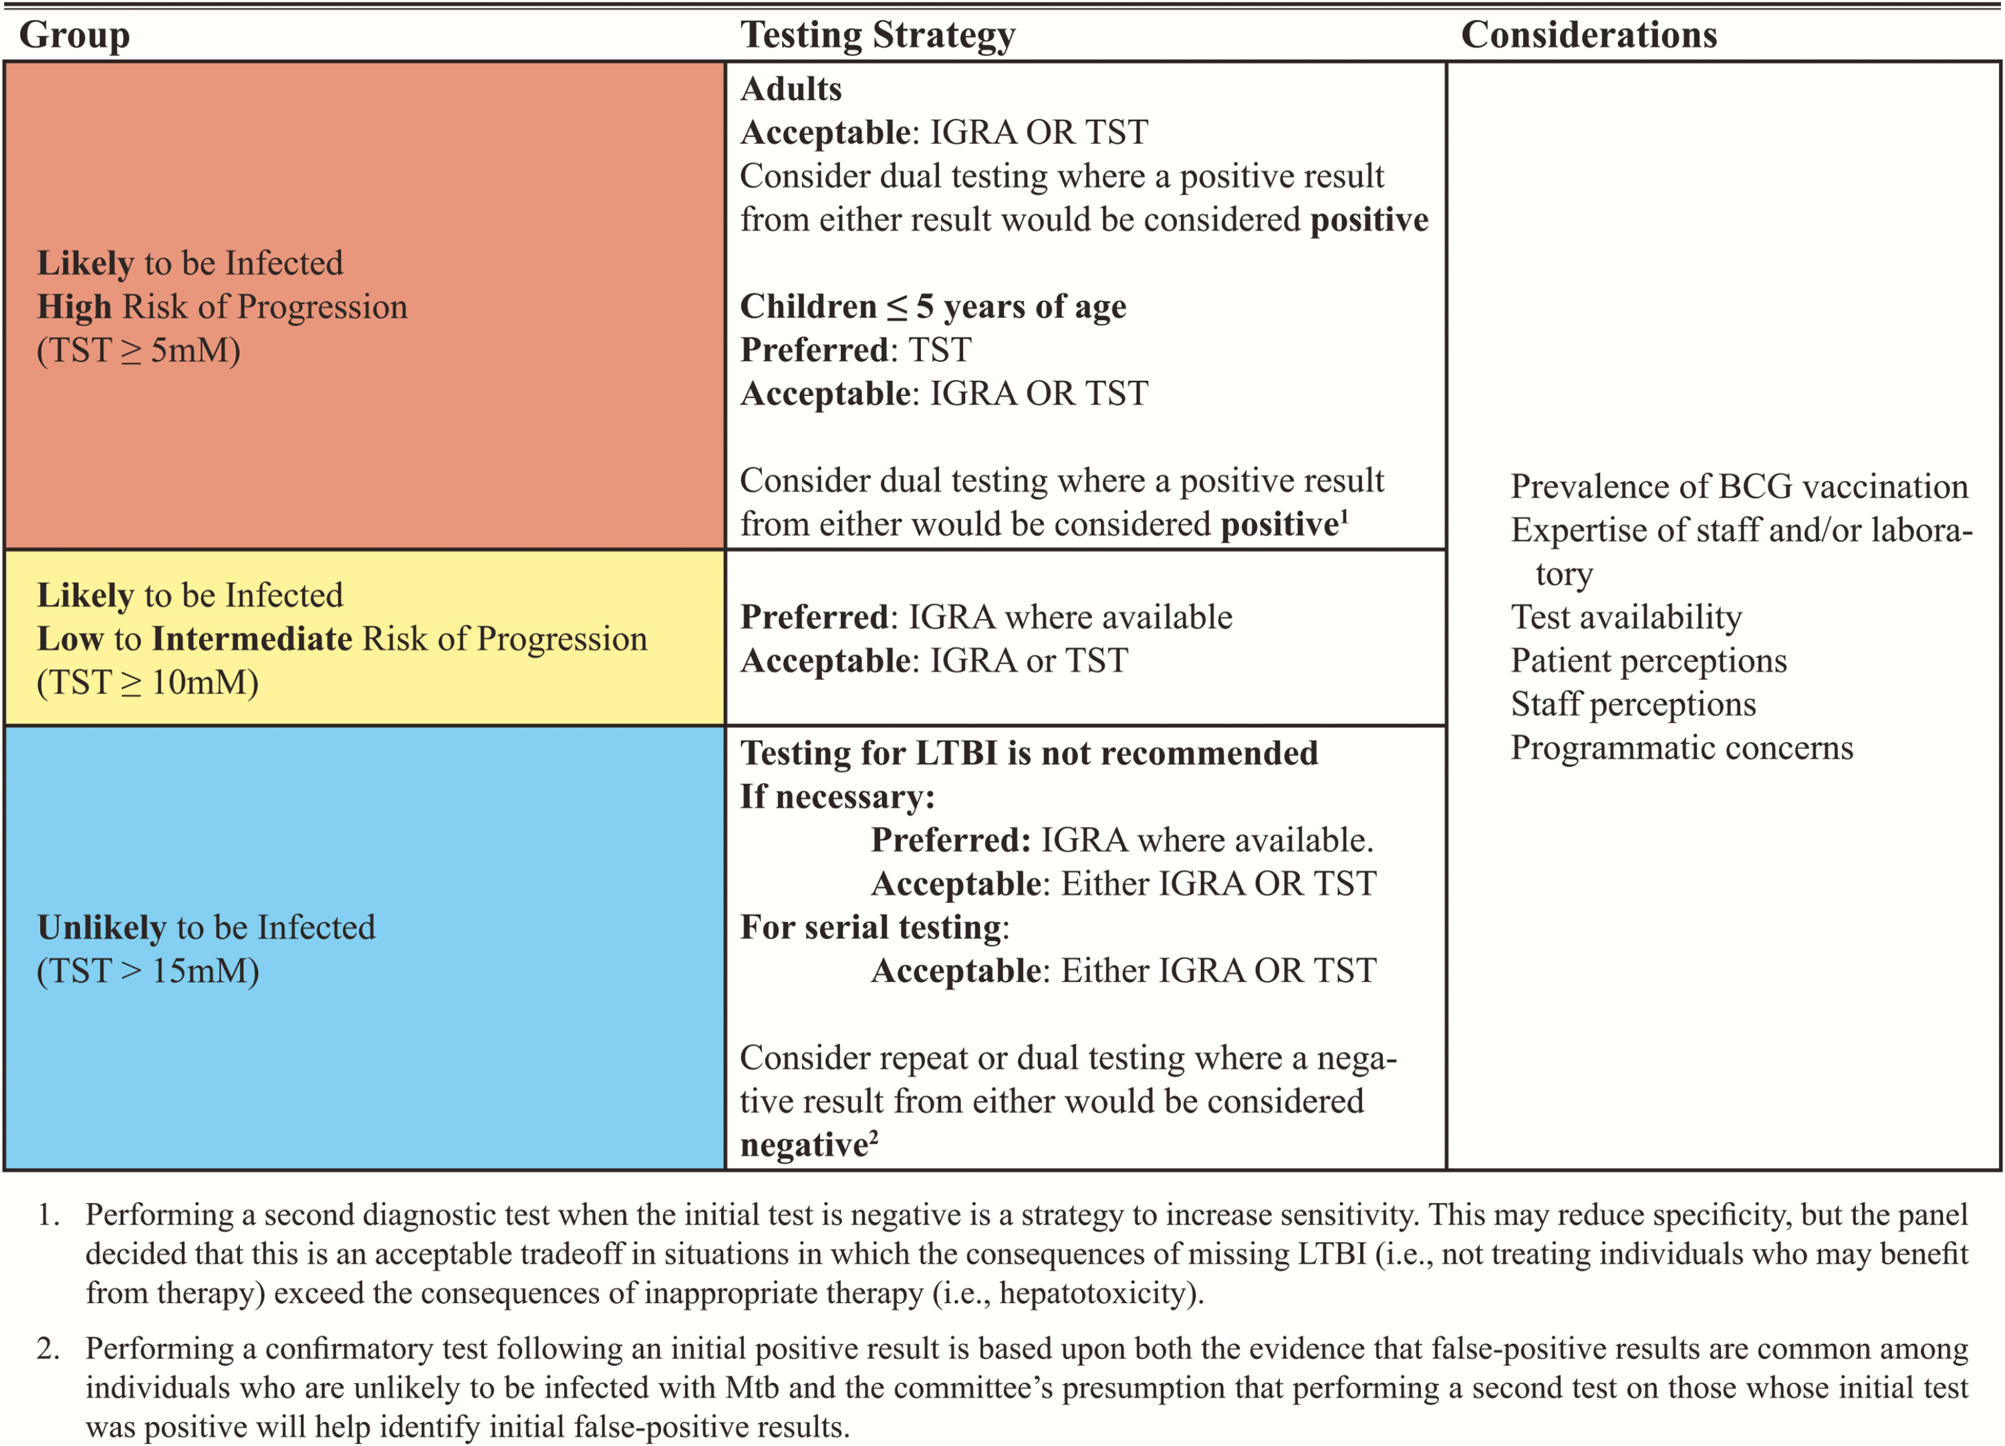
Figure 2. Summary of recommendations for testing for latent tuberculosis infection (LTBI). ¹Performing a ...
Notes:
Figure 2. Summary of recommendations for testing for latent tuberculosis infection (LTBI). 1Performing a second diagnostic test when the initial test is negative is a strategy to increase sensitivity. This may reduce specificity, but the panel decided that this is an acceptable trade-off in situations in which the consequences of missing LTBI (ie, not treating individuals who may benefit from therapy) exceed the consequences of inappropriate therapy (ie, hepatotoxicity). 2Performing a confirmatory test following an initial positive result is based upon both the evidence that false-positive results are common among individuals who are unlikely to be infected with Mycobacterium tuberculosis and the committee’s presumption that performing a second test on those patients whose initial test was positive will help identify initial false-positive results. Abbreviations: IGRA, interferon-γ release assay; LTBI, latent tuberculosis infection; TST, tuberculin skin test.
Unless provided in the caption above, the following copyright applies to the content of this slide: © The Author 2016. Published by Oxford University Press for the Infectious Diseases Society of America. All rights reserved. For permissions, e-mail journals.permissions@oup.com.

