Slide 1
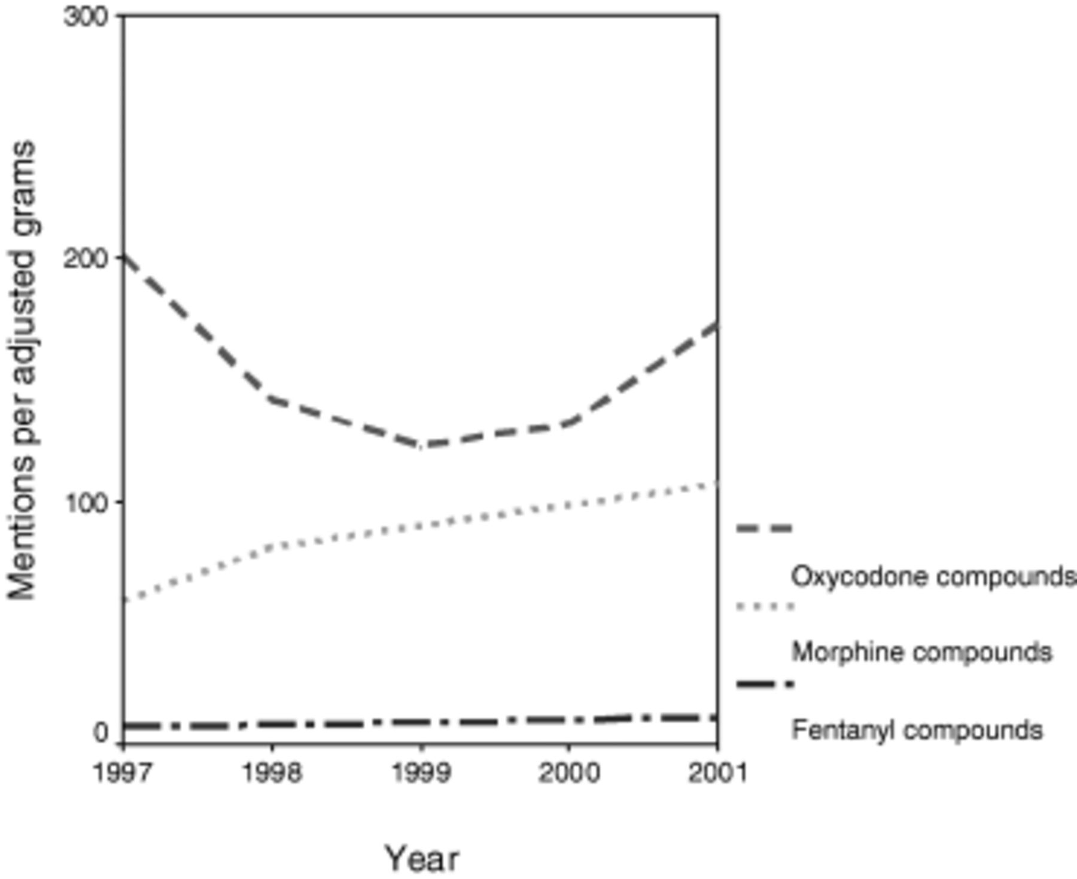
Figure 1 DAWN mentions of opioids divided by grams per 100,000 population (adjusted for equivalency)*. *Oxycodone ...
Notes:
Figure 1 DAWN mentions of opioids divided by grams per 100,000 population (adjusted for equivalency)*. *Oxycodone grams per 100,000 population were multiplied by a conversion factor of 1.5 and fentanyl grams per 100,000 population were multiplied by a conversion factor of 100 to obtain interdrug equivalency.
Unless provided in the caption above, the following copyright applies to the content of this slide:

