Slide 1
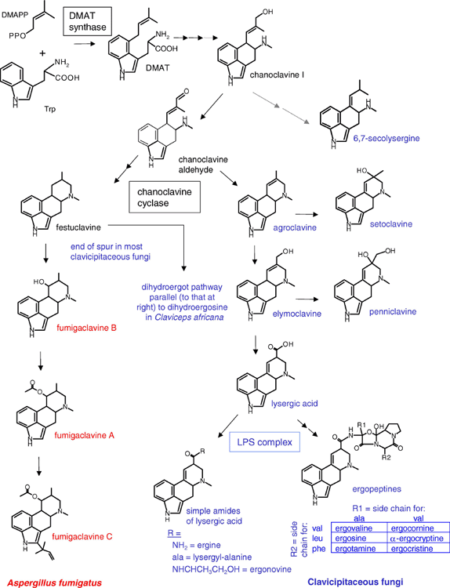
1 Critical intermediates and end products of the ergot alkaloid pathways of clavicipitaceous fungi and A. ...
Notes:
1 Critical intermediates and end products of the ergot alkaloid pathways of clavicipitaceous fungi and A. fumigatus. Names of alkaloids common to both pathways are in black. Red text indicates alkaloids unique to A. fumigatus and blue text those alkaloids or steps found only in clavicipitaceous fungi. Enzymes emphasized in the text are boxed near the steps that they catalyze. Dihydroergot alkaloids (not illustrated) of C. africana have a saturated “D” ring (fourth ring to form) like festuclavine and are named with a dihydro-prefix. Structures for side chains on simple amides of lysergic acid and ergopeptines are indicated in tables below the respective general structure. Abbreviations: DMAPP, dimethylallyl pyrophosphate; DMAT, dimethylallyl tryptophan; and, LPS, lysergyl peptide synthetase.
Unless provided in the caption above, the following copyright applies to the content of this slide: © 2005 Federation of European Microbiological Societies

Slide 2
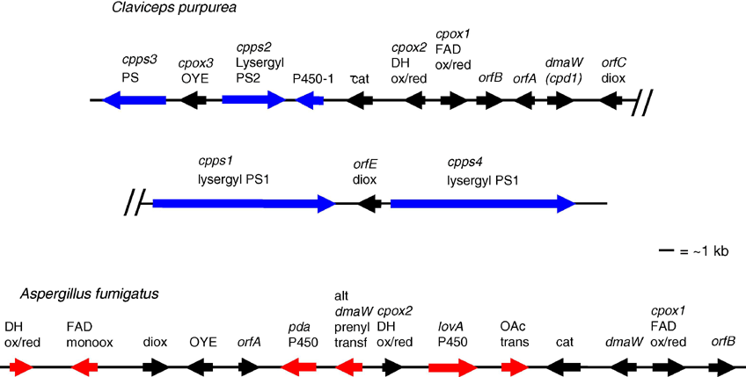
2 Parts of the ergot alkaloid gene clusters of C. purpurea and Aspergillus fumigatus redrawn from previously ...
Notes:
2 Parts of the ergot alkaloid gene clusters of C. purpurea and Aspergillus fumigatus redrawn from previously published work [13,19,30]. Arrows indicate the orientation of transcription. Color scheme is analogous to that in Fig. 1 in that genes indicated by black arrows are common to clusters from both fungi; those marked in blue are found in C. purpurea but not A. fumigatus and the converse is true for those marked in red. Abbreviations: Cp, C. purpurea; ps or PS peptide synthetase; ox or ox/red, oxidoreductase; OYE, old yellow enzyme; P450, cytochrome P450 monooxygenase; cat, catalase; DH, dehydrogenase; orf, open reading frame; diox, dioxygenase; monoox, monooxygenase; pda P450, similar to P450 involved in pisatin demethylase activity; alt, alternate; trans, transferase; OAc trans, O-acetyl transferase; lovA P450, similar to P450 involved in lovastatin biosynthesis. The scale applies to both clusters.
Unless provided in the caption above, the following copyright applies to the content of this slide: © 2005 Federation of European Microbiological Societies

Slide 3
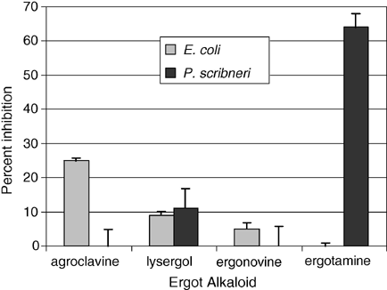
3 Inhibition (expressed as percent of no-alkaloid control) of Escherichia coli multiplication (lighter bars) or ...
Notes:
3 Inhibition (expressed as percent of no-alkaloid control) of Escherichia coli multiplication (lighter bars) or nematode (Pratylenchus scribneri) motility (darker bars) by the indicated ergot alkaloids. Multiplication of E. coli was measured spectrophotometrically (A600) after incubation with 100 μg/mL of the indicated ergot alkaloids in Luria–Bertani broth (37 °C, 250 rpm) for 5 h. Nematode motility was assessed microscopically after 24 h incubation at 25 °C in 5 μg/mL of the indicated ergot alkaloid. Error bars indicate standard error.
Unless provided in the caption above, the following copyright applies to the content of this slide: © 2005 Federation of European Microbiological Societies

