Slide 1
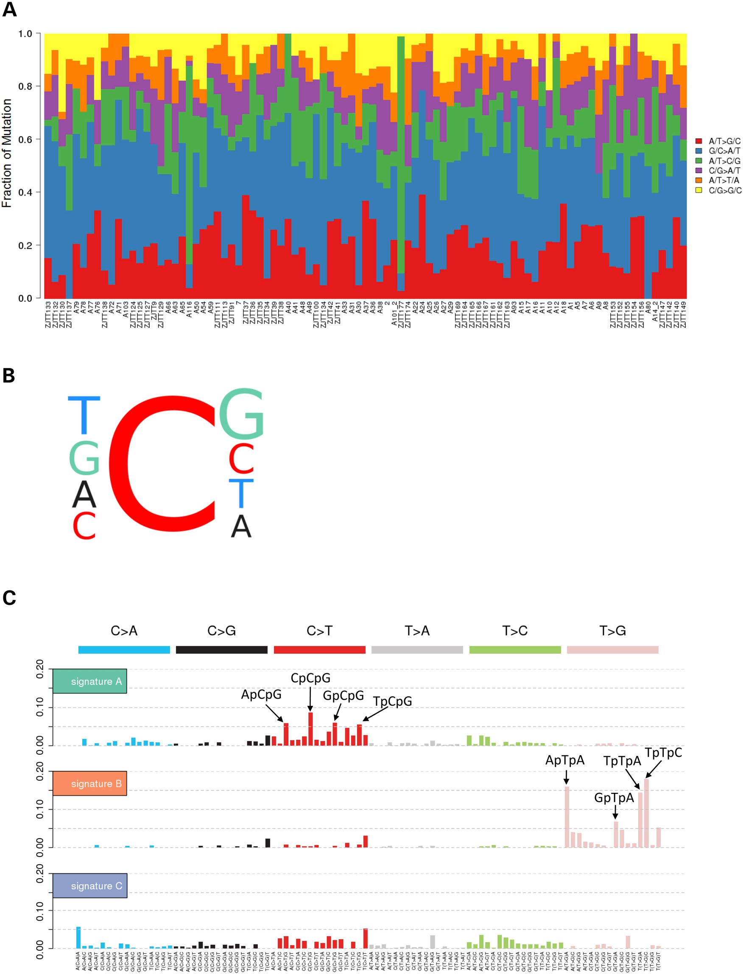
Figure 1. Mutation spectra and three mutational signatures identified in Chinese PTCs across the 91 patients. (A) The ...
Notes:
Figure 1. Mutation spectra and three mutational signatures identified in Chinese PTCs across the 91 patients. (A) The somatic point mutation spectrum observed in each of the 91 PTC cases. Overall, the C>T/G>A substitution was more commonly observed on average than other mutation types. (B) Trinucleotide contexts of mutations occurring at cytosine nucleotides in PTC. Font sizes of the bases at the 5′ and 3′ positions are proportional to their frequencies. (C) Ninety-six substitution classifications from WES data derived from the 91 pairs of Chinese PTC samples. Mutation types are displayed in different colors on the horizontal axis. The vertical axis depicts the percentage of mutations attributed to a specific mutation type.
Unless provided in the caption above, the following copyright applies to the content of this slide: © The Author 2016. Published by Oxford University Press. All rights reserved. For Permissions, please email: journals.permissions@oup.com

Slide 2
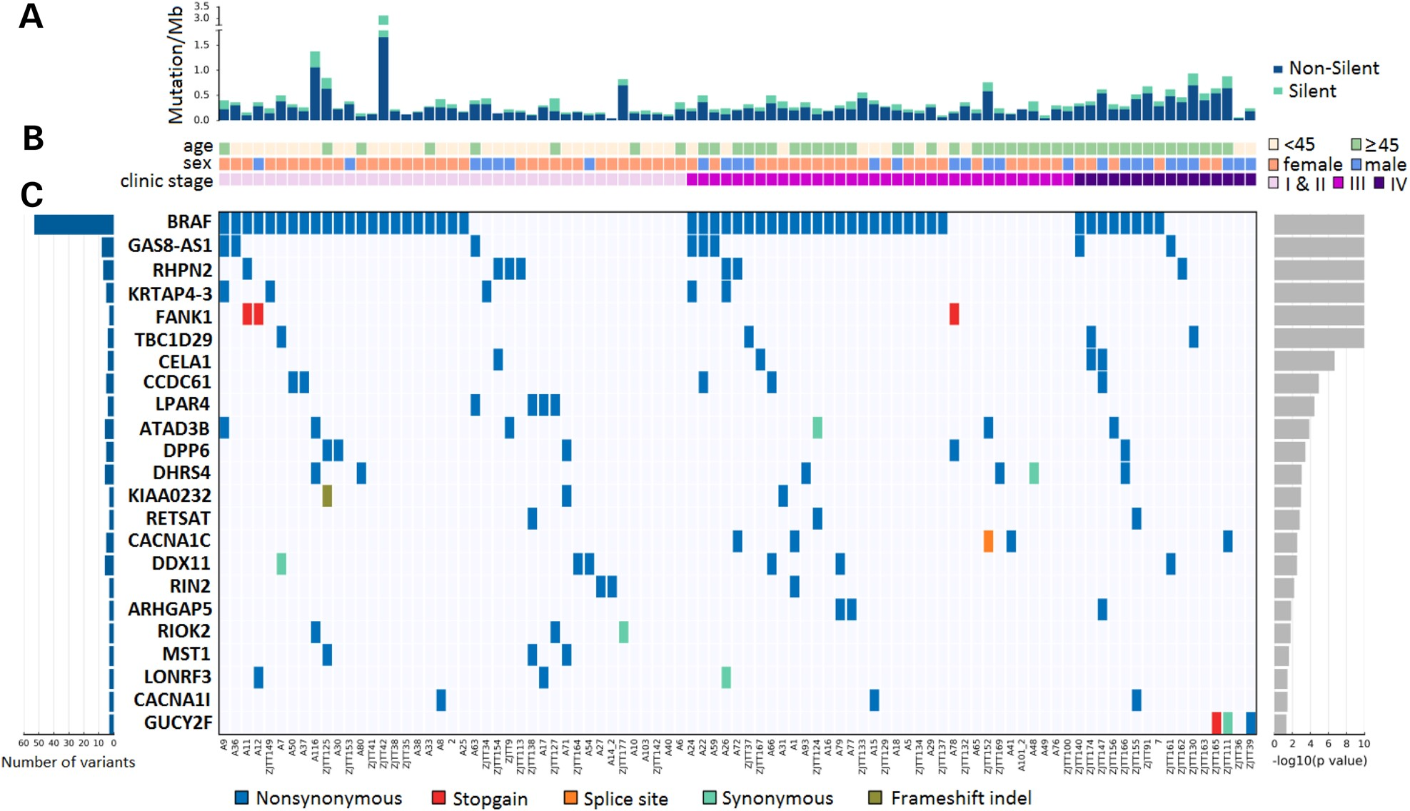
Figure 2. Exome-wide mutational landscape of PTC identified by whole-exome sequencing. (A) Number and type of ...
Notes:
Figure 2. Exome-wide mutational landscape of PTC identified by whole-exome sequencing. (A) Number and type of mutations. Non-silent mutations consist of missense, stopgain, stoploss, and splice site mutations, as well as frameshift indels and inframe indels. (B) Key clinicopathological characteristics. Stage was determined according to the sixth edition of the Union for International Cancer Control (UICC) staging system for thyroid cancer. (C) Middle, mutations in a selection of frequently mutated genes with ≥3 mutations, colored by the type of alteration. Samples are displayed as columns, arranged to emphasize mutual exclusivity among mutations. Left, the total number of somatic alterations that targeted each gene. Right, the logarithmic (log) transformations of P-values calculated by MutSigCV (Supplementary Material, Table S6).
Unless provided in the caption above, the following copyright applies to the content of this slide: © The Author 2016. Published by Oxford University Press. All rights reserved. For Permissions, please email: journals.permissions@oup.com

Slide 3
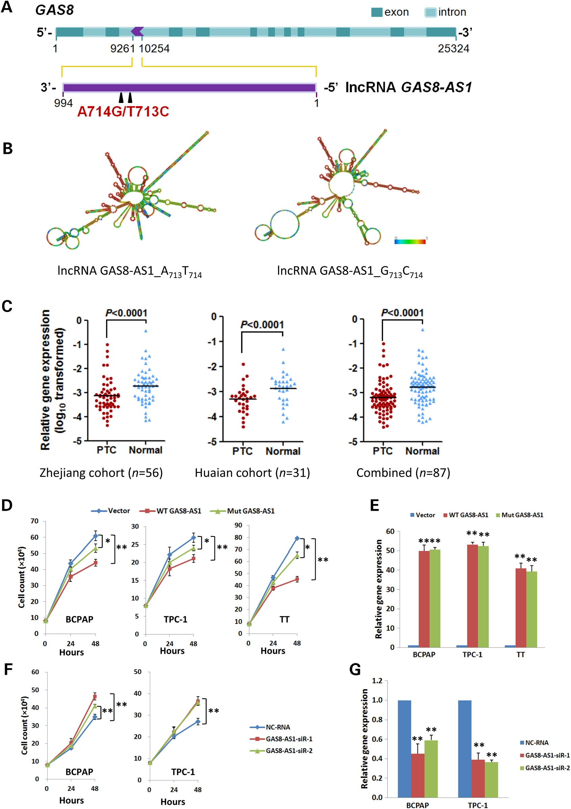
Figure 3. Identification of lncRNA GAS8-AS1 as a novel tumor suppressor gene in PTC. (A) Schematics of lncRNA GAS8-AS1, ...
Notes:
Figure 3. Identification of lncRNA GAS8-AS1 as a novel tumor suppressor gene in PTC. (A) Schematics of lncRNA GAS8-AS1, its host gene GAS8 and an A713T714>G713C714 dinucleotide substitution in lncRNA GAS8-AS1. (B) Prediction with the RNAfold software demonstrated that the A713T714>G713C714 dinucleotide substitution induces significant change of GAS8-AS1 RNA secondary structure. (C) lncRNA GAS8-AS1 expression detected in 87 pairs of PTC tissue specimens and normal tissues from different medical centers (56 pairs from Zhejiang Province Cancer Hospital and 31 pairs from Huaian No. 2 Hospital). (D) Ectopically expressed either wild-type lncRNA GAS8-AS1 (WT, A713T714) or the mutated one (Mut, G713C714) could significantly suppress cell viability in PTC cell lines (BCPAP and TPC-1) and thyroid medullary carcinoma TT cell line. (E) Ectopic expression levels of WT lncRNA GAS8-AS1 or the Mut GAS8-AS1 are comparable in BCPAP, TPC-1 and TT cell lines. (F) Depletion of endogenous lncRNA GAS8-AS1 expression in BCPAP and TPC-1 cells significantly increased cell proliferation. (G) Expression levels of lncRNA GAS8-AS1 after RNAi in BCPAP and TPC-1 cells. All experiments were performed in triplicates in three independent transfection experiments and each value represents mean ± SD. *P < 0.05; **P < 0.01.
Unless provided in the caption above, the following copyright applies to the content of this slide: © The Author 2016. Published by Oxford University Press. All rights reserved. For Permissions, please email: journals.permissions@oup.com

Slide 4
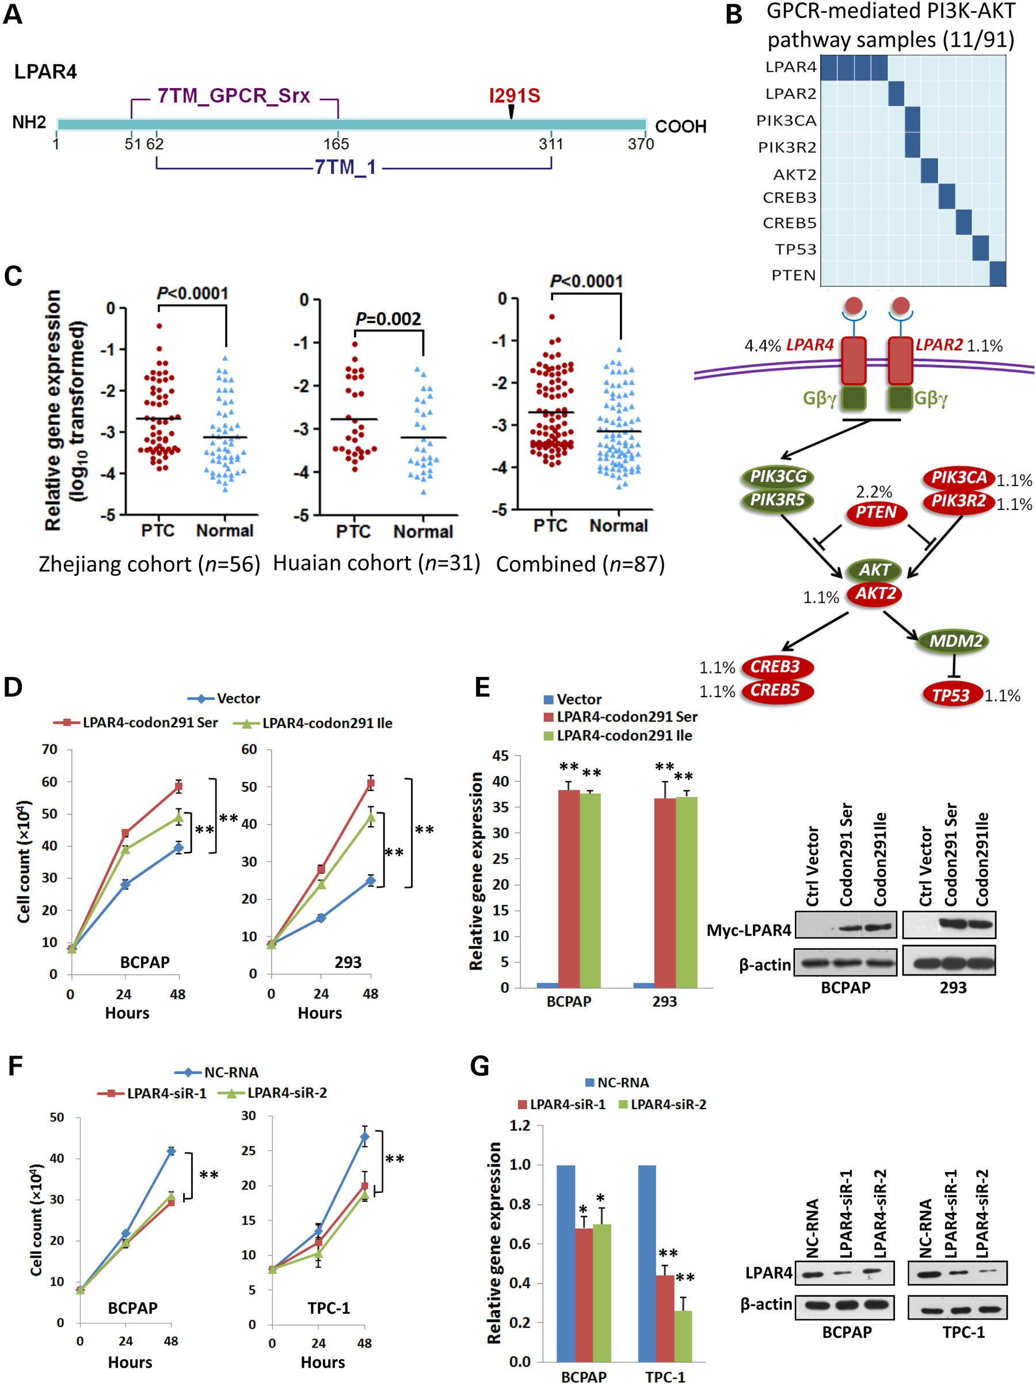
Figure 4. Identification of LPAR4 as a novel PTC oncogene. (A) The schematic of LPAR4 and an Ile291Ser (I291S) amino ...
Notes:
Figure 4. Identification of LPAR4 as a novel PTC oncogene. (A) The schematic of LPAR4 and an Ile291Ser (I291S) amino acid substitution in LPAR4. (B) Data matrix showing alterations of genes involved in the GPCR-mediated PI3K-AKT signaling pathway (Upper panel). Simplistic overview of the GPCR-mediated PI3K-AKT signaling pathway in PTC according to KEGG (Lower panel). (C) LPAR4 mRNA expression detected in 87 pairs of PTC tissue specimens and normal tissues from different medical centers (56 pairs from Zhejiang Province Cancer Hospital and 31 pairs from Huaian No. 2 Hospital). (D) Ectopically expressed either wild-type LPAR4 (codon291Ile) or the mutated one (codon291Ser) could significantly stimulate cell viability in BCPAP and HEK293 cells. (E) mRNA and protein expression levels of LPAR4-codon291Ile or LPAR4-codon291Ser were comparable in BCPAP and HEK293 cells. (F) Depletion of LPAR4 expression in BCPAP and TPC-1 cells significantly inhibited cell proliferation. (G) Expression levels of LPAR4 mRNA and protein after RNAi in BCPAP and TPC-1 cells. All experiments were performed in triplicates in three independent transfection experiments and each value represents mean ± SD. *P < 0.05; **P < 0.01.
Unless provided in the caption above, the following copyright applies to the content of this slide: © The Author 2016. Published by Oxford University Press. All rights reserved. For Permissions, please email: journals.permissions@oup.com

