Slide 1
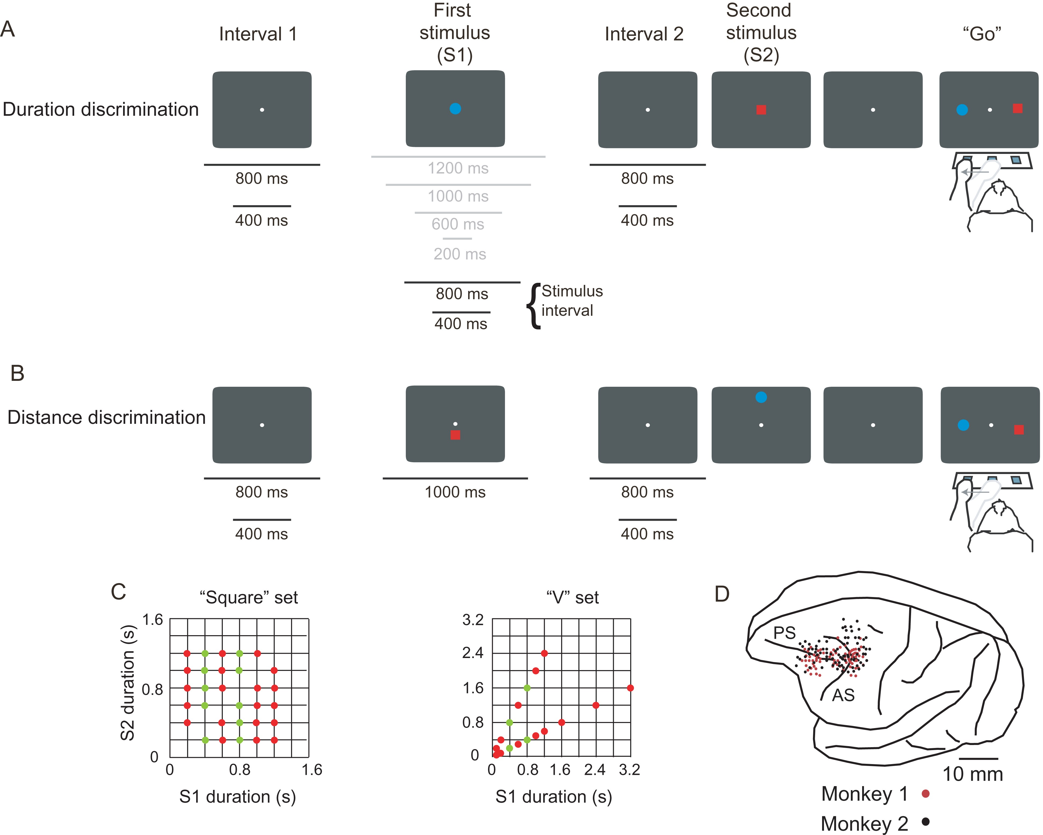
Figure 1. Task, stimulus durations, and sampled areas. (A) Duration task. (B) Distance task. The black lines ...
Notes:
Figure 1. Task, stimulus durations, and sampled areas. (A) Duration task. (B) Distance task. The black lines corresponding to a stimulus interval of 400 and 800 ms indicate the durations used for the analyses. The durations of intervals 1 and 2 were randomized independently, so that each interval 2 duration followed each interval 1 duration with equal probability. The gray lines indicate the durations of the “square” set excluded from the present analysis, which instead used S1 durations of 400 and 800 ms only. (C) Duration sets. The green dots indicate the stimulus durations used for analyzing duration effects for the S1 interval. (D) Penetration sites. Composite from both monkeys. AS: arcuate sulcus; PS: principal sulcus.
Unless provided in the caption above, the following copyright applies to the content of this slide: © The Author 2015. Published by Oxford University Press. All rights reserved. For Permissions, please e-mail: journals.permissions@oup.com

Slide 2
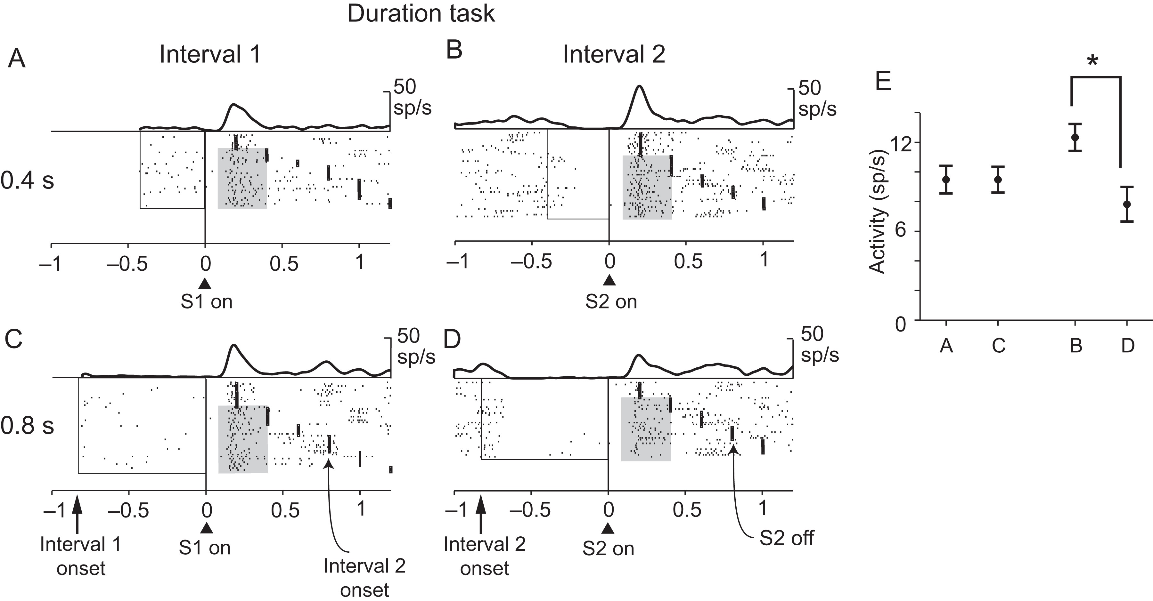
Figure 2. An example neuron recorded in the duration task (with the “square” set of durations) showing context ...
Notes:
Figure 2. An example neuron recorded in the duration task (with the “square” set of durations) showing context dependency between intervals 1 and 2. This neuron shows significant duration effects for interval 2. The gray background indicates the trials used for analysis, which excluded those with S1 and S2 durations of <400 ms. (A) Trials with an interval 1 duration of 400 ms. (B) Trials with an interval 2 duration of 400 ms. (C) Trials with an interval 1 duration of 800 ms. (D) Trials with an interval 2 duration of 800 ms. Each raster shows activity aligned on stimulus onset. Rasters are aligned on S1 onset in A and C and on S2 onset in B and D. Empty squares indicate the 2 interval durations. The dots to the right of the alignment lines indicate S1 offset in A and C and S2 offset in B and D. (E) Means ± SEM for the data shaded in gray in A–D. Asterisk indicates statistically significant difference.
Unless provided in the caption above, the following copyright applies to the content of this slide: © The Author 2015. Published by Oxford University Press. All rights reserved. For Permissions, please e-mail: journals.permissions@oup.com

Slide 3
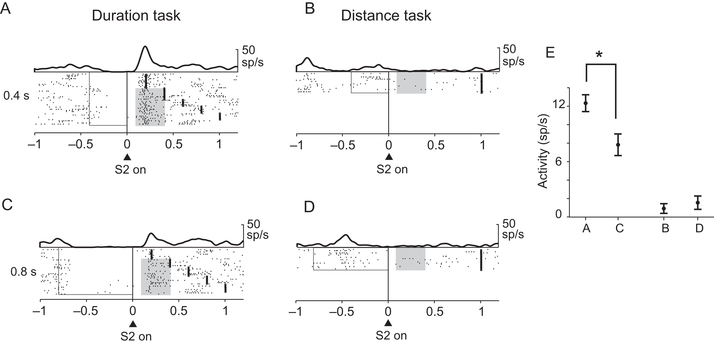
Figure 3. Same neuron as in Figure 2 showing duration effects that were task-dependent. This neuron shows significant ...
Notes:
Figure 3. Same neuron as in Figure 2 showing duration effects that were task-dependent. This neuron shows significant duration effects only in the duration task, with higher activity when interval 1 was 400 ms. The rasters of Figure 2B are plotted again for comparison with the duration task. (A) Duration task with an interval 2 of 400 ms. (B) Distance task with an interval 2 of 400 ms. (C) Duration task with an interval 2 of 800 ms. (D) Distance task with an interval 2 of 800 ms. (E) Means ± SEM for the data shaded in gray. Asterisk indicates statistically significant difference.
Unless provided in the caption above, the following copyright applies to the content of this slide: © The Author 2015. Published by Oxford University Press. All rights reserved. For Permissions, please e-mail: journals.permissions@oup.com

Slide 4
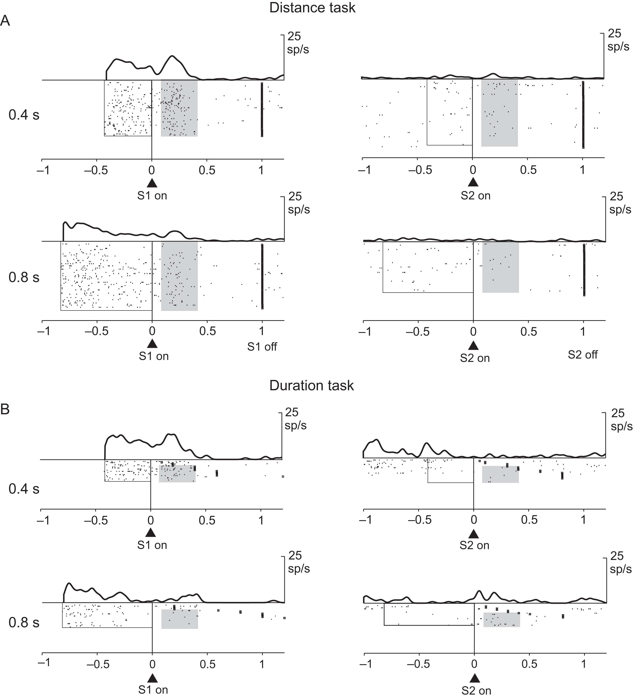
Figure 4. Neuron recorded in both the distance and the duration tasks (with the “V” set) showing both similarity ...
Notes:
Figure 4. Neuron recorded in both the distance and the duration tasks (with the “V” set) showing both similarity between tasks and context dependency for the 2 intervals. The neuron shows a preference for an interval 1 of 400 ms in both tasks, but no duration effect for interval 2. (A) Distance task. Top left: trials with an interval 1 of 400 ms. Bottom left: trials with an interval 1 of 800 ms. Top right: trials with an interval 2 of 400 ms. Bottom right: trials with an interval 2 of 800 ms. (B) as in A but for the duration task.
Unless provided in the caption above, the following copyright applies to the content of this slide: © The Author 2015. Published by Oxford University Press. All rights reserved. For Permissions, please e-mail: journals.permissions@oup.com

Slide 5
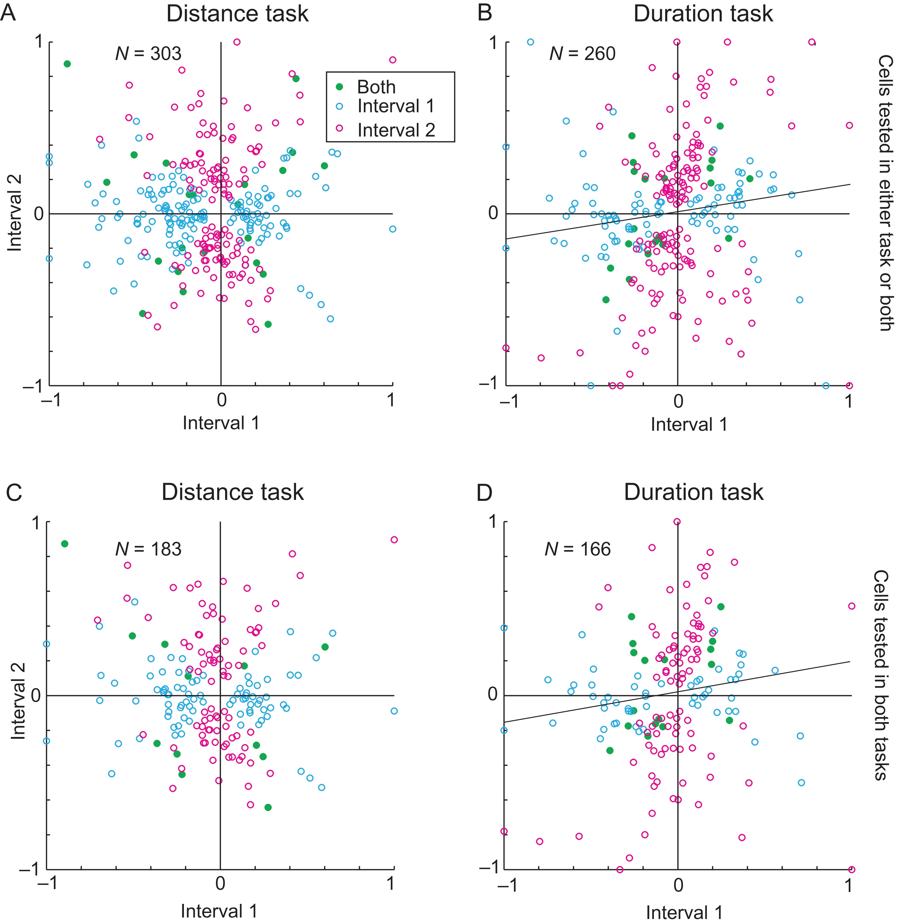
Figure 5. Scatter plots of modulation indices, as calculated for both intervals 1 and 2. Only cells with significant ...
Notes:
Figure 5. Scatter plots of modulation indices, as calculated for both intervals 1 and 2. Only cells with significant duration effects are included. (A) Interval 1 versus interval 2 for the distance task. (B) Interval 1 versus interval 2 for the duration task. (C and D) As in A and B, but only for the subpopulation of cells recorded in both tasks. The regression line is plotted for significant correlations only. Blue circles show the modulation indices for cells with significant duration effects only for interval 1; magenta circles represent cells with duration effects only for interval 2; and green circles represent cells that had duration effects for both intervals.
Unless provided in the caption above, the following copyright applies to the content of this slide: © The Author 2015. Published by Oxford University Press. All rights reserved. For Permissions, please e-mail: journals.permissions@oup.com

Slide 6
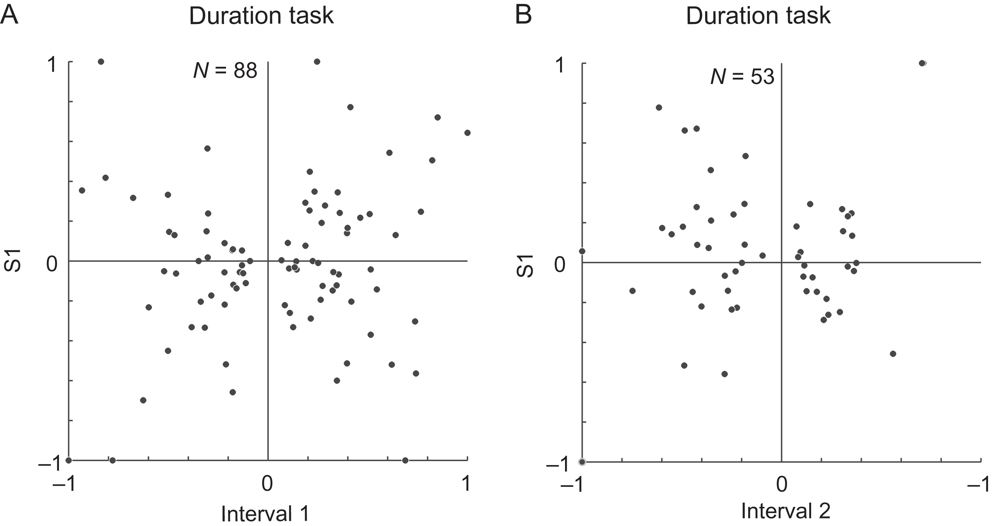
Figure 6. Scatter plots of the modulation indices for cells with significant duration effects for either interval 1 or ...
Notes:
Figure 6. Scatter plots of the modulation indices for cells with significant duration effects for either interval 1 or 2. (A) Interval 1 versus S1. (B) Interval 2 versus S1.
Unless provided in the caption above, the following copyright applies to the content of this slide: © The Author 2015. Published by Oxford University Press. All rights reserved. For Permissions, please e-mail: journals.permissions@oup.com

Slide 7
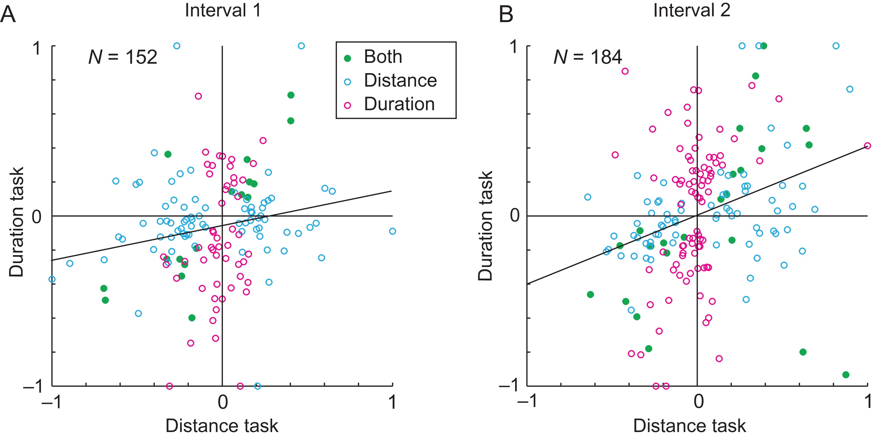
Figure 7. Between-task scatter plots of the modulation indices. (A) Interval 1. (B) Interval 2.
Notes:
Figure 7. Between-task scatter plots of the modulation indices. (A) Interval 1. (B) Interval 2.
Unless provided in the caption above, the following copyright applies to the content of this slide: © The Author 2015. Published by Oxford University Press. All rights reserved. For Permissions, please e-mail: journals.permissions@oup.com

Slide 8
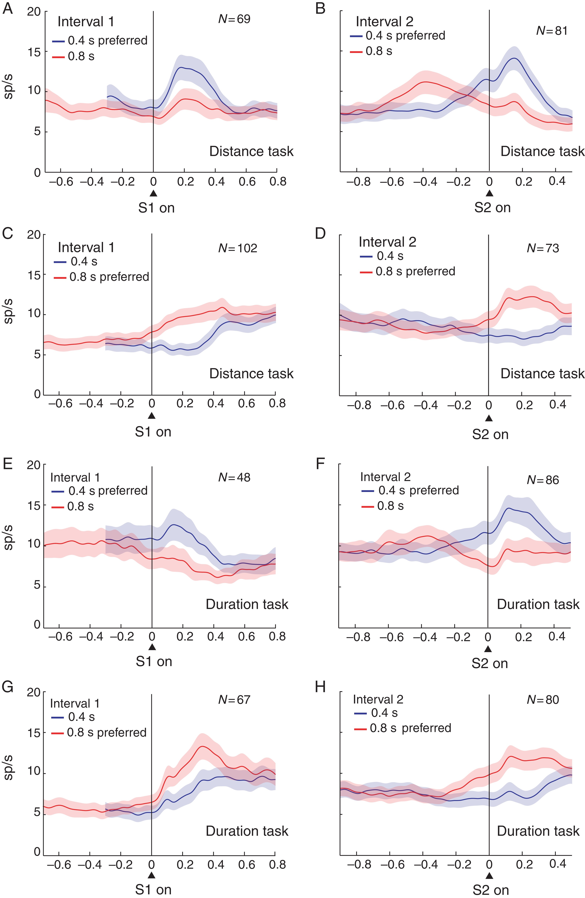
Figure 8. Population histograms showing the time course and the magnitude of duration effects for intervals 1 and 2. ...
Notes:
Figure 8. Population histograms showing the time course and the magnitude of duration effects for intervals 1 and 2. (A–D) Cells recorded in the distance task. (A) Cells with preference for an interval 1 of 400 ms. (B) Cells with preference for an interval 2 of 400 ms. (C) Cells with preference for an interval 1 of 800 ms. (D) Cells with preference for an interval 2 of 800 ms. (E–H) Cells recorded in the duration task, divided as in A–D.
Unless provided in the caption above, the following copyright applies to the content of this slide: © The Author 2015. Published by Oxford University Press. All rights reserved. For Permissions, please e-mail: journals.permissions@oup.com

