Slide 1
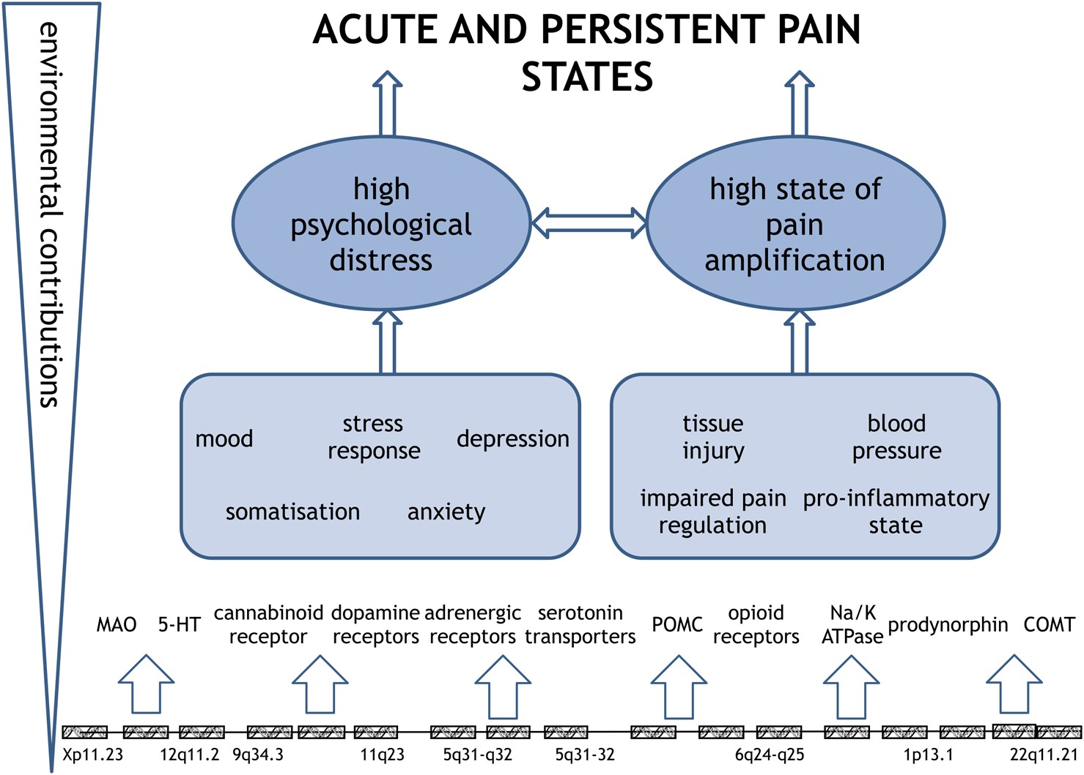
Fig 1 Model depicting likely determinants that contribute to the risk of onset and maintenance of acute and ...
Notes:
Fig 1 Model depicting likely determinants that contribute to the risk of onset and maintenance of acute and persistent pain states.
Unless provided in the caption above, the following copyright applies to the content of this slide: © The Author 2016. Published by Oxford University Press on behalf of the British Journal of Anaesthesia. All rights reserved. For Permissions, please email: journals.permissions@oup.com

