Slide 1
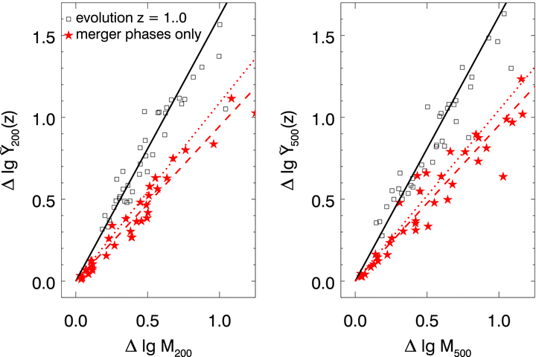
Figure 6 Logarithmic mass growth and increase in SZ signal scaled for cosmological evolution for all clusters in ...
Notes:
Figure 6 Logarithmic mass growth and increase in SZ signal scaled for cosmological evolution for all clusters in sample A. The left-hand panel shows the evolution within Δ= 200, the right-hand panel for Δ= 500. The black open symbols show the overall evolution of individual clusters between z= 1 and 0, the black solid lines are the best linear fit with zero intercept to these points, yielding a slope of 1.62 ± 0.19 at Δ= 200 (1.62 ± 0.29 at Δ= 500), consistent with the slope of the best-fitting scaling relation. Filled, red stars show the evolution of each cluster during merger phases, the dashed lines are the best linear fit with zero intercept to the evolution during mergers with slope 0.94 ± 0.15 (0.95 ± 0.22). The dotted lines show the best-fitting slope for the evolution during mergers when the merger criterion is relaxed to times when the fractional accretion rate per unit redshift is larger than the mean fractional accretion rate per unit redshift.
Unless provided in the caption above, the following copyright applies to the content of this slide: © 2011 The Authors Monthly Notices of the Royal Astronomical Society © 2011 RAS

Slide 2
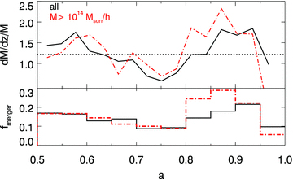
Figure 1 Fractions accretion rate per unit redshift (top panel) and merger fraction as a function of scalefactor. The ...
Notes:
Figure 1 Fractions accretion rate per unit redshift (top panel) and merger fraction as a function of scalefactor. The solid line shows the complete sample A, the dot–dashed line a subsample of massive clusters. The dotted line indicates the overall mean accretion rate. Accretion rate (merger fraction) are averaged over three (five) neighbouring simulation snapshots to reduce noise.
Unless provided in the caption above, the following copyright applies to the content of this slide: © 2011 The Authors Monthly Notices of the Royal Astronomical Society © 2011 RAS

Slide 3
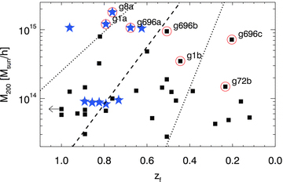
Figure 2 Distribution of formation redshifts z_{f} as a function of cluster mass. The symbols represent ...
Notes:
Figure 2 Distribution of formation redshifts zf as a function of cluster mass. The symbols represent clusters from sample A, the most massive cluster in each resimulation region is marked with a star symbol. Dashed (dotted) lines show a fit to the mean (1σ scatter) formation redshift as a function of friends-of-friends mass found in the Millennium Run (McBride et al. 2009), converted to spherical overdensity mass assuming M200= 0.7MFOF (see text for details). Formation redshift is defined as the redshift at which a halo reaches half its present-day mass. One cluster in sample A forms before z= 1, indicated by the left arrow. Open circles indicate the clusters shown as examples in subsequent plots, labels indicate the names of these clusters in Table 1 of Dolag et al. (2009).
Unless provided in the caption above, the following copyright applies to the content of this slide: © 2011 The Authors Monthly Notices of the Royal Astronomical Society © 2011 RAS

Slide 4
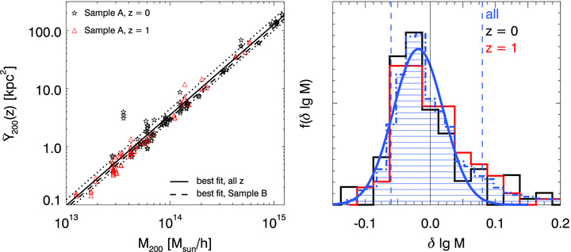
Figure 3 Left: relation between mass M₂₀₀ and integrated Compton Y₂₀₀ parameter for the z= 0 ...
Notes:
Figure 3 Left: relation between mass M200 and integrated Compton Y200 parameter for the z= 0 (stars) and z= 1 clusters (triangles) in sample A. The Compton Y parameter has been scaled to absorb the redshift evolution of the scaling relation in order to show the power-law relation . The solid and dotted lines show the best-fitting scaling relation for sample A and its 1σ error. For reference, the dashed line indicates the best-fitting scaling relation for sample B. Right: distribution of residuals of the best-fitting scaling relation for the full sample (filled histogram) and the redshift subsamples (black/red line), and the best-fitting Gaussian to the full distribution. The vertical dashed lines illustrate the 10 per cent and 90 per cent quantile for the full sample, illustrating the non-lognormality of the scatter distribution.
Unless provided in the caption above, the following copyright applies to the content of this slide: © 2011 The Authors Monthly Notices of the Royal Astronomical Society © 2011 RAS

Slide 5
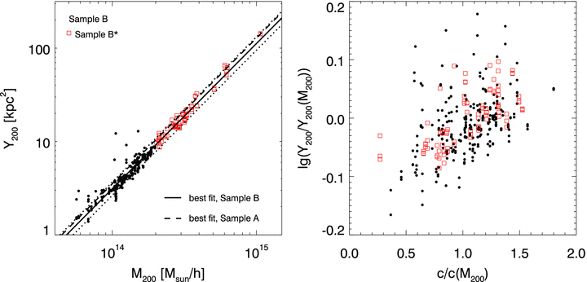
Figure 4 Left: relation between mass M₂₀₀ and integrated Compton Y₂₀₀ parameter for cluster ...
Notes:
Figure 4 Left: relation between mass M200 and integrated Compton Y200 parameter for cluster sample B. Massive clusters with M200 > 2 × 1014 M⊙ h−1 are shown with filled symbols. The solid and dotted lines show the best-fitting scaling relation for sample B and its 1σ error. For reference, the dashed line indicates the best-fitting scaling relation for sample A. The strong outliers with boosted Y signal in the low-mass range are visually identified to be caused by projection effects. Right: residuals of the Y–M relation at fixed mass versus scatter in the mass–halo concentration relation at fixed mass. Concentration measurements are from Ameglio et al. (2009); see text for details on the determination of c/c(M200).
Unless provided in the caption above, the following copyright applies to the content of this slide: © 2011 The Authors Monthly Notices of the Royal Astronomical Society © 2011 RAS

Slide 6
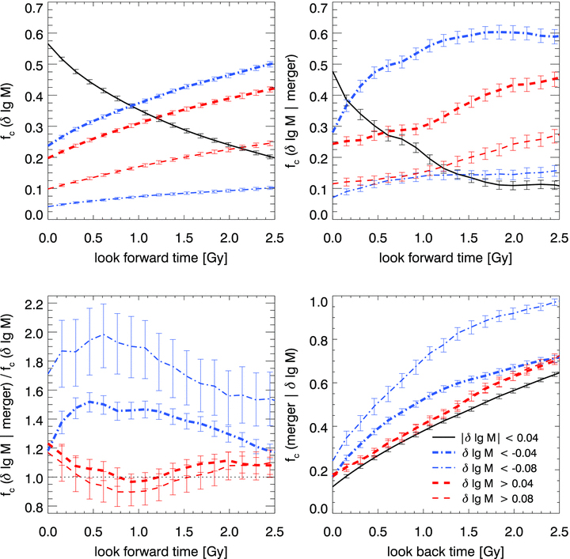
Figure 7 Top left: cumulative probability for a cluster to deviate from the scaling relation by as a function of ...
Notes:
Figure 7 Top left: cumulative probability for a cluster to deviate from the scaling relation by as a function of time. Thick (thin) dot–dashed blue lines show the fraction of clusters deviating at least 0.04 (0.08) below the scaling relation, corresponding to a bias of 10 per cent (20 per cent) in the inferred mass. Thick (thin) dashed lines show the fraction of clusters deviating at least 0.04 (0.08) above the scaling relation. The black solid lines show the fraction of cluster which deviate less that 10 per cent from the scaling relation within a given time. In all panels, error bars indicate statistical errors estimated from 100 bootstrap realizations. Top right: the same for merging clusters. Note that extended merging events are counted as multiple mergers, effectively giving more weight to major mergers. Bottom left: ratio of the above panels, highlighting the enhanced probability for mergers to evolve below the scaling relation compared to an average cluster. Bottom right: cumulative fraction of clusters which have undergone a merger as a function of look-back time and their current deviation from the scaling relation.
Unless provided in the caption above, the following copyright applies to the content of this slide: © 2011 The Authors Monthly Notices of the Royal Astronomical Society © 2011 RAS

Slide 7
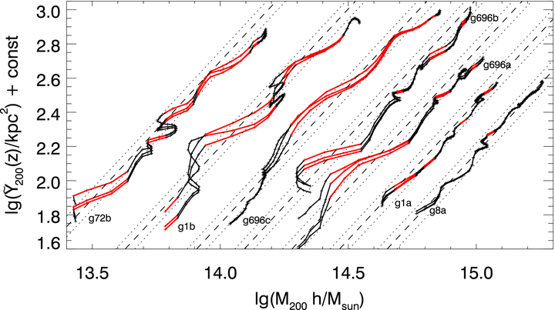
Figure 5 Evolution of six massive clusters in mass and , the redshift evolution scaled Y₂₀₀. Offsets are ...
Notes:
Figure 5 Evolution of six massive clusters in mass and , the redshift evolution scaled Y200. Offsets are added to show all clusters in one plot. We show three orthogonal projections for each cluster to illustrate the magnitude of projection effects. Phases identified as merging events are shown in red. The dashed and dotted lines show the best-fitting scaling relation for sample A and its 1σ error.
Unless provided in the caption above, the following copyright applies to the content of this slide: © 2011 The Authors Monthly Notices of the Royal Astronomical Society © 2011 RAS

Slide 8
Figure 8 Evolution of morphological parameters G, A, Ψ for four massive clusters from sample A; different lines in ...
Notes:
Figure 8 Evolution of morphological parameters G, A, Ψ for four massive clusters from sample A; different lines in each panel show the three orthogonal projections. The bottom panel shows the fractional accretion rate on a logarithmic scale, the dotted and dashed lines indicate the mean accretion and the accretion rate threshold used to define mergers throughout this analysis. Vertical lines mark the onset of mergers, i.e. the time when the fractional accretion rate first crosses the threshold used to define mergers. At the onset of a merger, clusters appear less concentrated, more asymmetric and show more substructure.
Unless provided in the caption above, the following copyright applies to the content of this slide: © 2011 The Authors Monthly Notices of the Royal Astronomical Society © 2011 RAS

Slide 9
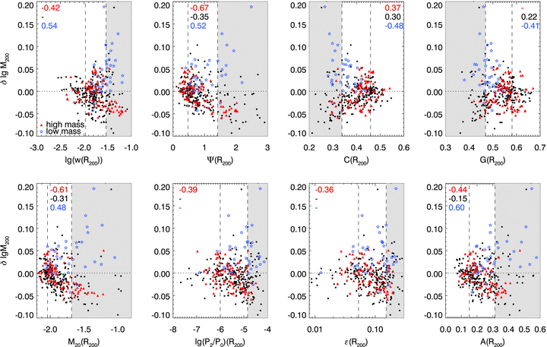
Figure 9 Relation between scatter in the M₂₀₀(Y₂₀₀) relation and morphological parameters for ...
Notes:
Figure 9 Relation between scatter in the M200(Y200) relation and morphological parameters for all clusters from sample B measured within an aperture of size R200. Open star symbols show clusters with M < 1014 M⊙ h−1, filled circles show clusters with 1014 M⊙ h−1 < M < 2 × 1014 M⊙ h−1, and filled triangles show massive clusters with M > 2 × 1014 M⊙ h−1. Dashed vertical lines indicate the 25 and 75 per cent quantiles of the morphology distribution. Shaded regions contain the 25 per cent of the data points which are classified as most disturbed by that morphological parameter. Numbers in the upper left or right corner give the Spearman rank correlation coefficient between the morphological parameter and scatter in the M(Y) relation. From top to bottom, these numbers are for mass samples M > 2 × 1014 M⊙ h−1, M > 1014 M⊙ h−1, M < 1014 M⊙ h−1. If a correlation is not significant (significance level >0.01), we do not list the correlation coefficient.
Unless provided in the caption above, the following copyright applies to the content of this slide: © 2011 The Authors Monthly Notices of the Royal Astronomical Society © 2011 RAS

Slide 10
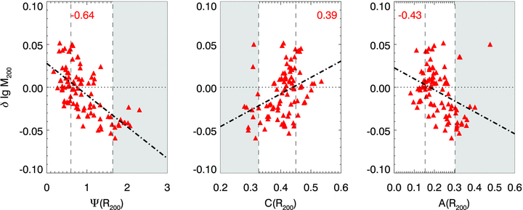
Figure 10 Relation between scatter in the M₂₀₀(Y₂₀₀) relation and morphological parameters for ...
Notes:
Figure 10 Relation between scatter in the M200(Y200) relation and morphological parameters for clusters with M > 2 × 1014 M⊙ h−1 from sample B, measured from SZ maps smoothed with a Gaussian beam with an FWHM of 150 kpc and sampled at a pixel scale of 37.5 kpc. Dashed vertical lines indicate the 25 and 75 per cent quantiles of the morphology distribution. Shaded regions contain the 25 per cent of the data points which are classified as most disturbed by that morphological parameter. Numbers in the upper left or right corner give the Spearman rank correlation coefficient between the morphological parameter and scatter in the M(Y) relation. Dot–dashed lines show the best-fitting linear relation.
Unless provided in the caption above, the following copyright applies to the content of this slide: © 2011 The Authors Monthly Notices of the Royal Astronomical Society © 2011 RAS

