Slide 1
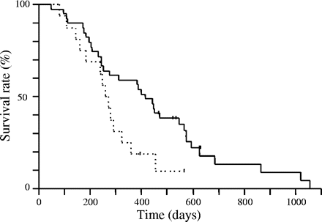
Figure 1. Survival of patients with or without favorable phenotypes. The solid line and dotted line represent patients ...
Notes:
Figure 1. Survival of patients with or without favorable phenotypes. The solid line and dotted line represent patients with or without 2 or 3 favorable phenotypes, respectively (P = 0.021).
Unless provided in the caption above, the following copyright applies to the content of this slide: © 2005 Foundation for Promotion of Cancer Research

