Slide 1
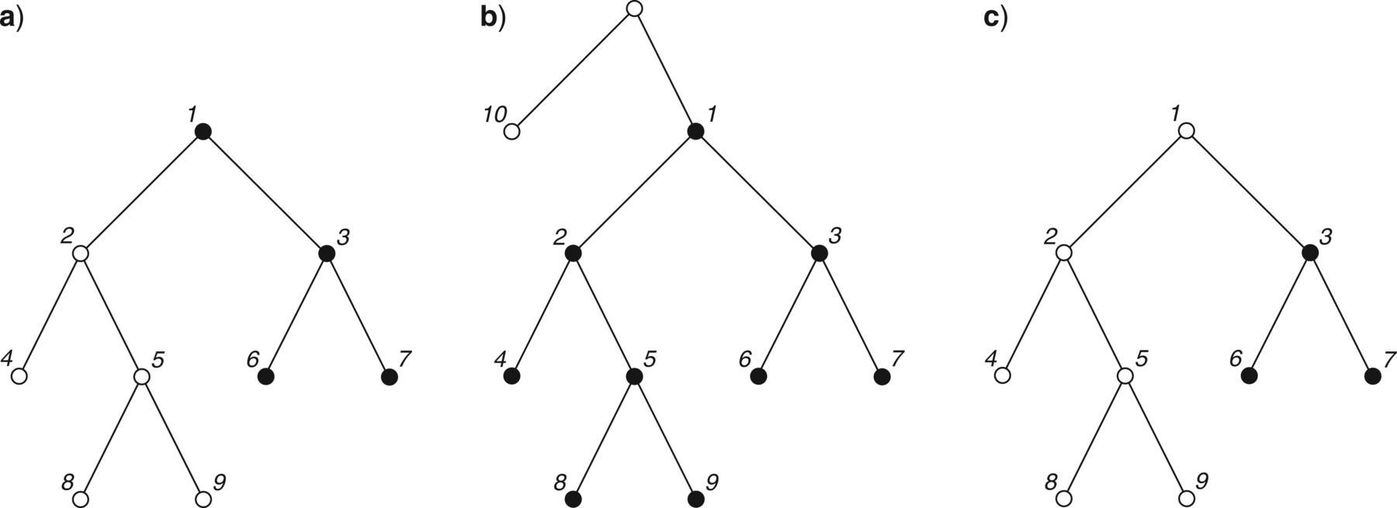
Figure 2 Erroneously and correctly inferred clade compositions under branch-based definitions on a relationship tree. ...
Notes:
Figure 2 Erroneously and correctly inferred clade compositions under branch-based definitions on a relationship tree. a) Example of Martin et al. (2010) in which the circumscribed group supposedly includes species 1, 3, 6, and 7; the group is paraphyletic because it does not include all of the descendants of ancestor 1 (2, 4, 5, 8, and 9 are excluded). b) Example illustrating that using a standard branch-based definition to infer the composition of a clade that includes species 1, 3, 6, and 7 will also include the other descendants of species 1 (2, 4, 5, 8, and 9). Here, the name is defined as designating the clade originating in the earliest ancestor of 7 that is not an ancestor of 10. The earliest ancestor of 7 that is not an ancestor of 10 is 1, so the designated clade contains 1 and all of its descendants (2–9). c) Example illustrating that a using standard branch-based definition to infer the composition of a clade that excludes species 2, 4, 5, 8, and 9 will also exclude species 1. Here, the name is defined as designating the clade originating in the earliest ancestor of 7 that is not an ancestor of 9. The earliest ancestor of 7 that is not an ancestor of 9 is 3, and therefore the clade includes 3, 6, and 7 and excludes 2, 4, 5, 8, and 9 as well as 1. In all three diagrams, the branches of the trees represent ancestor-descendant relationships, and the nodes represent species. Species included in the relevant group or clade are represented by black nodes.
Unless provided in the caption above, the following copyright applies to the content of this slide: © The Author(s) 2013. Published by Oxford University Press, on behalf of the Society of Systematic Biologists. All rights reserved. For Permissions, please email: journals.permissions@oup.com

Slide 2
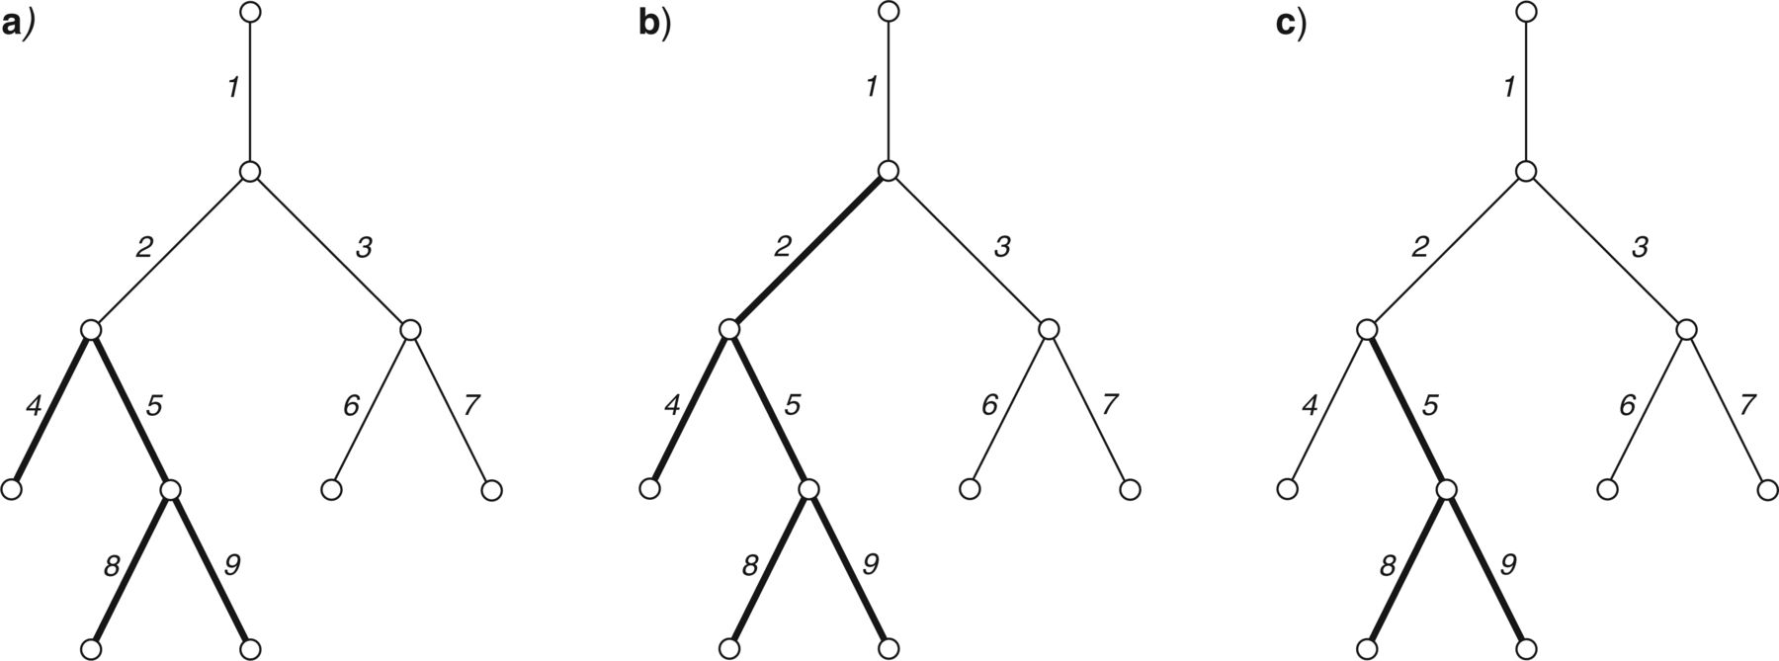
Figure 1 Erroneously and correctly inferred clade compositions under node-based definitions on a lineage tree. a) ...
Notes:
Figure 1 Erroneously and correctly inferred clade compositions under node-based definitions on a lineage tree. a) Example of Martin et al. (2010) in which the circumscribed group supposedly includes species 4, 5, 8, and 9 but not 2; the group is polyphyletic because the MRCA (2) of the included species is not itself included. b) Example illustrating that using a standard node-based definition to infer the composition of a clade that includes species 4, 5, 8, and 9 will also include species 2. Here, the name is defined as designating the clade originating in the MRCA of 4 and 9. The MRCA of 4 and 9 is 2, which is therefore included in the clade. c) Example illustrating that using a standard node-based definition to infer the composition of a clade that excludes species 2 will also exclude at least one of the species from the set {4, 5, 8, 9}. Here, the name is defined as designating the clade originating in the MRCA of 8 and 9. The MRCA of 8 and 9 is 5, and therefore the clade includes 5, 8, and 9 but excludes not only 2 but also 4. In all three diagrams, the branches of the trees represent lineage segments (species), and the nodes represent speciation events. Species included in the relevant group or clade are represented by thicker branches.
Unless provided in the caption above, the following copyright applies to the content of this slide: © The Author(s) 2013. Published by Oxford University Press, on behalf of the Society of Systematic Biologists. All rights reserved. For Permissions, please email: journals.permissions@oup.com

Slide 3
Figure 3 Rationale for the names “node-based” and “branch-based” phylogenetic definitions. a) “Node-based” refers to ...
Notes:
Figure 3 Rationale for the names “node-based” and “branch-based” phylogenetic definitions. a) “Node-based” refers to the fact that definitions of this kind specify the ancestor in which the clade being named originated as the point in the tree where the ancestral lineages of the internal specifiers (in this case, A and B) coalesce. It is natural to equate such a point with a node, represented by the black dot in the diagram. b) “Branch-based” refers to the fact that definitions of this kind specify the ancestor in which the clade being named originated as the first segment in a lineage that is ancestral to the internal specifier (in this case, A) but not to the external specifier (in this case, C). It is natural to equate such a lineage segment with a branch, represented by the thick line with an arrow in the diagram. In both diagrams, the trees are lineage trees in the sense described in the PhyloCode (where a node represents an ancestor at the instant of a speciation event rather than the speciation event itself); the specifiers are positioned at the ends of branches to indicate that the clades may include other species that are not shown (e.g., species that are more closely related to A than to B).
Unless provided in the caption above, the following copyright applies to the content of this slide: © The Author(s) 2013. Published by Oxford University Press, on behalf of the Society of Systematic Biologists. All rights reserved. For Permissions, please email: journals.permissions@oup.com

Slide 4
Figure 4 If the ancestor in which a clade originates is considered to be an entire species (rather than the last part ...
Notes:
Figure 4 If the ancestor in which a clade originates is considered to be an entire species (rather than the last part of a species), it might seem that minimum- and maximum-clade definitions are simply different methods for specifying the same clades and ancestors. For the relationship tree illustrated in a) the last common ancestor of A and B (minimum-clade definition) and the earliest ancestor of A that is not an ancestor of C (maximum-clade definition) refer to the same clade, the members of which are represented by black nodes. The same is true for the lineage tree illustrated in b), where the members of the specified clade are represented by thicker branches. Although this conclusion of equivalency would be correct if all species that have ever existed and their phylogenetic relationships were known with certainty, its limitations in the context of incomplete and provisional knowledge are illustrated in Figures 5–7.
Unless provided in the caption above, the following copyright applies to the content of this slide: © The Author(s) 2013. Published by Oxford University Press, on behalf of the Society of Systematic Biologists. All rights reserved. For Permissions, please email: journals.permissions@oup.com

Slide 5
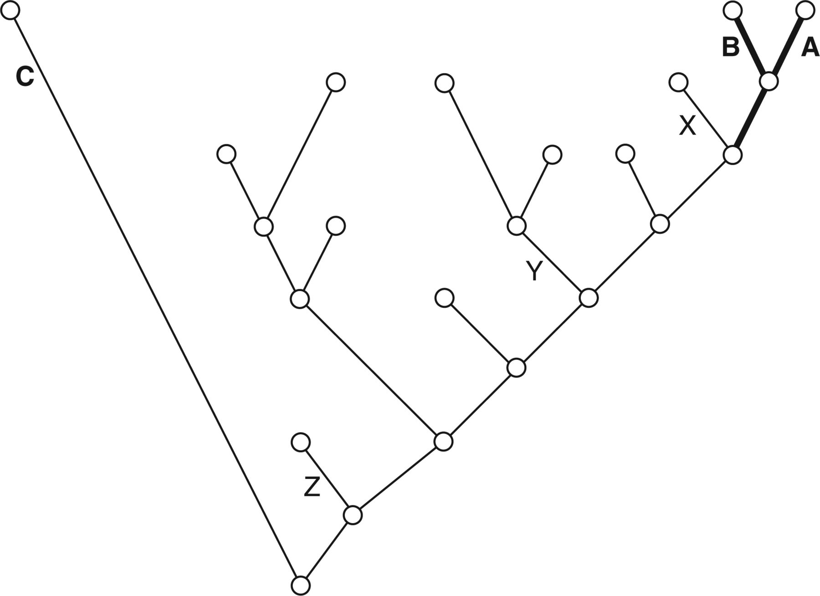
Figure 5 Limitations of maximum-clade (“branch-based”) and utility of minimum-clade (“node-based”) definitions for ...
Notes:
Figure 5 Limitations of maximum-clade (“branch-based”) and utility of minimum-clade (“node-based”) definitions for defining the names of crown clades. To define the name of the crown clade composed of species A and B using a maximum-clade definition, a member of the immediate sister group of the crown clade—in this case, extinct species X—must be used as an external specifier in the defining formula (e.g., max [A not X]). If species X has not been discovered and the name of a different member of the stem group (e.g., Y or Z) is used instead, the name will not refer to the crown clade. By contrast, the minimum-clade defining formula min (A and B) can be used to apply a name to the crown clade without knowledge of X or any other member of the stem group. The tree illustrated here is a lineage tree, and the ancestors in which clades originate are considered to be entire species (rather than parts thereof). The vertical component of the diagram represents time, with the present represented by the level of the terminal nodes of branches A, B, and C. Members of the crown clade to be named are indicated by thicker branches.
Unless provided in the caption above, the following copyright applies to the content of this slide: © The Author(s) 2013. Published by Oxford University Press, on behalf of the Society of Systematic Biologists. All rights reserved. For Permissions, please email: journals.permissions@oup.com

Slide 6
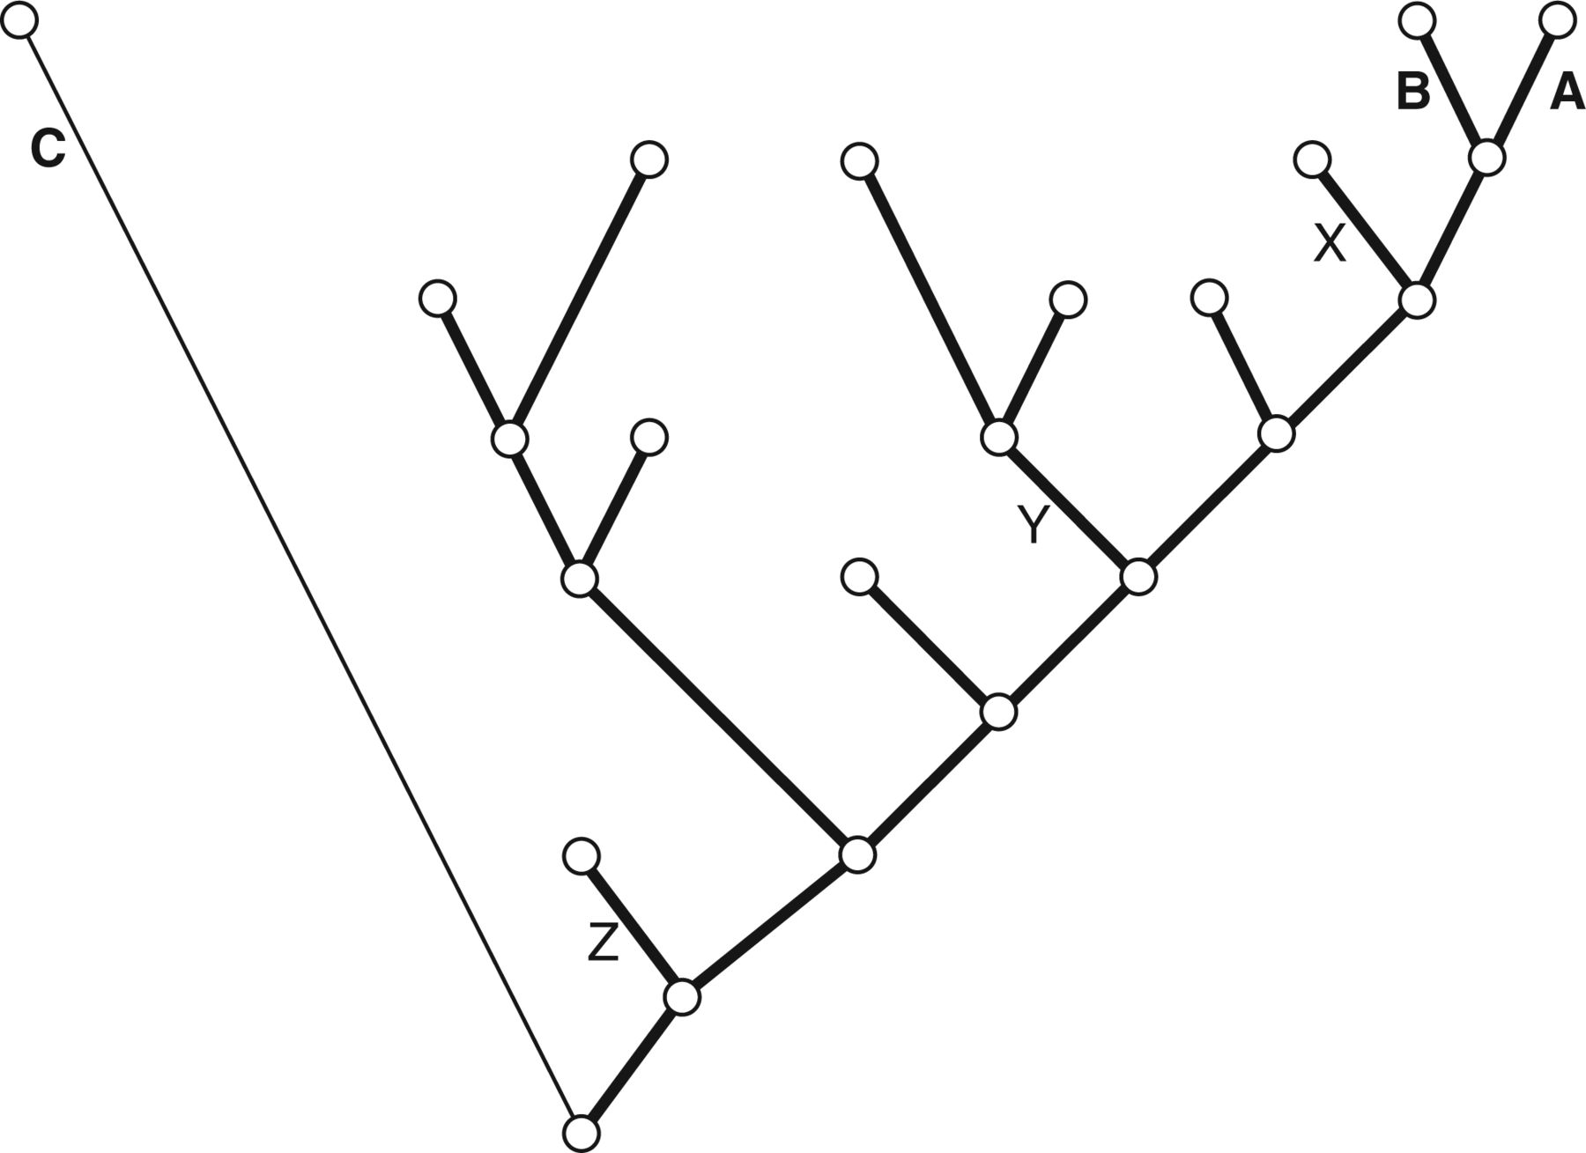
Figure 6 Limitations of minimum-clade (“node-based”) and utility of maximum-clade (“branch-based”) definitions for ...
Notes:
Figure 6 Limitations of minimum-clade (“node-based”) and utility of maximum-clade (“branch-based”) definitions for defining the names of total clades. To define the name of the total clade corresponding to the crown clade composed of species A and B using a minimum-clade definition, a member of the extinct group representing the first divergence within the total clade—in this case, extinct species Z—must be used as an internal specifier in the defining formula (e.g., min [A and Z]). If species Z has not been discovered and the name of a different member of the stem group (e.g., X or Y) is used instead, the name will not refer to the total clade. By contrast, the maximum-clade defining formula max (A not C) can be used to apply a name to the total clade without knowledge of Z or any other member of the stem group. The tree illustrated here is a lineage tree and the ancestors in which clades originate are considered to be entire species (rather than parts thereof). The vertical component of the diagram represents time, with the present represented by the level of the terminal nodes of branches A, B, and C. Members of the total clade to be named are indicated by thicker branches.
Unless provided in the caption above, the following copyright applies to the content of this slide: © The Author(s) 2013. Published by Oxford University Press, on behalf of the Society of Systematic Biologists. All rights reserved. For Permissions, please email: journals.permissions@oup.com

Slide 7
Figure 7 Different consequences of minimum-clade (“node-based”) and maximum-clade (“branch-based”) definitions in the ...
Notes:
Figure 7 Different consequences of minimum-clade (“node-based”) and maximum-clade (“branch-based”) definitions in the context of alternative phylogenetic hypotheses. The following definitions are applied in the context of the three phylogenetic hypotheses illustrated in a–c: Athena = min (A and B); Minerva = max (A not C). In the context of phylogenetic hypothesis a), both Athena and Minerva refer to the same clade (the names are synonymous). In the context of hypothesis b), Minerva refers to a more inclusive clade than does Athena. In the context of hypothesis c), Athena refers to a more inclusive clade than does Minerva. All three trees are relationship trees (branches represent relationships; nodes represent species). Gray-filled circles = members of Athena only; black-filled circles = members of Minerva only; gray- and black-filled circles = members of both Athena and Minerva; unfilled circles = members of neither Athena nor Minerva.
Unless provided in the caption above, the following copyright applies to the content of this slide: © The Author(s) 2013. Published by Oxford University Press, on behalf of the Society of Systematic Biologists. All rights reserved. For Permissions, please email: journals.permissions@oup.com

