Slide 1
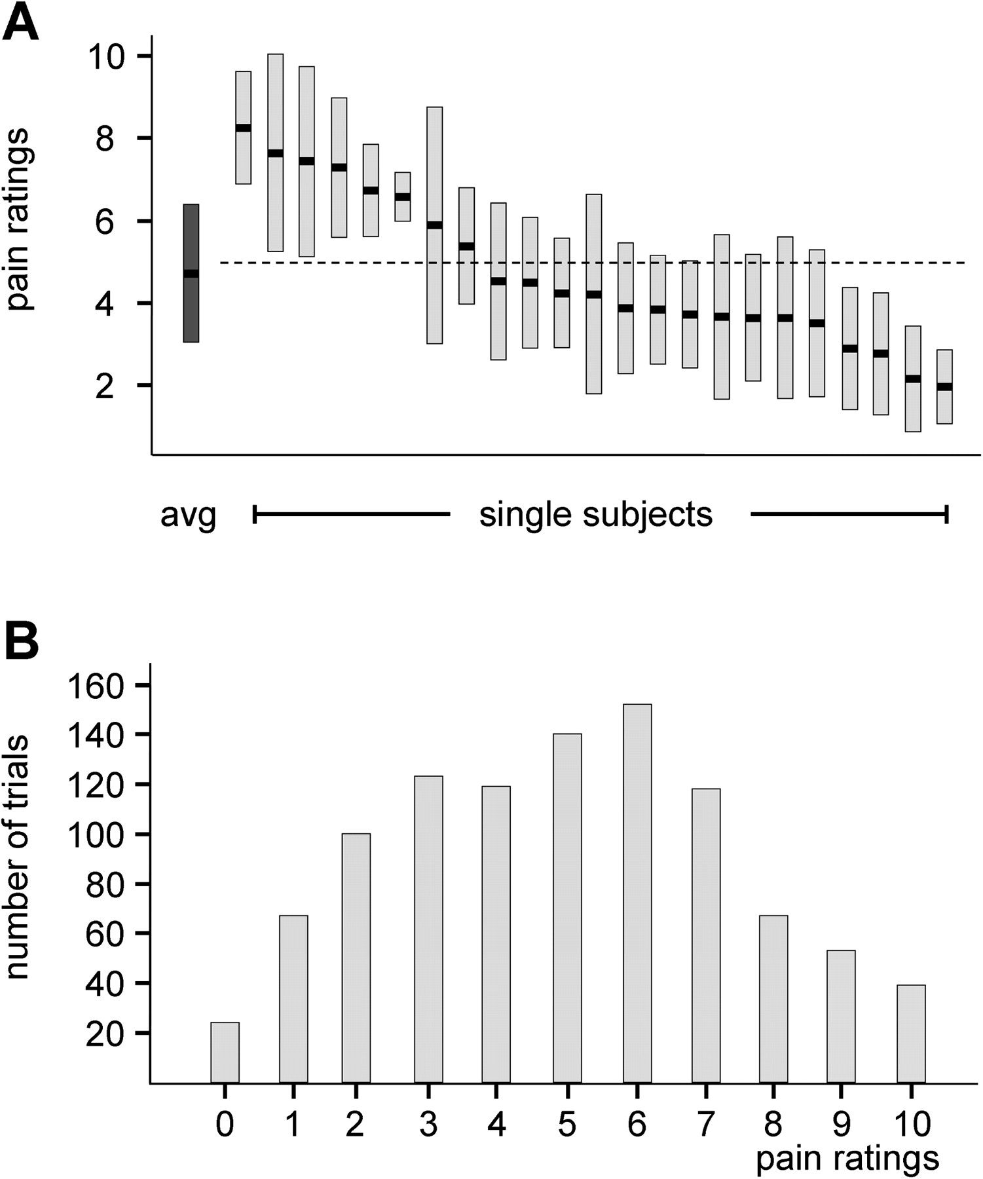
Figure 1. Behavioral data. (A) Individual pain ratings (light gray, mean ± standard deviations) and the mean pain ...
Notes:
Figure 1. Behavioral data. (A) Individual pain ratings (light gray, mean ± standard deviations) and the mean pain rating across all subjects (black, mean ± standard deviation). Subjects with a mean pain rating of >5 or ≤5 (dashed horizontal line) were labeled pain sensitive or pain insensitive, respectively. (B) Distribution of single-trial pain ratings.
Unless provided in the caption above, the following copyright applies to the content of this slide: © The Author 2011. Published by Oxford University Press. All rights reserved. For permissions, please e-mail: journals.permissions@oup.com

Slide 2
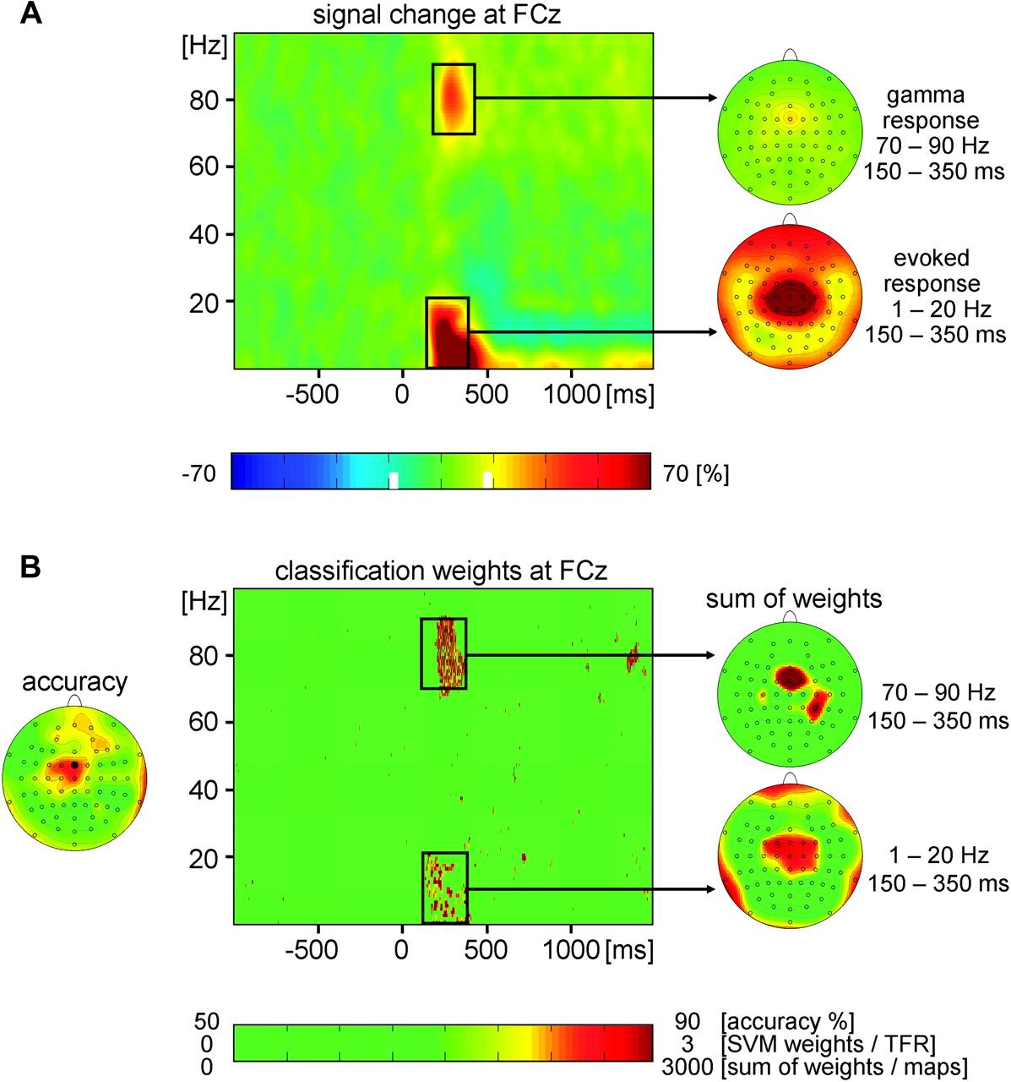
Figure 2. (A) Neuronal responses to painful stimuli. TFR of neuronal activity at electrode FCz coded as percent signal ...
Notes:
Figure 2. (A) Neuronal responses to painful stimuli. TFR of neuronal activity at electrode FCz coded as percent signal change with respect to a prestimulus baseline (left). The group mean TFR has been averaged across trials and subjects. Group mean topography of gamma and evoked responses coded as percent signal change with respect to a prestimulus baseline (right). (B) Decoding an individual's sensitivity to pain. Topography of classification accuracy for the single-trial TFR data (left). The SVM discrimination TFR at electrode FCz shows the classification weight, that is, the predictive value as a function of time and frequency (middle). Topography of classification weights for the gamma response and the evoked theta response (right).
Unless provided in the caption above, the following copyright applies to the content of this slide: © The Author 2011. Published by Oxford University Press. All rights reserved. For permissions, please e-mail: journals.permissions@oup.com

Slide 3
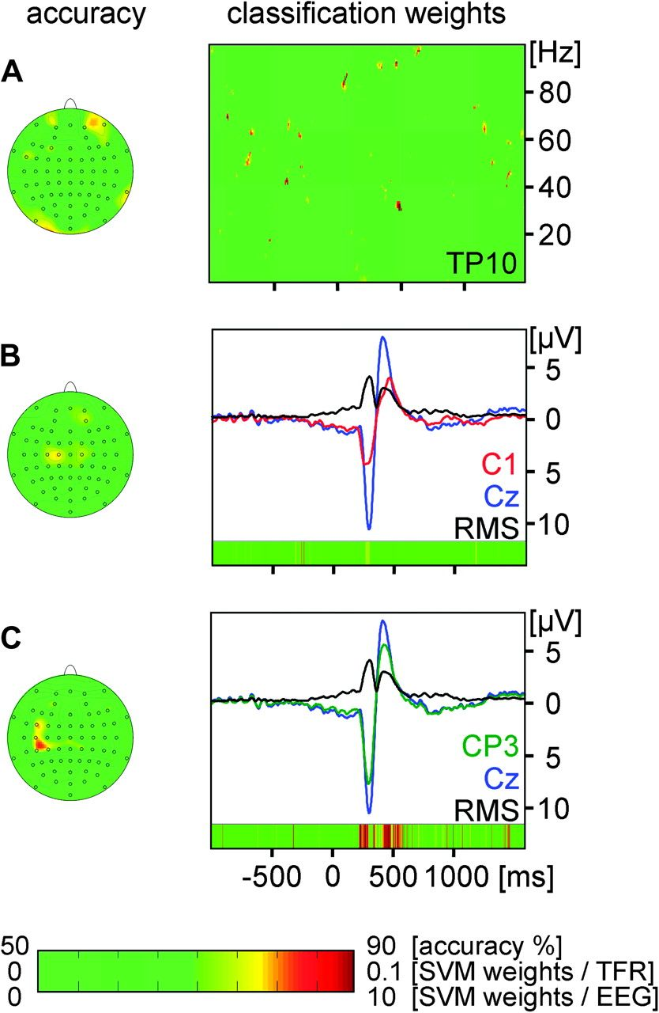
Figure 3. Decoding an individual's sensitivity to pain based on (A) the averaged TFR, (B) the single-trial raw EEG ...
Notes:
Figure 3. Decoding an individual's sensitivity to pain based on (A) the averaged TFR, (B) the single-trial raw EEG data, and (C) the averaged EP. Left panels show topographies of classification accuracy. Right panels show SVM classification weights color coded as a function of time and frequency (A) and as a function of time (B,C). (A) and (C) also include time courses of signals at selected electrodes and root mean squares (RMSs) of all electrodes.
Unless provided in the caption above, the following copyright applies to the content of this slide: © The Author 2011. Published by Oxford University Press. All rights reserved. For permissions, please e-mail: journals.permissions@oup.com

