Slide 1
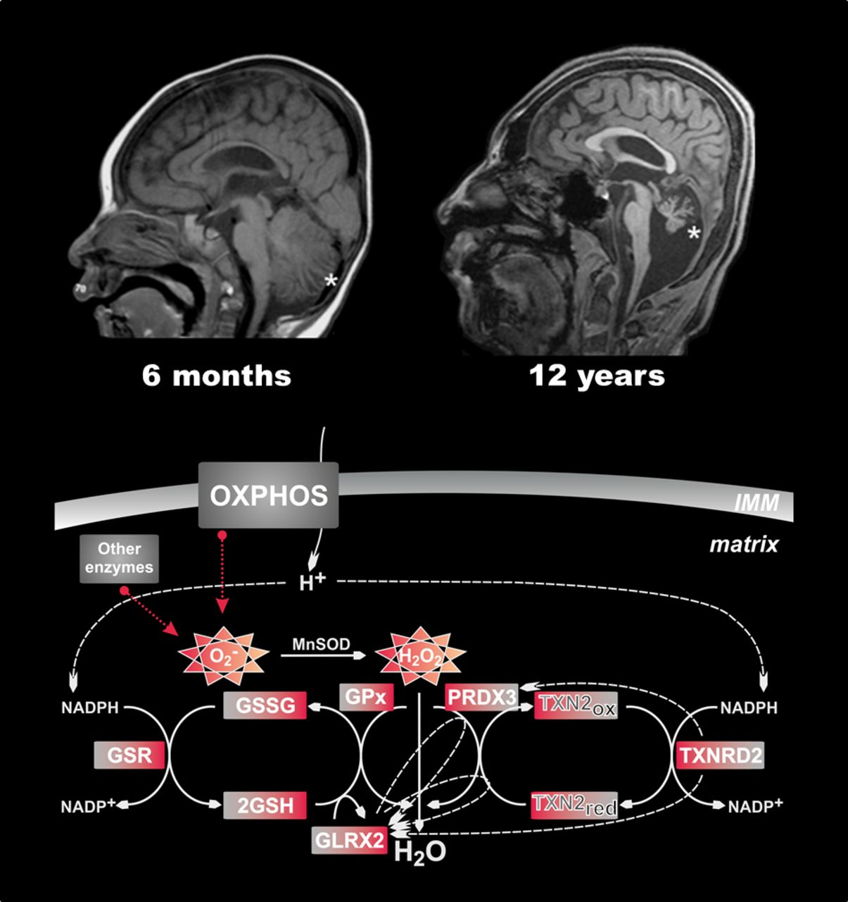
Thioredoxin-2 (TXN2) is a redox protein essential for mitochondrial reactive oxygen species (ROS) ...
Notes:
Thioredoxin-2 (TXN2) is a redox protein essential for mitochondrial reactive oxygen species (ROS) homeostasis. Using exome sequencing, Holzerova et al. uncover a homozygous stop mutation in TXN2 in an adolescent with infantile-onset neurodegeneration and severe cerebellar atrophy. Antioxidant supplementation suppresses ROS production, improves cell viability and mitigates clinical symptoms.
Unless provided in the caption above, the following copyright applies to the content of this slide: © The Author (2015). Published by Oxford University Press on behalf of the Guarantors of Brain. All rights reserved. For Permissions, please email: journals.permissions@oup.com

Slide 2
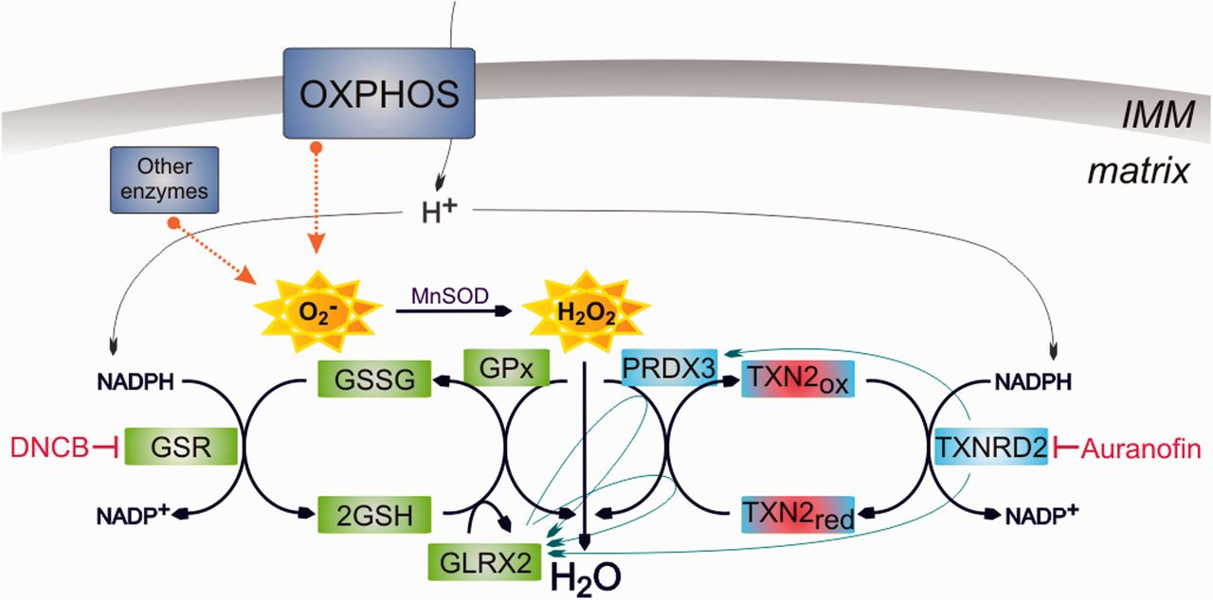
Figure 1 Function of TXN2 in the ROS defence system. The schematic representation of the ROS scavenging systems shows ...
Notes:
Figure 1 Function of TXN2 in the ROS defence system. The schematic representation of the ROS scavenging systems shows involved proteins in two crosslinked pathways within the mitochondrial matrix. Different proteins as well as complexes of the oxidative phosphorylation system (OXPHOS) produce reactive oxygen species in the form of superoxide (O2−), which spontaneously converts to hydrogen peroxide (H2O2), or with the help of manganese superoxide dismutase (MnSOD). Within mitochondria, H2O2 is sensed by PRDX3 and oxidation of PRDX3 is reduced by TXN2, which is highlighted in red due to a missing function. TXN2 is reduced by TXNRD2 and NAPDH. In the glutathione pathway, glutathione peroxidase (GPx) reduces H2O2 and is subsequently reduced by GSH molecules, which form dimers (GSSG) or by glutaredoxin 2 (GLRX2). Using NADPH, glutathione reductase (GSR) reduces dimers of GSH. Inhibitors of the systems are depicted in red. DNCB = 2,4-dinitrochlorobenzene; IMM = inner mitochondrial membrane.
Unless provided in the caption above, the following copyright applies to the content of this slide: © The Author (2015). Published by Oxford University Press on behalf of the Guarantors of Brain. All rights reserved. For Permissions, please email: journals.permissions@oup.com

Slide 3
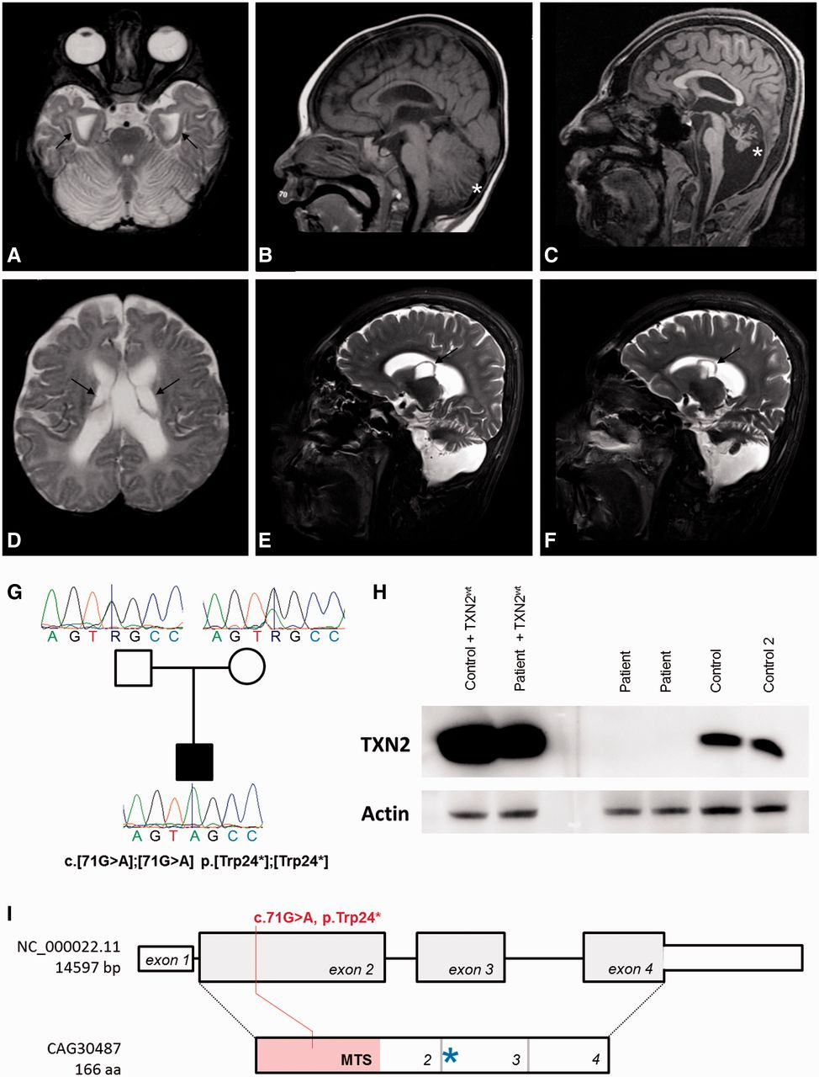
Figure 2 Brain imaging and genetic findings. (A) Brain MRI, T₂-weighted image, axial view at the age of 6 ...
Notes:
Figure 2 Brain imaging and genetic findings. (A) Brain MRI, T2-weighted image, axial view at the age of 6 months demonstrating bilateral abnormal hippocampal shape (black arrows). Moreover, an abnormally increased T2 signal intensity of the cerebellum is observed. (B and C) T1-weighted images, sagittal view at the age of 6 months (B) and 12 years (C) showing the development of severe cerebellar atrophy (cerebellum is marked by asterisks). (D) T2-weighted image, axial view at the age of 6 months demonstrating large bilateral subependymal cysts (black arrows). (E and F) T2-weighted images, right (E) and left (F) parasagittal view at the age of 12 years, also depicting the bilateral subependymal cysts. (G) Homozygous mutation in a patient sample was confirmed by Sanger sequencing. Non-consanguineous parents are both heterozygous carriers of the mutation. (H) Total cell extracts from fibroblast cell lines were separated by SDS-PAGE and blotted on a PVDF membrane, which was labelled with anti-thioredoxin-2 (generated against 138 of 166 amino acids) and anti-β-actin antibodies and developed with different exposure times. No TXN signal was observed in the samples prepared from patient fibroblast cell line in contrast to control cell lines and after re-expression of TXN2 in control and patient cell line (+TXN2WT). Both membrane scans interpret a representative selection of the whole image. (I) The homozygous mutation c.71 G>A causes a premature stop codon. The gene TXN2 consists of four exons, of which exon 1 is not translated and exon 2 contains a predicted mitochondrial targeting sequence (MTS). TXN2 contains an active site (WCGPC, indicated by a blue asterisk) that is located at the very beginning of exon 3. The second in-frame ATG codon is located after the active site of the protein.
Unless provided in the caption above, the following copyright applies to the content of this slide: © The Author (2015). Published by Oxford University Press on behalf of the Guarantors of Brain. All rights reserved. For Permissions, please email: journals.permissions@oup.com

Slide 4
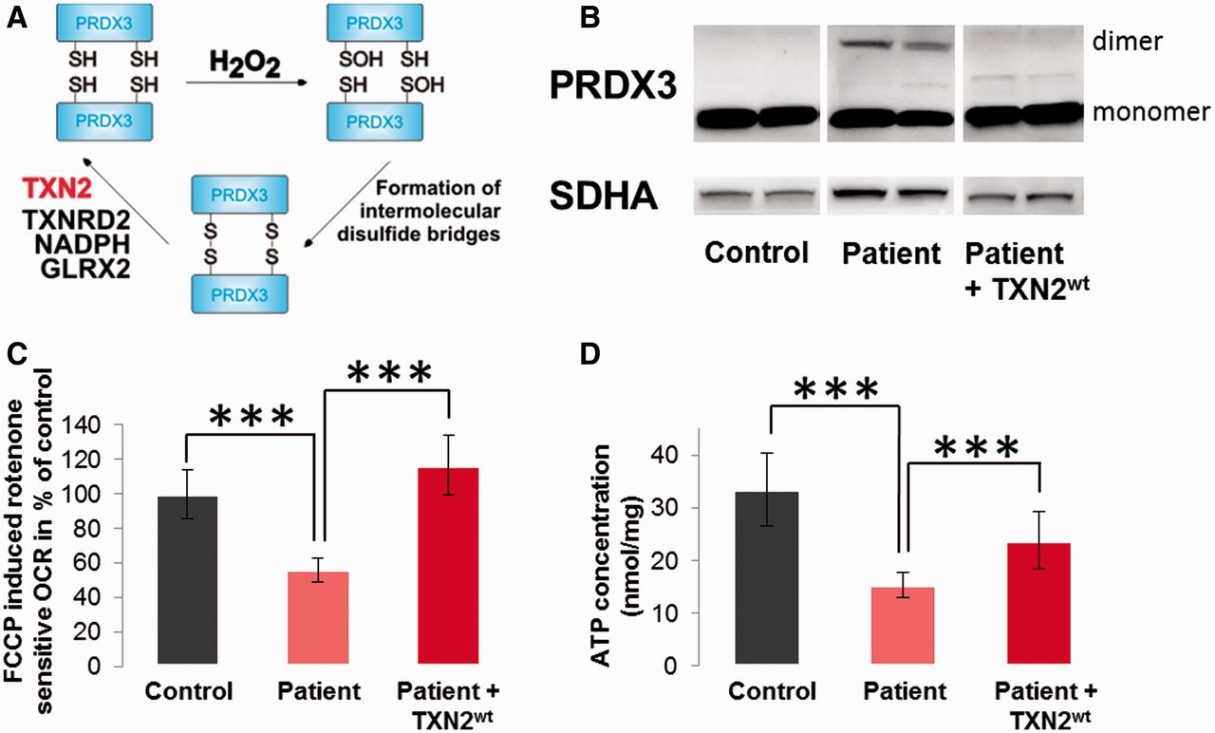
Figure 3 Cellular consequences of TXN2 deficiency. As indicated in scheme (A), TXN2 reduces PRDX3 dimers and restores ...
Notes:
Figure 3 Cellular consequences of TXN2 deficiency. As indicated in scheme (A), TXN2 reduces PRDX3 dimers and restores the monomeric, active form. Missing function of TXN2 protein led to detectable amounts of PRDX3 dimers (B). Presented membrane scans interpret a representative selection of the whole image. Succinate dehydrogenase complex subunit A (SDHA) was used as a loading control. (C) FCCP-uncoupled induced, rotenone-sensitive oxygen consumption rate was analysed by XF96 Extracellular Flux Analyzer. Control values were set as 100%. Respiration of patient fibroblast was significantly reduced. Re-expression of TXN2 rescued the respiratory function. (D) ATP production measured in whole cells revealed significant reduction in patient fibroblasts compared to control cells and cells with re-expressed TXN2. Values were normalized to protein content after measurement.
Unless provided in the caption above, the following copyright applies to the content of this slide: © The Author (2015). Published by Oxford University Press on behalf of the Guarantors of Brain. All rights reserved. For Permissions, please email: journals.permissions@oup.com

Slide 5
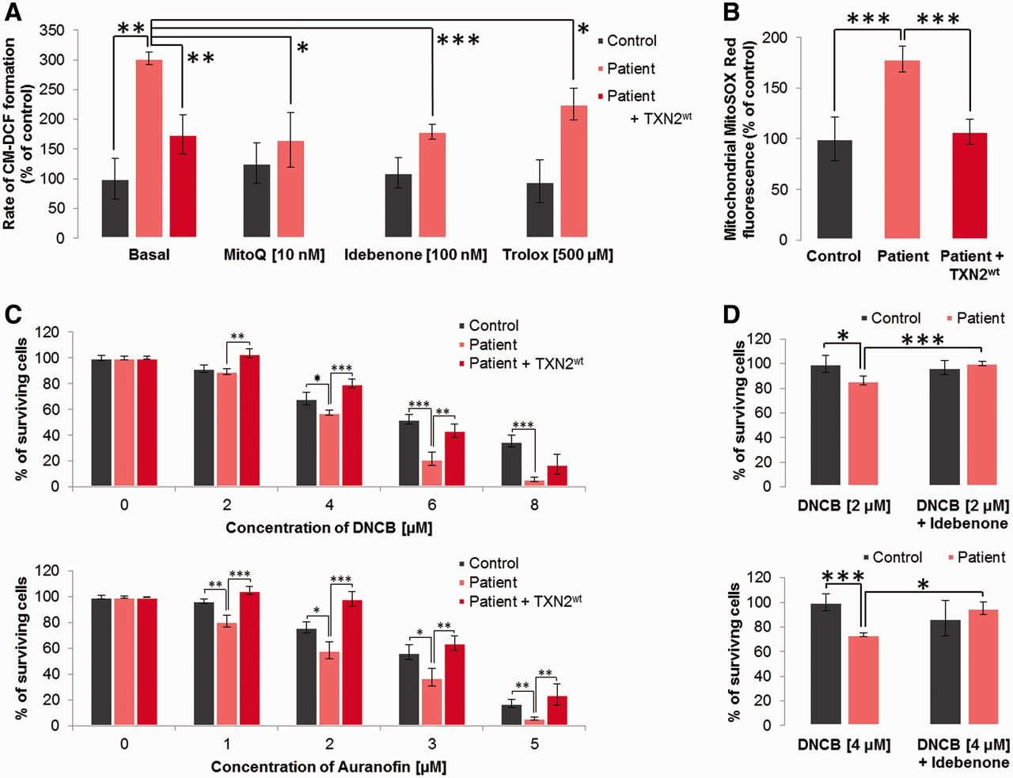
Figure 4 Cellular response to ROS production and scavenging. (A) Global cellular ROS levels were determined by using ...
Notes:
Figure 4 Cellular response to ROS production and scavenging. (A) Global cellular ROS levels were determined by using the fluorescent indicator CM-H2DCFA. Patient fibroblasts showed increased ROS levels, which were normalized by re-expression of TXN2. Antioxidant treatment (MitoQ, Idebenone and Trolox) reduced ROS levels in patient cells. (B) Mitochondrial ROS levels were measured by using the mitochondria-targeted superoxide indicator MitoSOX Red. (C) Cell survival assay: cells were treated for 72 h with the indicated concentrations of pharmacological inhibitors. Patient cells were significantly more sensitive to inhibition of the corresponding system glutathione reductase (DCNB; top) and TXNRD2 (Auranofin; bottom). Re-expression of TXN2 rescued this phenotype and normalized the survival rate. (D) Idebenone (200 nM) furthermore improved cell survival rate in a 72 h assay with different concentration of DNCB (2 and 4 μM, top and bottom, respectively).
Unless provided in the caption above, the following copyright applies to the content of this slide: © The Author (2015). Published by Oxford University Press on behalf of the Guarantors of Brain. All rights reserved. For Permissions, please email: journals.permissions@oup.com

