Slide 1
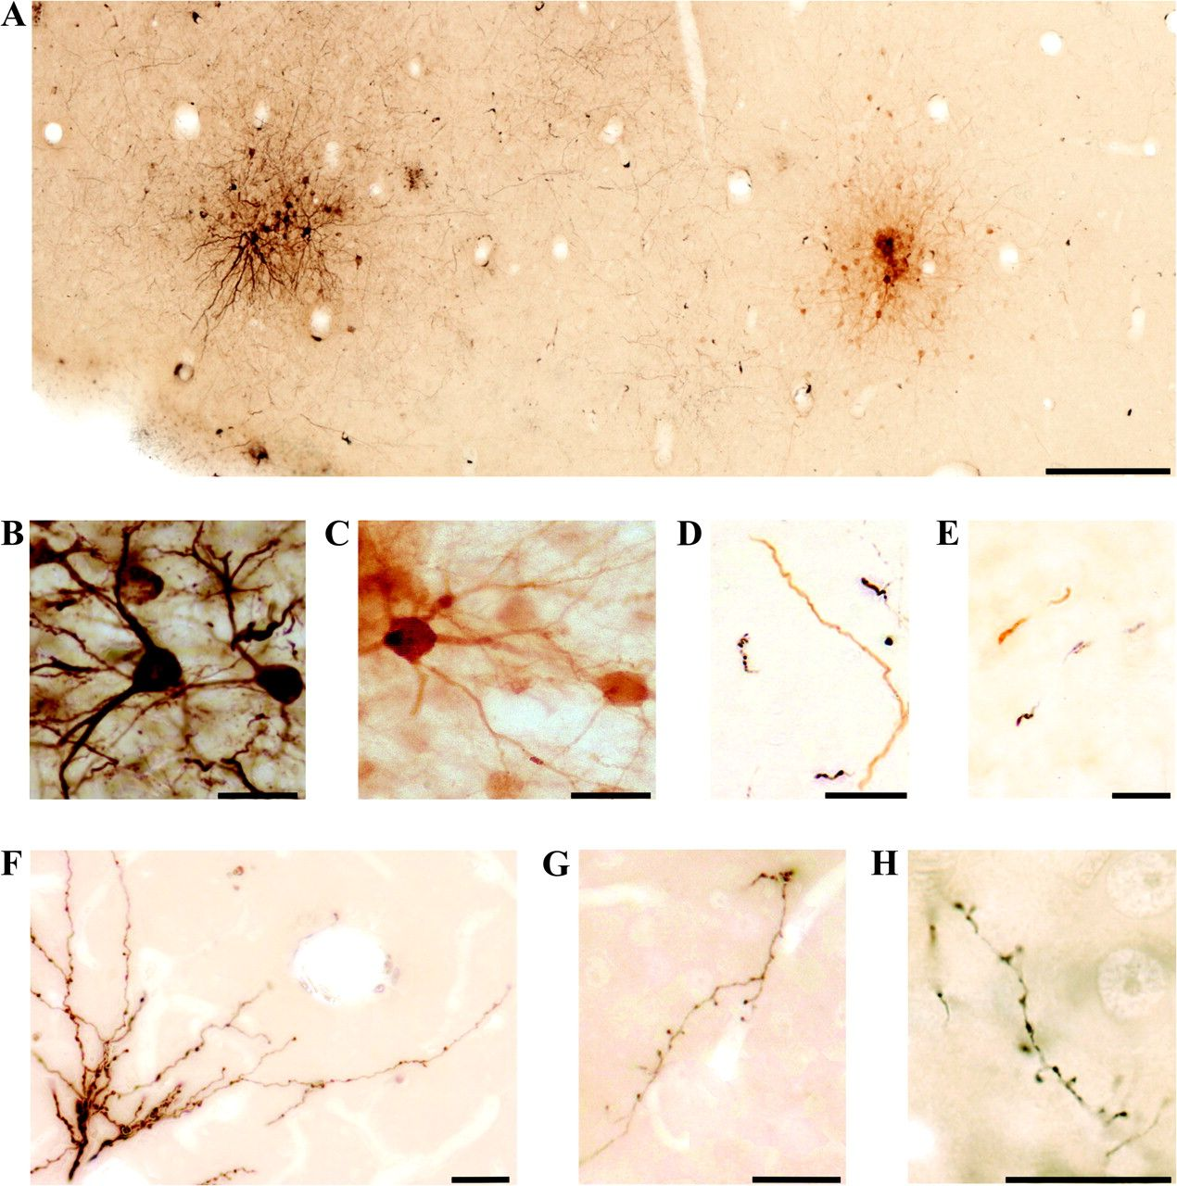
Figure 1. Light microscopic images of neurons labeled with FR and BDA. Each tracer was revealed in one color: black for ...
Notes:
Figure 1. Light microscopic images of neurons labeled with FR and BDA. Each tracer was revealed in one color: black for FR and light-colored brown for BDA. (A–C) Two injection sites in cat Ca09 (left hemisphere), located 240 μm (A, C), and 360 μm (B) below the cortical surface. The two colors can be clearly distinguished in A and at higher magnifications in (B) and (C) (FR and BDA, respectively). (D, E) Labeled callosal axons in deep cortical sections not treated with osmium, in the right hemisphere of cat Ca09, located 1200 μm (D) and 2280 μm (E) below the cortical surface. The deep cortical sections were not treated with osmium in order to determine the origin of labeled callosal axons according to their color: the injection site of FR (black) or of BDA (light-colored brown). (F–H) Labeled callosal axons in superficial sections treated with osmium. (F) Cat Ca15, depth: 1020 μm; (G, H) Cat Ca09, depth: 600 and 960 μm, respectively. Scale bars, 250 μm (A); 25 μm (B–H).
Unless provided in the caption above, the following copyright applies to the content of this slide: © The Author 2009. Published by Oxford University Press. All rights reserved. For permissions, please e-mail: journals.permissions@oxfordjournals.org

Slide 2
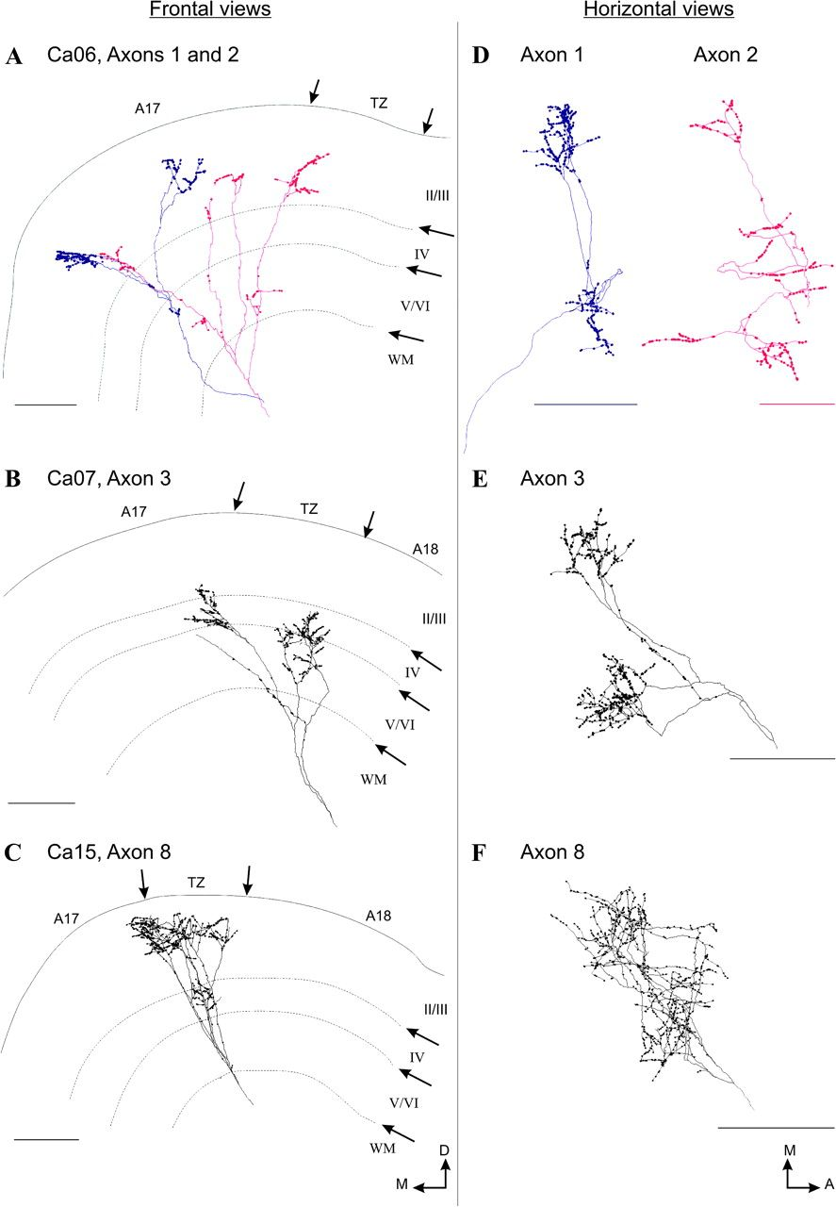
Figure 2. Three-dimensional reconstructions of callosal axon terminals (in right hemispheres). (A–C) Frontal views of ...
Notes:
Figure 2. Three-dimensional reconstructions of callosal axon terminals (in right hemispheres). (A–C) Frontal views of axons 1 and 2 (cat Ca06), axon 3 (cat Ca07), and axon 8 (cat Ca15). The limits of cortical layers II/III, IV, V/VI, and of the white matter (WM) are indicated. The arrows at the top of each panel point the location of the 1-mm-wide TZ between A17 (on the left) and A18 (on the right). These limits (cortical layers and TZ) are those observed in one frontal plane at an antero-posterior level corresponding approximately to the center of the callosal axon's extent in the horizontal plane (Horsley–Clarke coordinates: P2 for axons 1 and 2; A1 for axon 3; A3 for axon 8). (D–F) Horizontal views (in a plane parallel to the cortical surface) of the same axons. A, anterior; D, dorsal; M, medial. Scale bars, 500 μm.
Unless provided in the caption above, the following copyright applies to the content of this slide: © The Author 2009. Published by Oxford University Press. All rights reserved. For permissions, please e-mail: journals.permissions@oxfordjournals.org

Slide 3
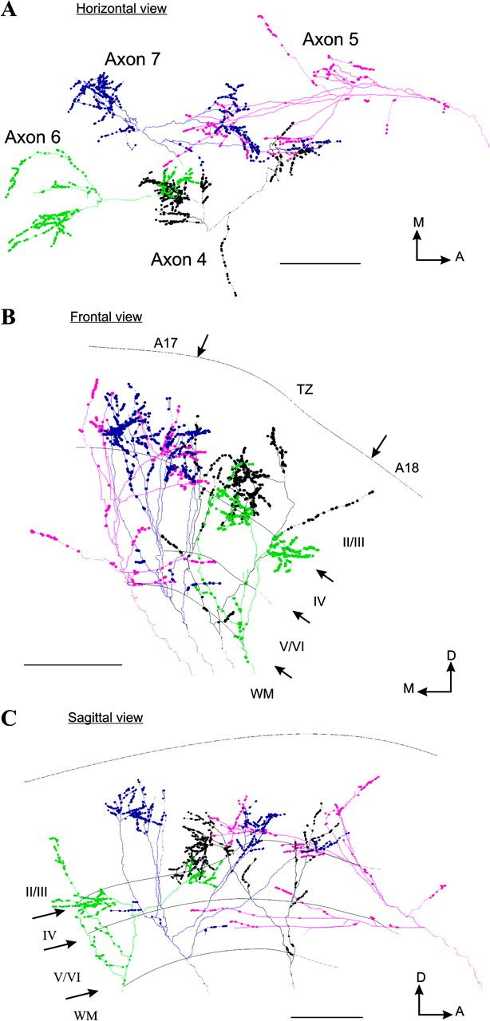
Figure 3. Three-dimensional reconstructions of four callosal axons originating from two neighboring injection sites. ...
Notes:
Figure 3. Three-dimensional reconstructions of four callosal axons originating from two neighboring injection sites. (A–C) Horizontal, frontal and sagittal views of axons 4 and 5 from the first injection site and axons 6 and 7 from the second injection site in cat Ca09. Same legend as in Figure 2. Scale bars, 500 μm.
Unless provided in the caption above, the following copyright applies to the content of this slide: © The Author 2009. Published by Oxford University Press. All rights reserved. For permissions, please e-mail: journals.permissions@oxfordjournals.org

Slide 4
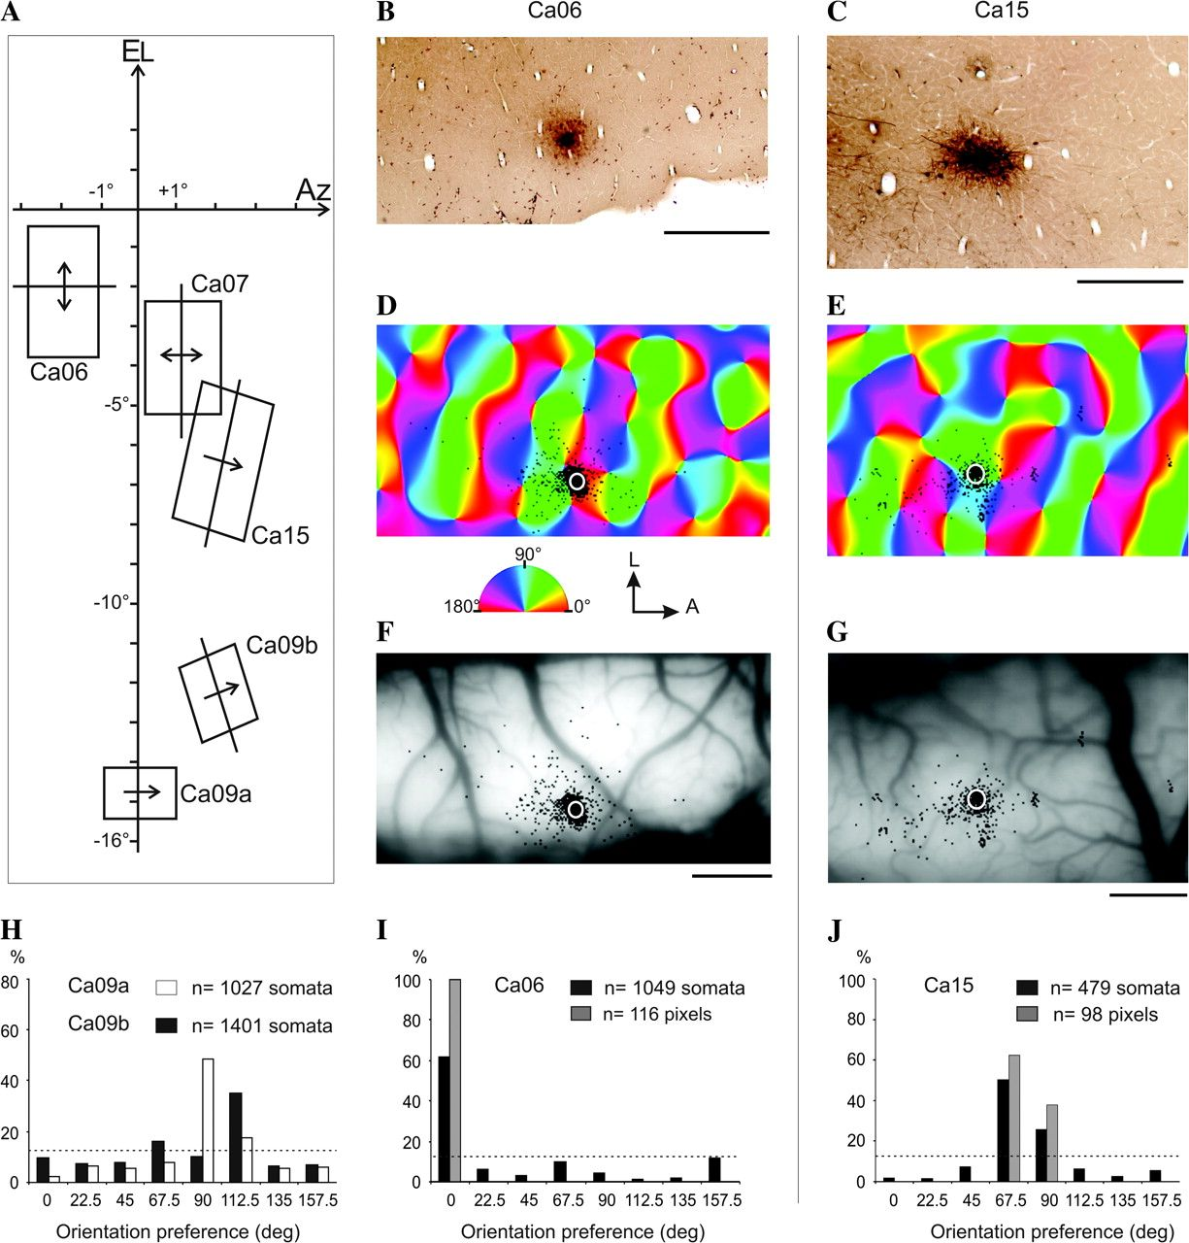
Figure 4. Analysis of the orientation preference at the injection sites (left hemispheres). (A) Location of the ...
Notes:
Figure 4. Analysis of the orientation preference at the injection sites (left hemispheres). (A) Location of the receptive fields, preferred orientation and preferred direction of the units recorded at the injection sites. These parameters were determined by multiunit recordings performed with the same glass pipettes that were used for iontophoretic injections. Only receptive fields of the units recorded with the stimulation of the contralateral eye (right eye) are presented. In cat Ca09, two injections were performed at different locations with two different tracers: injection site Ca09a with BDA and injection site Ca09b with FR. El, elevation; Az, azimuth. (B–G) Injection sites in cat Ca06 (left column) and cat Ca15 (right column). (B, C) Light microscopic images of the injection sites (BDA). (D, E) Distribution of the labeled neuronal somata (in black) superimposed on orientation preference map (the preferred angle of a region is color-coded as indicated in the half circle). The injection core is indicated by a white circle. (F, G) Blood vessel pattern of the imaged region in (D) and (E) respectively. (H–J) Distribution of the labeled neuronal somata and of the pixels within the injection core in the different orientation domains (22.5° binning). Bars in (H) and black bars in (I) and (J) indicate the percentage of labeled neuronal somata. The distributions of the labeled neuronal somata in the different orientation domains were, in all cases, significantly centered on one orientation (V-test [modified Rayleigh test], P < 0.01). This orientation was defined as the orientation preference at the injection site: 90° for Ca09a (H), 112.5° for Ca09b (H), 0° for Ca06 (I), and 67.5° for Ca15 (J). Gray bars in (I) and (J) indicate the percentage of image pixels within the region of the injection core. The dotted line corresponds to the percentage of pixels that would be expected in each bin for an even distribution (12.5%). A, anterior; L, lateral. Scale bar, 500 μm (B, C); 1 mm (F, G).
Unless provided in the caption above, the following copyright applies to the content of this slide: © The Author 2009. Published by Oxford University Press. All rights reserved. For permissions, please e-mail: journals.permissions@oxfordjournals.org

Slide 5
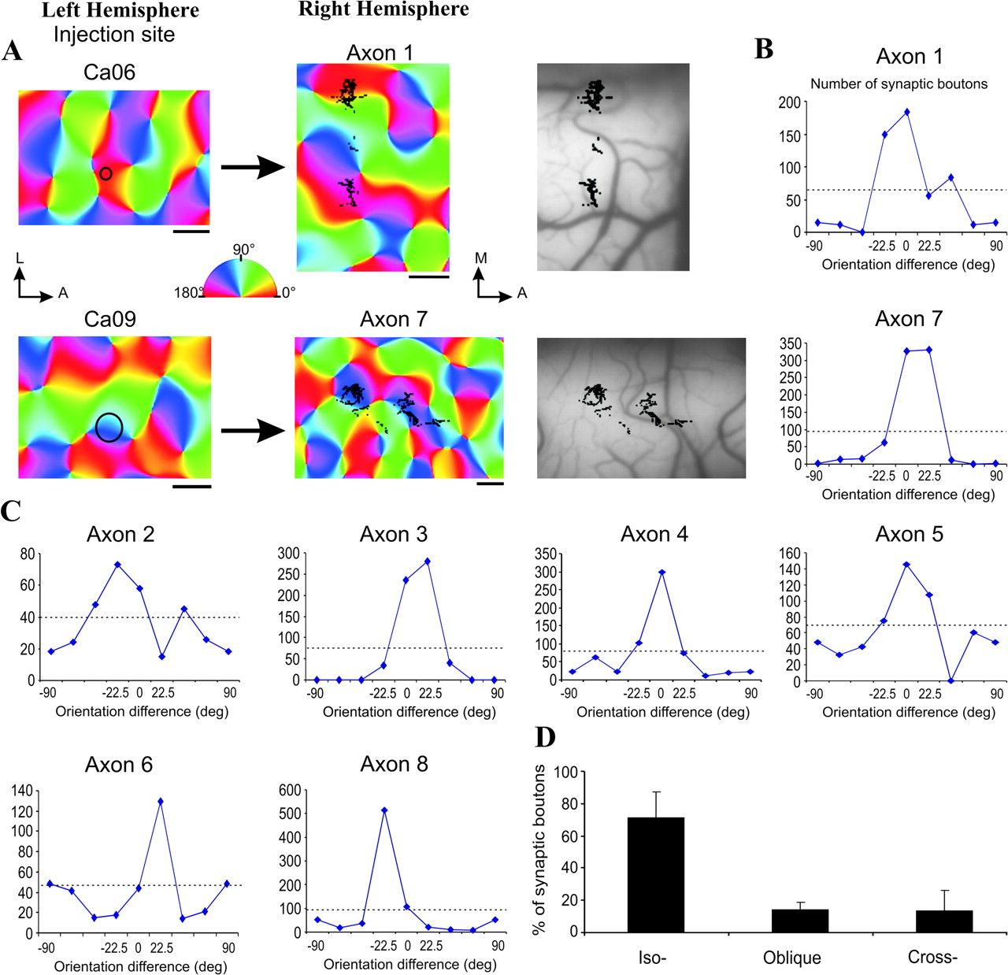
Figure 5. Modular specificity of callosal connections related to orientation preference. (A) Orientation preference ...
Notes:
Figure 5. Modular specificity of callosal connections related to orientation preference. (A) Orientation preference maps with the location of the injection core (black circle) in the left hemisphere and the distribution of the synaptic boutons (in black) of a corresponding callosal axon in the right hemisphere (axon 1 in cat Ca06, axon 7 in cat Ca09). (B, C) Number of synaptic boutons of callosal axons in orientation domains. Orientation preferences were expressed relative to that at the injection sites using 22.5° resolution (0° corresponds to an orientation preference that is similar to that at the injection site; 90° corresponds to an orientation preference orthogonal to that at the injection site). The eight distributions have their peak at 0 ± 22.5°. The horizontal dotted line indicates for each axon the number of boutons that would be expected for an even distribution. (D) Percentages of synaptic boutons of callosal axons in iso- (±30°), oblique- (±30–60°), and cross- (±60–90°) orientation domains with respect to the orientation preference at the injection sites. The eight callosal axons connected preferentially iso-orientation domains with, in average, 72% (standard deviation = 17) of their synaptic boutons. Error bars indicate standard deviation. Scale bars 500 μm. A, anterior; M, medial; L, lateral.
Unless provided in the caption above, the following copyright applies to the content of this slide: © The Author 2009. Published by Oxford University Press. All rights reserved. For permissions, please e-mail: journals.permissions@oxfordjournals.org

Slide 6
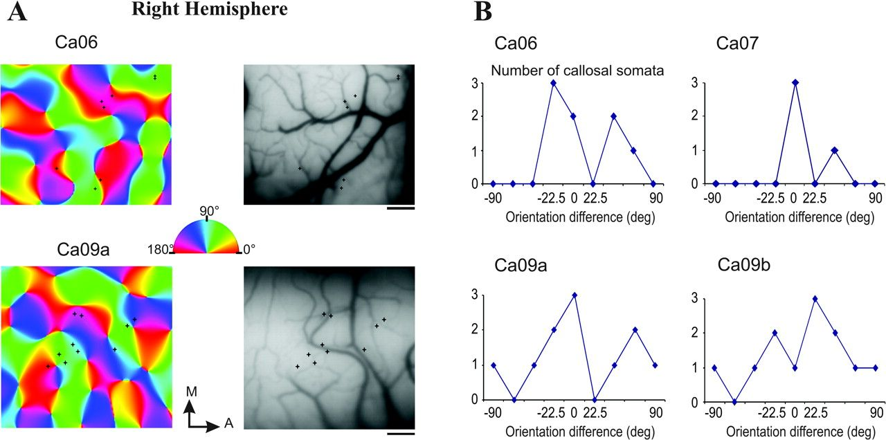
Figure 6. Distribution of retrogradely labeled somata of callosal neurons in orientation domains. (A) Neuronal somata ...
Notes:
Figure 6. Distribution of retrogradely labeled somata of callosal neurons in orientation domains. (A) Neuronal somata are indicated by black stars superimposed on orientation preference maps of the right hemisphere of cats Ca06 and Ca09. Right panels: blood vessel patterns of the imaged regions. (B) Number of retrogradely labeled somata in orientation domains of the right hemisphere of cats Ca06, Ca07, and Ca09. Orientation preferences were expressed relative to that at the injection sites, as in Figure 5. Scale bars, 500 μm. A, anterior; M, medial.
Unless provided in the caption above, the following copyright applies to the content of this slide: © The Author 2009. Published by Oxford University Press. All rights reserved. For permissions, please e-mail: journals.permissions@oxfordjournals.org

Slide 7
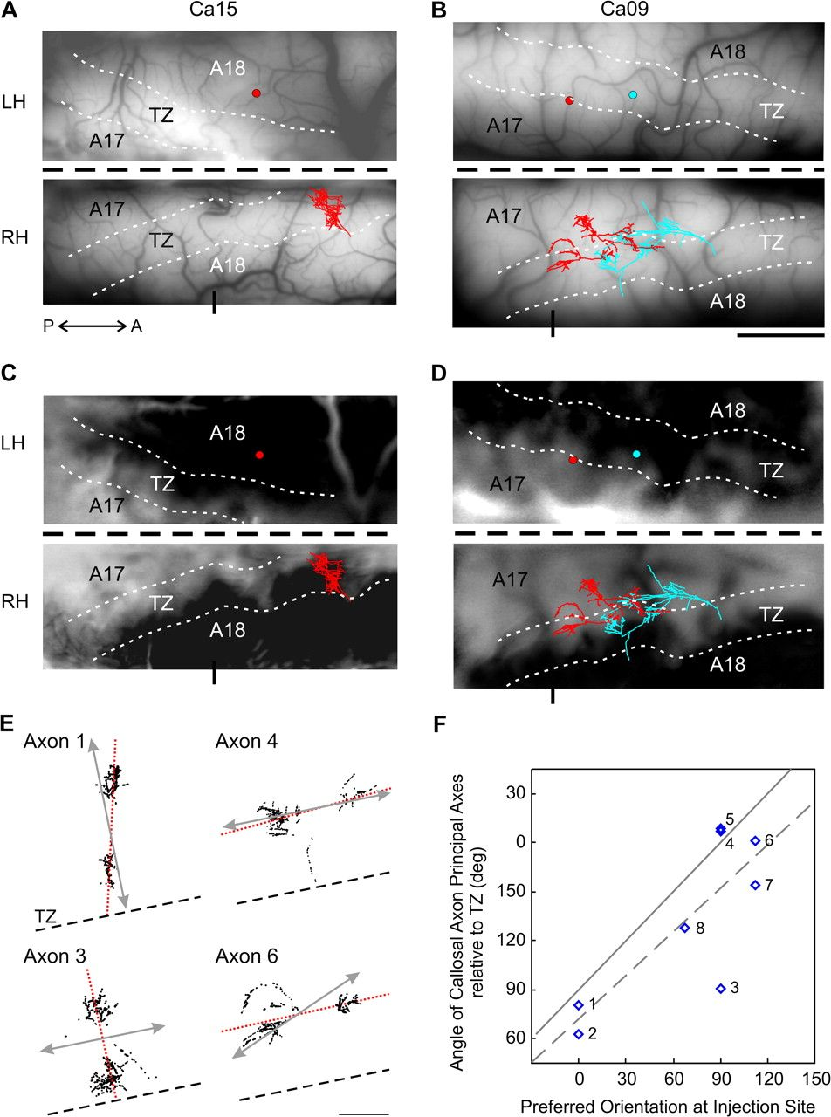
Figure 7. Visuotopic organization and axial specificity of callosal connections. (A, B) Overlap of the injection sites ...
Notes:
Figure 7. Visuotopic organization and axial specificity of callosal connections. (A, B) Overlap of the injection sites in the left hemisphere (LH) and the callosal axon terminals in the right hemisphere (RH) with images of the blood vessel pattern at the cortical surface. The reconstructed axon in Ca15 (A) is axon 8 (see detailed reconstruction in Fig. 2). In case of Ca09, two different tracers were injected at nearby locations (blue circle for injection site Ca09a and red one for Ca09b). In the opposite hemisphere, labeled axons coming from each injection site (red axons 4 and 5 for Ca09a and blue axons 6 and 7 for Ca09b) were shifted in the same direction and with the same distance as that separating their respective injection sites (see detailed reconstructions of these axons in Fig. 3). (C, D) Differential maps used to localize the transition zone between A17 and A18, in cats Ca15 (A) and Ca09 (B). The maps were obtained by dividing the sum of all SCMs imaged during the presentation of drifting gratings optimized for the activation of A18 (0.15 cpd, 4.5 Hz) by the sum of all SCMs imaged during the presentation of “A17-specific stimuli” (0.6 cpd, 1.5 Hz). Area 18 corresponds to the dark region. The anterior part of the cortex is on the right. The thick horizontal black dashed line indicates the midline between both hemispheres; thin white dashed lines indicate the transition zone between A17 and A18 (TZ). Short vertical line at the bottom of each panel (in RH) shows stereotaxic coordinate AP0. The blood vessel patterns of the imaged regions are shown in (A) and (B), respectively. LH, left hemisphere; RH, right hemisphere; A, anterior; P, posterior. Scale bar, 2 mm. (E) Schemes illustrating the spatial distribution of callosal axon terminals (black dots) with respect to the axis of the 17/18 transition zone (black dashed lines). The schemes were rotated to align the TZs with each other. The red dashed lines indicate the principal axis of each axon's terminal field (first principal component of the set of x and y coordinates of the boutons). The double arrows (gray) represent the mapping of a retinotopic axis in A17 that corresponded to the preferred orientation at the injection site (e.g., 0° for axon 1; see Table 2). The examples show axons for which the principal axis of synaptic boutons distribution (red dashed lines) was approximately parallel (axons 1, 4, 6) or perpendicular (axon 3) to the axis derived from orientation preference (double arrows) at injection sites. Scale bars, 500 μm. (F) The angle between the preferred axis of the callosal axon terminals and the TZ was compared with the orientation preference at the corresponding injection site. The solid line shows the expected result if the preferred axes of callosal axons were perfectly parallel to the axes of preferred orientation at the injection sites. This prediction is based on the retinotopic map in A17 with the assumptions that iso-elevation and iso-azimuth lines are orthogonal to each other (see Supplementary Fig. 1) and that the magnification factor is equal in all directions. The dashed line indicates the linear fit to the data (R2 = 0.62). Axon 3 was an outlier showing an elongation perpendicular to the predicted axis. The number of each axon (Tables 1 and 2, Figs 2 and 3) is indicated next to the data points.
Unless provided in the caption above, the following copyright applies to the content of this slide: © The Author 2009. Published by Oxford University Press. All rights reserved. For permissions, please e-mail: journals.permissions@oxfordjournals.org

