Slide 1
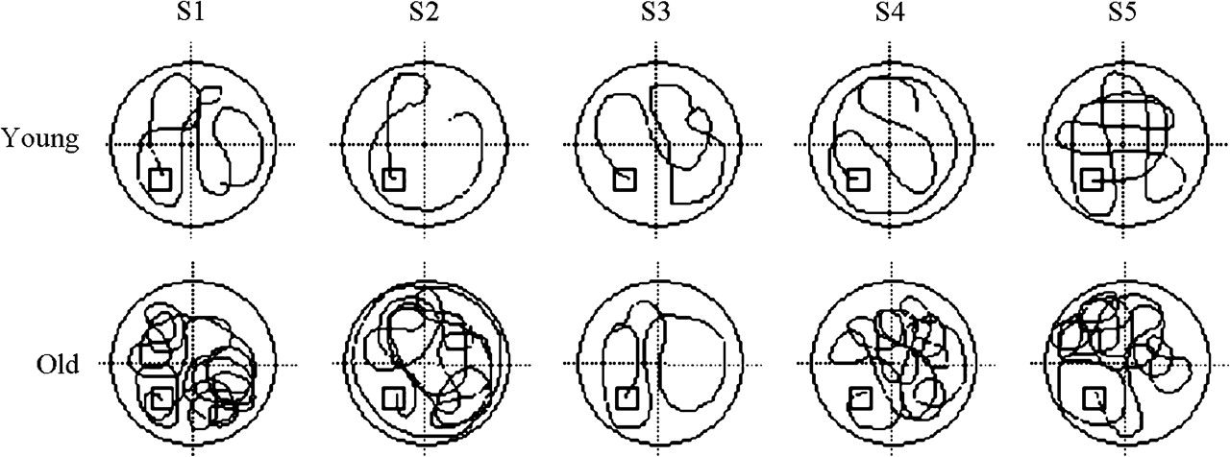
Figure 1. Top view of virtual MWT search paths (trial 1) in 5 representative young and old subjects in a previous study ...
Notes:
Figure 1. Top view of virtual MWT search paths (trial 1) in 5 representative young and old subjects in a previous study (Moffat and Resnick 2002). Older subjects took longer to find the platform and traveled a longer linear distance in their initial search. Inefficient search strategies and a reluctance to disengage from nongoal locations may contribute to this age difference on trial 1.
Unless provided in the caption above, the following copyright applies to the content of this slide: © The Author 2006. Published by Oxford University Press. All rights reserved. For permissions, please e-mail: journals.permissions@oxfordjournals.org

Slide 2
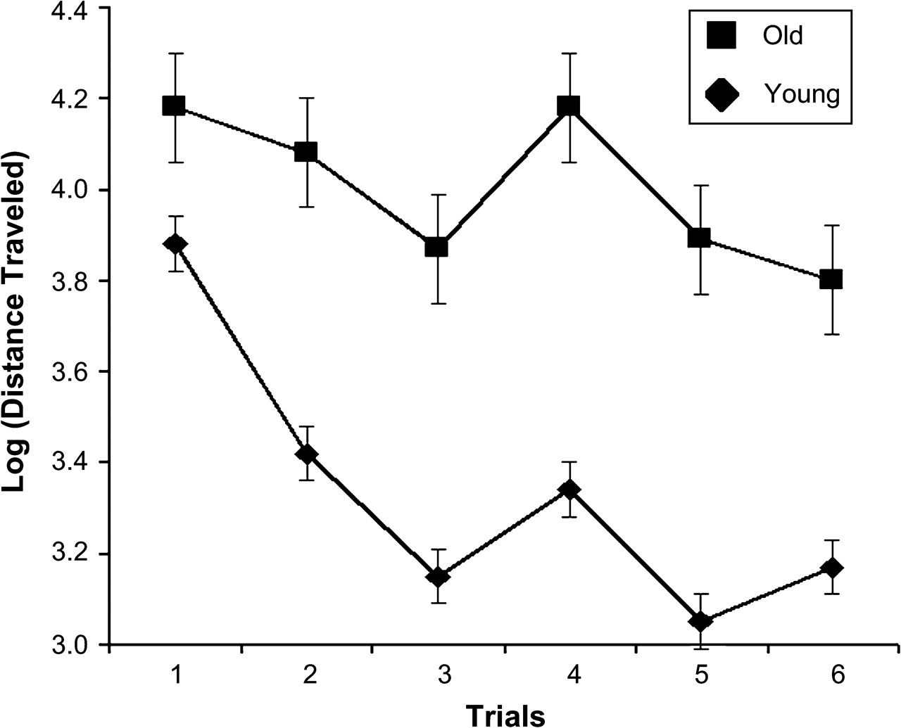
Figure 2. Total distance traveled in the vMWT as a function of age and trial. Performance improved across trials and ...
Notes:
Figure 2. Total distance traveled in the vMWT as a function of age and trial. Performance improved across trials and older participants traversed a longer path in locating the hidden platform on all 6 trials.
Unless provided in the caption above, the following copyright applies to the content of this slide: © The Author 2006. Published by Oxford University Press. All rights reserved. For permissions, please e-mail: journals.permissions@oxfordjournals.org

