Slide 1
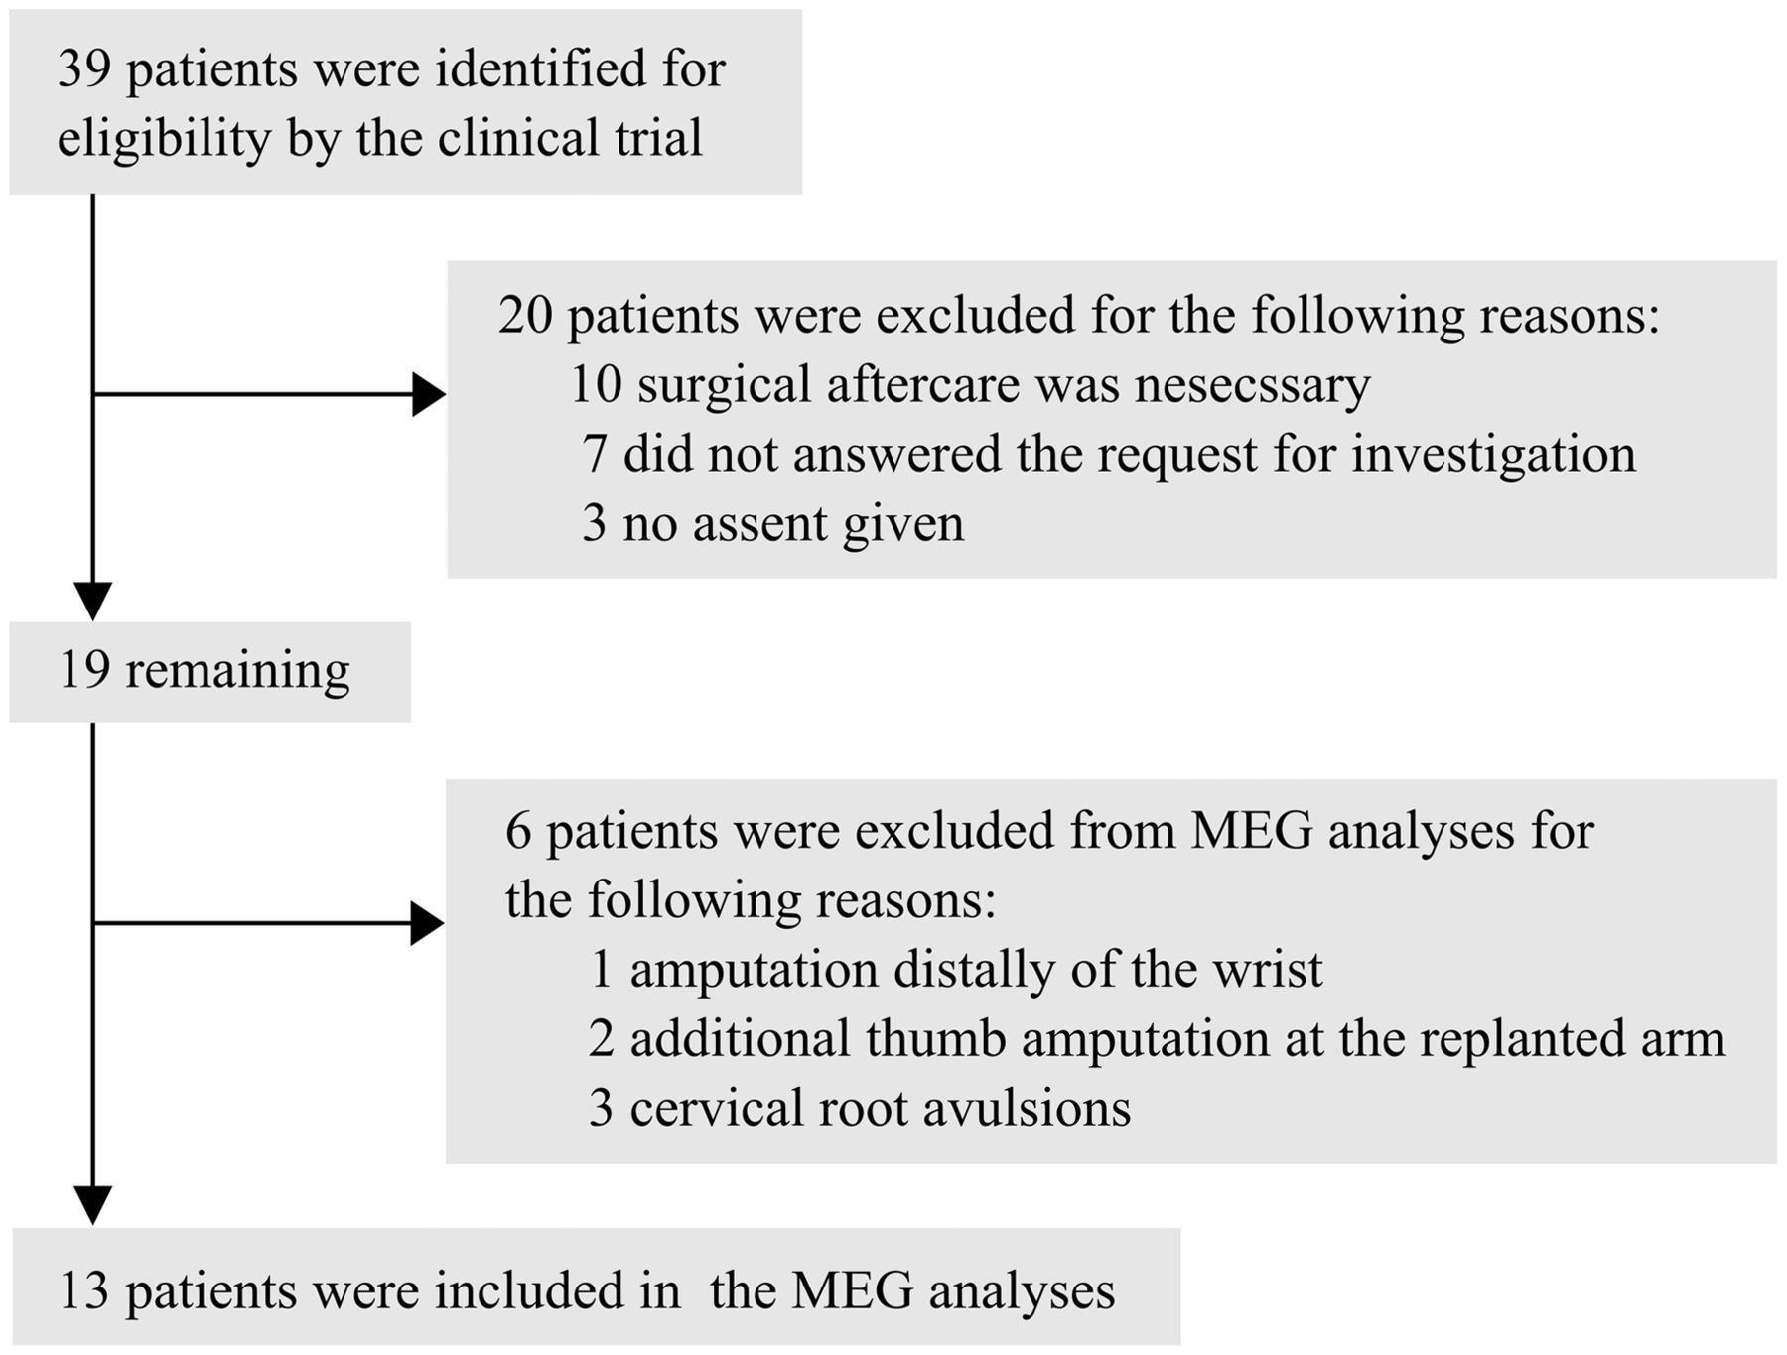
Figure 1 Flow chart of included patients.
Notes:
Figure 1 Flow chart of included patients.
Unless provided in the caption above, the following copyright applies to the content of this slide: © The Author (2014). Published by Oxford University Press on behalf of the Guarantors of Brain. All rights reserved. For Permissions, please email: journals.permissions@oup.com

Slide 2
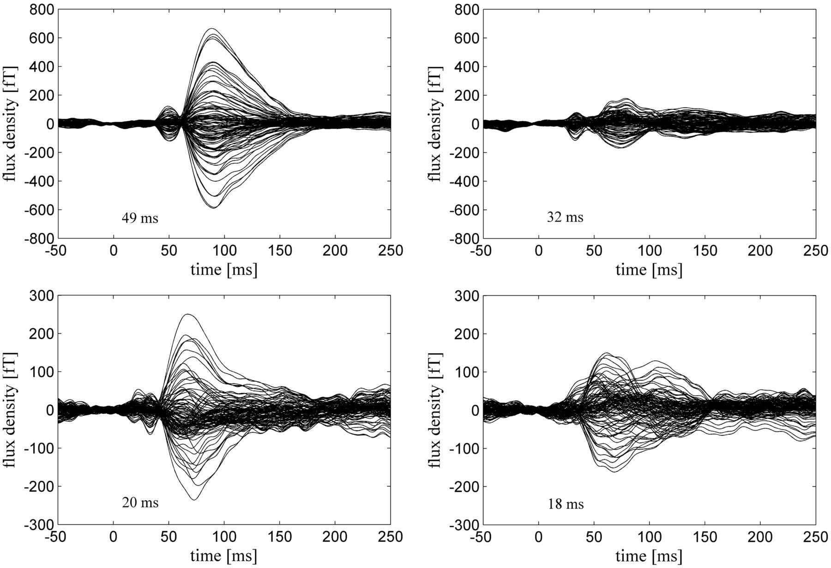
Figure 2 MEG waveforms (butterfly plots) for a typical subject. Left: somatosensory-evoked fields over the hemisphere ...
Notes:
Figure 2 MEG waveforms (butterfly plots) for a typical subject. Left: somatosensory-evoked fields over the hemisphere contralateral to replantation. Right: somatosensory-evoked magnetic field over the hemisphere ipsilateral to replantation. Top left: somatosensory-evoked magnetic field to stimulation of the thumb (D1) on the replanted hand; upper right: somatosensory-evoked magnetic field to stimulation of D1 on the non-replanted hand. Bottom left: somatosensory-evoked magnetic field to lip stimulation on the side of replantation. Bottom right: somatosensory-evoked magnetic field to lip stimulation on the side contralateral to replantation (control side).
Unless provided in the caption above, the following copyright applies to the content of this slide: © The Author (2014). Published by Oxford University Press on behalf of the Guarantors of Brain. All rights reserved. For Permissions, please email: journals.permissions@oup.com

Slide 3
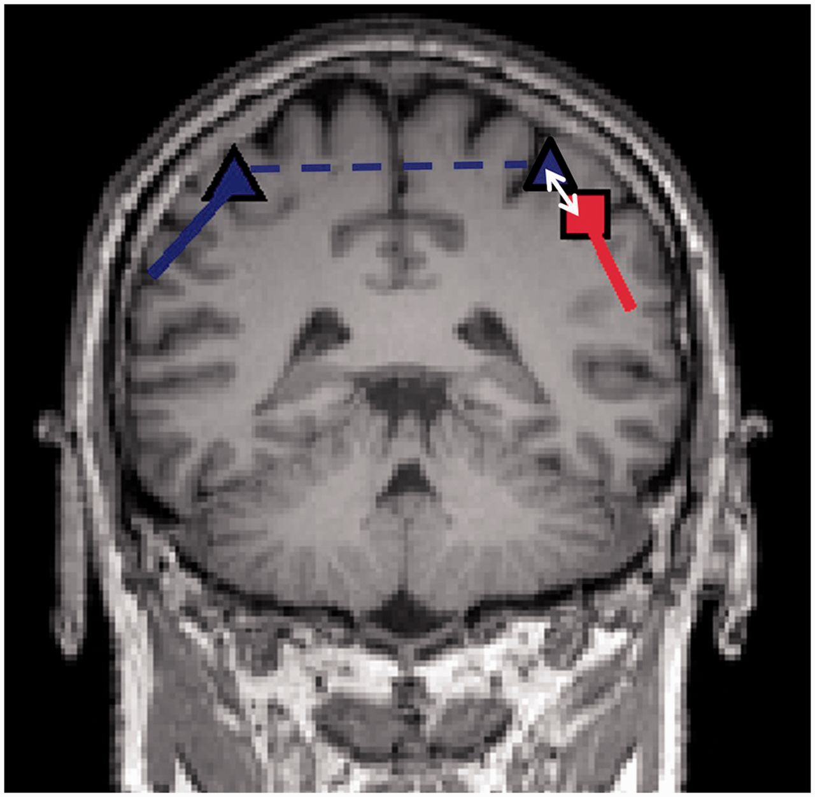
Figure 3 Coronar slice of a T₁-weighted image including dipole projections for dipoles determined after ...
Notes:
Figure 3 Coronar slice of a T1-weighted image including dipole projections for dipoles determined after thumb stimulation in one subject. The blue triangle represents the dipole determined after stimulation of the non-affected right thumb while the red square shows the dipole determined after stimulation of the left thumb which was part of the replanted extremity. The solid blue and red lines indicate the dipole orientations. The dashed line indicates that the dipole determined after stimulation of the non-affected right thumb was mirrored along the y–z plane of the internal coordinate system of the MEG system, which divides the brain along the longitudinal fissure. Within the contralateral hemisphere, the Euclidean distance between the dipole locations is computed as indicated by the white arrow.
Unless provided in the caption above, the following copyright applies to the content of this slide: © The Author (2014). Published by Oxford University Press on behalf of the Guarantors of Brain. All rights reserved. For Permissions, please email: journals.permissions@oup.com

Slide 4
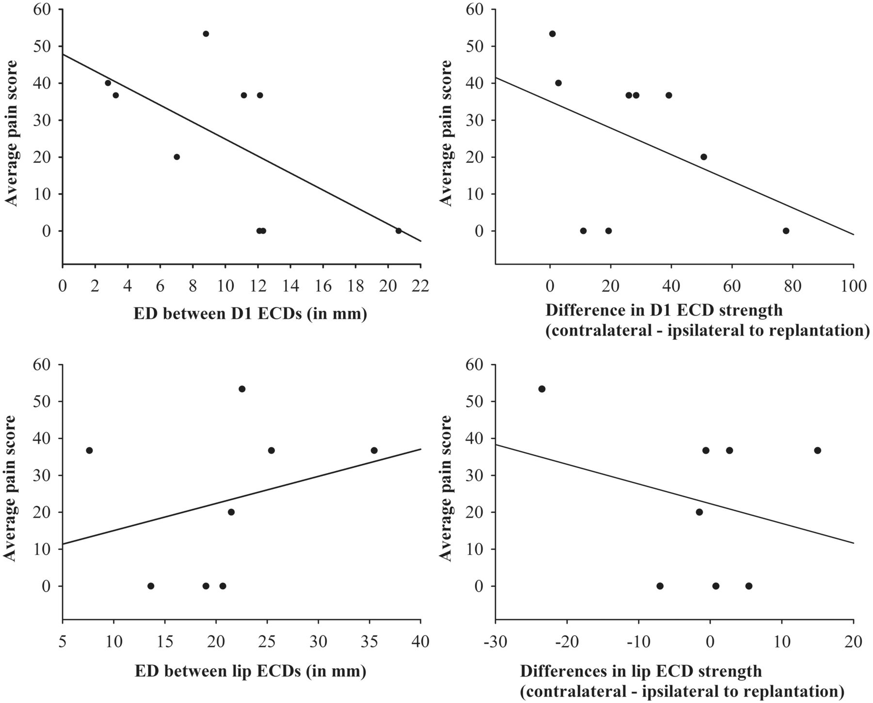
Figure 4 Relationship between reorganization in the primary somatosensory cortex (SI) and average pain score. Top: ...
Notes:
Figure 4 Relationship between reorganization in the primary somatosensory cortex (SI) and average pain score. Top: reorganization of the SI representation of the thumb (D1). Bottom: reorganization of the SI representation of the lip. Reorganization was assessed as Euclidean distance (ED) between locations of ECD to the stimulation of lip/D1 contralateral to replantation and the mirrored ECD to the stimulation of lip/D1 contralateral to replantation (left) and as difference of ECD strength to these stimulations (right). Note that only the correlation between Euclidean distance between D1 ECDs and average pain score (top left) reached significance (P < 0.05).
Unless provided in the caption above, the following copyright applies to the content of this slide: © The Author (2014). Published by Oxford University Press on behalf of the Guarantors of Brain. All rights reserved. For Permissions, please email: journals.permissions@oup.com

