Slide 1
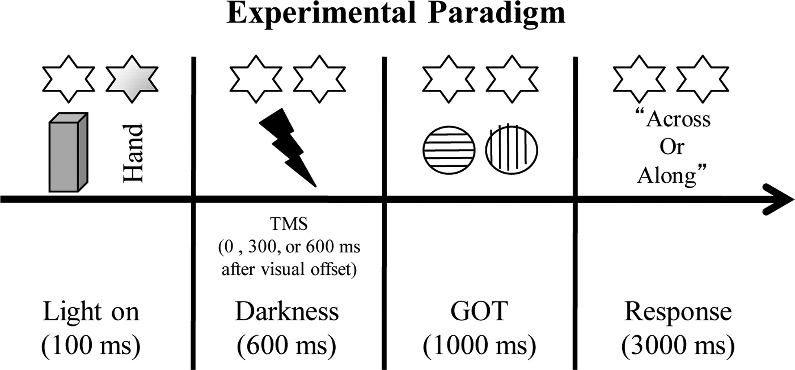
Figure 1. Experimental paradigm. At the beginning of each trial, subjects viewed either their right hand or a neutral ...
Notes:
Figure 1. Experimental paradigm. At the beginning of each trial, subjects viewed either their right hand or a neutral object for 100 ms, followed by darkness. Tactile gratings were delivered to the right middle finger 600 ms subsequent to visual stimulation. After tactile stimulation, subjects reported whether the gratings were oriented across or along the finger by pressing 1 of 2 keys with the left hand. In the first experiment, TMS was delivered immediately after visual stimulation over SMHA, aIPS, or pIPS. In the second experiment, TMS over aIPS was applied 0, 300, or 600 ms after visual offset. Stars indicate the lights on either side of the mirror.
Unless provided in the caption above, the following copyright applies to the content of this slide: © The Author 2012. Published by Oxford University Press. All rights reserved. For Permissions, please e-mail: journals.permissions@oup.com

Slide 2
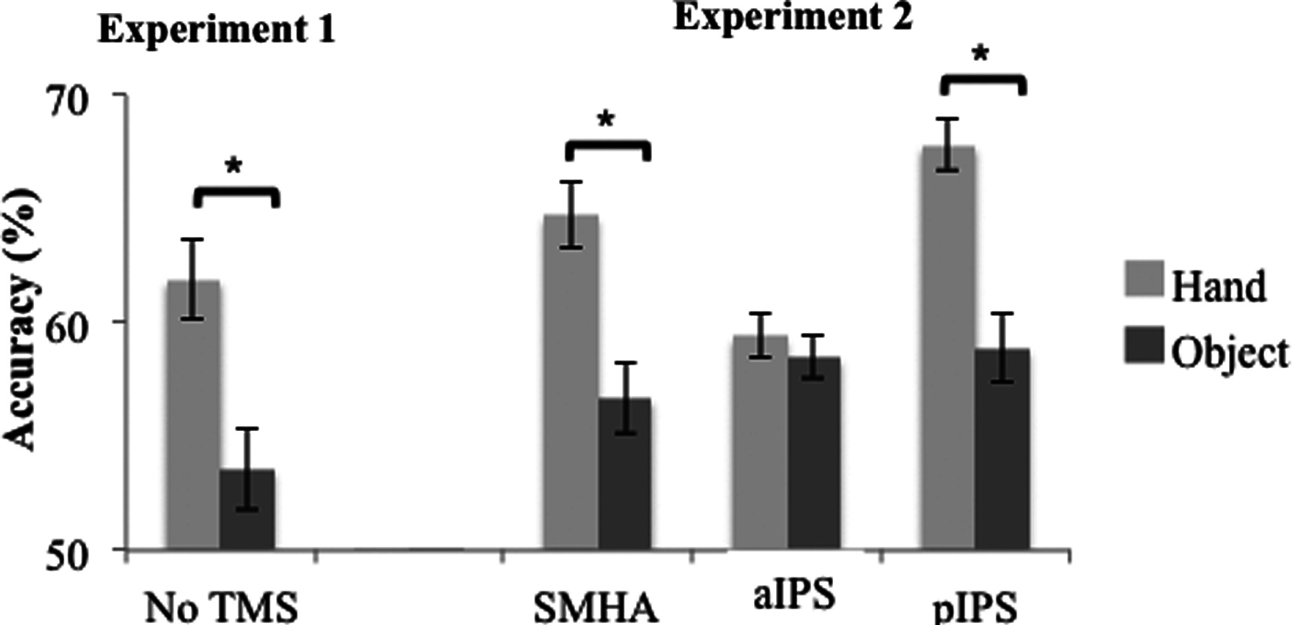
Figure 2. Effect of TMS over different cortical areas. Experiment 1 showed an increase in tactile discrimination after ...
Notes:
Figure 2. Effect of TMS over different cortical areas. Experiment 1 showed an increase in tactile discrimination after vision of the hand when compared with the object and thus the VET effect. Experiment 2 showed that TMS over aIPS abolished the VET effect, but not TMS over SMHA or pIPS. Mean and standard errors are shown. Asterisk indicates significant differences between the view-hand and view-object conditions.
Unless provided in the caption above, the following copyright applies to the content of this slide: © The Author 2012. Published by Oxford University Press. All rights reserved. For Permissions, please e-mail: journals.permissions@oup.com

Slide 3
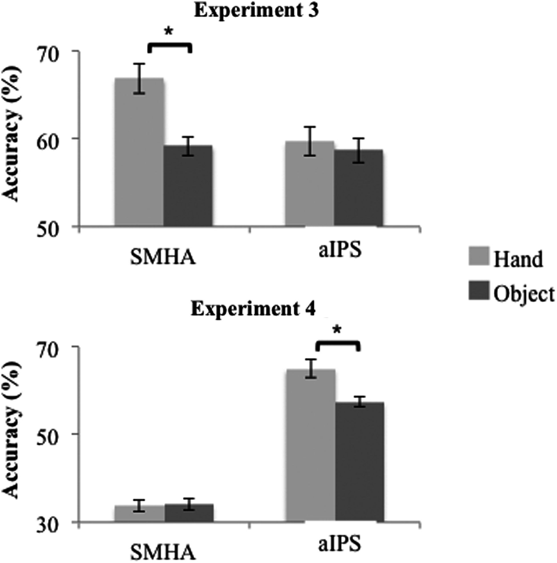
Figure 3. Effect of TMS at 45% intensity (experiment 3) and of TMS after tactile stimulation (experiment 4). Experiment ...
Notes:
Figure 3. Effect of TMS at 45% intensity (experiment 3) and of TMS after tactile stimulation (experiment 4). Experiment 3 confirmed the results of experiment 2: TMS over aIPS abolished the VET effect, but TMS over SMHA did not. Experiment 4 showed tactile masking by TMS delivered after tactile stimulation over SMHA, but not by TMS over aIPS.
Unless provided in the caption above, the following copyright applies to the content of this slide: © The Author 2012. Published by Oxford University Press. All rights reserved. For Permissions, please e-mail: journals.permissions@oup.com

Slide 4
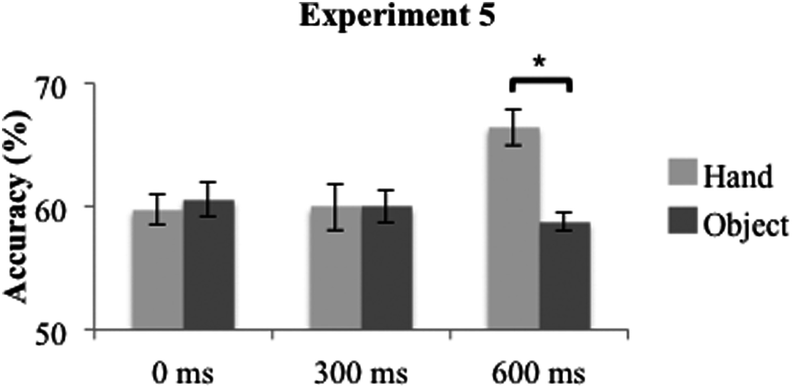
Figure 4. Effect of aIPS stimulation at different time points. Experiment 5 showed that TMS applied 0 and 300 ms after ...
Notes:
Figure 4. Effect of aIPS stimulation at different time points. Experiment 5 showed that TMS applied 0 and 300 ms after visual stimulation reduced the VET effect. In contrast, TMS applied 600 ms after visual stimulation left the VET effect intact.
Unless provided in the caption above, the following copyright applies to the content of this slide: © The Author 2012. Published by Oxford University Press. All rights reserved. For Permissions, please e-mail: journals.permissions@oup.com

