Slide 1
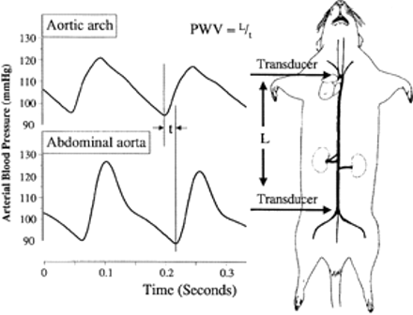
Fig. 1 Representation of the proximal (aortic arch) and distal (abdominal aorta) pressure wave forms. PWV is ...
Notes:
Fig. 1 Representation of the proximal (aortic arch) and distal (abdominal aorta) pressure wave forms. PWV is calculated by dividing the propagation distance (l) by the propagation time (t). Propagation time is the difference in time between the beginning of the upstroke of the two pulsatile wave forms.
Unless provided in the caption above, the following copyright applies to the content of this slide: Copyright © 2000, European Society of Cardiology

Slide 2
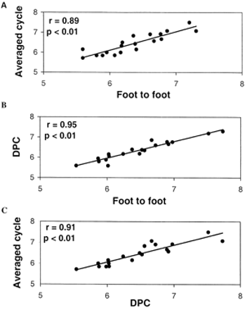
Fig. 3 Correlation of pulse wave velocity (m/s) measured by 3 different methods in the same 19 samples. (A) Foot to ...
Notes:
Fig. 3 Correlation of pulse wave velocity (m/s) measured by 3 different methods in the same 19 samples. (A) Foot to foot of averaged cycles method vs. the normal foot to foot method. (B) Diastolic phase center (DPC) method vs. normal foot to foot method. (C) Foot to foot of averaged cycles vs. the DPC method.
Unless provided in the caption above, the following copyright applies to the content of this slide: Copyright © 2000, European Society of Cardiology

Slide 3
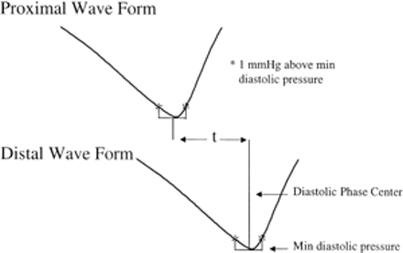
Fig. 2 Diastolic phase center (DPC) calculation for determining propagation time for PWV calculation, using the ...
Notes:
Fig. 2 Diastolic phase center (DPC) calculation for determining propagation time for PWV calculation, using the diastolic portion of a wave form from the proximal and distal transducers. The center of the diastolic phase is determined at 1 mmHg above minimum diastolic pressure. Propagation time is determined by subtracting the proximal wave form DPC from the distal wave form DPC.
Unless provided in the caption above, the following copyright applies to the content of this slide: Copyright © 2000, European Society of Cardiology

Slide 4
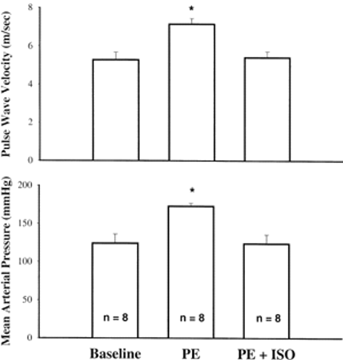
Fig. 5 Pulse wave velocity and mean arterial blood pressure in rats. Baseline: before any treatment; PE: when mean ...
Notes:
Fig. 5 Pulse wave velocity and mean arterial blood pressure in rats. Baseline: before any treatment; PE: when mean arterial blood pressure reached plateau during the infusion of phenylephrine; PE+ISO: isoproterenol was given to decrease blood pressure when blood pressure reached plateau during PE infusion. The data in the PE+ISO group was taken when mean arterial blood pressure was equal to basal level in each individual animal. *, P<0.05, vs. baseline or PE+ISO.
Unless provided in the caption above, the following copyright applies to the content of this slide: Copyright © 2000, European Society of Cardiology

Slide 5
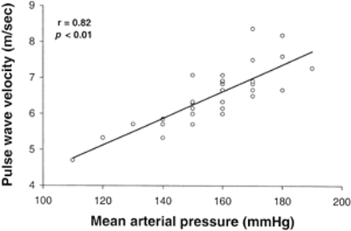
Fig. 4 Relationship between pulse wave velocity and mean arterial blood pressure in rats infused with ...
Notes:
Fig. 4 Relationship between pulse wave velocity and mean arterial blood pressure in rats infused with phenylephrine.
Unless provided in the caption above, the following copyright applies to the content of this slide: Copyright © 2000, European Society of Cardiology

Slide 6
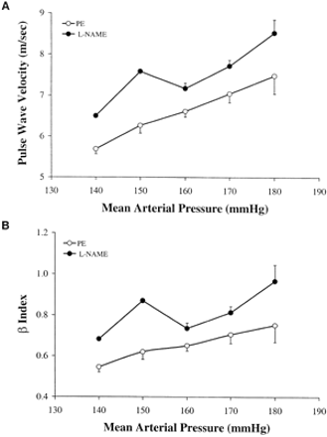
Fig. 6 Relationship of (A) pulse wave velocity vs. mean arterial blood pressure and (B) β index vs. mean arterial ...
Notes:
Fig. 6 Relationship of (A) pulse wave velocity vs. mean arterial blood pressure and (B) β index vs. mean arterial blood pressure in rats treated with phenylephrine (PE) or Nω-nitro-l-arginine methyl ester (l-NAME). Both PWV and β index were significantly higher with l-NAME treatment compared to PE at each given level of MAP, P<0.01.
Unless provided in the caption above, the following copyright applies to the content of this slide: Copyright © 2000, European Society of Cardiology

Slide 7
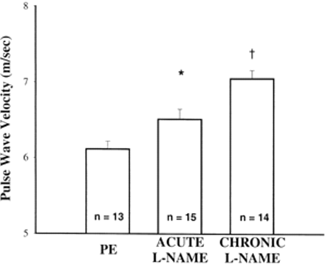
Fig. 7 Effect of phenylephrine (PE) and acute or chronic l-NAME treatment on pulse wave velocity when mean arterial ...
Notes:
Fig. 7 Effect of phenylephrine (PE) and acute or chronic l-NAME treatment on pulse wave velocity when mean arterial blood pressure was normalized with isoproterenol to 150 mmHg in all three groups. *, P<0.05 vs. PE. †, P<0.01, vs. PE and acute l-NAME.
Unless provided in the caption above, the following copyright applies to the content of this slide: Copyright © 2000, European Society of Cardiology

Slide 8
Fig. 8 Relative contribution (%) of blood pressure, vascular smooth muscle tone and vascular remodeling to PWV ...
Notes:
Fig. 8 Relative contribution (%) of blood pressure, vascular smooth muscle tone and vascular remodeling to PWV increase after treatment of phenylephrine (PE), acute and chronic l-NAME, respectively. PWV was measured when mean blood pressure was 125 mmHg at baseline and 150 mmHg after PE, acute or chronic l-NAME treatment, respectively. The value of PWV in chronic l-NAME group was taken as 100%.
Unless provided in the caption above, the following copyright applies to the content of this slide: Copyright © 2000, European Society of Cardiology

