Slide 1
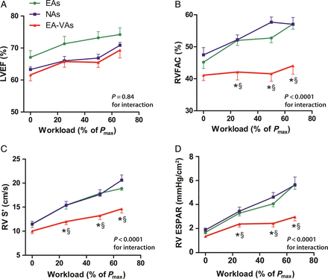
Figure 1 Echocardiographic measures demonstrating reduced right-ventricular (RV) reserve in athletes with arrhythmias. ...
Notes:
Figure 1 Echocardiographic measures demonstrating reduced right-ventricular (RV) reserve in athletes with arrhythmias. Changes in (A) left-ventricular ejection fraction (LVEF), (B) RV fractional area change (RVFAC), (C) RV peak systolic tricuspid annular velocity (RV S′), and (D) RV end-systolic pressure–area relationship (RV ESPAR) from rest to peak exercise. P-values are shown for the interaction between group and exercise intensity. At each exercise intensity, *P < 0.05 for the difference between endurance athletes with ventricular arrhythmias (EA-VAs) and EAs and §P < 0.05 for the difference between EA-VAs and non-athletes (NAs). Error bars depict the standard error of the mean.
Unless provided in the caption above, the following copyright applies to the content of this slide: Published on behalf of the European Society of Cardiology. All rights reserved. © The Author 2015. For permissions please email: journals.permissions@oup.com.

Slide 2
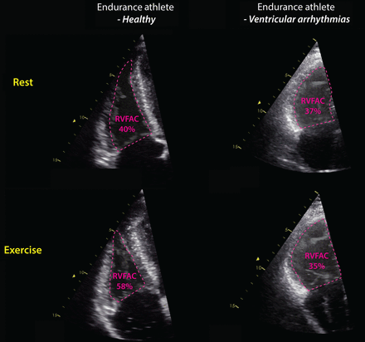
Figure 2 Reduced exercise right-ventricular (RV) function in an athlete with arrhythmias when compared with normal ...
Notes:
Figure 2 Reduced exercise right-ventricular (RV) function in an athlete with arrhythmias when compared with normal exercise RV function in a healthy endurance athlete. End-systolic images of the RV are depicted at rest and at peak exercise in a healthy endurance athlete (EA) and an athlete with ventricular arrhythmias (EA-VA). There is a clear reduction in RV end-systolic area from rest to peak exercise in EA resulting in an appropriate increase in RV fractional area change (RVFAC), whereas the RV area does not decrease in EA-VA and the RVFAC does not increase. The difference in RV augmentation is even better appreciated in video format (see Supplementary material online, Video S1).
Unless provided in the caption above, the following copyright applies to the content of this slide: Published on behalf of the European Society of Cardiology. All rights reserved. © The Author 2015. For permissions please email: journals.permissions@oup.com.

Slide 3
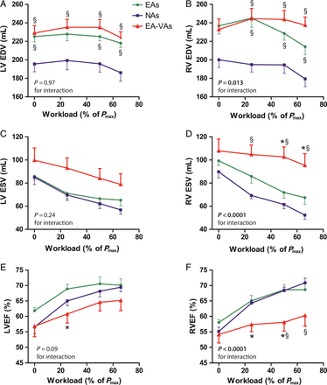
Figure 3 Magnetic resonance-derived biventricular volume changes during exercise. Changes in EDV, end-diastolic ...
Notes:
Figure 3 Magnetic resonance-derived biventricular volume changes during exercise. Changes in EDV, end-diastolic volume; ESV, end-systolic volume; and EF, ejection fraction during incremental exercise are shown for endurance athletes with ventricular arrhythmias (EA-VAs) (red), EAs (green), and non-athletes (NAs) (blue). P-values are shown for the interaction between group and exercise-intensity. At each exercise intensity, *P < 0.05 for the difference between EA-VAs and EAs and §P < 0.05 for the difference between EA-VAs and NAs. Error bars depict the standard error of the mean.
Unless provided in the caption above, the following copyright applies to the content of this slide: Published on behalf of the European Society of Cardiology. All rights reserved. © The Author 2015. For permissions please email: journals.permissions@oup.com.

Slide 4
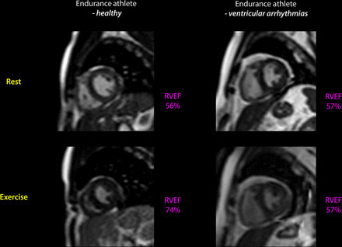
Figure 4 Reduced exercise right-ventricular (RV) function in an athlete with arrhythmias when compared with normal ...
Notes:
Figure 4 Reduced exercise right-ventricular (RV) function in an athlete with arrhythmias when compared with normal exercise RV function in a healthy endurance athlete. End-systolic images are depicted at rest and at peak-exercise in a healthy endurance athlete (EA) and an athlete with ventricular arrhythmias (EA-VA). In EA, there is augmentation of both LV and RV function with exercise and the RV ejection fraction increases from 56 to 74%. Resting RV function is similar in EA and EA-VA, but RV function fails to augment in EA-VA. The difference in RV augmentation is even better appreciated in video format (see Supplementary material online, Video S2).
Unless provided in the caption above, the following copyright applies to the content of this slide: Published on behalf of the European Society of Cardiology. All rights reserved. © The Author 2015. For permissions please email: journals.permissions@oup.com.

Slide 5
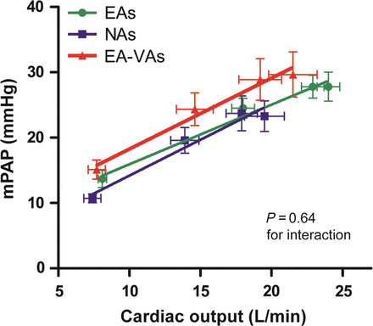
Figure 5 Relationship between mean pulmonary artery pressure and cardiac output. The relationship between mPAP and CO ...
Notes:
Figure 5 Relationship between mean pulmonary artery pressure and cardiac output. The relationship between mPAP and CO is similar for EAs, NAs, and EA-VAs as indicated by the fact that there is no significant interaction between groups and the mPAP/ CO relationship. Error bars depict the standard error of the mean.
Unless provided in the caption above, the following copyright applies to the content of this slide: Published on behalf of the European Society of Cardiology. All rights reserved. © The Author 2015. For permissions please email: journals.permissions@oup.com.

Slide 6
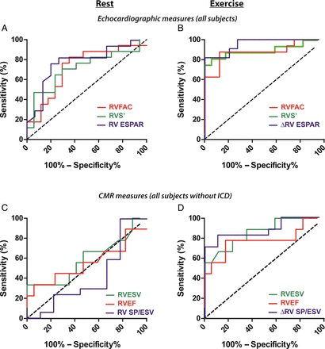
Figure 6 Receiver operating characteristic (ROC) curves for echocardiographic and CMR measures of RV function at rest ...
Notes:
Figure 6 Receiver operating characteristic (ROC) curves for echocardiographic and CMR measures of RV function at rest and during exercise. Areas under curve (AUC) represent test accuracy in differentiating athletes with arrhythmias from healthy athletes and non-athletes. AUCs for RV fractional area change (RVFAC), RV peak systolic tricuspid annular velocity (RV S′), and RV end-systolic pressure–area relationship (RV ESPAR) improved from rest to exercise (A and B, P≤0.05). Resting CMR measures (ESV, end-systolic volume; EF, ejection fraction; SP/ESV, end-systolic pressure–volume relationship) could not differentiate a smaller cohort of athletes with arrhythmias from healthy subjects (C), but all AUCs improved (P < 0.05) and demonstrated good accuracy during exercise (D).
Unless provided in the caption above, the following copyright applies to the content of this slide: Published on behalf of the European Society of Cardiology. All rights reserved. © The Author 2015. For permissions please email: journals.permissions@oup.com.

