Slide 1
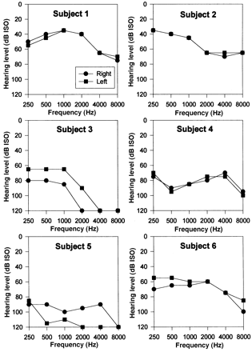
Fig. 1 Pure-tone audiograms.
Notes:
Fig. 1 Pure-tone audiograms.
Unless provided in the caption above, the following copyright applies to the content of this slide: © Oxford University Press 2000

Slide 2
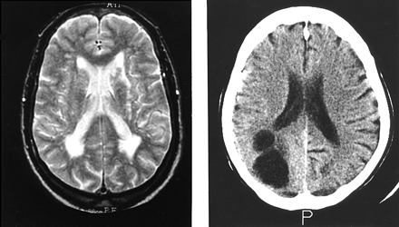
Fig. 2 Structural imaging of Subjects 2 and 6. MRI of Subject 2 (left) shows multiple vascular lesions in the ...
Notes:
Fig. 2 Structural imaging of Subjects 2 and 6. MRI of Subject 2 (left) shows multiple vascular lesions in the hemispheric deep white matter. CT scan of Subject 6 (right) shows a large arachnoid cyst in the right occipital lobe.
Unless provided in the caption above, the following copyright applies to the content of this slide: © Oxford University Press 2000

Slide 3
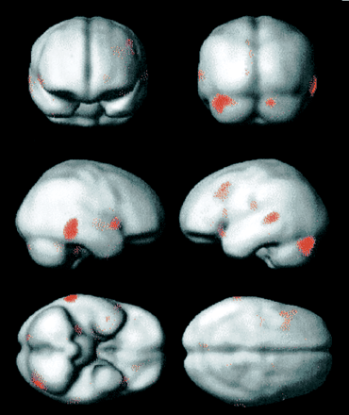
Fig. 3 Functional imaging (correlated activity with hallucination strength surface reading). PET group analysis for ...
Notes:
Fig. 3 Functional imaging (correlated activity with hallucination strength surface reading). PET group analysis for Subjects 1–4 showing areas where regional cerebral blood flow increased as a linear function of hallucinosis intensity. The functional data shown were thresholded at the P < 0.001 (uncorrected) voxel level and rendered on to an MRI surface template with the same degree of smoothing as the PET data.
Unless provided in the caption above, the following copyright applies to the content of this slide: © Oxford University Press 2000

Slide 4
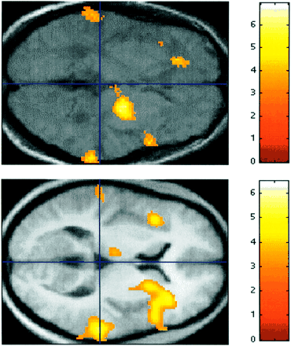
Fig. 4 Functional imaging. (Top) PET group analysis for Subjects 1–4 showing areas where regional cerebral blood ...
Notes:
Fig. 4 Functional imaging. (Top) PET group analysis for Subjects 1–4 showing areas where regional cerebral blood flow increased as a linear function of hallucinosis intensity (no sound stimulus). The data shown were rendered on to an axial section of the mean T1-weighted MRI for the four subjects. (Bottom) For comparison, data for the activation during the normal perception of patterned–segmented sound in nine normal subjects (Griffiths et al., 1999a) are shown superimposed on an axial section at the same level. Both sections are at the vertical level z = 0 mm. A line at y = –30 mm corresponds to the anteroposterior maximum for the planum temporale (Westbury et al., 1999). Notice the bilateral activation in the region of the planum temporale in both analyses.
Unless provided in the caption above, the following copyright applies to the content of this slide: © Oxford University Press 2000

Slide 5
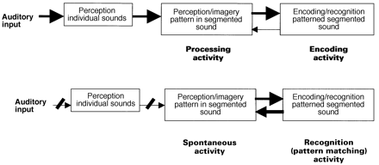
Fig. 5 (Top) The processes occurring during the normal perception of pattern in segmented sound. (Bottom) The ...
Notes:
Fig. 5 (Top) The processes occurring during the normal perception of pattern in segmented sound. (Bottom) The proposed basis for musical hallucinations, due to spontaneous activity in the module for the perception and imagery of pattern in segmented sound.
Unless provided in the caption above, the following copyright applies to the content of this slide: © Oxford University Press 2000

