Slide 1
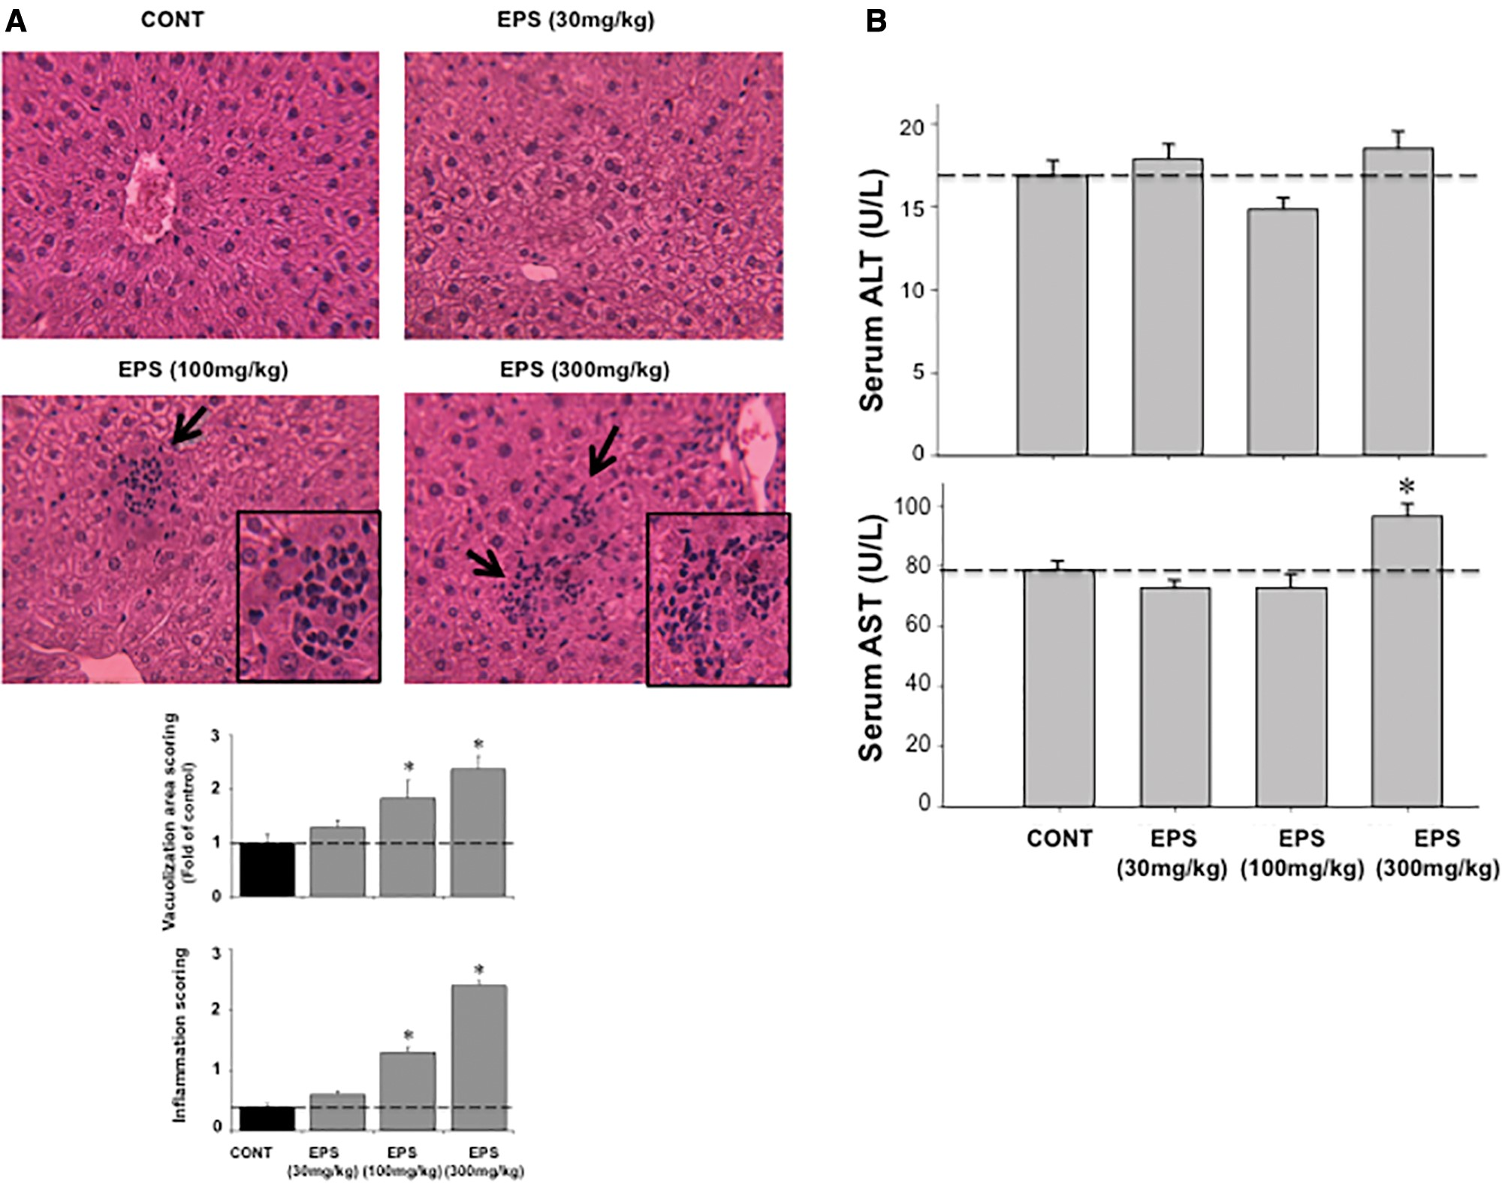
Figure 4 The impact of EPS on the alterations of histopathology of mouse liver and serum ALT and AST levels. A, Top ...
Notes:
Figure 4 The impact of EPS on the alterations of histopathology of mouse liver and serum ALT and AST levels. A, Top panel, Histology of mouse liver after EPS treatment. Mice were orally administrated with 30, 100, and 300 mg/kg of EPS once daily for 14 days. Formalin-preserved mouse livers were processed for H&E staining. The arrows point to foci of inflammation in mouse liver (400× amplification). Bottom panel, vacuolization area scoring of liver sections (Top panel) was determined by ImageJ, as described previously (Ye et al., 2016) (n = 5 images/treatment). In addition, inflammation foci were counted in 20 consecutive fields in each group (Bottom). Grade 0: no inflammation foci per field; Grade 1: <2 foci per field; Grade 2: ≥2 foci per field. Refer to the reference of Lee et al (2016). B, Alteration of serum ALT (Top panel) and AST (Bottom panel) levels by EPS treatment. Values were expressed as mean ± SE. Asterisk indicates statistical difference between treatment group and control group (P < .05).
Unless provided in the caption above, the following copyright applies to the content of this slide: © The Author 2017. Published by Oxford University Press on behalf of the Society of Toxicology. All rights reserved. For permissions, please e-mail: journals.permissions@oup.comThis article is published and distributed under the terms of the Oxford University Press, Standard Journals Publication Model (https://academic.oup.com/journals/pages/open_access/funder_policies/chorus/standard_publication_model)

Slide 2
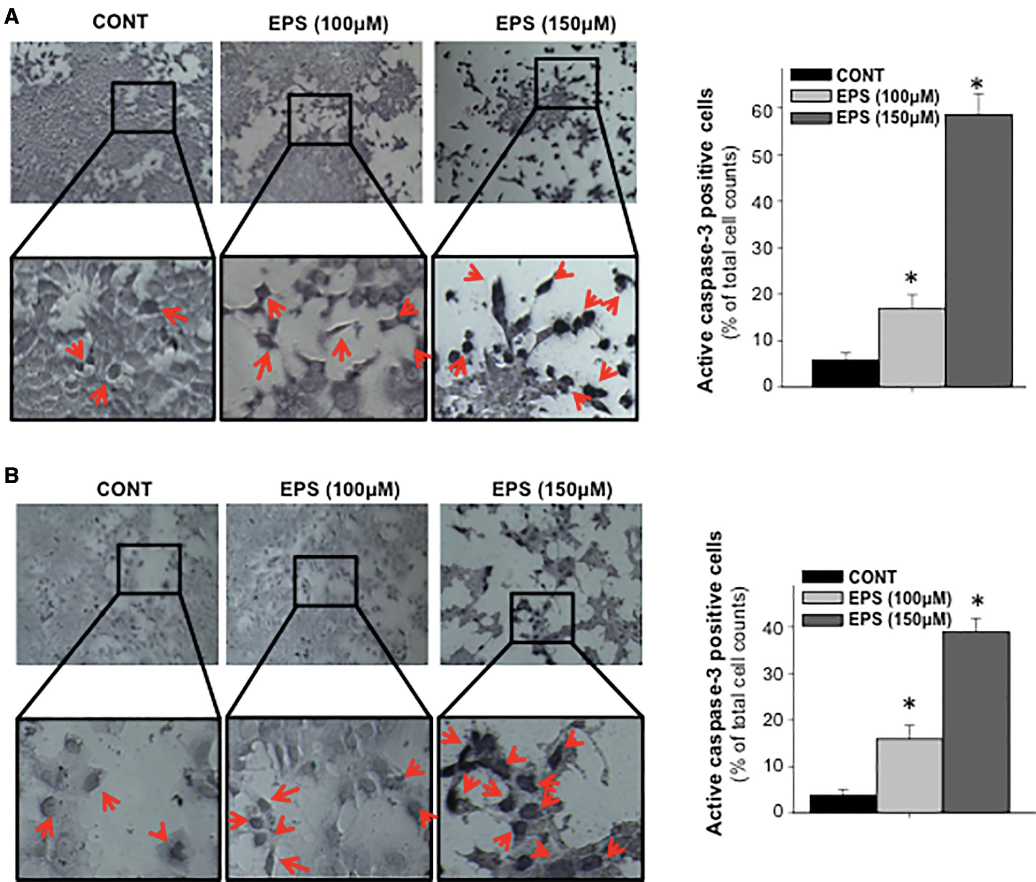
Figure 3 Immunocytostaining of Caspase-3 protein in EPS-treated hepatoma cells. Mouse Hepa1c1c7 (A) and human Hep3B ...
Notes:
Figure 3 Immunocytostaining of Caspase-3 protein in EPS-treated hepatoma cells. Mouse Hepa1c1c7 (A) and human Hep3B (B) cells were treated, in triplicate, with 100 and 150 μM EPS for 48 h. Control group received 0.1% DMSO. The left panel is typical images of AP-stained cells for active Caspase-3. The right panel depicts the percentage of active Caspase-3 positively stained cells versus total cell counts. The arrows pointed to active Caspase-3 positive cells, revealed by AP staining. Asterisks indicate statistical difference between EPS treatment and control group (P < 0.05).
Unless provided in the caption above, the following copyright applies to the content of this slide: © The Author 2017. Published by Oxford University Press on behalf of the Society of Toxicology. All rights reserved. For permissions, please e-mail: journals.permissions@oup.comThis article is published and distributed under the terms of the Oxford University Press, Standard Journals Publication Model (https://academic.oup.com/journals/pages/open_access/funder_policies/chorus/standard_publication_model)

Slide 3
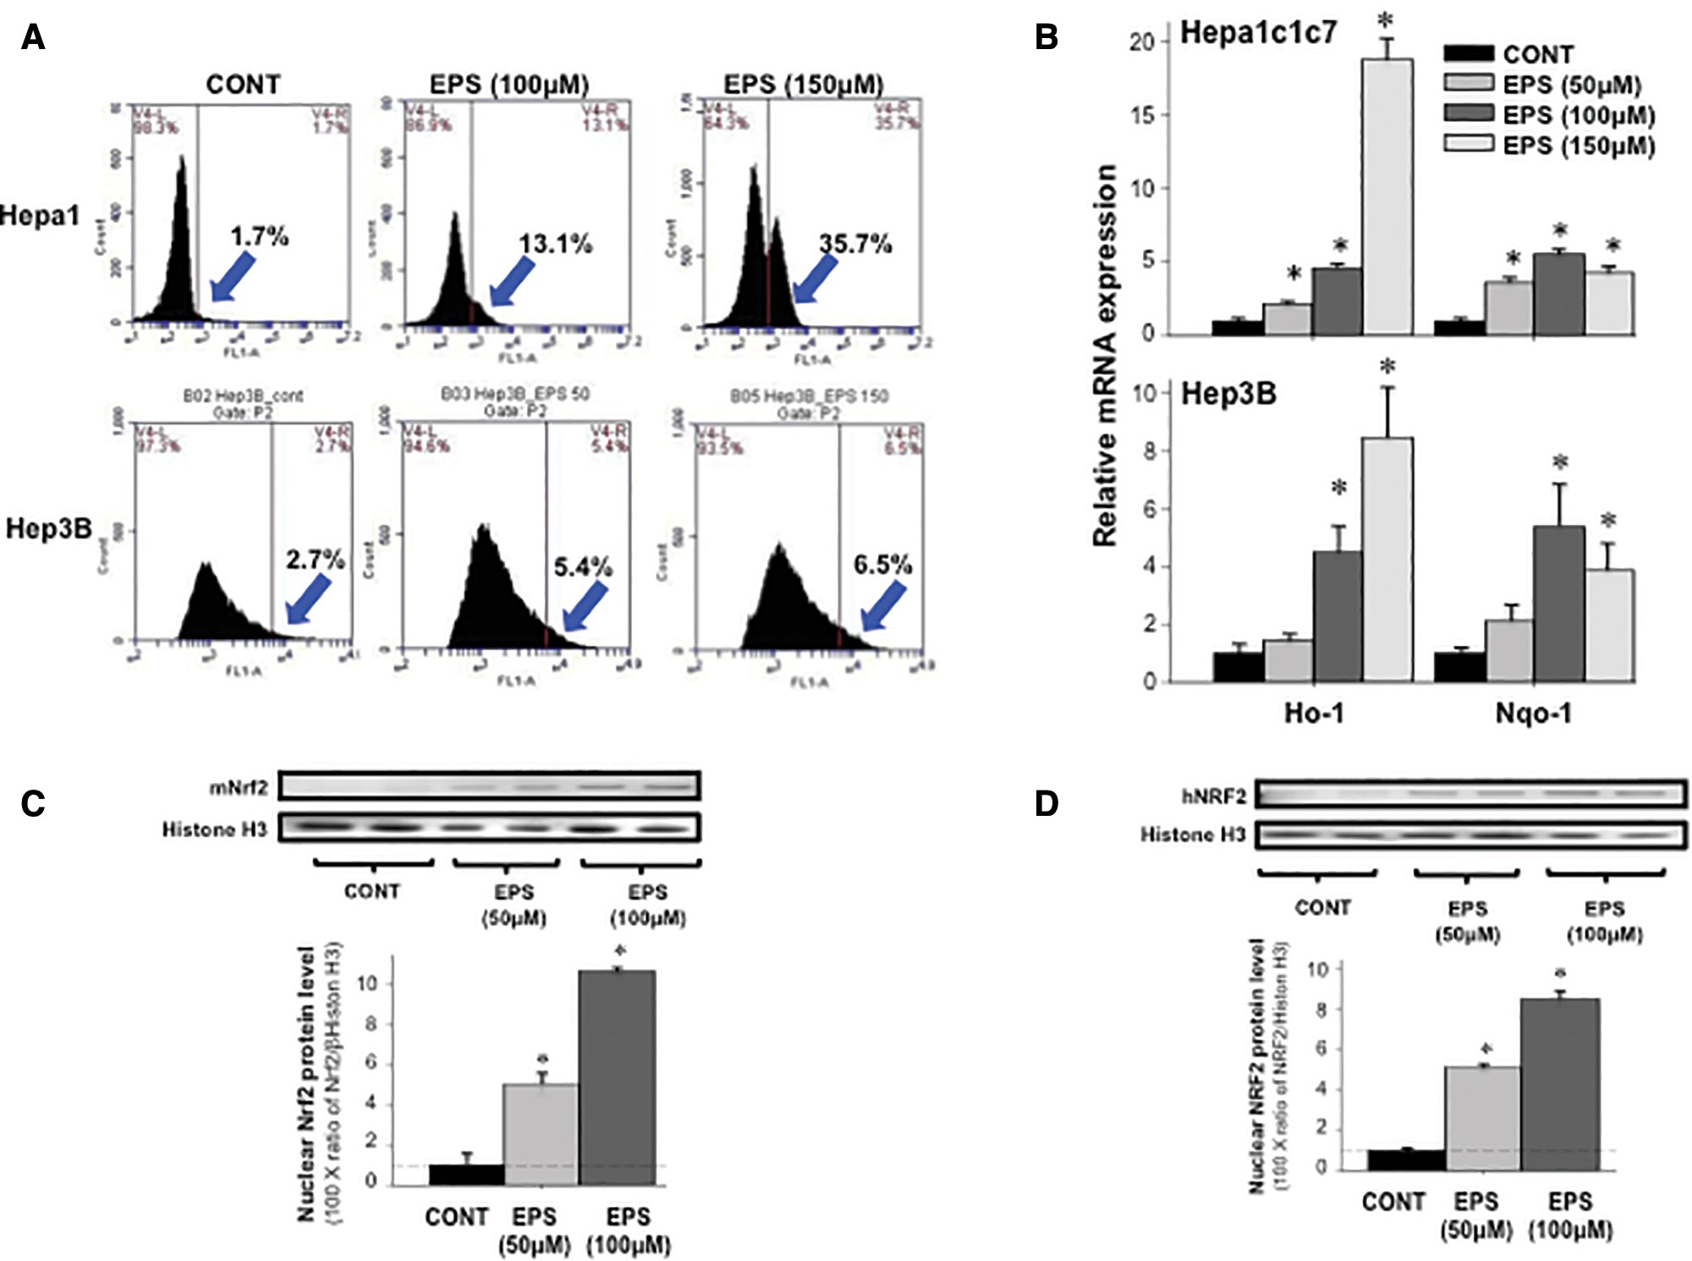
Figure 2 The impact of EPS on the production of oxidative stress and Nrf2 activation in cultured hepatoma cells. A, ...
Notes:
Figure 2 The impact of EPS on the production of oxidative stress and Nrf2 activation in cultured hepatoma cells. A, Flow cytometry assays of oxidative stress in EPS-treated mouse and human hepatoma cells. Mouse Hepa1c1c7 cells and human Hep3B cells were treated with EPS for 24 hours. Control group received 0.1% DMSO. The oxidative stress was detected using flow cytometry (see “Materials and Methods” section). The arrows pointed to the oxidative stress-positive population. B, Regulation of Ho-1/HO-1 and Nqo-1/NQO-1 mRNA expression by EPS in cultured hepatoma cells. Mouse Hepa1c1c7 and human Hep3B cells were treated, in triplicate, with 50, 100, and 150 μM EPS for 48 h. Control group received 0.1% DMSO. Messenger RNA expression of mouse (Top panel) and human (Bottom panel) Ho-1/HO-1 and Nqo-1/NQO-1 were determined by quantitative real-time PCR. Effects of EPS on nuclear Nrf2/NRF2 protein levels in cultured mouse (C) and human (D) hepatoma cells. Mouse Hepa1c1c7 and human Hep3B hepatoma cells, in triplicate, were treated with 50 and 100 μM EPS for 48 h. Control received 0.1% DMSO. Nuclear protein levels of Nrf2/NRF2 were expressed as the ratio of Nrf2/NRF2 to Histone H3. All data are expressed as mean ± SE. Asterisks indicate statistical difference between EPS treatment and control group (P < .05).
Unless provided in the caption above, the following copyright applies to the content of this slide: © The Author 2017. Published by Oxford University Press on behalf of the Society of Toxicology. All rights reserved. For permissions, please e-mail: journals.permissions@oup.comThis article is published and distributed under the terms of the Oxford University Press, Standard Journals Publication Model (https://academic.oup.com/journals/pages/open_access/funder_policies/chorus/standard_publication_model)

Slide 4
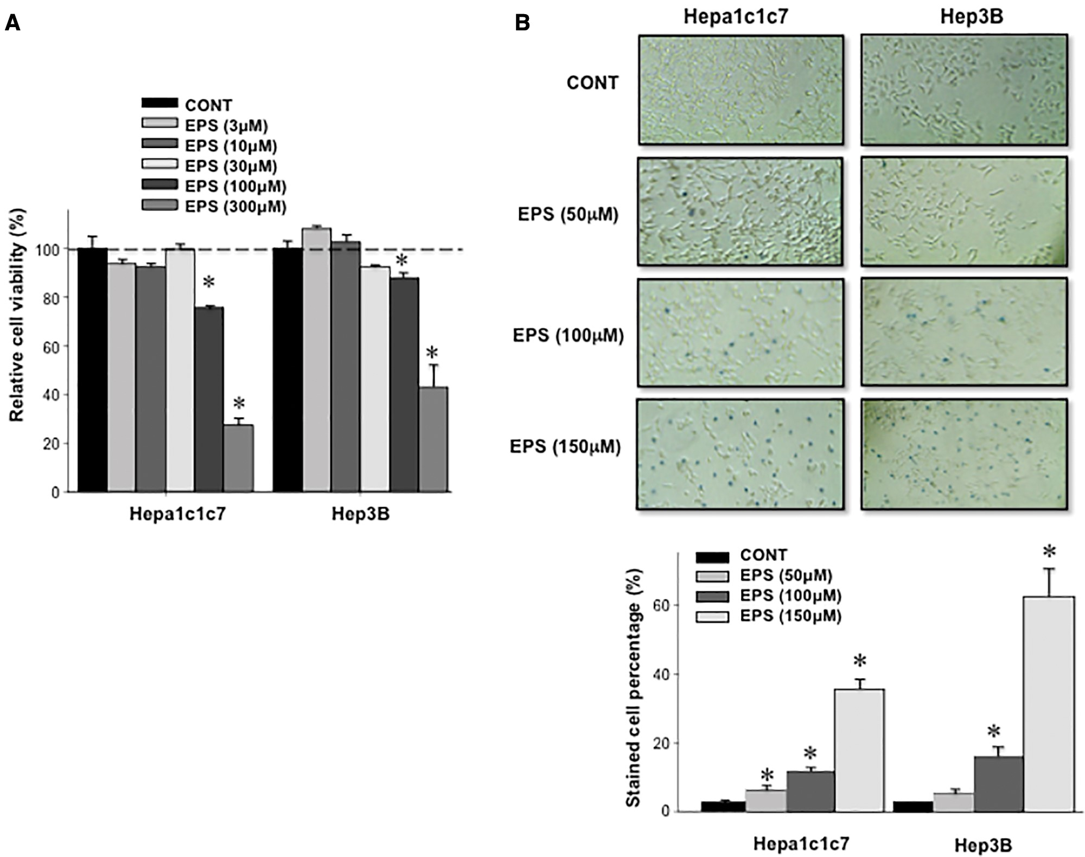
Figure 1 The impact of EPS on the cell viability of mouse and human hepatoma cells. A, MTT assays of EPS-treated ...
Notes:
Figure 1 The impact of EPS on the cell viability of mouse and human hepatoma cells. A, MTT assays of EPS-treated hepatoma cells. Mouse Hepa1c1c7 and human Hep3B cells were treated, in quadruplicate, with 3, 10, 30, 100, and 300 μM EPS for 48 h. Control group received 0.1% DMSO. Then, MTT assays were performed to determine the cell viability. B, Trypan blue exclusion assays of cultured hepatoma cells after EPS treatment. Mouse Hepa1c1c7 and human Hep3B cells were treated, in triplicate, with 50, 100, and 150 μM EPS for 48 h. Control group received 0.1% DMSO. Cell viability was determined by Trypan blue assays. The Top panel showed morphology of treated Hepa1c1c7 and Hep3B cells and the Bottom panel showed the percentage of stained cells with Trypan blue dye. All data are expressed as mean ± SE. Asterisks indicate statistical difference between EPS-treated group and control group (P < 05).
Unless provided in the caption above, the following copyright applies to the content of this slide: © The Author 2017. Published by Oxford University Press on behalf of the Society of Toxicology. All rights reserved. For permissions, please e-mail: journals.permissions@oup.comThis article is published and distributed under the terms of the Oxford University Press, Standard Journals Publication Model (https://academic.oup.com/journals/pages/open_access/funder_policies/chorus/standard_publication_model)

Slide 5
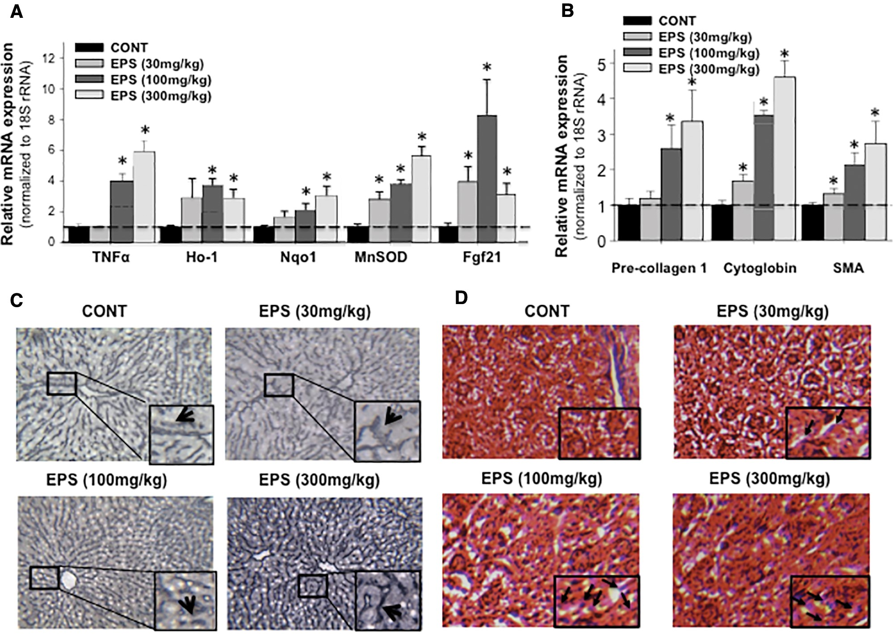
Figure 5 Gene and protein regulation by EPS in mouse liver. The mice were treated with 30, 100, and 300mg/kg EPS once ...
Notes:
Figure 5 Gene and protein regulation by EPS in mouse liver. The mice were treated with 30, 100, and 300mg/kg EPS once daily for 14 days (n = 6/treatment). Control group received corn oil. The mRNA expression of TNF-α, Fgf21, and oxidative stress-associated genes (A), as well as pro-fibrotic genes (B) were quantified by real-time PCR, which are normalized to 18S rRNA expression. The data were expressed as mean ± SE. Asterisks indicate statistical difference between EPS treatment group and control group (P < .05). C, The immunohistochemistry staining of Collagen-1 in mouse liver (200× amplification). Collagen-I protein was stained in blue color. D, Trichrome staining of mouse livers (200× amplification). Mouse livers were processed for Trichrome staining (see “Materials and Methods section” for detail). Connective tissue is stained blue, nuclei are stained dark red/purple, and cytoplasm is stained red/pink. Arrows point to the cells in blue color.
Unless provided in the caption above, the following copyright applies to the content of this slide: © The Author 2017. Published by Oxford University Press on behalf of the Society of Toxicology. All rights reserved. For permissions, please e-mail: journals.permissions@oup.comThis article is published and distributed under the terms of the Oxford University Press, Standard Journals Publication Model (https://academic.oup.com/journals/pages/open_access/funder_policies/chorus/standard_publication_model)

Slide 6
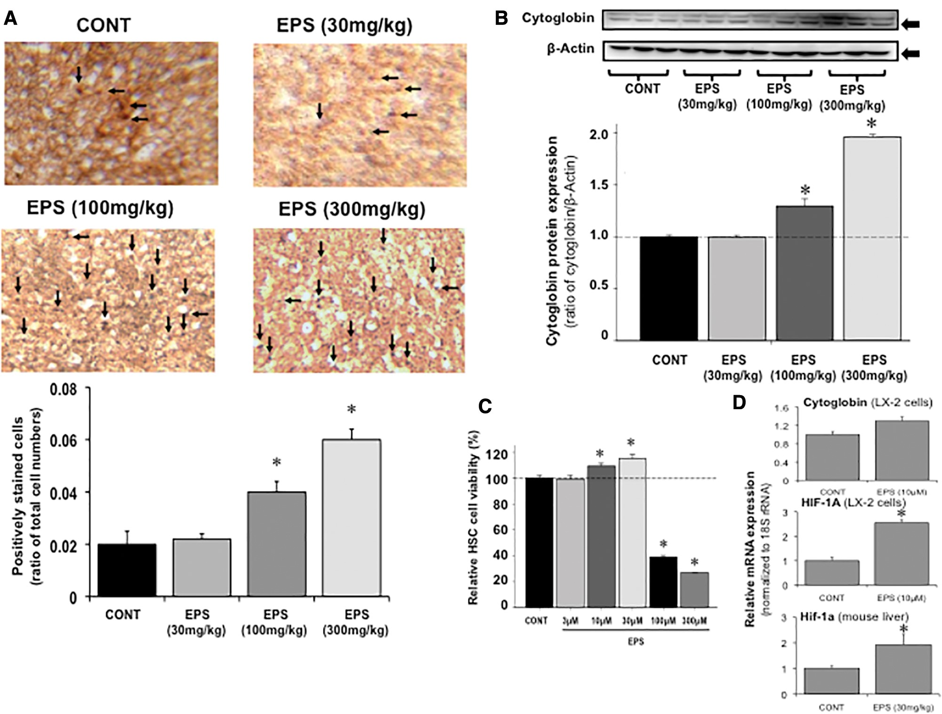
Figure 6 The impact of EPS on the activation of HSCs. A, Immunohistochemistry staining of Cytoglobin protein in mouse ...
Notes:
Figure 6 The impact of EPS on the activation of HSCs. A, Immunohistochemistry staining of Cytoglobin protein in mouse liver after EPS treatment. Adult male wild-type C57BL/6 mice were administrated with 30, 100, and 300 mg/kg EPS once daily for 14 days (n = 6/treatment). The control received corn oil. Frozen liver sections were processed for Cytoglobin Immunohistochemistry. Cells that expressed Cytoglobin protein were stained in dark brown by HRP staining (200× amplification). Top panel, images of mouse liver after EPS treatment. Arrows point to the cells stained in dark brown. Bottom panel, percentage of Cytoglobin-positively stained cells. B, Western blots of cytoglobin protein expression in mouse liver. Top panel, protein bands revealed by Western blots. Bottom panel, the expression of Cytoglobin protein was expressed as the ratio of Cytoglobin to β-actin. C, MTT assays of EPS-treated human HSCs. Human LX-2 HSCs (3000 cells/well) were treated, in quadruplicate, with 3, 10, 30, 100, and 300 μM EPS for 48 h. Control group received 0.1% DMSO. Then, MTT assays were performed to determine the cell viability. D, mRNA expression of Cytoglobin and HIF-1A in 10 μM EPS-treated human LX-2 cells (in quadruplicate) as well as Hif-1a mRNA expression in 30 mg/kg EPS-treated mouse liver (n = 6/treatment). All data are expressed as mean ± SE. (*P < .05).
Unless provided in the caption above, the following copyright applies to the content of this slide: © The Author 2017. Published by Oxford University Press on behalf of the Society of Toxicology. All rights reserved. For permissions, please e-mail: journals.permissions@oup.comThis article is published and distributed under the terms of the Oxford University Press, Standard Journals Publication Model (https://academic.oup.com/journals/pages/open_access/funder_policies/chorus/standard_publication_model)

Slide 7
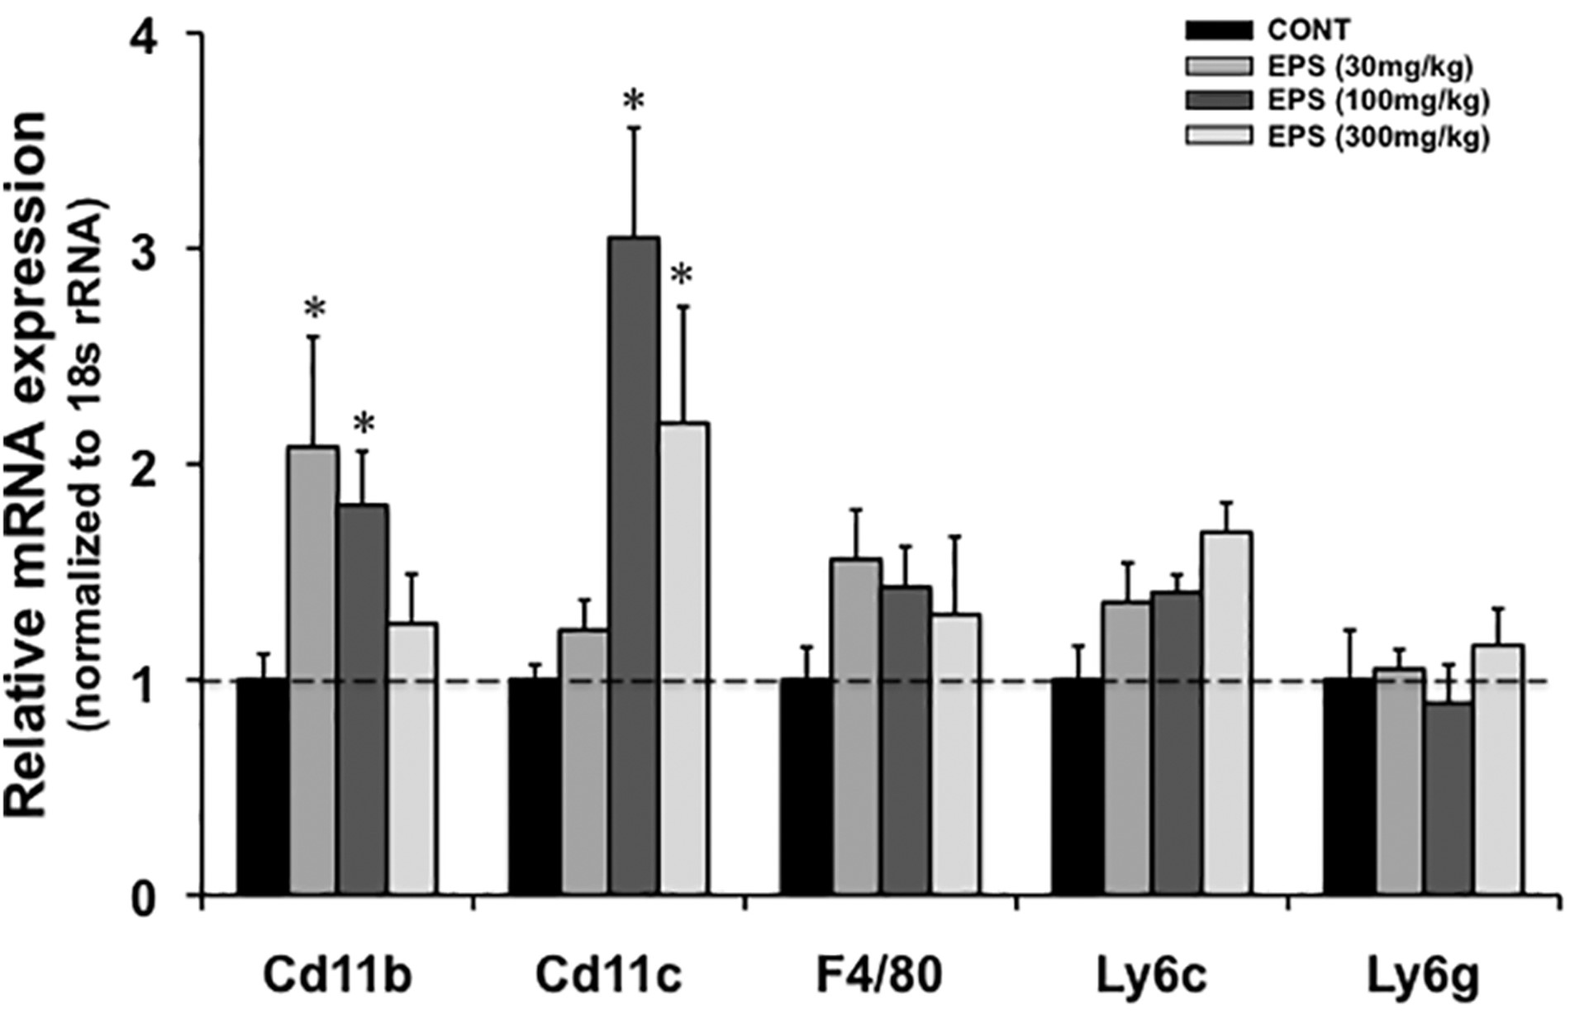
Figure 7 Regulation of inflammation-associated genes by EPS in mouse liver. The mice were treated with 30, 100, and ...
Notes:
Figure 7 Regulation of inflammation-associated genes by EPS in mouse liver. The mice were treated with 30, 100, and 300 mg/kg EPS once daily for 14 days (n = 6/treatment). Control group received corn oil. The mRNA expression of CD11b, CD11c, F4/80, Ly6g, and Ly6c were quantified by real-time PCR, which are normalized to 18S rRNA expression. The data were expressed as mean ± SE. Asterisks indicate statistical difference between EPS treatment group and control group (P < .05).
Unless provided in the caption above, the following copyright applies to the content of this slide: © The Author 2017. Published by Oxford University Press on behalf of the Society of Toxicology. All rights reserved. For permissions, please e-mail: journals.permissions@oup.comThis article is published and distributed under the terms of the Oxford University Press, Standard Journals Publication Model (https://academic.oup.com/journals/pages/open_access/funder_policies/chorus/standard_publication_model)

