Slide 1
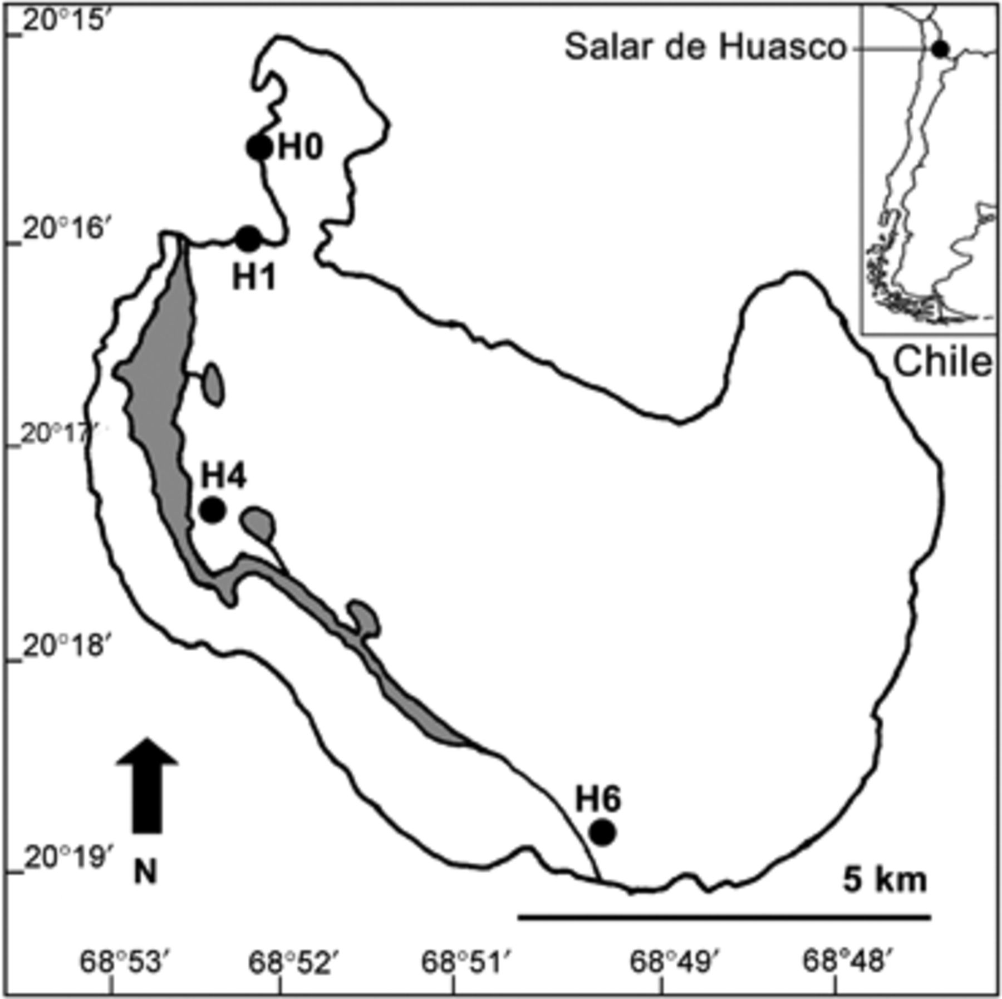
1 Map indicating the location of Salar de Huasco and four study sites (H0, H1, H4 and H6). Gray areas indicate ...
Notes:
1 Map indicating the location of Salar de Huasco and four study sites (H0, H1, H4 and H6). Gray areas indicate the presence of permanent lagoons.
Unless provided in the caption above, the following copyright applies to the content of this slide: © 2010 Federation of European Microbiological Societies

Slide 2
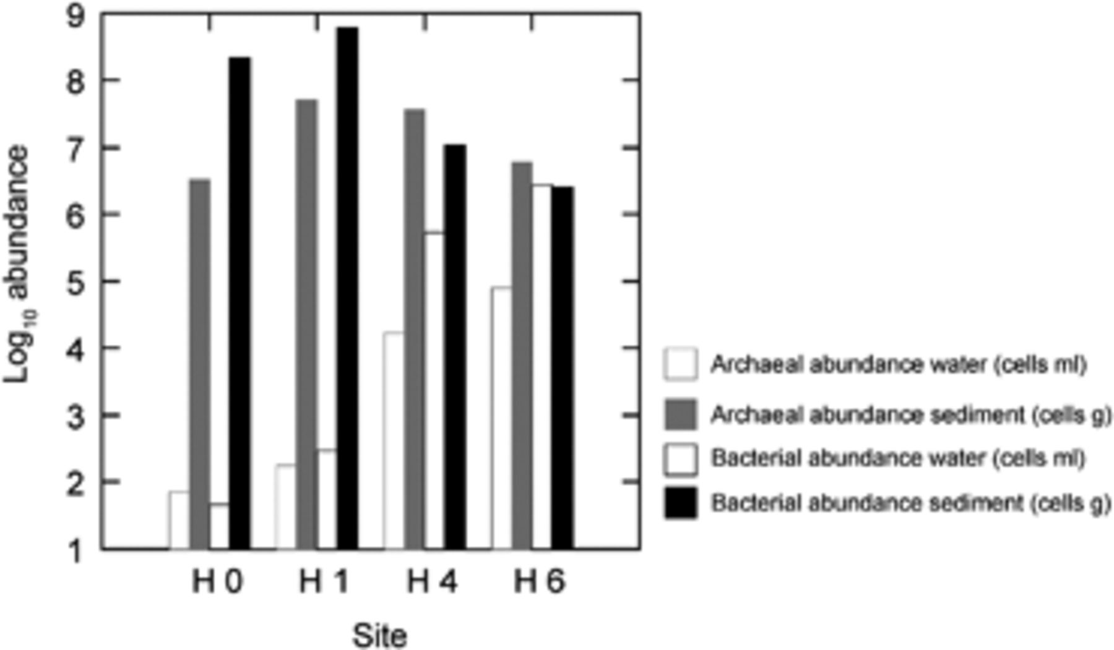
2 Relative abundance of Bacteria and Archaea in Salar de Huasco at the sampling sites, determined by qPCR.
Notes:
2 Relative abundance of Bacteria and Archaea in Salar de Huasco at the sampling sites, determined by qPCR.
Unless provided in the caption above, the following copyright applies to the content of this slide: © 2010 Federation of European Microbiological Societies

Slide 3
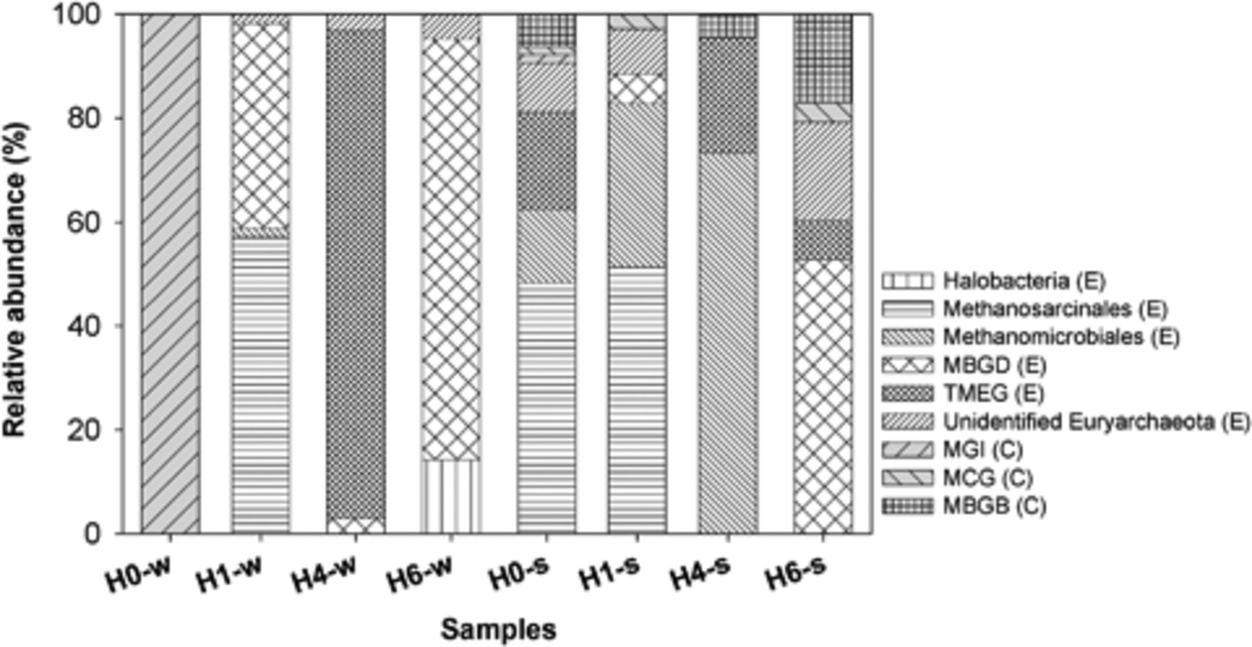
3 Composition of clone libraries of 16S rRNA gene from water and sediment samples. Affiliation of the ...
Notes:
3 Composition of clone libraries of 16S rRNA gene from water and sediment samples. Affiliation of the phylogenetic groups is indicated for Euryarchaeota (E) and Crenarchaeota (C). Group designations: MBGD, Marine Benthic Group D; MBGB, Marine Benthic Group B (Vetriani et al., 1999); TMEG, Terrestrial Miscellaneous Euryarchaeotal Group (Takai et al., 2001); MG-I, Marine Group I (DeLong, 1998); MCG, Miscellaneous Crenarchaeotic Group (Teske, 2006).
Unless provided in the caption above, the following copyright applies to the content of this slide: © 2010 Federation of European Microbiological Societies

Slide 4
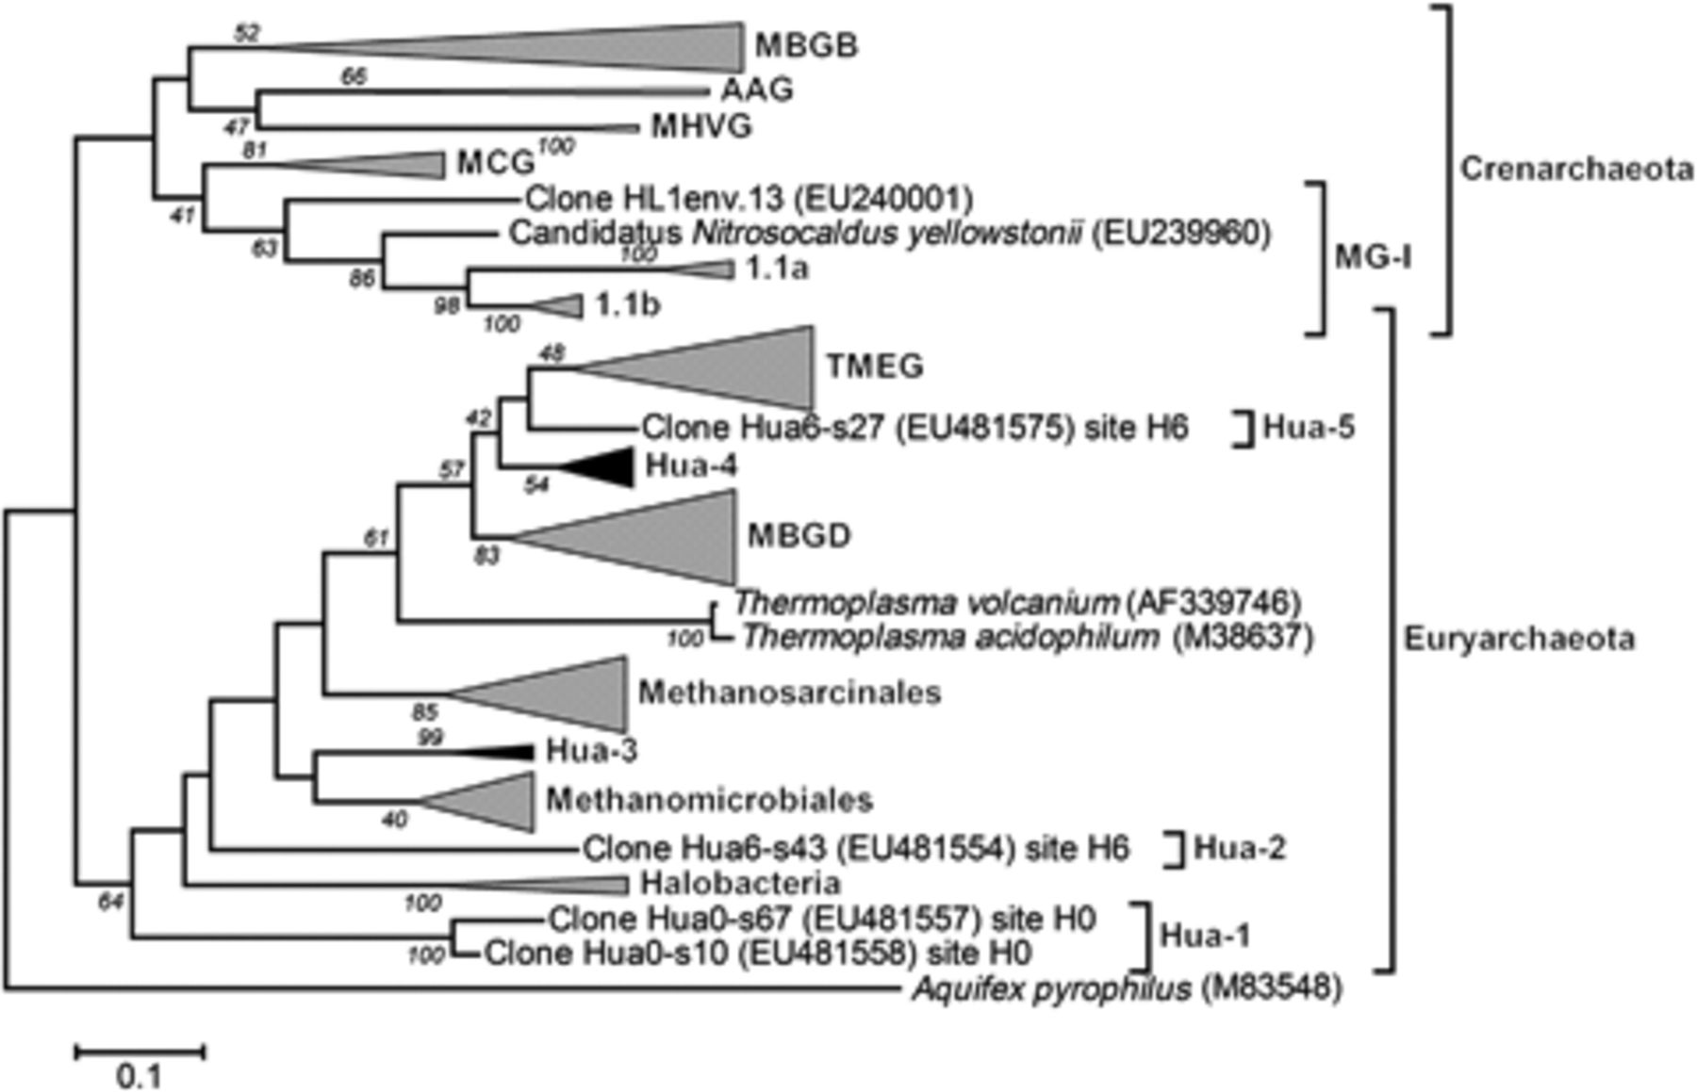
4 Phylogenetic tree based on partial 16S rRNA gene sequences (∼800 bp) of phylotypes of Archaea in water ...
Notes:
4 Phylogenetic tree based on partial 16S rRNA gene sequences (∼800 bp) of phylotypes of Archaea in water calculated by maximum likelihood analysis. Group designations: MG-I, Marine Group I (DeLong, 1998); MCG, Miscellaneous Crenarchaeotic Group (Teske, 2006); MHVG, Marine Hydrothermal Vent Group (Takai & Horikoshi, 1999); AAG, Ancient Archaeal Group (Takai & Horikoshi, 1999); MBGB, Marine Benthic Group B (Vetriani et al., 1999); MBGD, Marine Benthic Group D; TMEG, Terrestrial Miscellaneous Euryarchaeotal Group (Takai et al., 2001); Hua-1, Hua-2, Hua-3, Hua-4, Hua-5, Unidentified Euryarchaeota clusters. The scale bar represents a 10% nucleotide sequence difference. Aquifex pyrophilus (M83548) was used as an outgroup. Groups in gray include sequences from Salar de Huasco. Groups in black largely consist of sequences from Salar de Huasco. Figure S4 shows the detailed tree.
Unless provided in the caption above, the following copyright applies to the content of this slide: © 2010 Federation of European Microbiological Societies

