Slide 1
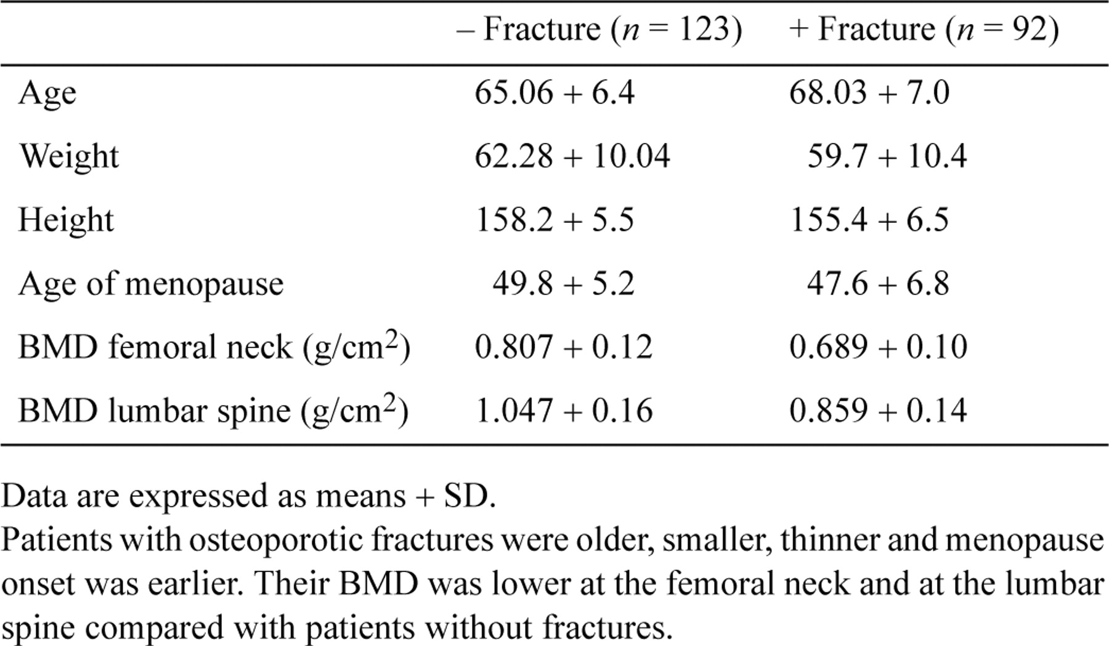
Table 1 Clinical data for the 215 post-menopausal women studied in the presence or absence of fractures
Notes:
Table 1 Clinical data for the 215 post-menopausal women studied in the presence or absence of fractures
Unless provided in the caption above, the following copyright applies to the content of this slide: © 1998 Oxford University Press

Slide 2
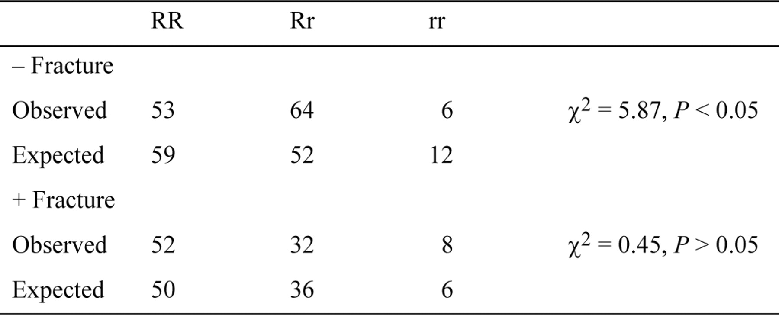
Table 2 Observed and expected number of patients with the different genotypes in each group, with or without ...
Notes:
Table 2 Observed and expected number of patients with the different genotypes in each group, with or without fractures
Unless provided in the caption above, the following copyright applies to the content of this slide: © 1998 Oxford University Press

Slide 3
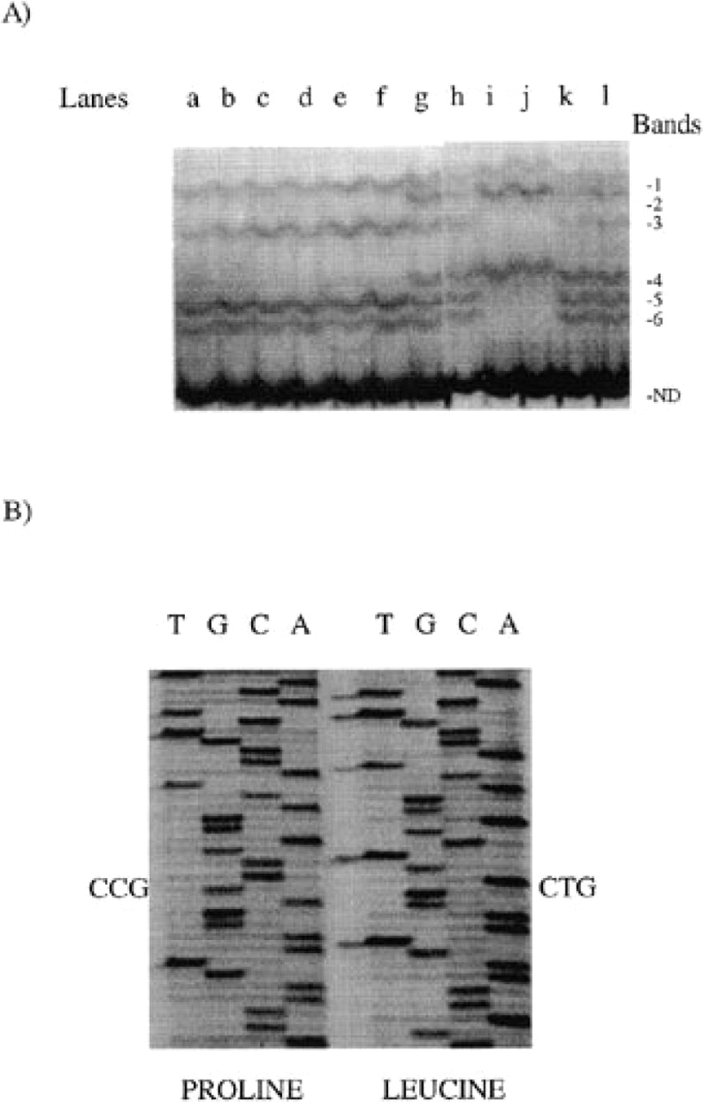
Figure 1 CTR polymorphism is at amino acid 447 where a T→C mutation changes a leucine to a proline. PCR amplification ...
Notes:
Figure 1 CTR polymorphism is at amino acid 447 where a T→C mutation changes a leucine to a proline. PCR amplification of genomic DNA was carried out using specific primers bordering the polymorphic 447 site. (A) Autoradio-graphy of SSCP gel. Lanes a-f, DNA from individuals with the leucine allele (bands 1 and 3, additional bands 5 and 6); lanes i and j, DNA from patients with the proline allele (bands 2 and 4 and sometimes additional band 1); lanes g, h and k, DNA from patients with the two alleles; lane l, DNA from the TT cell line with the two alleles. ND, non-denatured DNA. (B) Partial sequence of PCR products amplified from patients homozygous for proline or leucine alleles
Unless provided in the caption above, the following copyright applies to the content of this slide: © 1998 Oxford University Press

Slide 4
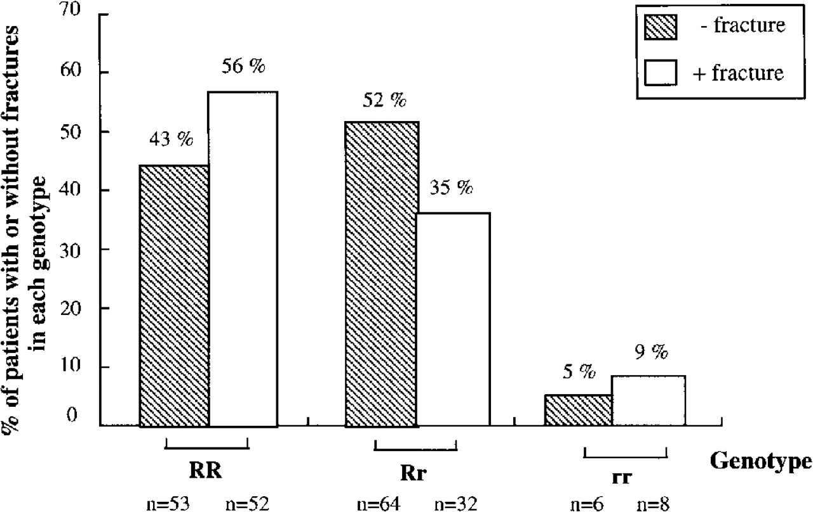
Figure 2 Distribution of the genotypes of CTR in 215 post-menopausal women with (+ fracture) or without (− fracture) ...
Notes:
Figure 2 Distribution of the genotypes of CTR in 215 post-menopausal women with (+ fracture) or without (− fracture) fractures. Analysis of the CTR genotype distribution in patients with osteoporotic fractures compared with patients without osteoporotic fractures showed that heterozygotes (Rr) have a distinct advantage over homozygotes (RR and rr) concerning fractures. − Fracture / + fracture χ2=6.63, P < 0.037.
Unless provided in the caption above, the following copyright applies to the content of this slide: © 1998 Oxford University Press

Slide 5
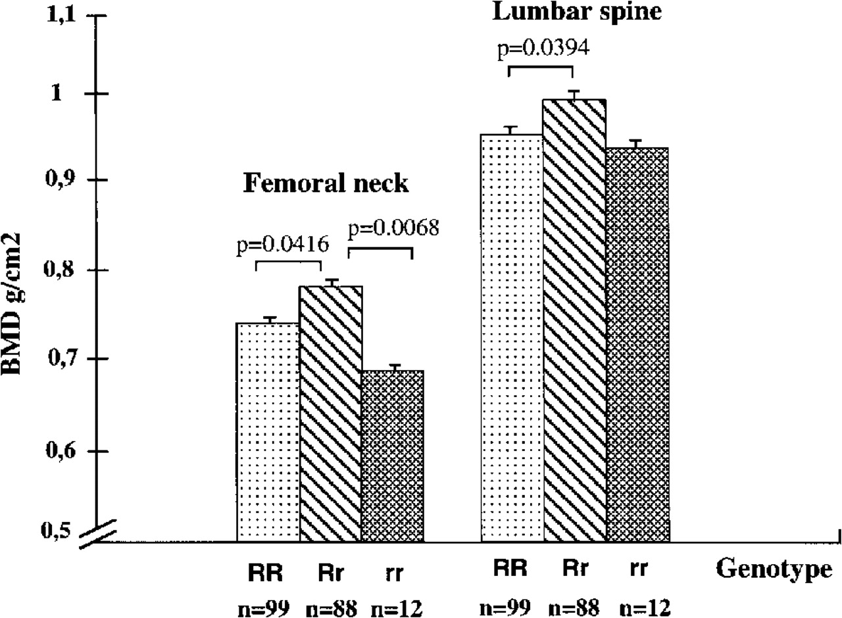
Figure 3 A polymorphic CTR site is related to BMD. BMD at the femoral neck and lumbar spine in 199 subjects according ...
Notes:
Figure 3 A polymorphic CTR site is related to BMD. BMD at the femoral neck and lumbar spine in 199 subjects according to their genotype. Results are expressed as the means ± SEM. Results were analyzed by covariance analysis to correct for the effects of age, weight, height, age of menopause and duration of hormone replacement therapy. p indicates the level of significance between the two means (Fisher's LSD test). This analysis confirmed the existence of a significantly higher BMD value at the femoral neck in Rr versus RR and rr subjects and at the lumbar spine in Rr versus RR subjects.
Unless provided in the caption above, the following copyright applies to the content of this slide: © 1998 Oxford University Press

Slide 6
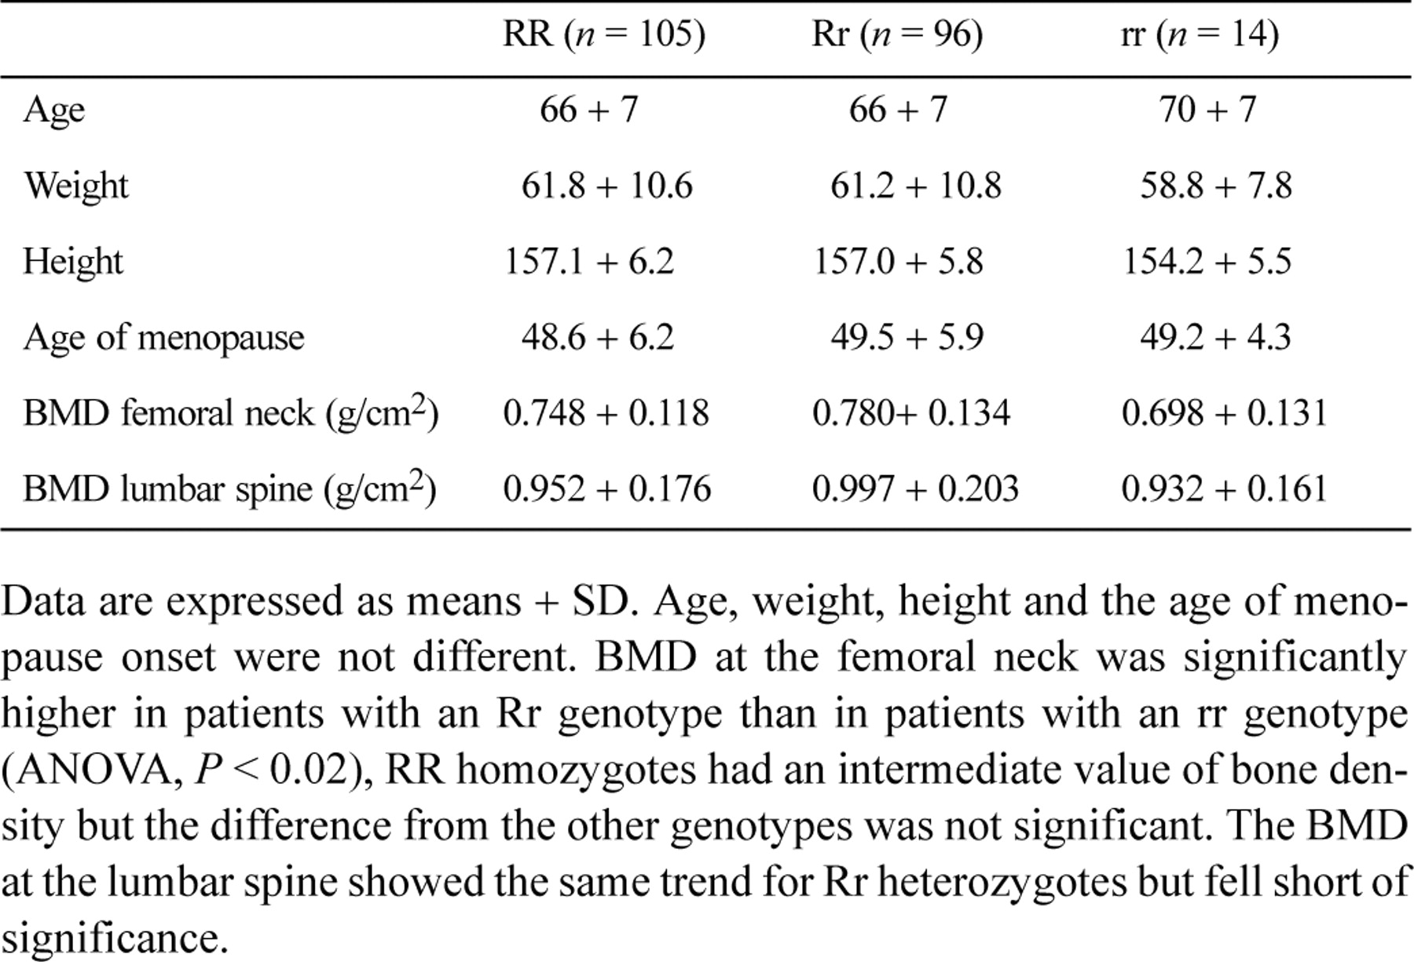
Table 3 Clinical data for the 215 post-menopausal women studied for each CTR genotype
Notes:
Table 3 Clinical data for the 215 post-menopausal women studied for each CTR genotype
Unless provided in the caption above, the following copyright applies to the content of this slide: © 1998 Oxford University Press

