Slide 1
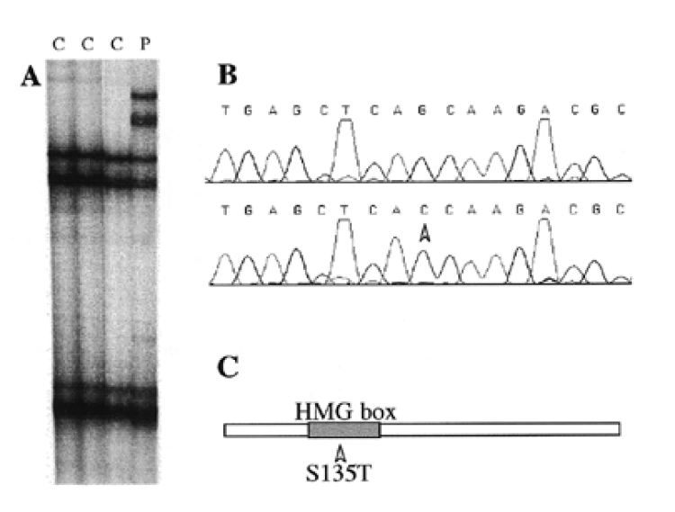
Figure 1 The S135T mutation. (A) SSCP analysis shows a band shift in the distal part of exon 3 (C, control DNAs; P, ...
Notes:
Figure 1 The S135T mutation. (A) SSCP analysis shows a band shift in the distal part of exon 3 (C, control DNAs; P, patient DNA). (B) After cloning of the PCR product, DNA sequencing revealed a G (normal allele, upper sequence) to C (mutated allele, lower sequence) transversion. (C) This mutation results in a Ser→Thr missense mutation localized in the central part of the HMG box, which is the DNA-binding domain of the SOX factors.
Unless provided in the caption above, the following copyright applies to the content of this slide: © 1999 Oxford University Press

Slide 2
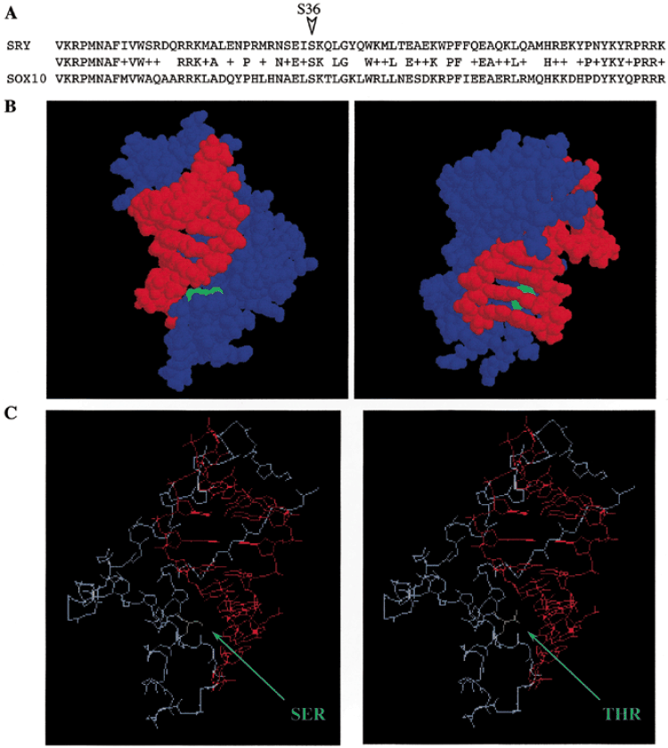
Figure 2 Structure of the HMG domain of SRY and the SOX10^{S135T} mutation. (A) Homology between the SRY and ...
Notes:
Figure 2 Structure of the HMG domain of SRY and the SOX10S135T mutation. (A) Homology between the SRY and the SOX10 HMG domains. (B) Three-dimensional representation of the interaction between the HMG domain of SRY and the target DNA sequence. The two views illustrate the close interaction between the DNA helix (red) and the Ser (green) at position 36 of the SRY HMG domain (blue). (C) The Ser→Thr (green) mutation is placed in the SRY HMG domain (blue) to illustrate its possible effecton the interaction with DNA (red). Except for the Ser/Thr, only the backbone of the HMG domain is represented.
Unless provided in the caption above, the following copyright applies to the content of this slide: © 1999 Oxford University Press

Slide 3
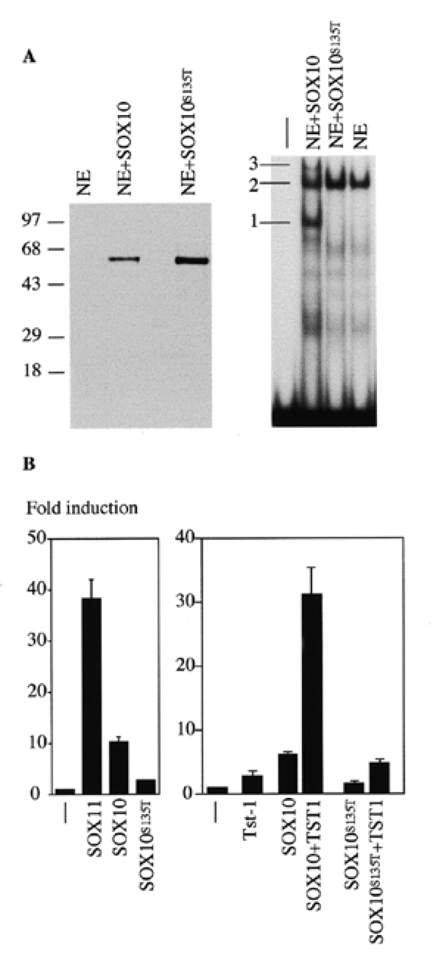
Figure 3 In vitro studies of the S135T mutation. (A) Western blot analysis of 8 µg of nuclear extract (NE) containing ...
Notes:
Figure 3 In vitro studies of the S135T mutation. (A) Western blot analysis of 8 µg of nuclear extract (NE) containing wild-type SOX10 or SOX10S135T factor (size markers are shown on the left in kDa), and gel shift assay with 0.8 µg of the same extracts and the FXO oligonucleotide probe (16) showing the absence of DNA binding by the mutated factor. Complex 1, SOX10 + DNA; complex 2, OCT1 + DNA; complex 3, SOX10 + OCT1 + DNA. (B) Transient transfection experiments in U138 glioblastoma cells confirm the absence of autonomous transcriptional activity (3×SX luc reporter) of the SOX10S135T factor in comparison with the wild-type SOX10 factor and the inability to synergistically stimulate the activity of the POU domain protein Tst-1/Oct6/SCIP (3×FXO luc reporter). Luciferase activities were determined in three independent experiments each performed in duplicate. Data are presented as fold induction above the level obtained for the luciferase reporter without co-transfected transcription factor.
Unless provided in the caption above, the following copyright applies to the content of this slide: © 1999 Oxford University Press

